Slide 1



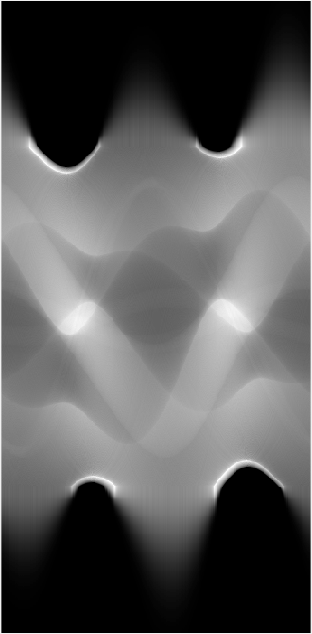
A. Global projection
B. Truncated projection
C. Edge-Gauss
D. Scout IT

