Slide 1
Scout IT
Kriti Sen Sharma

Slide 2



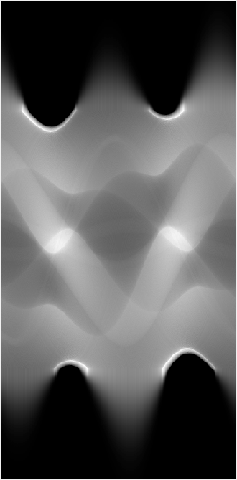
Global projection
Truncated projection
Edge-Gauss
Scout IT

Slide 3
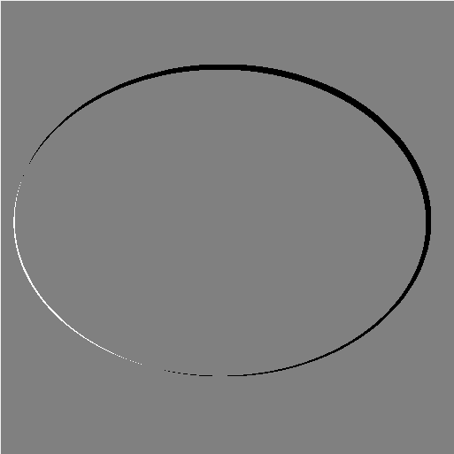
Convex hull of phantom
- Convex hull of estimated ellipse

Slide 4
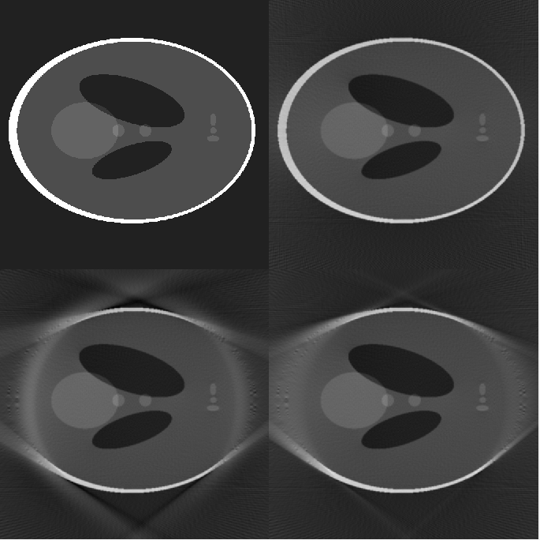
Phantom
Fan-beam (global)
Convex hull of phantom
- Convex hull of estimated ellipse
Edge-Gauss
Scout IT

Slide 5
Phantom
Fan-beam (global)
Edge-Gauss
Scout IT

Slide 6
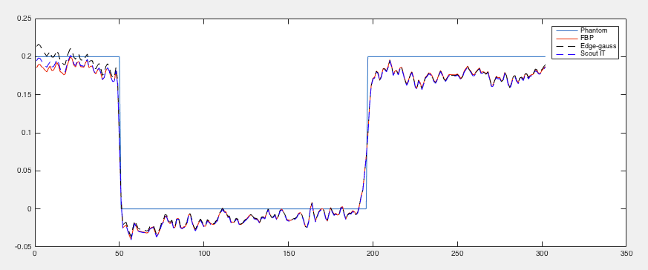

Slide 7
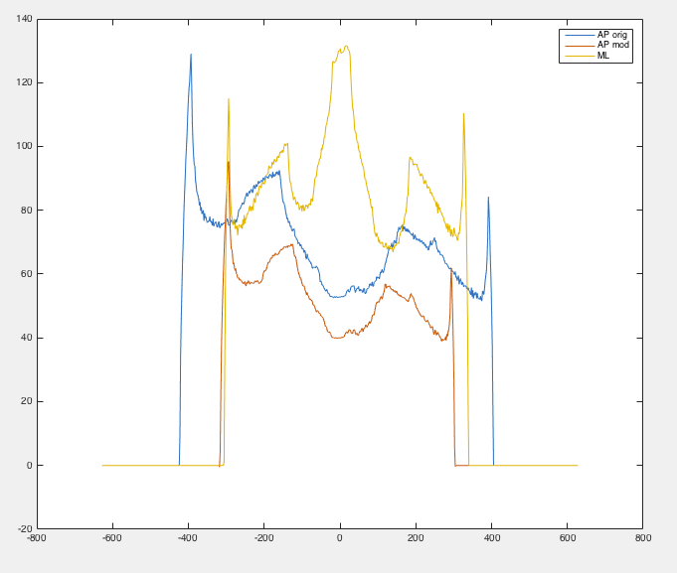
AP orig
AP mod
ML

