Slide 1
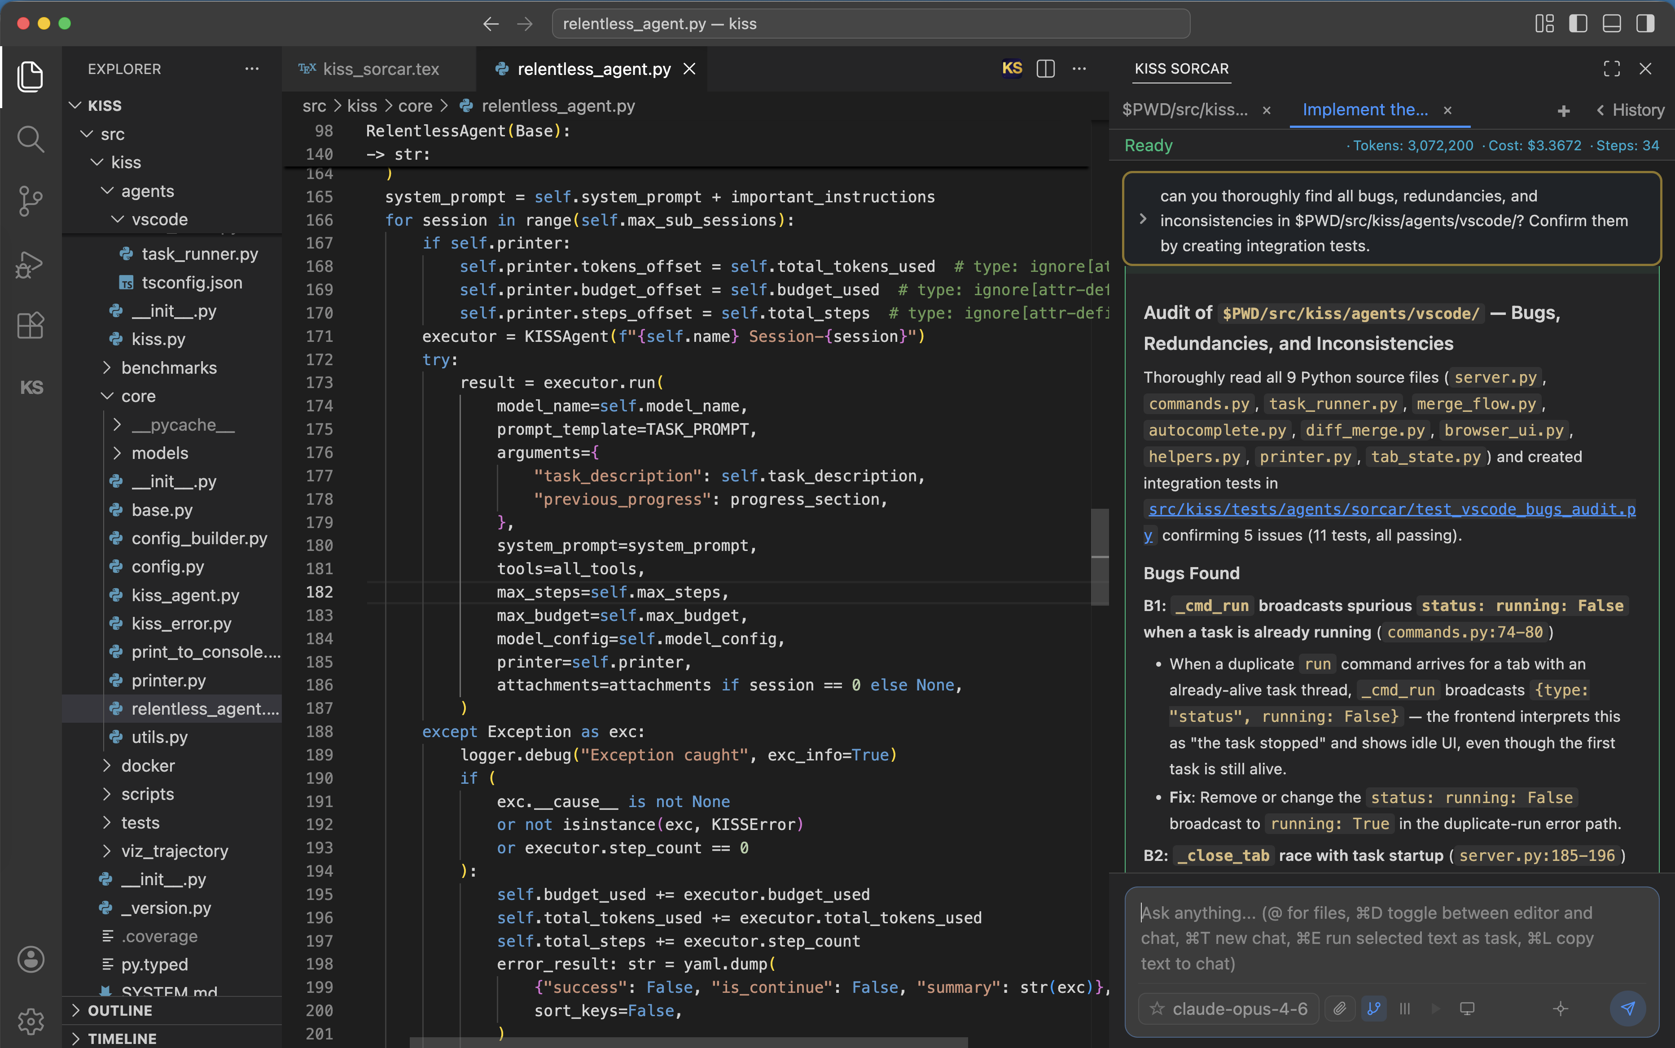
KISS Sorcar
Building Trustworthy AI for Software Engineering
Lessons from a Two-Stage, Human-in-the-Loop Approach
Koushik Sen
EECS Department, UC Berkeley
ksen@berkeley.edu
"Everything should be made as simple as possible, but not simpler." — Albert Einstein
https://github.com/ksenxx/kiss_ai

Slide 2
What This Talk Covers
01 A two-stage (bicameral) trustworthiness framework
02 Model-generated functional tests for code quality
03 Don't train general-purpose models — reuse large ones
04 Co-creative coding with open models
05 Skill files & token management
06 Assumptions in language-model training
07 Training models for user awareness
08 Over-indexing & data gaps
09 Trade-offs in AI patch generation
10 Benchmark evaluation strategy
11 AI code generation & trust challenges
12 Human-in-the-loop code review
13 Prompt-injection risks
14 AI agent development challenges
15 Git for continuous debugging
16 Model strengths & limitations
17 AI tools for production debugging

Slide 3
01
A Two-Stage Trustworthiness Framework

Slide 4
Separate Generation from Verification
▪ Decouple model training/generation from an independent external verification stage.
▪ A “bicameral” design — two cooperating chambers: one proposes, the other checks.
▪ Independent verification builds trust that holds across many different use cases.
▪ Trustworthiness comes from the second stage, not from trusting the generator alone.
Bicameral = a two-chamber structure (as in a two-house legislature), used here as a metaphor for proposer + verifier.

Slide 5
02
Model-Generated Functional Tests

Slide 6
SOFTWARE DEVELOPMENT
Validate Code with Tests the Model Writes
▪ Have the model generate functional tests to validate the quality of generated code.
▪ Tests give an objective signal of correctness instead of trusting raw output.
▪ Weigh both code quality and the cost of producing and running it.
▪ Functional tests become the contract the generated code must satisfy.

Slide 7
03
Avoid Training General-Purpose Models

Slide 8
Reuse Large Models Instead of Training Your Own
▪ Training a general-purpose model from scratch is hard, expensive, and often unnecessary.
▪ Build on existing large foundation models rather than reinventing them.
▪ Focus effort on the application layer, evaluation, and verification — not pre-training.

Slide 9
04
Co-Creative Code Generation with Open Models

Slide 10
Open Models for Secure, Proprietary Workflows
▪ Open models can be post-trained to handle proprietary data securely on-premise.
▪ Custom skill files let Claude Code reach internal tools and private context.
▪ This enables a co-creative loop between developer and model inside the company's walls.
“Cloud code” in the transcript refers to Claude Code; skill files are reusable SKILL.md tool/instruction bundles.

Slide 11
05
Skill Files & Token Management

Slide 12
PYTHON CODE ANALYSIS
Preload Skill Files to Save Tokens
▪ Re-invoking skill files on every call repeatedly re-reads them and wastes tokens.
▪ Preloading skill files once keeps the instructions resident in context.
▪ Result: lower token consumption and more efficient Python code-analysis runs.

Slide 13
06
Assumptions in Language-Model Training

Slide 14
Assumptions, Search, and the Human in the Loop
▪ Language models lean on built-in assumptions and search-based methods.
▪ Better evaluation is needed to expose where those assumptions break.
▪ Keeping human developers involved reduces bugs and improves performance.

Slide 15
07
Training Models for User Awareness

Slide 16
Make Models Aware of What the User Knows
▪ Train models to be more informative and calibrated to the user's existing knowledge.
▪ Large companies (e.g., Facebook) trace how development unfolds over time.
▪ Signals such as a user's email-domain context can influence model behavior.
Examples reflect the speaker's observations; specific corporate practices were stated illustratively.

Slide 17
08
Over-Indexing & Data Gaps

Slide 18
Two Failure Modes That Hurt Research
▪ Over-indexing — fitting too tightly to narrow data — limits generality.
▪ Data gaps leave models blind in areas with little or no coverage.
▪ Together these challenges make academic survival and progress harder.

Slide 19
09
Trade-offs in AI Patch Generation

Slide 20
When Patches Lack Traceability
▪ AI-generated patches often lack traceability of how a decision was reached.
▪ That makes the rationale behind a change hard to reconstruct or audit.
▪ It also obscures trade-offs between performance and security.

Slide 21
10
Benchmark Evaluation Strategy

Slide 22
Evaluate Against a Defined Test Set
▪ Measure model performance against a clearly specified test set.
▪ Require the model to meet or exceed agreed benchmark standards before acceptance.
▪ A fixed benchmark makes progress comparable and regressions visible.

Slide 23
11
AI Code Generation & Trust Challenges

Slide 24
When Output Outpaces Human Review
▪ AI-generated code raises trust issues because developers must verify large outputs.
▪ Generation can exceed human coding velocity, so review becomes the bottleneck.
▪ This complicates both security and quality assurance at scale.

Slide 25
12
Human-in-the-Loop Code Review

Slide 26
No Acceptance Without Human Verification
▪ The team insists every piece of AI-generated code is verified by a human.
▪ Regression tests are required to confirm nothing existing was broken.
▪ Detailed workflow explanations must accompany changes before they are accepted.

Slide 27
13
AI Code Review & Prompt-Injection Risks

Slide 28
Review, Explain, Validate — and Stay Alert
▪ The reviewer reads AI-generated code, then explains and independently validates it.
▪ Prompt injection can occur when a model follows embedded instructions too strictly.
▪ Treat external/untrusted content as data, not as commands to obey.

Slide 29
14
AI Agent Development Challenges

Slide 30
Living with Agent Limits
▪ Working with Claude Code agents surfaces capability limits and token constraints.
▪ Independent validation of agent output is essential, not optional.
▪ Human feedback remains the anchor for AI code quality.

Slide 31
15
Git for Continuous Debugging

Slide 32
Commit Often, Debug Forever
▪ Commit roughly every minute to capture fine-grained code changes and bugs.
▪ The Git history becomes a queryable database of work.
▪ Track tasks, commits, and bugs through that history for fast root-cause analysis.

Slide 33
16
Model Strengths & Limitations

Slide 34
Different Models, Different Edges
▪ AI models vary in strengths and weaknesses — compare them on arena.ai.
▪ Rankings shift constantly; at the time of the talk GPT-5.1 sat around eighth.
▪ Deep-research tasks need specialized data (e.g., Google Maps) general models lack.
arena.ai is a live model-comparison leaderboard; rankings are volatile and were accurate as a snapshot only.

Slide 35
17
AI Tools for Production Debugging

Slide 36
OPERATIONS
Prompt Your Way Through the Logs
▪ Use AI tools to debug production issues, not just to write new code.
▪ Effective prompting is what turns raw logs into actionable insight.
▪ The quality of the question largely determines the quality of the diagnosis.

Slide 37
Key Takeaways
• Separate generation from independent verification — trust comes from the second stage.
• Keep humans in the loop: regression tests, explanations, and review before acceptance.
• Reuse large models; post-train open models for proprietary, secure workflows.
• Manage tokens, commit continuously, and pick models by task using live benchmarks.
Koushik Sen · ksen@berkeley.edu · github.com/ksenxx/kiss_ai

