Slide 1
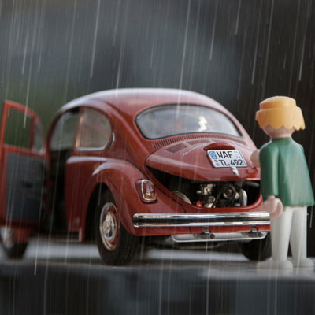
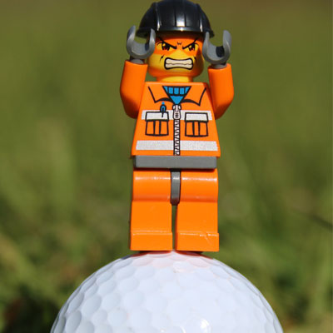
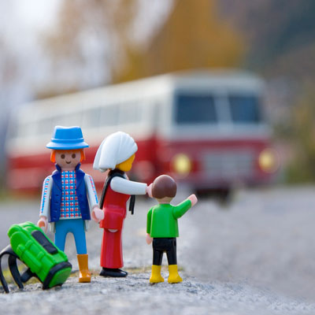
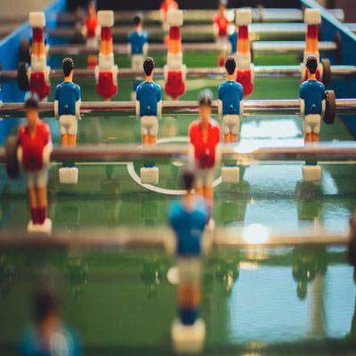
The Complaint Department
TEAM MARKELTAT
Maria Beane, Kelana Latimer, Tatiana Wilcox

Slide 2
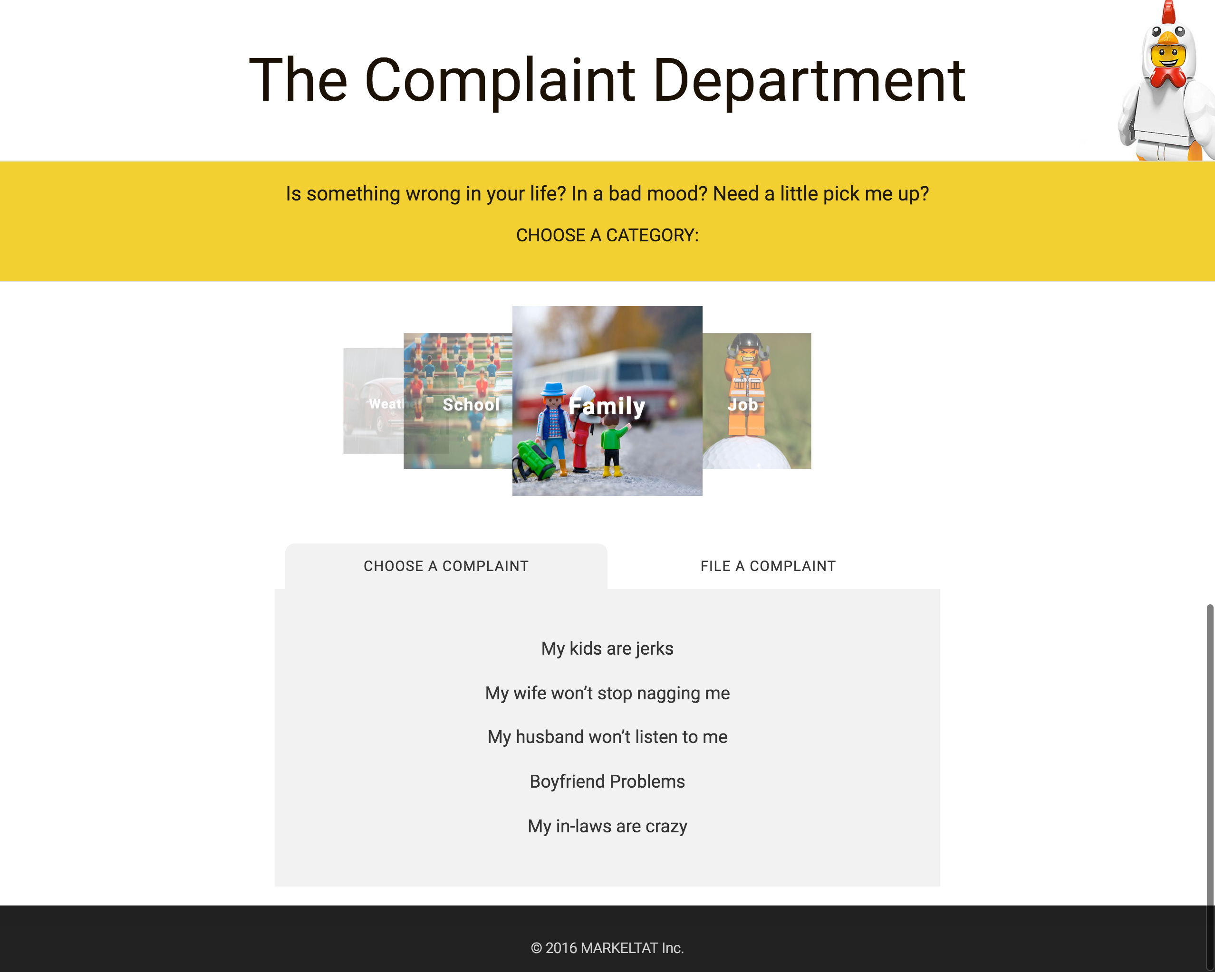
stark-bastion-63847.herokuapp.com

Slide 3
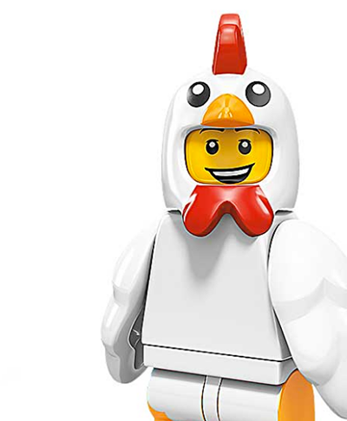
THE IDEA
Life is stressful. But it’s not that bad!
Take a break. Make a complaint and have a laugh.

Slide 4
HOW IT WORKS
CHOOSE A CATEGORY
CHOOSE A COMPLAINT
FILE A COMPLAINT
SEARCH
DISPLAY MEDIA
NO
FEELING BETTER?
YES

Slide 5






TECHNOLOGY
Materialize
Front-end framework
JS – modal, carousel, tabs
YouTube API
Video Search
Google Search API
Custom Search
Firebase
Stored complaints, keywords, and user emails

Slide 6
FRONT END

Slide 7
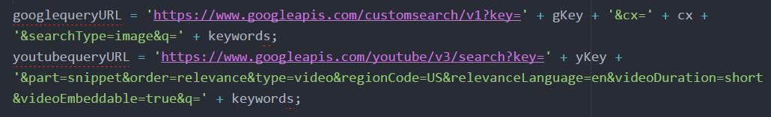
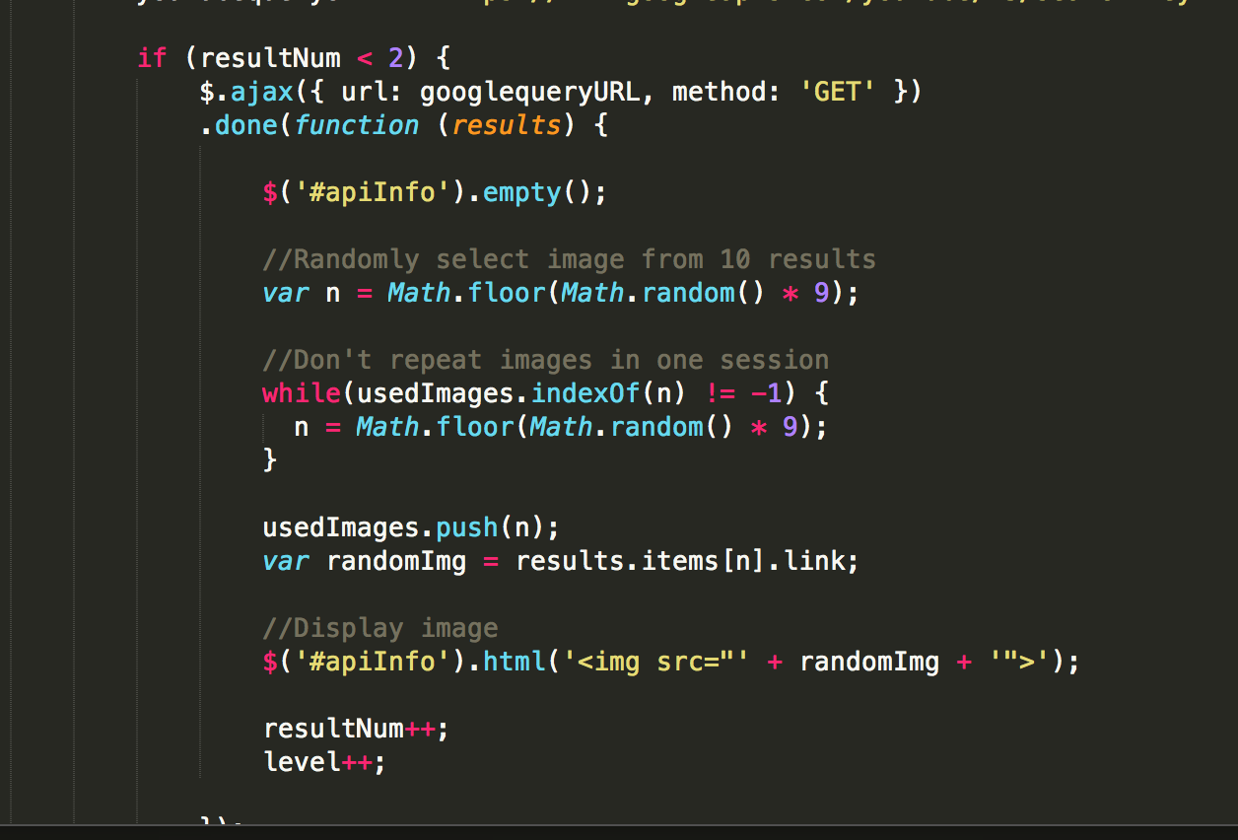
API

Slide 8
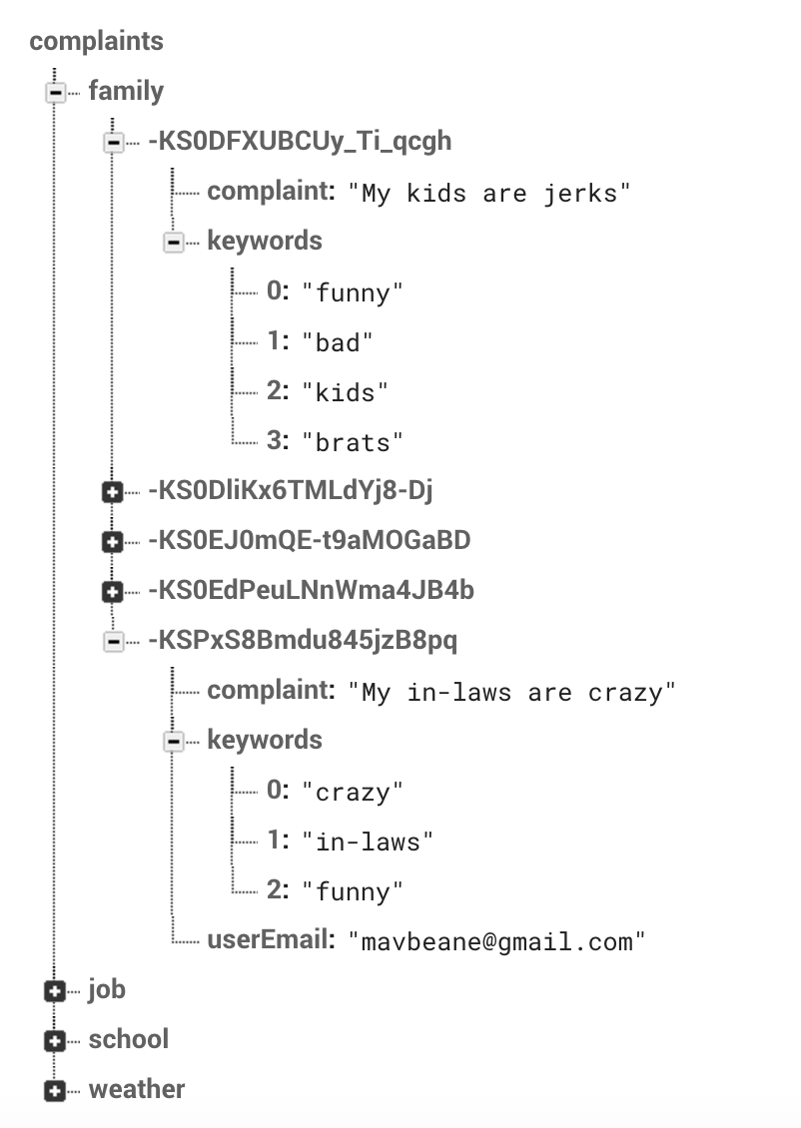
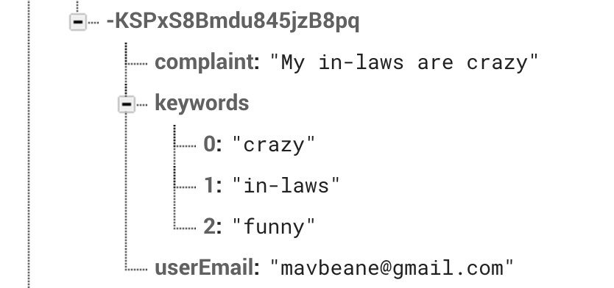
FIREBASE

Slide 9
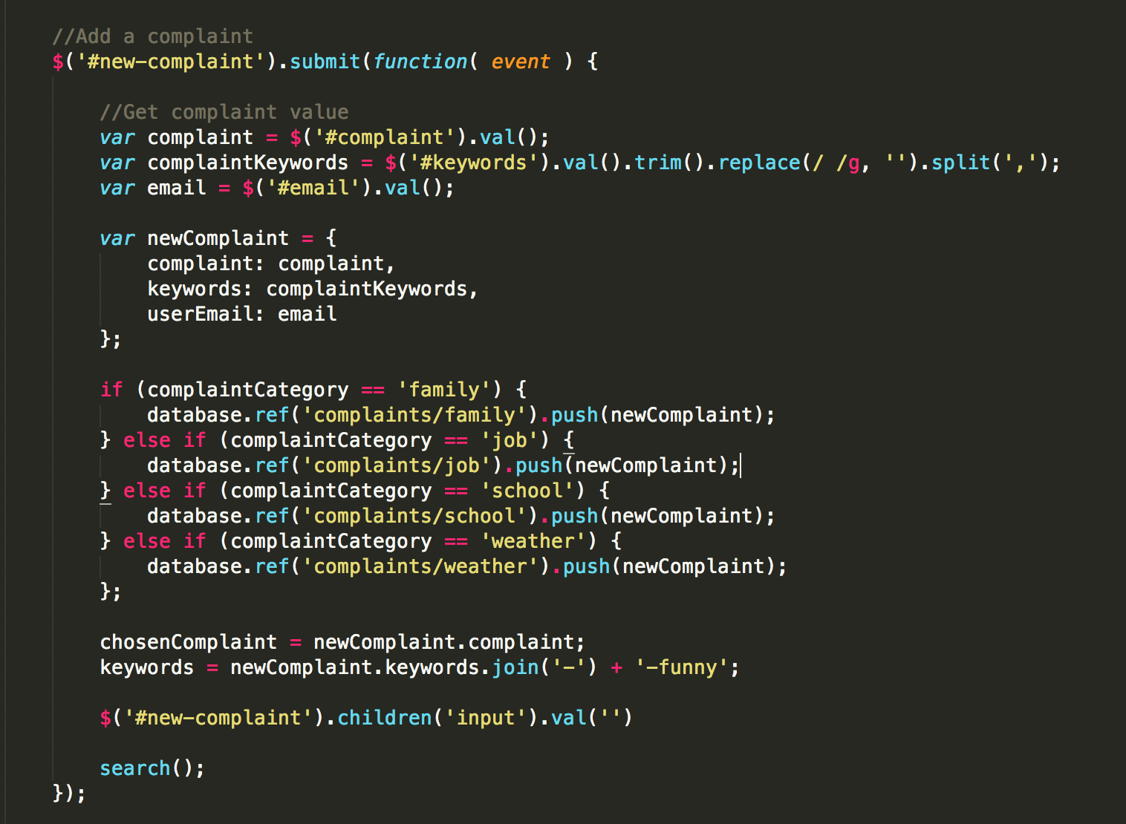

Slide 10
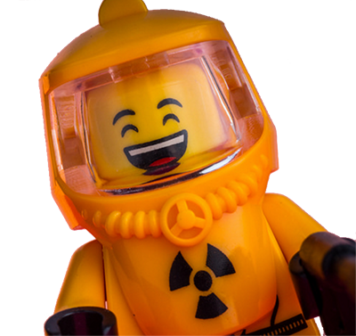
PROBLEMS
Images and video in the search – Not always appropriate
Keywords that worked!
Adding to firebase based on user selection
Image sizing

Slide 11

TO DO
Fine tune keywords and search parameters
Rotate more images/videos
Game/Interactive element
Upvote/downvote images
Email Subscription

