Slide 1

Common Data
Environment (CDE)
Solution Architecture Presentation
CDE
Core
Data
Products
Sources
Users
Ingestion • Real‑time Alerts • Lakehouse • Serving APIs • AI Assistant • Cognitive & Predictive • Observability
01

Slide 2
What is CDE?
A managed data backbone that collects, classifies, stores, serves, and monitors data across operational and analytical use cases.
Unified ingress
Real-time action
Trusted lakehouse
Secure consumption
Receives webhooks and pulls vendor APIs through controlled entry paths.
Splits urgent events into a fast broker lane for alerts and action.
Keeps raw payloads and transforms them into curated and publish zones.
Serves data to dashboards, virtual assistants, partners, and applications.
CDE in one sentence
The CDE turns many sources of data into governed, queryable, operationally useful information — with clear paths for urgent alerts, analytics, AI queries, monitoring, and audit.
02

Slide 3
Presentation storyline
Use this deck to introduce the CDE concept first, then walk through modules, functions, flow, and technology stack.
1
Purpose
What the CDE solves and where it fits
2
Modules
Ingress, ingestion, lakehouse, serving, AI, monitoring, logging
3
How it works
Receive-based, pull-based, fast-path, raw-to-gold, serving
4
Tech stack
Kong, n8n/Python, Redis, MinIO, DuckDB/Polars, FastAPI, Grafana, ELK
5
Delivery
Roadmap and operational considerations
03

Slide 4
CDE core modules
Each module has a clear responsibility; together they form a controlled path from data intake to business consumption.
Ingress Perimeter
Ingestion Engine
Fast Path
Kong API Gateway
n8n / Python Worker
Redis Streams / Kafka
Auth, API keys/JWT, CORS, rate limit, proxy routing
Webhook receive, API polling, normalization, priority classification
Critical event queue, consumer groups, urgent alert dispatch
Lakehouse
Serving Layer
AI Assistant
MinIO + DuckDB / Polars
FastAPI / Go / PostgREST
OpenClaw / ElevenLabs / Telegram / WhatsApp
Bronze raw, Silver curated, Gold publish data zones
Translate REST calls into optimized DB or lake queries
Natural-language querying, incident logging, root-cause Q&A
Cognitive + Predictive
Observability
Logging
ML Engine + AI Reasoner
Prometheus + Grafana
Filebeat + Logstash + Elasticsearch + Kibana
Anomaly detection, forecasting, RCA, prescriptions, early warnings
Host, container, API and predictive alert dashboards
Central log search, audit, RCA evidence, alert rules
04

Slide 5
Technology stack map
Recommended components by responsibility, aligned to the CDE flow.
Security / Edge
Kong Gateway OSS
API key/JWT, rate limiting, proxy cache, route governance
Workflow / Code
n8n + Python / Go
Low-code orchestration for quick flows; custom workers for scale and control
Urgent Eventing
Redis Streams / Kafka
Brokered fast path for critical, predictive and prescription events
Storage
MinIO / MongoDB / PostgreSQL
Object lake, raw documents, operational serving tables
Transformation
DuckDB / Polars
JSON-to-Parquet, cleaning, aggregation, analytical SQL
AI / Predictive ML
ML models
Isolation Forest, Autoencoder, Prophet, PatchTST, LightGBM for anomaly detection, forecasting and PdM/RUL
Cognitive Reasoning
Qdrant / PGVector + Knowledge Graph
RAG over SOPs, causal RCA, next-best-action recommendations
Serving
FastAPI / Go / PostgREST
REST façade for operational DB, Gold Parquet and cognitive endpoints
Monitoring / Logs
Prometheus + Grafana + ELK
Metrics, dashboards, predictive alerts, audit and log analytics
05

Slide 6
How the CDE works: end-to-end lifecycle
The operating model splits fast operational action from reliable data persistence and curated publishing.
1
2
3A
3B
4
5
6
Ingest
Classify
Act
Store
Transform
Serve
Observe
Receive webhook or pull API data
Normalize, validate, evaluate severity
Send ALARM/CRITICAL to urgent broker
Persist 100% raw payloads
Raw → Curated → Publish
Expose secure APIs and AI query tools
Metrics dashboards and centralized log analytics
Important design principle
Urgent notification should not wait for storage or batch ETL. Storage and analytics are durable paths; alerts are an immediate operational path.
06

Slide 7
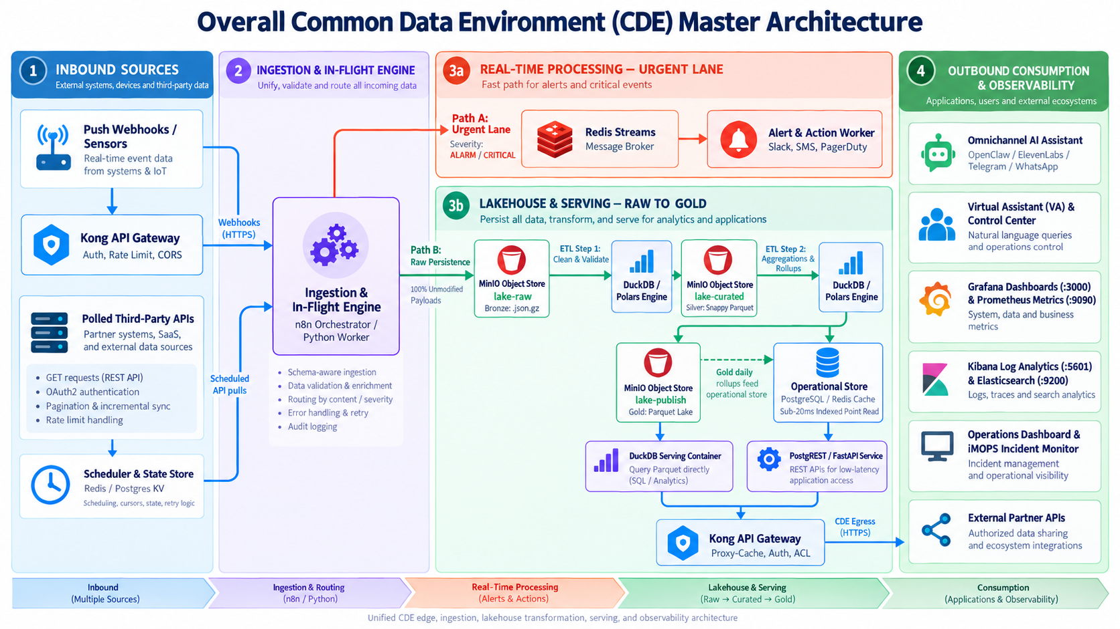
Overall CDE Master Architecture
Full solution overview across inbound sources, ingestion, urgent processing, lakehouse serving, and consumption.
07

Slide 8
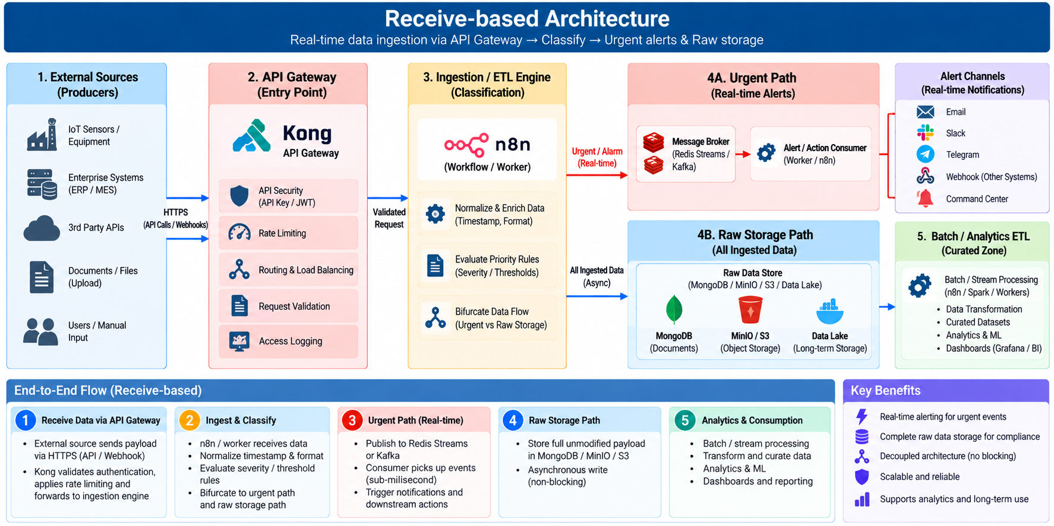
Receive-based Architecture
For sources that push data through API calls or webhooks into the CDE.
08

Slide 9
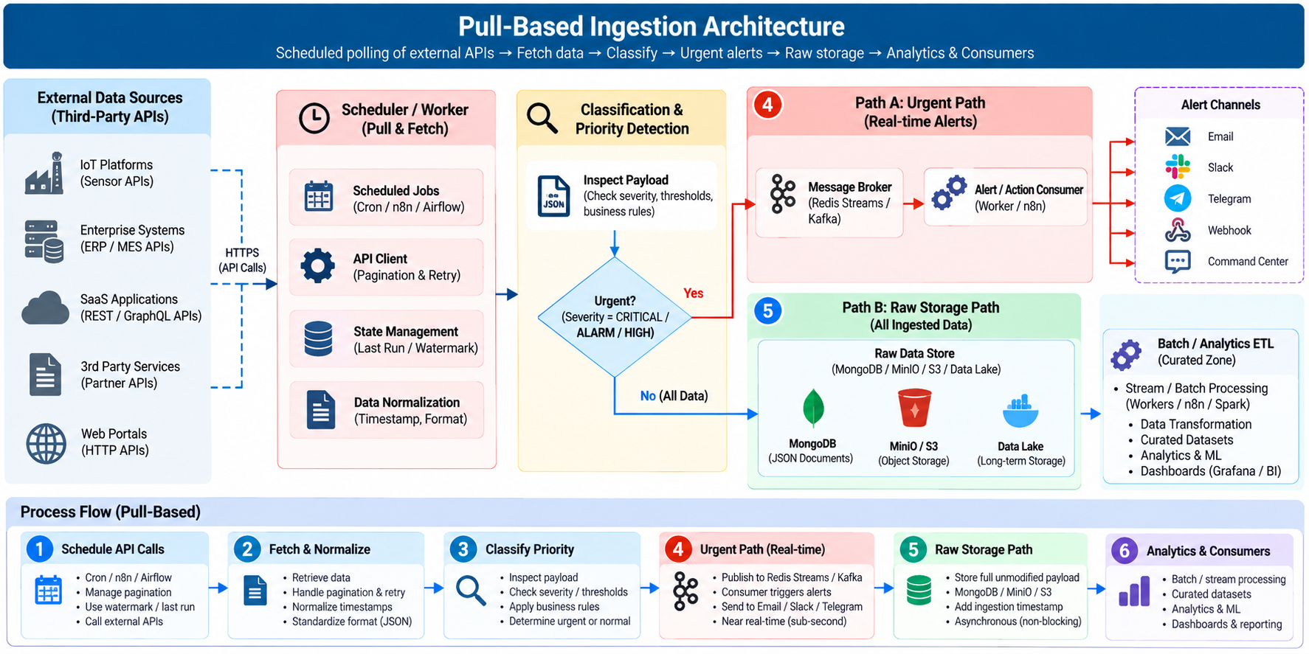
Pull-based Ingestion Architecture
For third-party APIs that require scheduled polling, pagination, watermarking, and retry handling.
09

Slide 10
Raw-to-Gold Lakehouse model
MinIO stores the lake zones; DuckDB/Polars perform the compute and transformations.
Bronze / Raw
lake-raw
Silver / Curated
lake-curated
Gold / Publish
lake-publish
ETL Step 1
DuckDB / Polars
Immutable payload copy
Compressed JSON / JSONL
Audit and re-processing
Clean Parquet
Deduplicated
Schema enforced
Rollups + KPIs
Parquet and DB mirror
Ready for APIs
Operational serving mirror
High-frequency Gold summaries can be copied to PostgreSQL or Redis for low-latency VA and dashboard lookups.
10

Slide 11
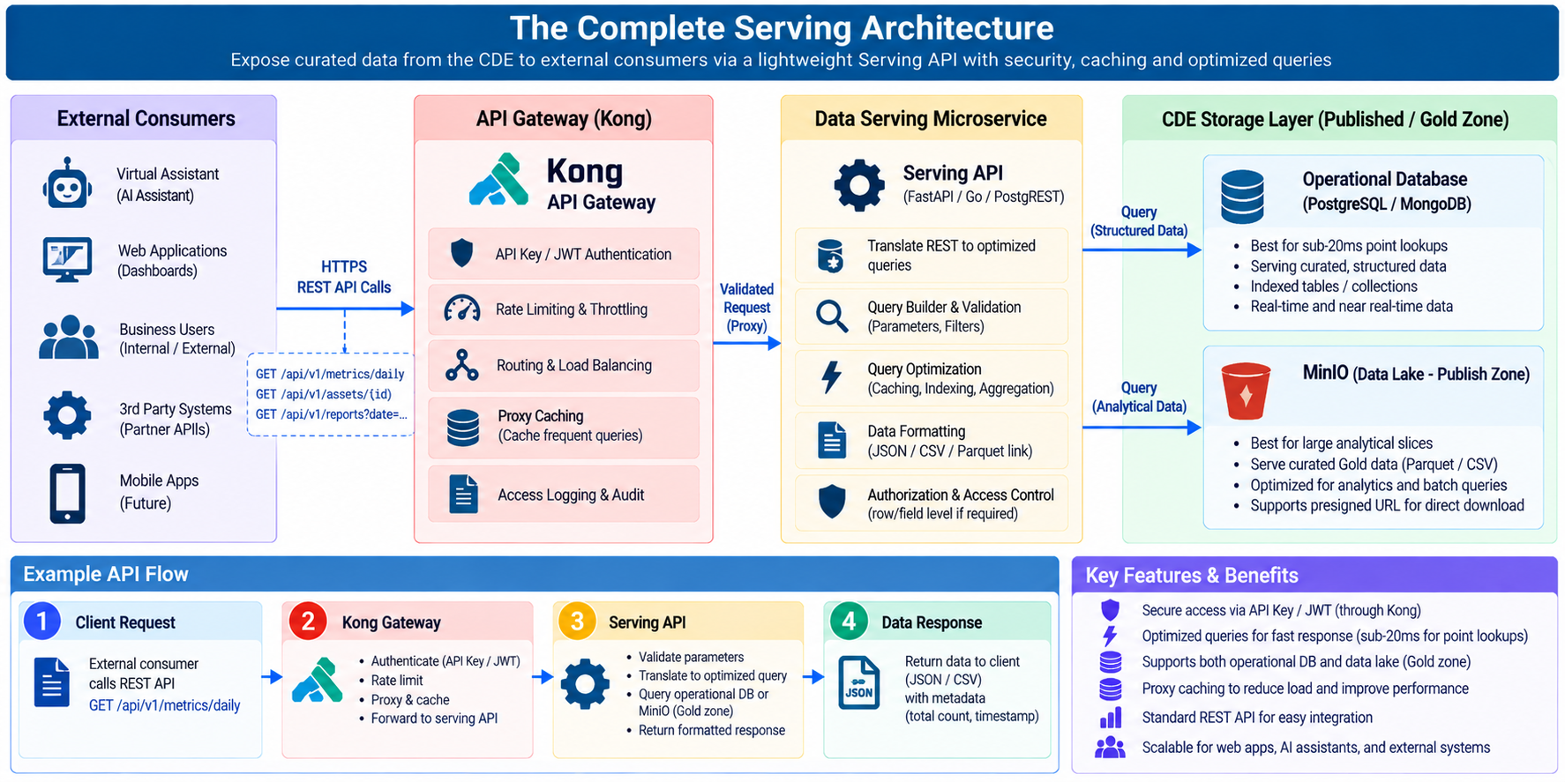
The Complete Serving Architecture
A Serving API sits between Kong and published storage to translate REST calls into optimized Gold-zone queries.
11

Slide 12
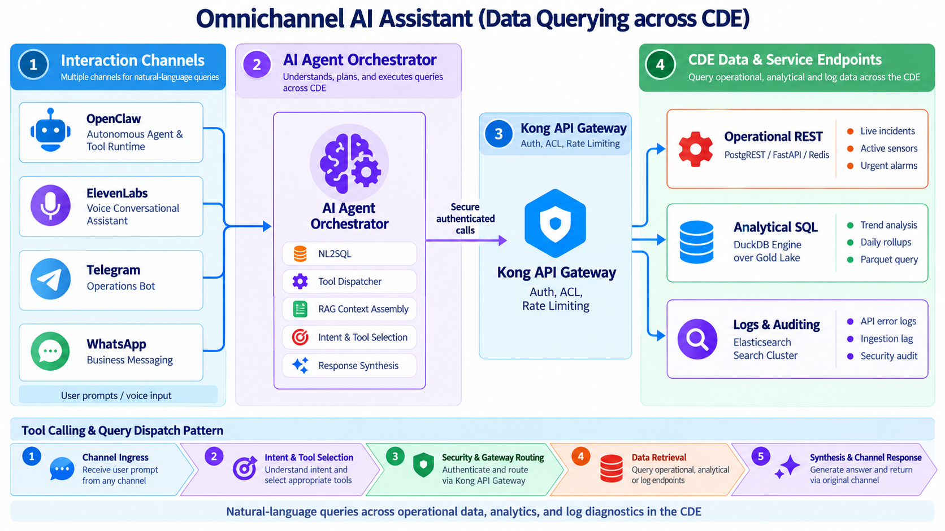
Omnichannel AI Assistant
Natural-language and voice channels query operational REST, analytical SQL, and log diagnostics through Kong.
12

Slide 13
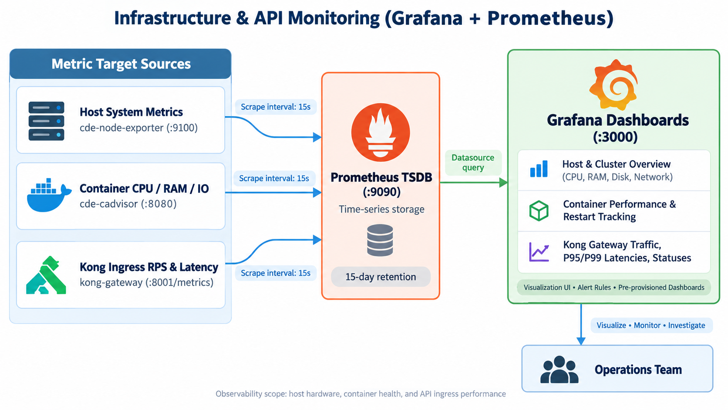
Infrastructure & API Monitoring
Prometheus scrapes host, container, and Kong metrics; Grafana presents dashboards for operations.
13

Slide 14
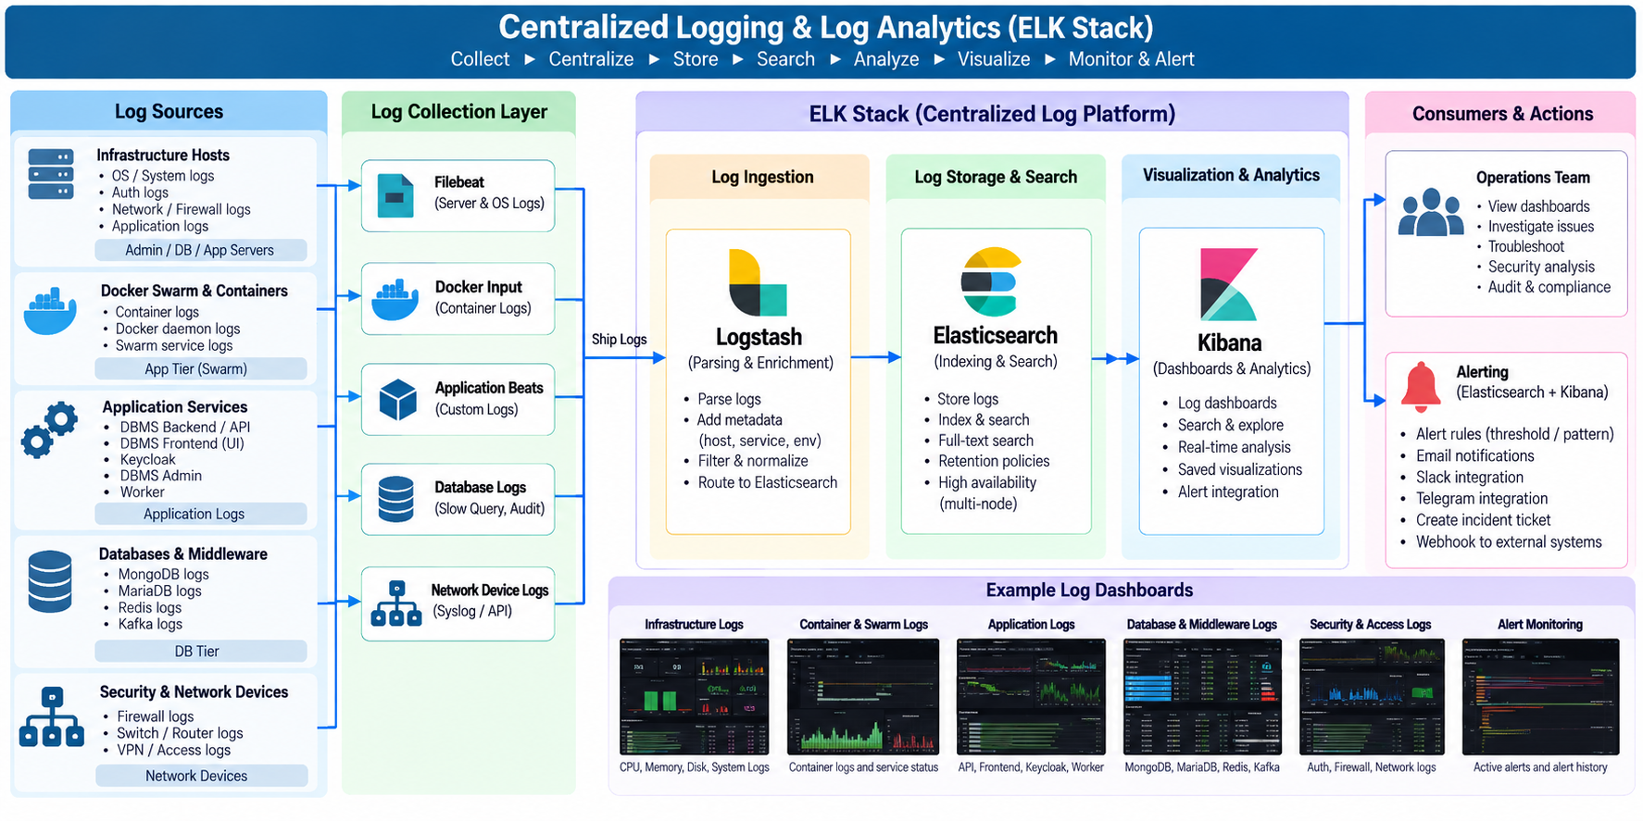
Centralized Logging & Log Analytics
Filebeat and Logstash route infrastructure, container, application, database, and gateway logs into Elasticsearch and Kibana.
14

Slide 15
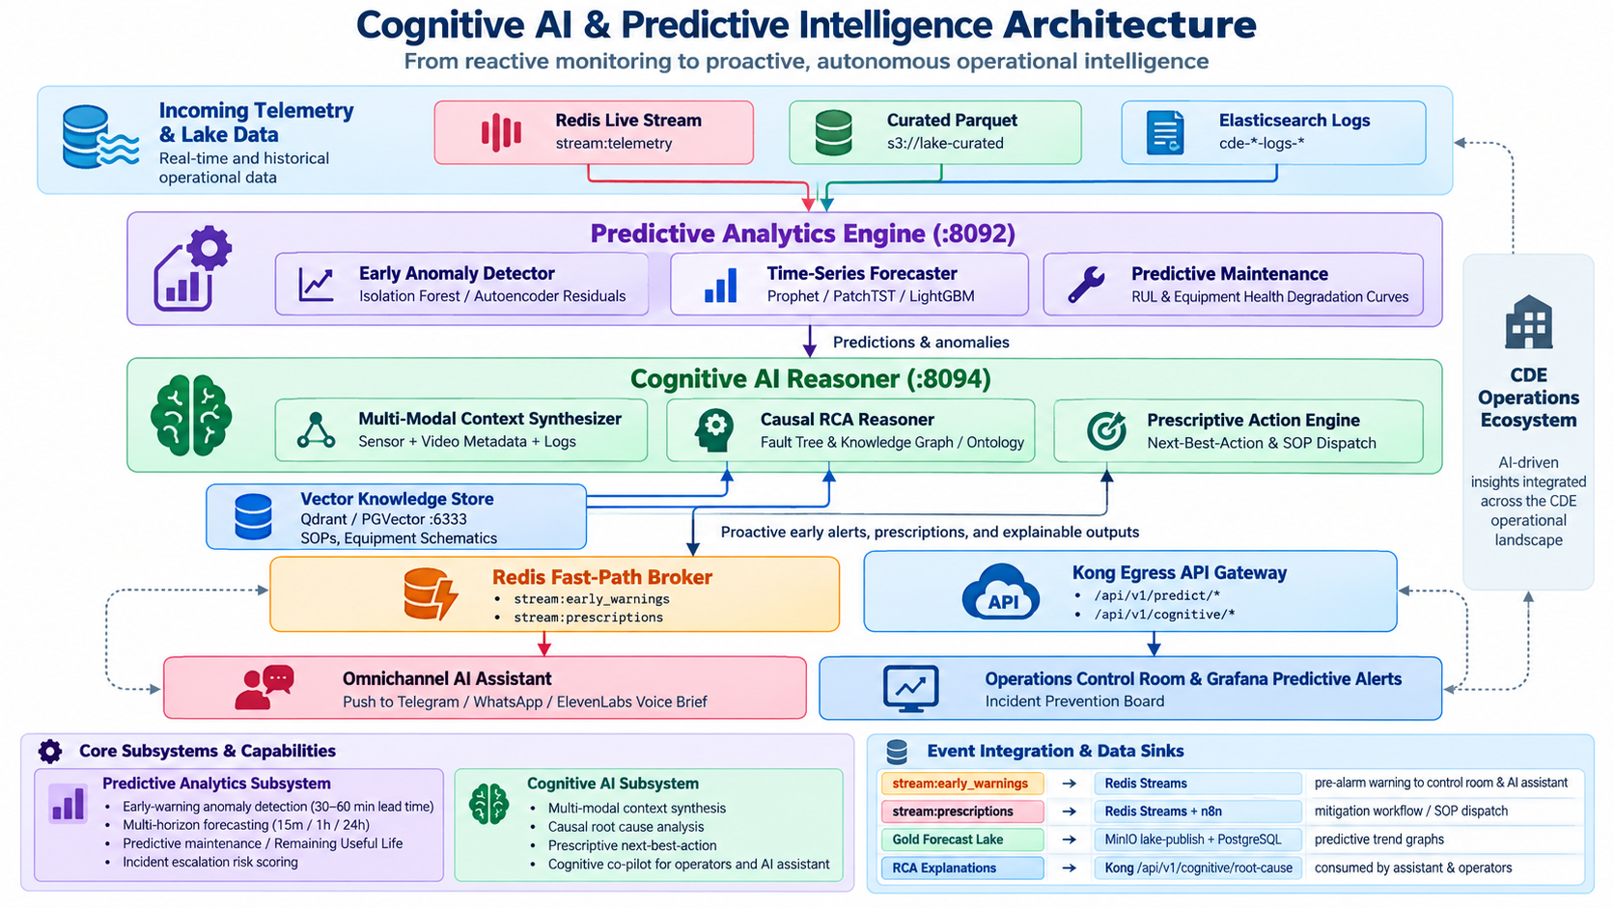
Cognitive AI & Predictive Intelligence Architecture
Moves the CDE from reactive monitoring to proactive early warning, root-cause analysis, and prescribed mitigation.
15

Slide 16
Cognitive AI & Predictive Analytics Engine
Predict failures before they happen, diagnose complex root causes, and prescribe concrete mitigation actions.
Early anomaly detection
Time-series forecasting
Isolation Forest, dynamic Z-score, autoencoder residuals detect subtle multi-variate drift before hard thresholds.
Prophet, PatchTST and LightGBM forecast flow, crowd density, ingestion throughput and capacity pressure.
Predictive maintenance
Cognitive RCA + NBA
RUL and equipment health curves estimate degradation, wear rate and service windows before failure.
Knowledge graph, fault tree and vector SOP search explain root cause and recommend next-best-action.
Event integration & data sinks
stream:early_warnings
Predictive Engine → Redis Streams
Pre-alarm warning to control room and AI Assistant
stream:prescriptions
Cognitive Engine → Redis Streams + n8n
Automated mitigation workflow, SOP dispatch, work order draft
Gold Forecast Lake
Predictive Engine → MinIO lake-publish + PostgreSQL
Predictive trend graphs and capacity planning views in Grafana
RCA Explanations
Cognitive Engine → Kong /api/v1/cognitive/root-cause
On-demand explanations for Assistant and operators
16

Slide 17
CDE functions by audience
Users can query data, log incidents, receive predictive alerts, retrieve RCA explanations, and trigger guided actions through the AI Assistant.
Operations team
Business users
Live/predictive alerts, incident tracking, RCA explanations, corrective action
Ask AI Assistant for data, reports, incident status and operational summaries
Field / support users
Security / audit
Log incidents, receive prescriptions, trigger SOP workflow or work-order draft
Query logs, trace requests, review access failures and compliance evidence
Users / AI Assistant
Ask AI Assistant to query CDE data
Log / report incidents from chat or voice
Check incident status, metrics, and history
Generate summaries, tables, and reports
17

Slide 18
Suggested implementation roadmap
Build a thin working slice first, then scale data sources, service endpoints, AI channels, and operations coverage.
1
2
3
4
5
Foundation
Ingestion MVP
Data product
Consumption
Operations hardening
Kong, Redis, MinIO, worker runtime, base network/security
One push source + one pull API, raw bucket, urgent rule
Bronze → Silver → Gold jobs, operational DB mirror
Serving API, dashboard, VA or Telegram query path
Grafana, ELK, alert rules, runbooks, access review
Presentation close
CDE is not only a storage layer — it is an operational data platform that ingests, acts, governs, serves, and observes.
18

