Slide 1
EKS
AWS

Slide 2
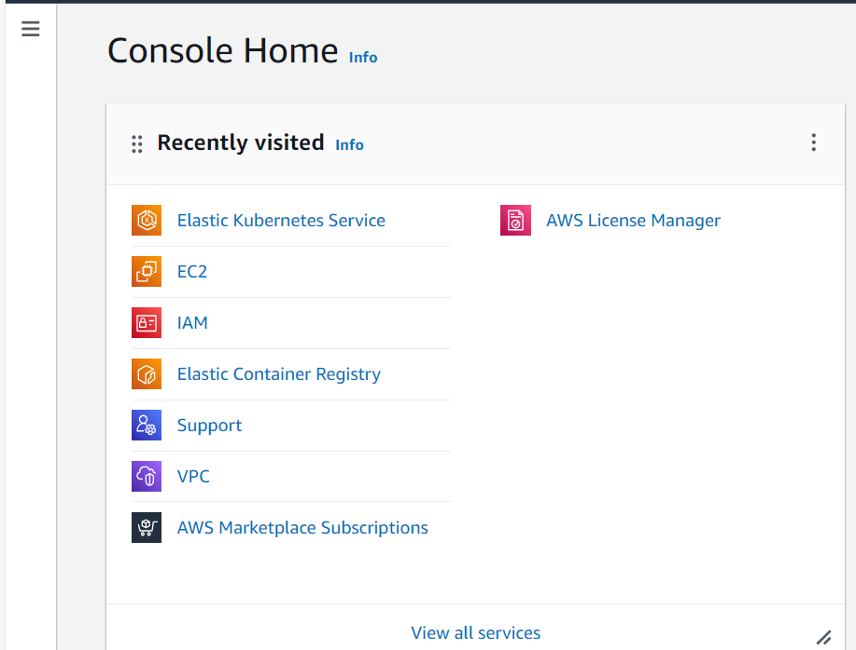
AWS - Home

Slide 3
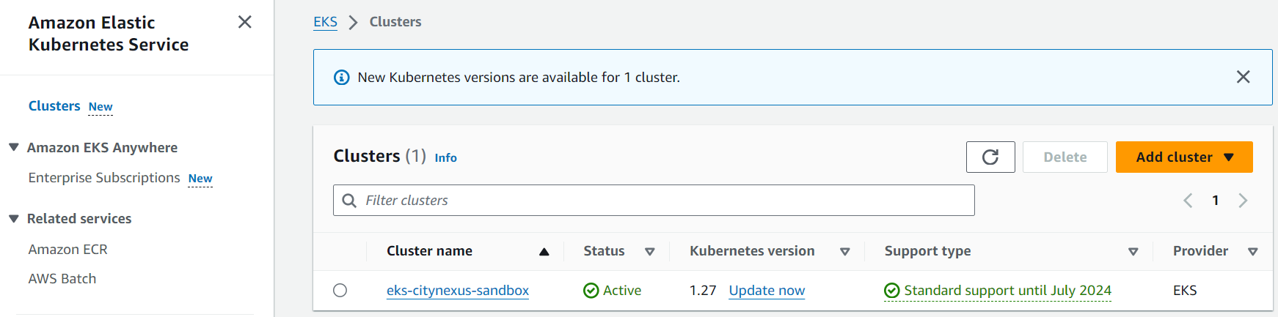
EKS - Home

Slide 4
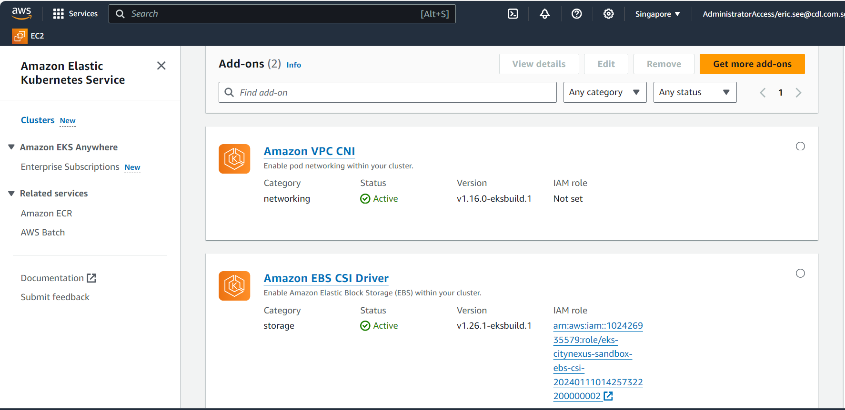
EKS Plugins

Slide 5
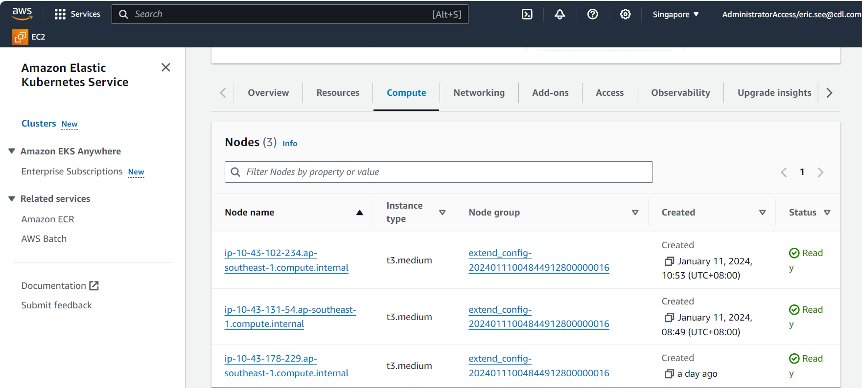
EKS – Compute Nodes

Slide 6
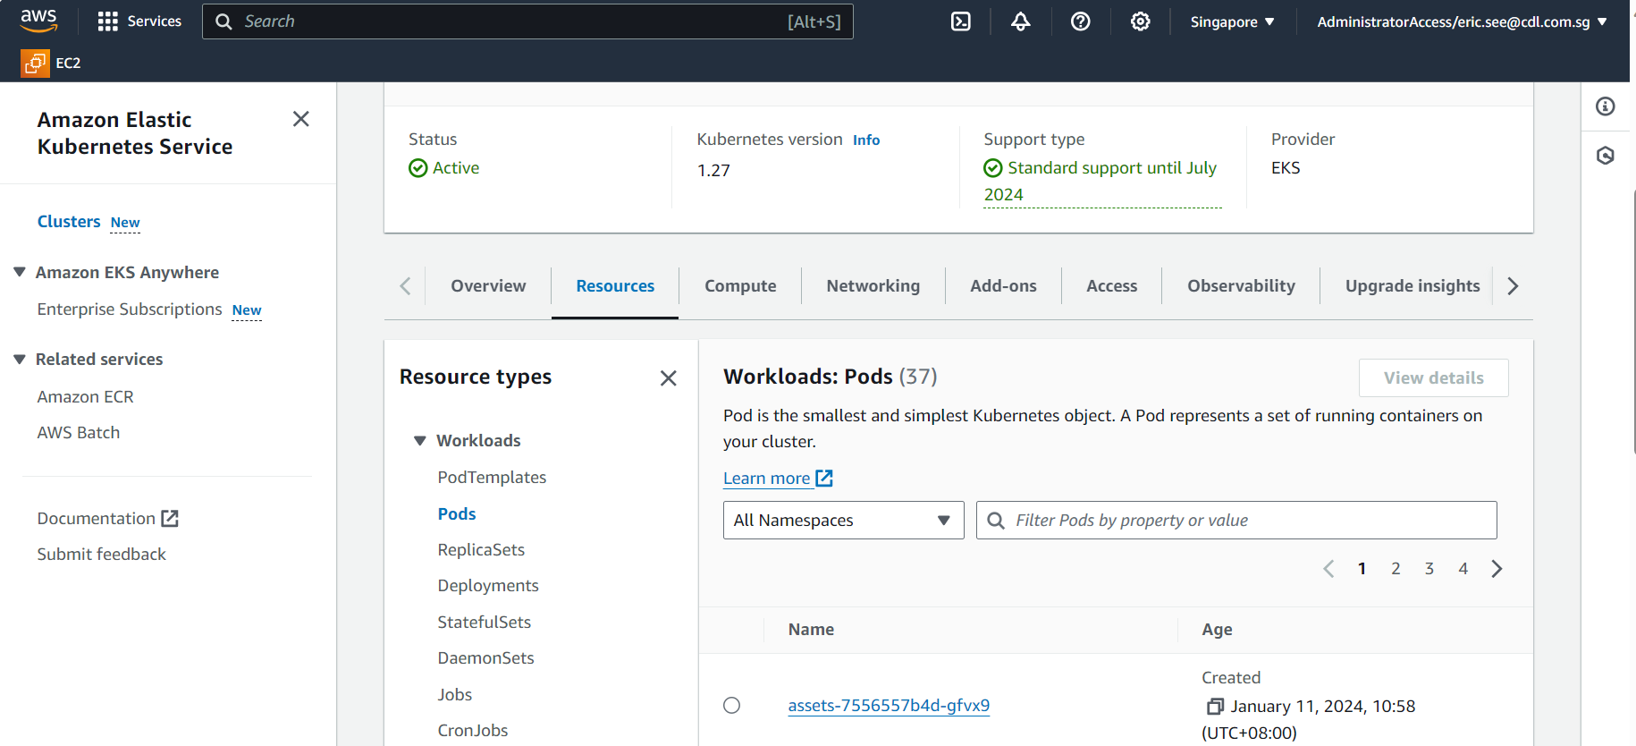
EKS – Resources Home

Slide 7
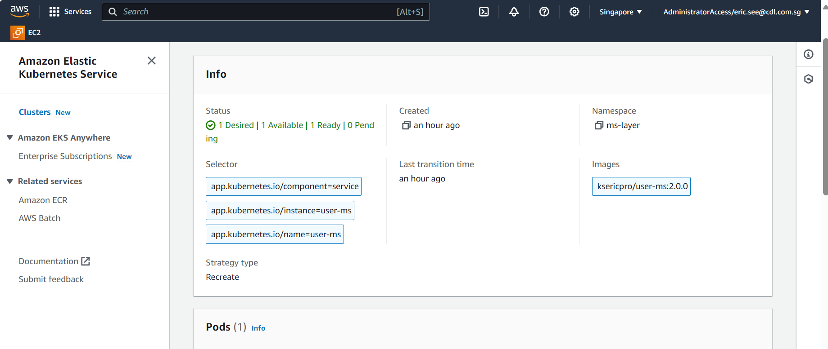
EKS –Deployments

Slide 8
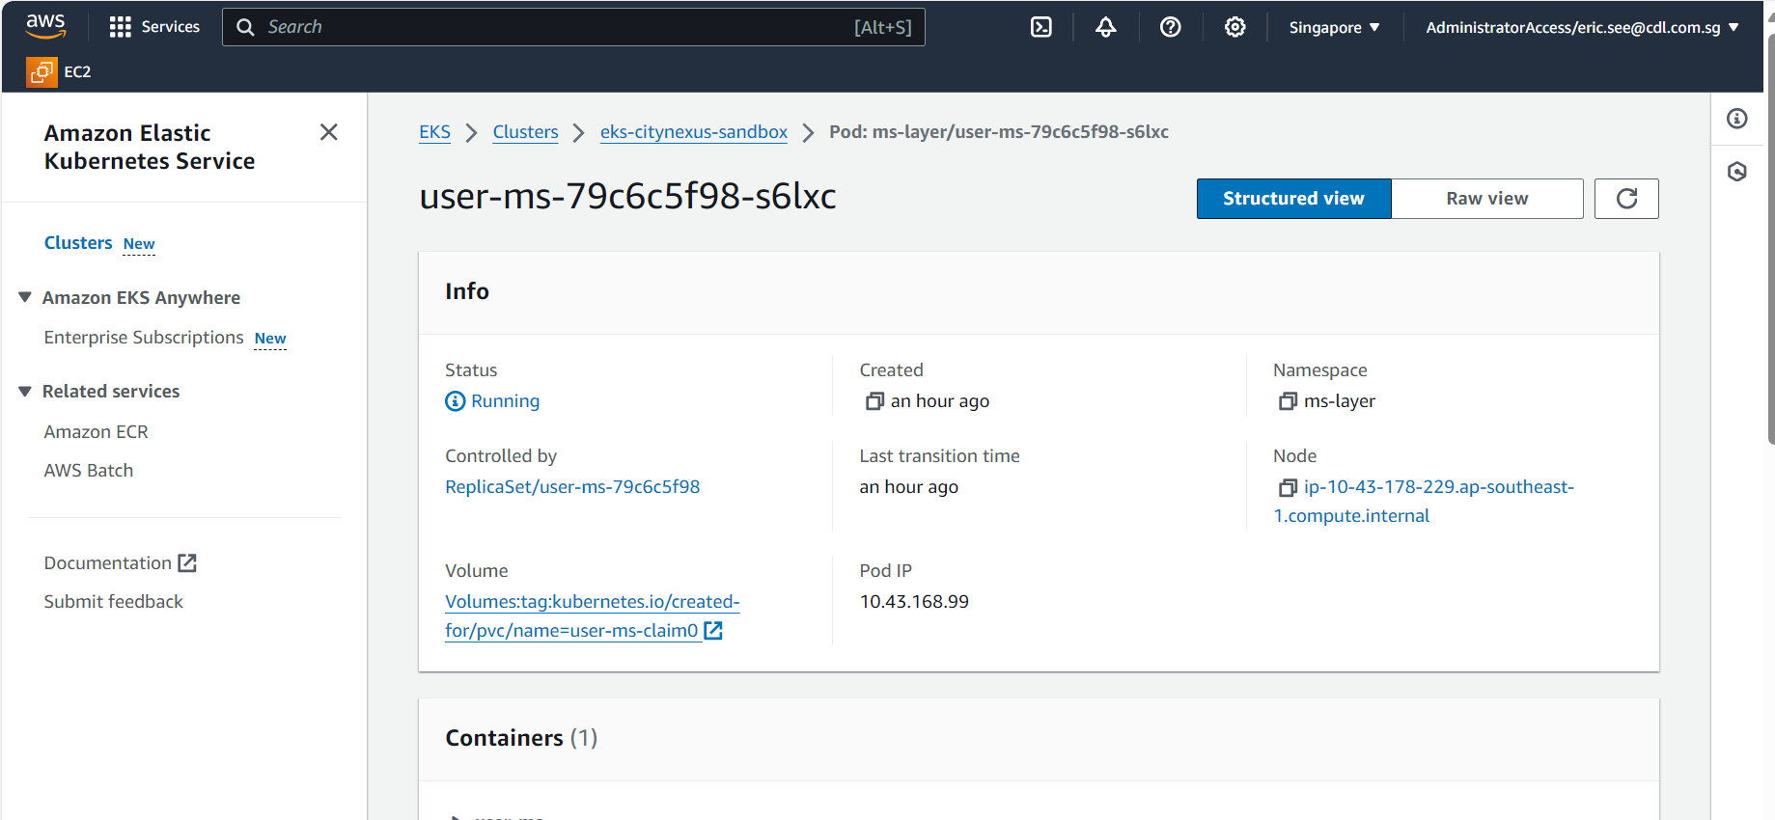
EKS –Pods

Slide 9
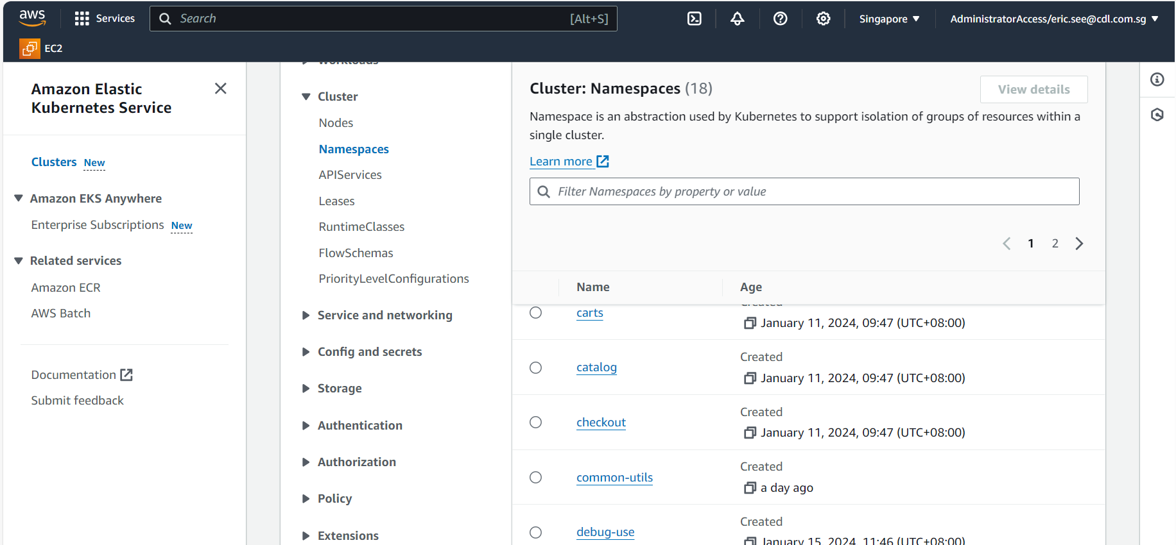
EKS –Namespaces

Slide 10
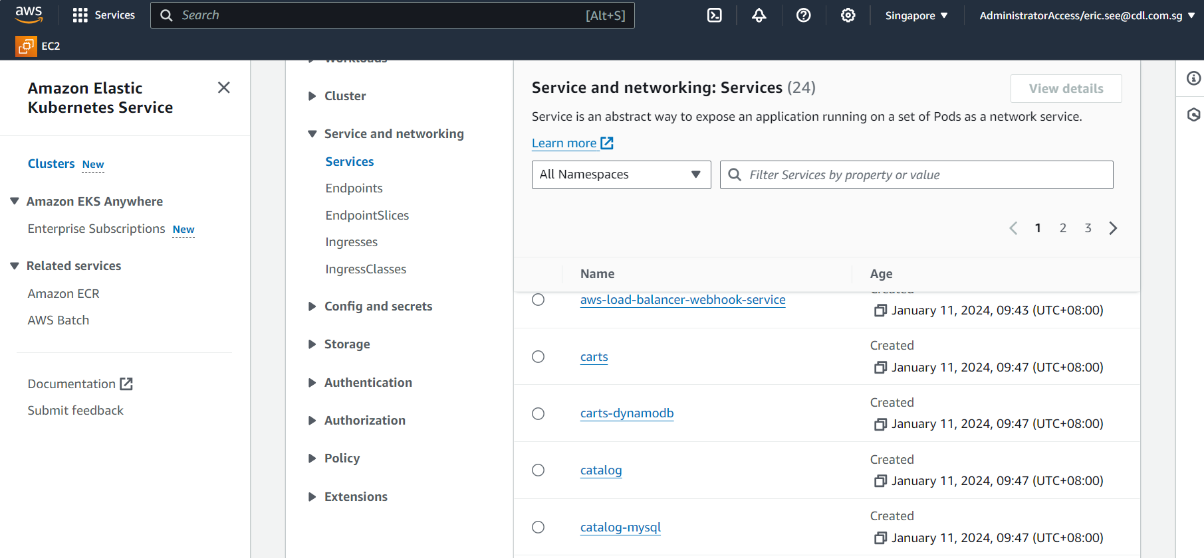
EKS – Services

Slide 11
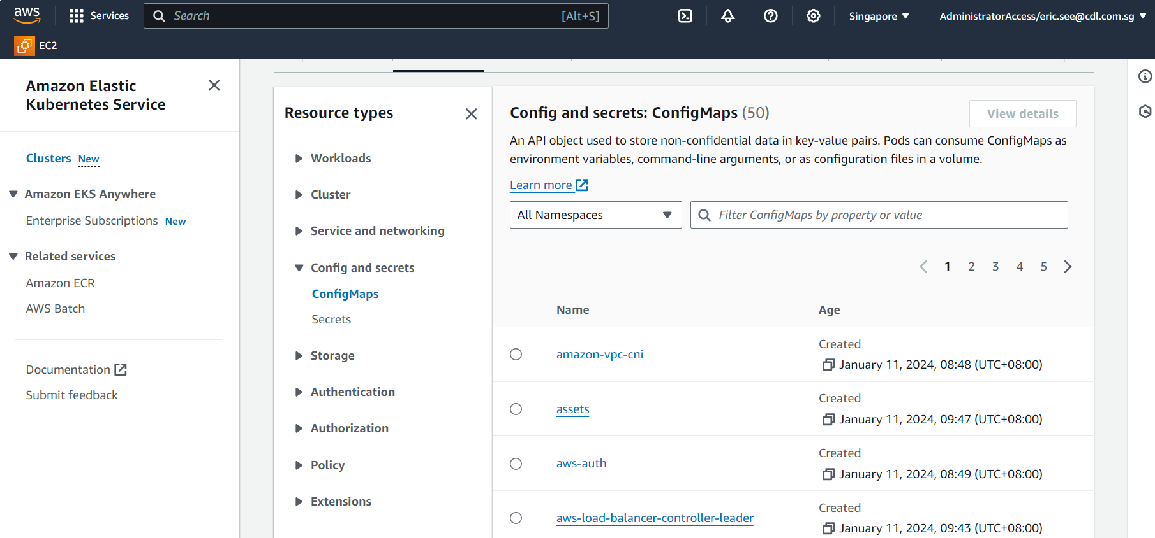
EKS –Config Map

Slide 12
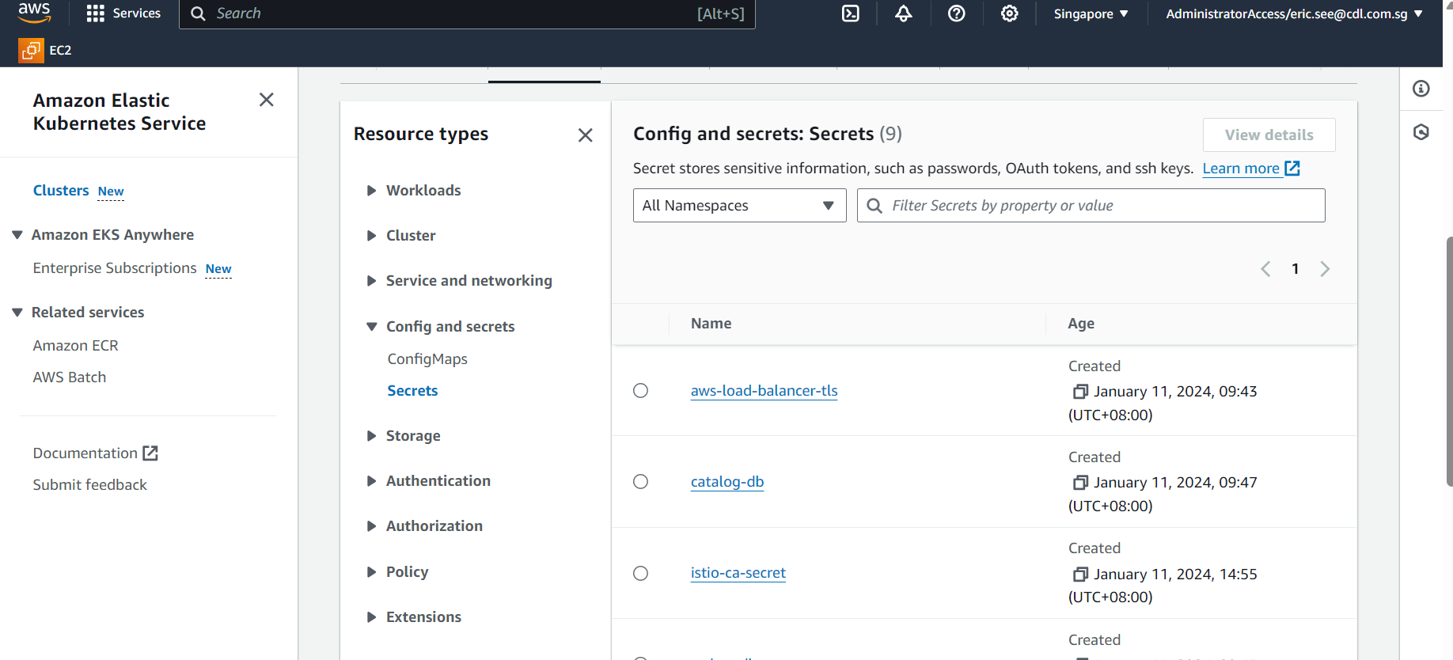
EKS – Secrets

Slide 13
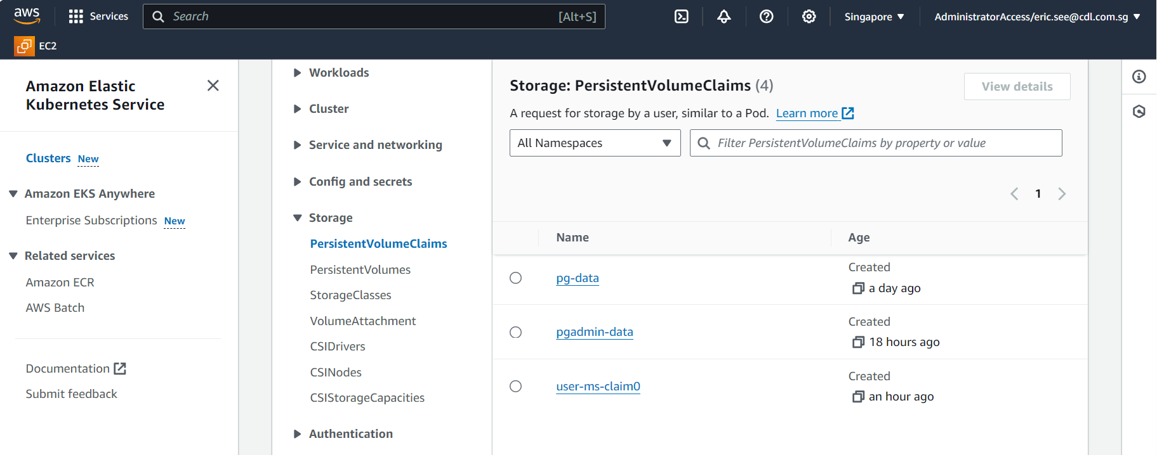
EKS – PVC

Slide 14
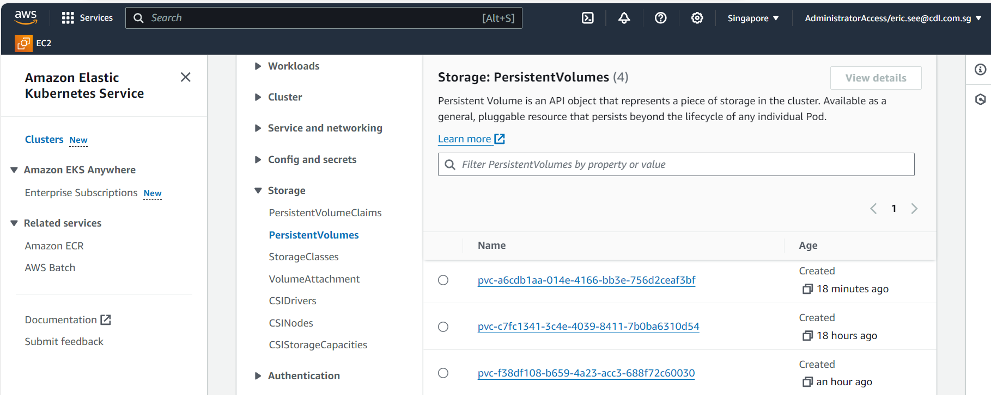
EKS - PV

Slide 15
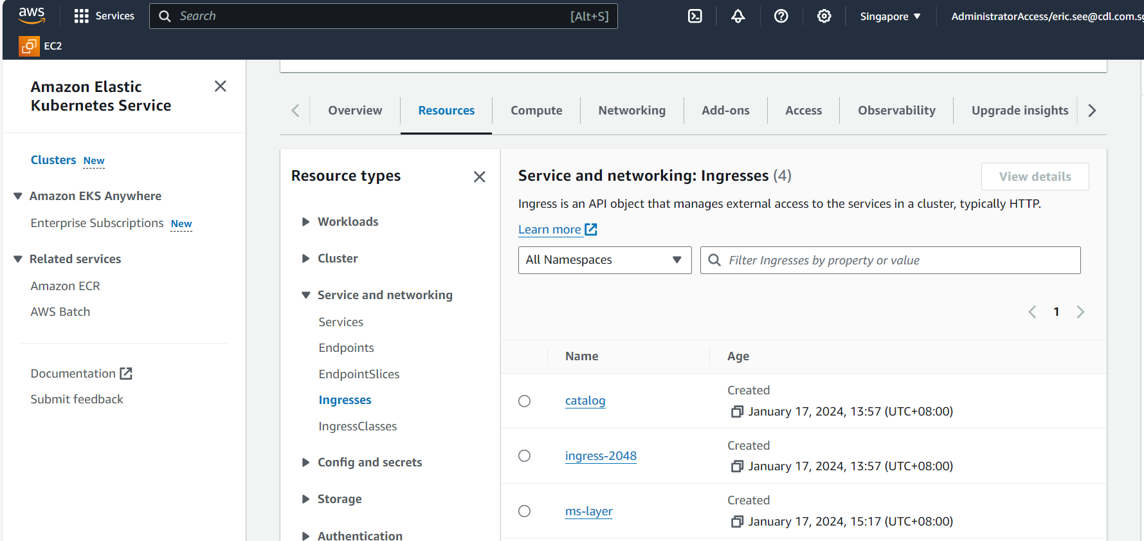
EKS - Ingress

Slide 16
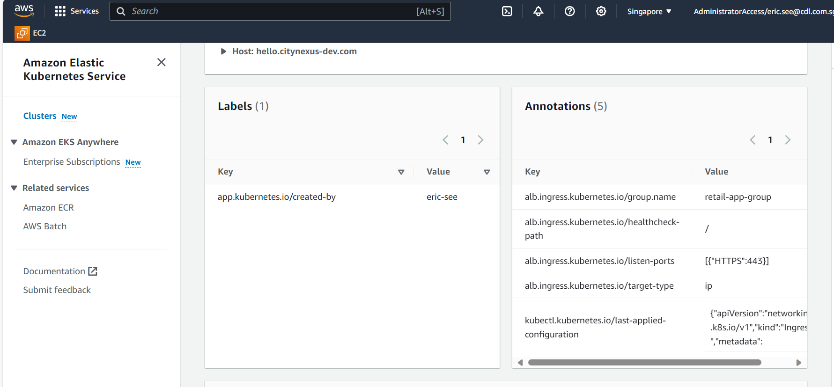
EKS – Ingress Annotations

Slide 17
Simple Setup
notification
rabbitmq
helloworld
ALB
Ingress
postgres
sillyworld
user
pgadmin
ms-layer
common-utils
EKS cluster

Slide 18

Proper Setup – API gateway
user
rabbitmq
ALB
Ingress
Zuul
postgres
notification
pgadmin
ms-layer
common-utils
EKS cluster

