Slide 1
Rising Rates and housing Impact

Slide 2
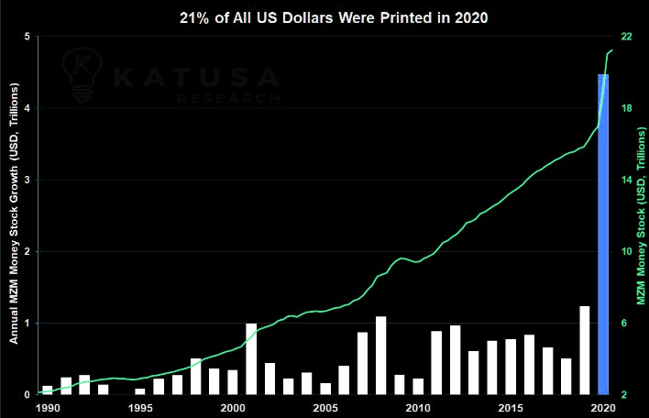
Introduction
Austin, TX
Known as a hot real estate market
Fed set lending rates to near 0% in 2020
~4 trillion US Dollars printed in reaction to Covid

Slide 3
Hypothesis
Fed rate increases in 2022 are cooling down the Austin real estate market.
Trend saw rising housing prices in local markets during 2020 and 2021 with down trends occurring in 2022
Impacts we focused on included housing sale prices, inventory, and whether homes are being sold above or below listing price.

Slide 4
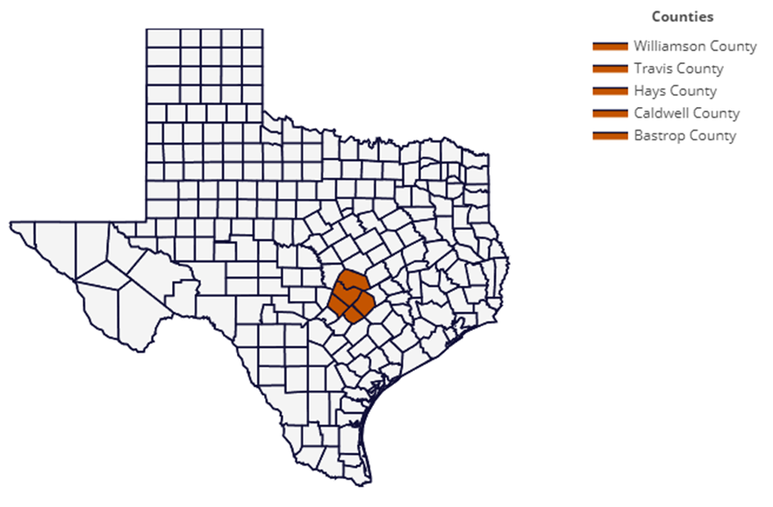
Geographic focus

Slide 5
Real estate metrics

Slide 6
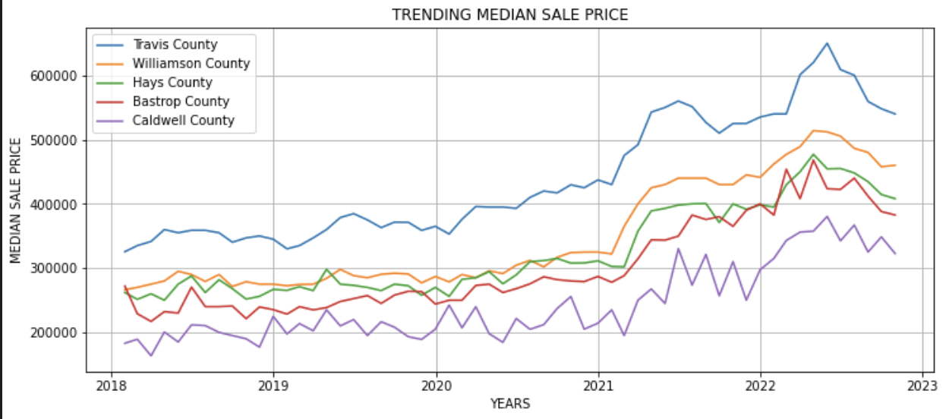
Trending median sale price

Slide 7
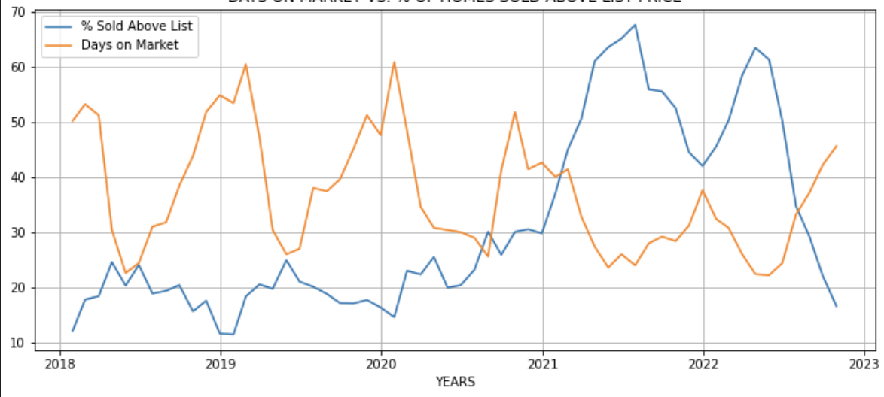
Days on market vs. % of homes sold above list price

Slide 8
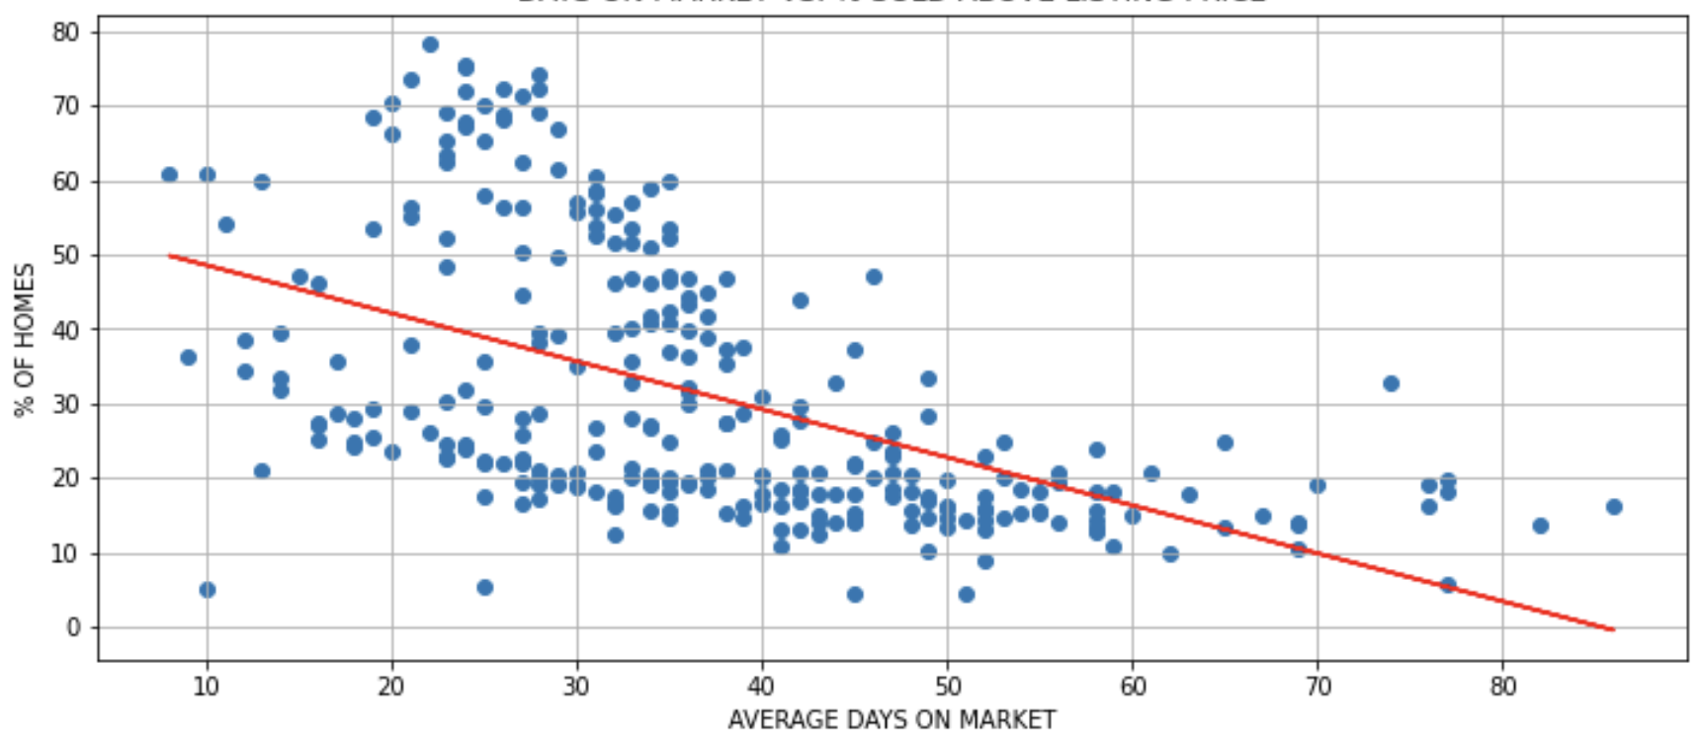
Days on market vs. % sold above listing price
R-value -0.52

Slide 9
Fed & Mortgage Rates

Slide 10
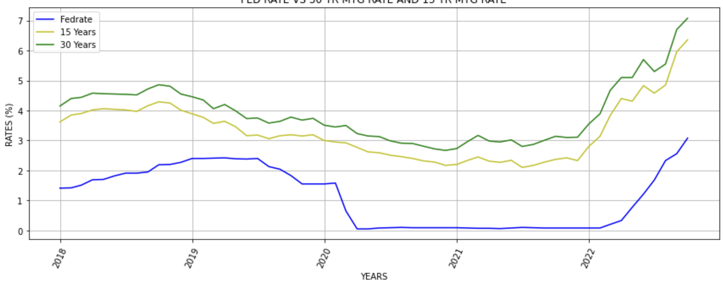
Fed rate vs. 30-year mtg rate and 15-year mtg rate

Slide 11
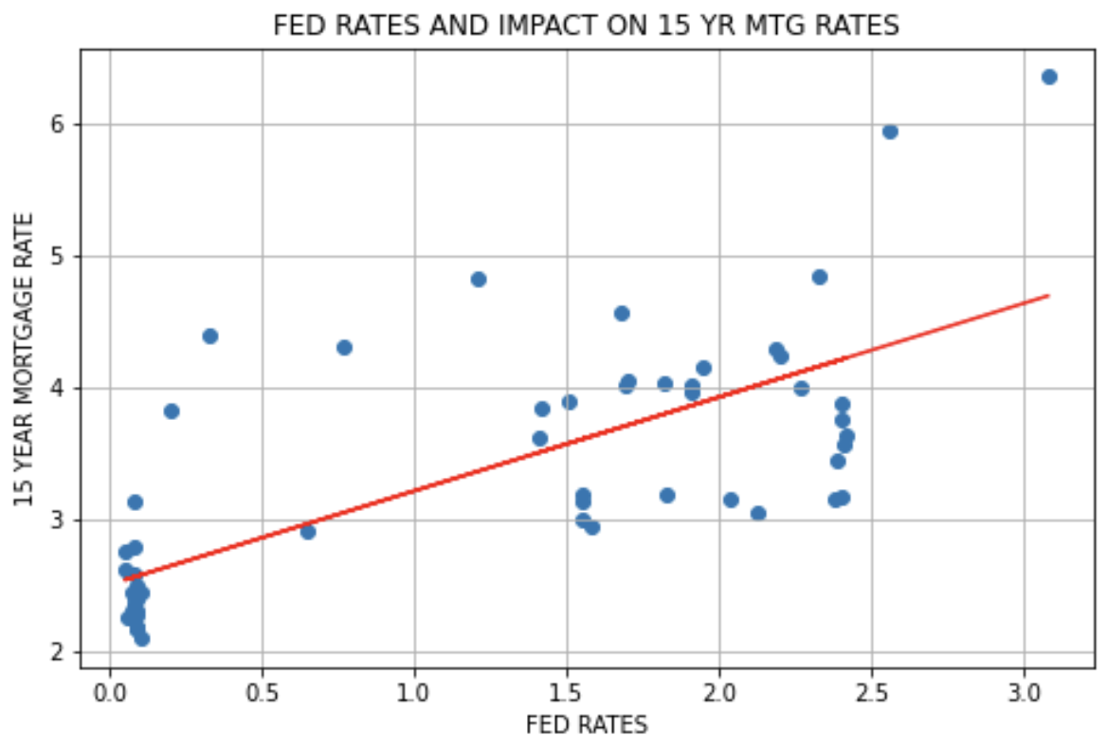
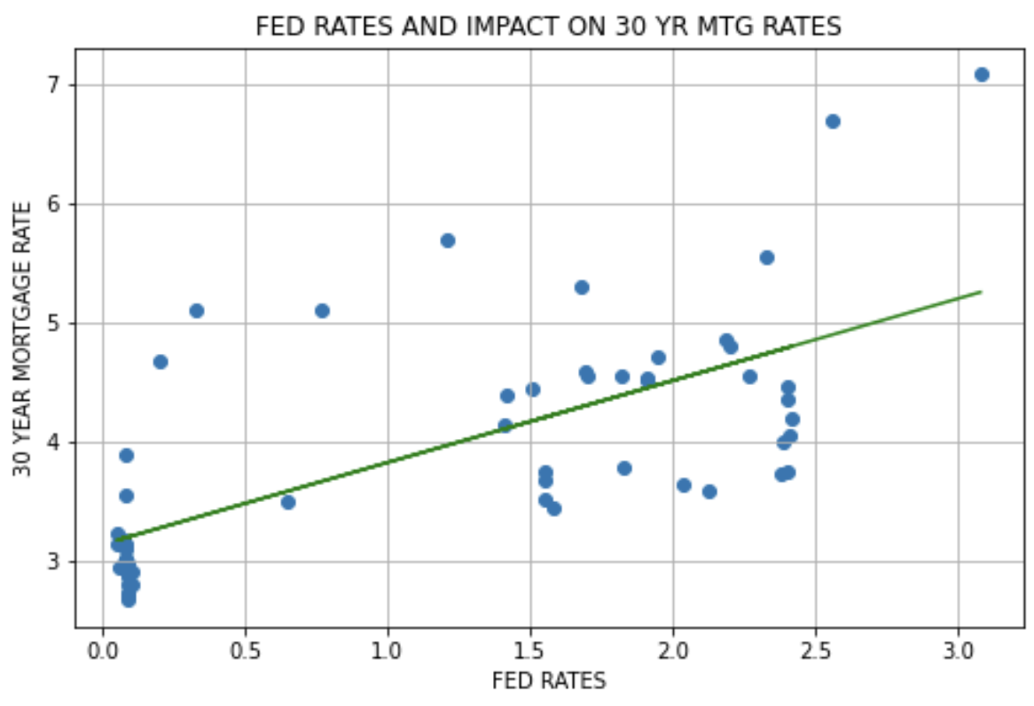
R-value 0.73
R-value 0.69

Slide 12
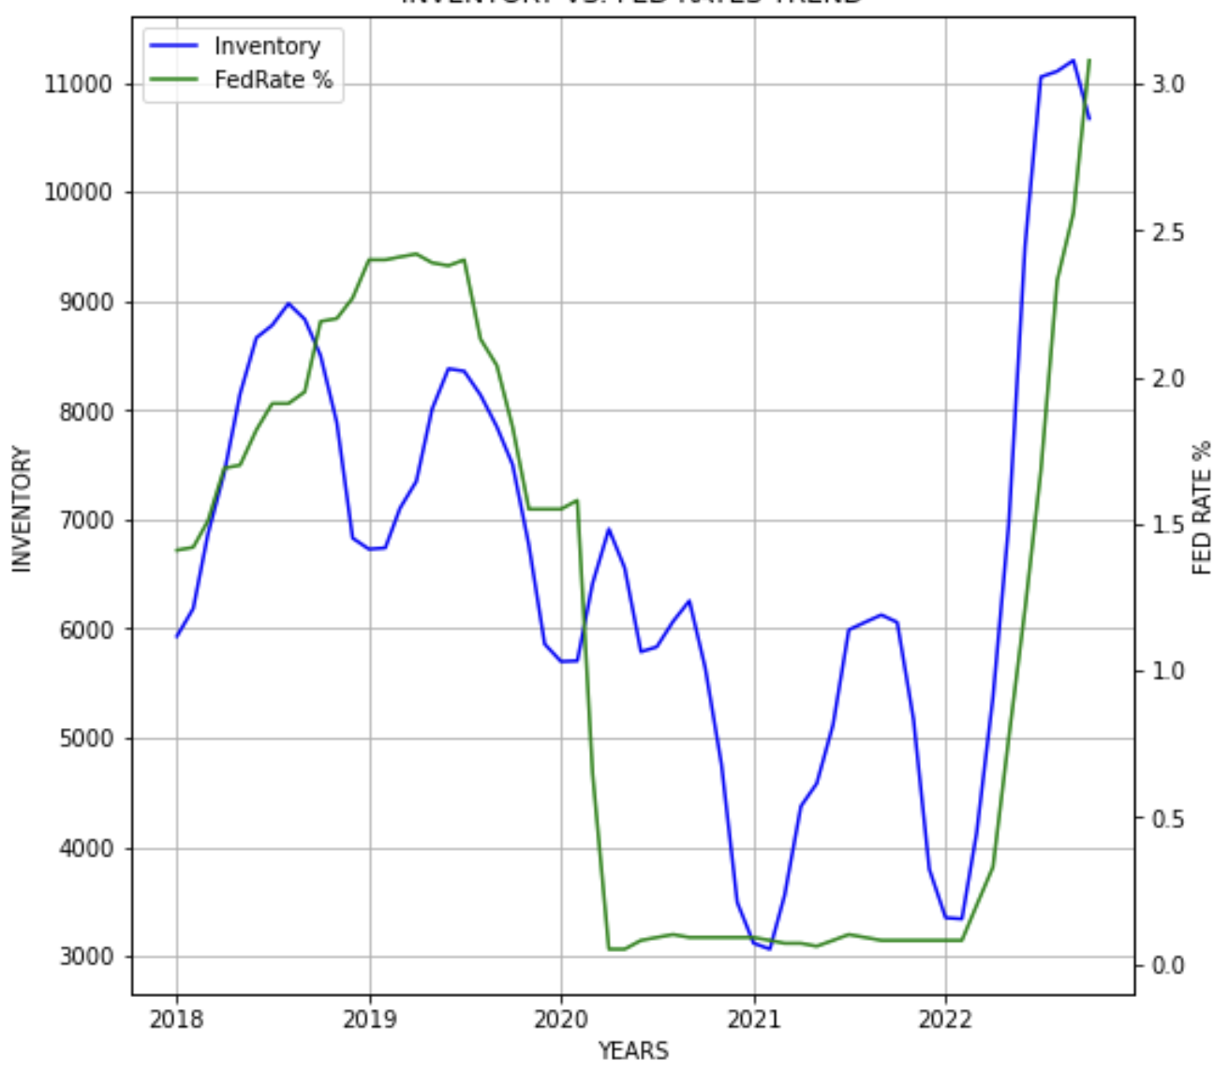
Inventory vs. fed rates trend

Slide 13
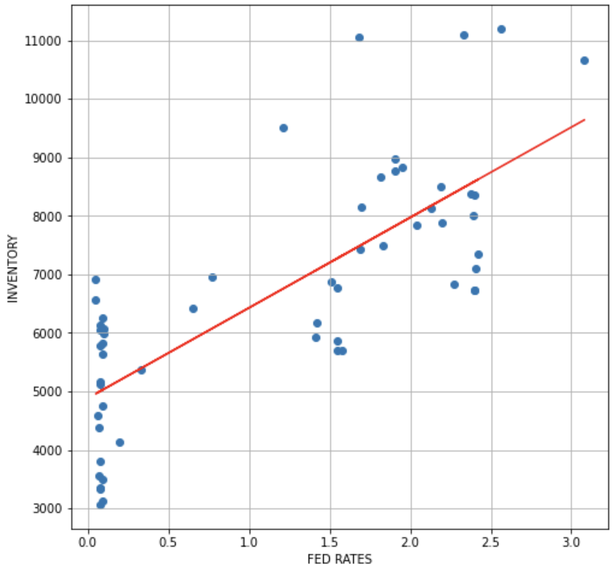
Inventory vs. fed rates correlation
R-value 0.76

Slide 14
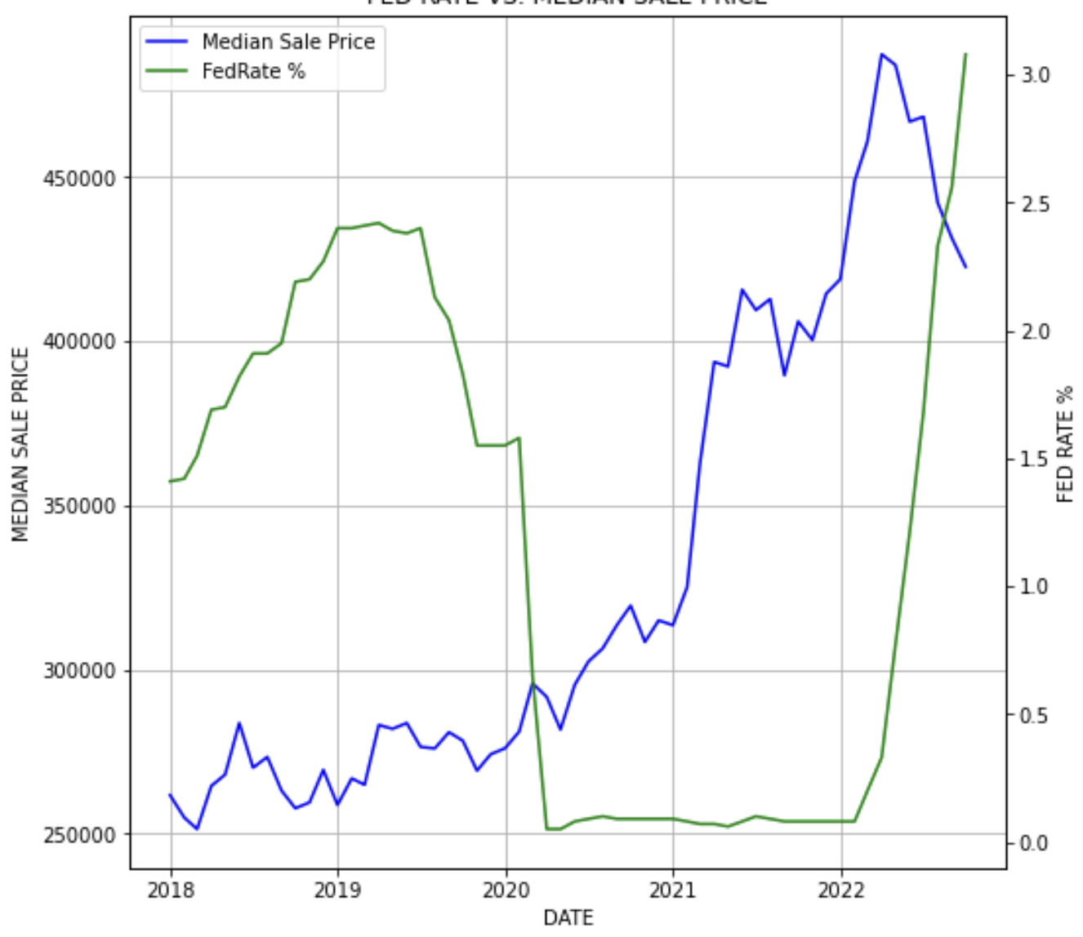
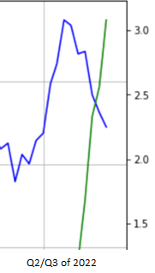
Fed rate vs. median sale price

Slide 15
Conclusion
Raising Fed Rates are causing Mortgage Rates to go up significantly
We are seeing trends in Median Price, Inventory, Price Cuts, Days on Market with sufficient statistical correlation to support our hypothesis
Fed rate increases are cooling down the Austin housing market

