Slide 1
Notichat ERD
Kyle Pendergast, Kevin Frautschi, Anton Foretich

Slide 2
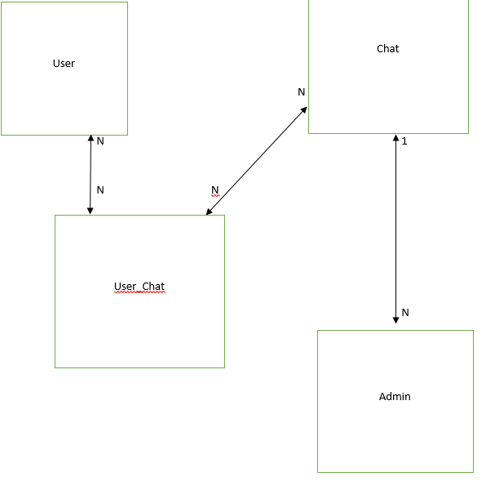
ERD

Slide 3
Table Data
Users: UserID, Email, PhoneNumber, PasswordValue
Chat: ChatID, UserID, ChatName, ChatAdmins
Admin: AdminID, AdminName, ChatID, ChatName, MessageText, Time, Date
User_Chat: UserID, ChatID, ChatName

