Slide 1
Notichat ERD
Kyle Pendergast, Kevin Frautschi, Anton Foretich

Slide 2
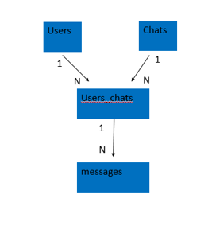
ERD

Slide 3
Table Data
Users: UserID, Email, PhoneNumber, UserName, PasswordValue
Chat: ChatID, ChatName
User_Chat: Users_ChatsID, UserID, ChatID
Messages: MessageID, MessageText

