Slide 1
IDS ASSIGNMENT

Slide 2
WINE REVIEWS

Slide 3
Contents
Outline of dataset
Data cleaning
Data visualization
Correlation
Hypothesis Testing

Slide 4
OUTLINE OF DATASET
This dataset contains 15 columns and about 1000 rows.
11 Categorical Columns
4 Numerical Columns

Slide 5
DATA CLEANING
Data cleaning is the process of detecting and correcting corrupt records from a set of records, table or a database.
The categorical columns with data as “NaN” is replaced with the data in the previous row.
Whereas the numerical columns with data “NaN” is replaced with mean of the entire column.
Columns with missing values:
region_1, region_2 , taster_name, taster_twitter_handle, price

Slide 6
BEFORE AND AFTER CLEANING THE DATASET

Slide 7
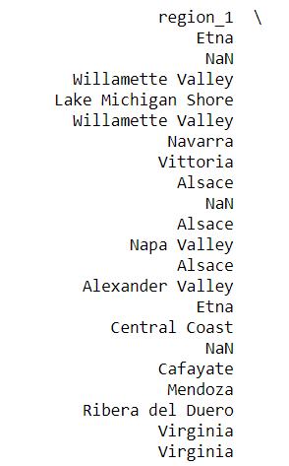
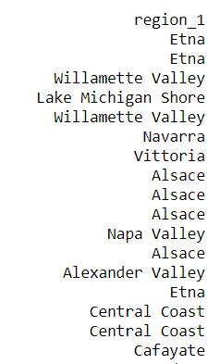
CATEGORICAL DATA

Slide 8
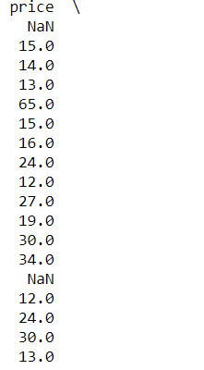
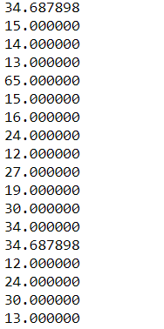
NUMERICAL DATA

Slide 9
DATA VISUALIZATION

Slide 10
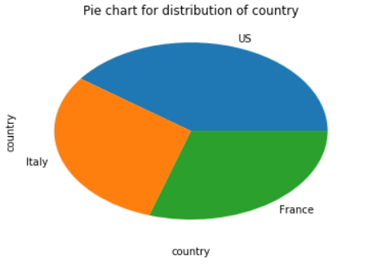
PIE CHART SHOWING WINE REVIEWS IN DIFFERENT COUNTRIES

Slide 11
INSIGHTS:
From the pie chart we can conclude that the maximum number of reviews are coming from the USA.
It also indicates that almost equal number of reviews are coming from the countries France and Italy.

Slide 12
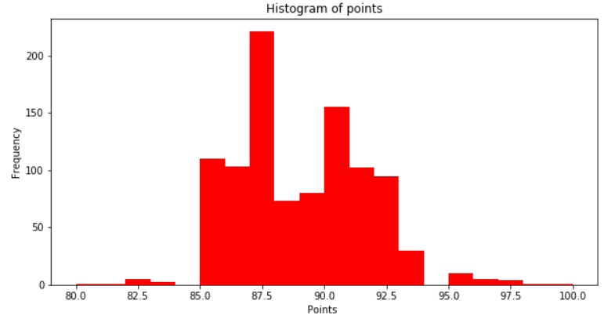
HISTOGRAM OF POINTS

Slide 13
INSIGHTS:
From the above histogram the average points given by the users is 88.5825.
The mode for the points i.e. the most frequent rating given by the users is 87.
It can also be seen that the frequency of a rating of 100 is very low.

Slide 14
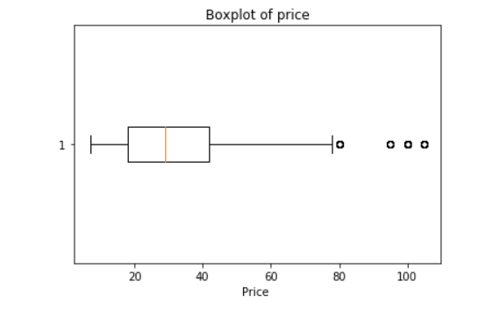
BOX PLOT OF WINE PRICE

Slide 15
INSIGHTS:
The above box plot contains outliers, but they cannot be removed as this shows the variance in price of wine.
It is also very evident that the box plot is positively skewed.
Some values that can be calculated from the box plot:
Median : 29.0
Q1: 18.0
Q3:42.0
Interquartile Range:24.0
Max:105.0
Min:7.0
On further calculations the mean and mode is found to be 33.709 and 15.0 respectively which proves that the plot is positively skewed as mode<median<mean.

Slide 16
CORRELATION

Slide 17
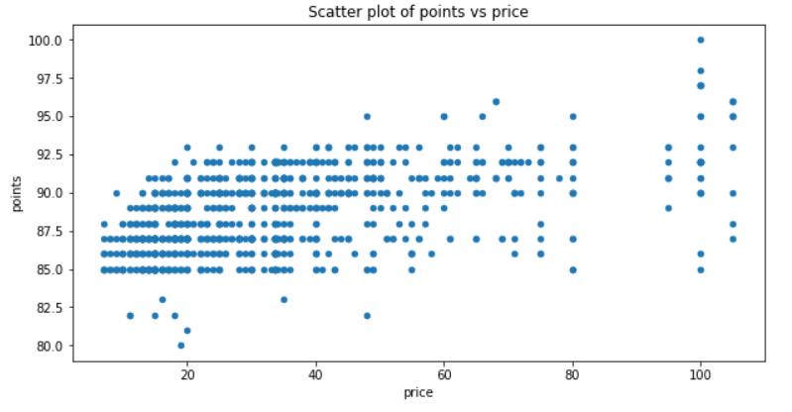
SCATTER PLOT OF POINTS vs PRICE

Slide 18
INSIGHTS:
From the scatter plot it is evident that the correlation between points and price is strong.
By drawing the best fit line for the above plot we notice that the line passes through most of the data.
df['points’].corr(df['price’]) = 0.54. This shows that a strong correlation exists between points and price.

Slide 19
HYPOTHESIS TESTING

Slide 20
Sample mean is 32.773
Sample standard deviation is 18.615
Population mean is 33.709
Null hypothesis(H0): Sample mean = 33.709
Alternate hypothesis(Ha):Sample mean != 33.709
z value is -2.51
p value is 0.006
p<0.05, hence Alternate hypothesis is true as we can reject the Null hypothesis.

Slide 21
TEAM MEMBERS:
SAI TARUN- PES1201700494
GOUTHAM KS - PES1201700295
YASH KUMAR – PES1201700772

Slide 22
THANK YOU

