Slide 1

eduConnect
Guided By:
Prof. M.K. Patel,
Computer Dept,
LCIT
Prepared By:
Kishan S. Gor
Ajay D. Mandera
Sonali K. Patel
Free Powerpoint Templates

Slide 2
Introduction
After college time, college students have no educational contacts with people related with college and university. So we decided to build a new environment to connect those people easily in any time at any place. We will create a system which connects all these people together. This system will reflect virtual places of all University and College related things. This will give an opportunity to people stay connected with the study
related stuff all the time.

Slide 3
Introduction
Currently, no system is being used by the University to keep all students, faculties and other related persons stay connected with each other round the clock. There are many open source Forums or Discussion Boards available which can be used to share information between students and related persons but they become very limited to their own functionality. It lacks the flexibility for more integration in studies. Instead of this, a single portal would be desired which has more flexibility and provides more functionality than just forums.

Slide 4
Project Definition
So we decided to build a new environment to connect those people easily in any time at any place. We will create a system which connects all these people together. This system will reflect virtual places of all University and College related things. This system will adopt the concept of Social Networking sites and model it to make it useful in education. This system will have all virtual places that we see in real life, like a university, colleges, departments, classes and people that are related to educational activity. And these virtual objects won’t be limited just to the system but this will reflect objects of real life, i.e. these all virtual objects would have existence in real life too. So the goal of this system is to incorporate the latest technologies and trends to make education better and interesting.

Slide 5
Proposed System
Objective:
To keep students and guides or lectures as well as the in-charge persons of the University to stay connected with each other.
Project Definition:
Adding social integration and use of latest Internet technology in Education System and providing a platform for students and University people to stay connected with each other 24x7.

Slide 6
Proposed System
Project Scope:
This system will have several components which include Private Messages, Talks, Forums, Chats, Groups, Events and many more. All this features will be education oriented and somehow interesting.
Project Platform:
This is a web-based System. System will use xHTML and CSS for designing. Javascript and techniques like AJAX for better UX. PHP will be used for server side scripting and MySQL as a database.

Slide 7
Features
Users and Permission Levels
Talks
Forums
Private Messaging
Groups
Chat

Slide 8
Future Extensions
Events
Quiz/Competition

Slide 9
How will System work?
When system will start, University Admin will set all University details and data. Now Admin will have rights to add a college and set its data. So if any college is interested in joining this system, it can ask University Admin for it and he will add the college with all necessary details. Now after colleges have been added, College Admin will have rights to add department, class and college related stuff. Once college is set, it’s time for students to join. Whenever a user wants to join the system, it will apply for it online.

Slide 10
How will System work?
He will register will what type of users he is (faculty, student, etc) and fill all data about him. Now college admin will verify this data and approve the user and then user will be able to use the system. College Admin will have permission to set privilege level of the user so that in future promotion and demotions of user level can be possible. After all this, users will be able to use the system seamlessly.

Slide 11
System Analysis
Fact Finding Technique
Feasibility Study
Requirement Specification

Slide 12
Fact Finding Technique
The young generation is tending much towards the Social Media, and so concept of having Networking in study will be very useful. But the question was how we can make this concept “education oriented”? We are already using Forums or Discussion boards, IRC for subject oriented chat, Social Networking sites like Facebook, Twitter, Google+ etc and education portals like Moodle, but these all have some features issing in each other. We wanted to build a System that combines all goods from them and have all-in-one system.

Slide 13
Fact Finding Technique
We had some questionnaires and informal interviews with some students, faculties and some other experts. We considered their suggestions and advices and came up for this system.

Slide 14
Feasibility Study
Operational
This system does not require any special technical skills to be used. Interface will be simple and easy to use, self explaining. All colleges and most students/faculties have access to Internet and so it is easy to access the system. Any person having minimal knowledge of English can use this system with ease.
Technical
This system requires a web server with PHP and MySQL. University and colleges already have web servers with these facilities and so technically, it is feasible to deploy the system.

Slide 15
Feasibility Study
Economical
University and our college already have web hosting for their own sites.
Implementation
Our team already has good experience with Web Developement with PHP and MySQL on server side and so it will be easy for team to build system using them.

Slide 16
Requirement Specification
Functional
Non-Functional
  Transport
  Security
  Performance

Slide 17
System Design
Class Diagram
Use- Case Diagrams
Dataflow Diagrams

Slide 18
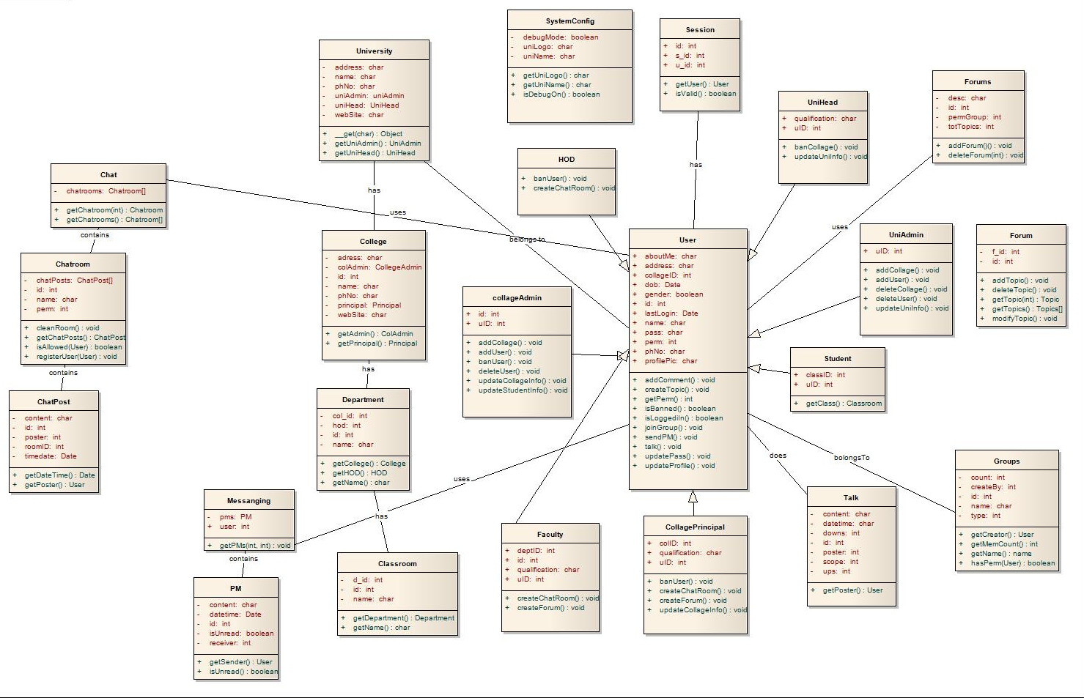
Class Diagram

Slide 19
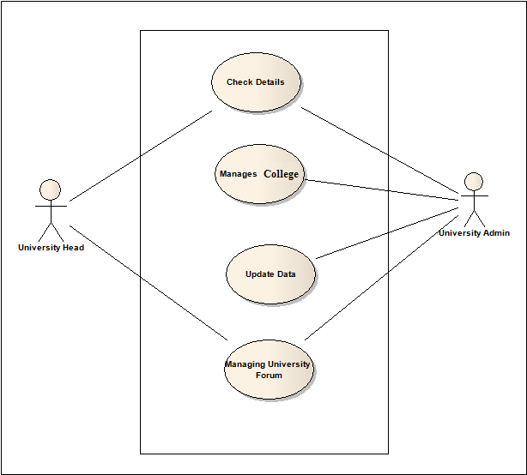
Use-Case Diagram

Slide 20
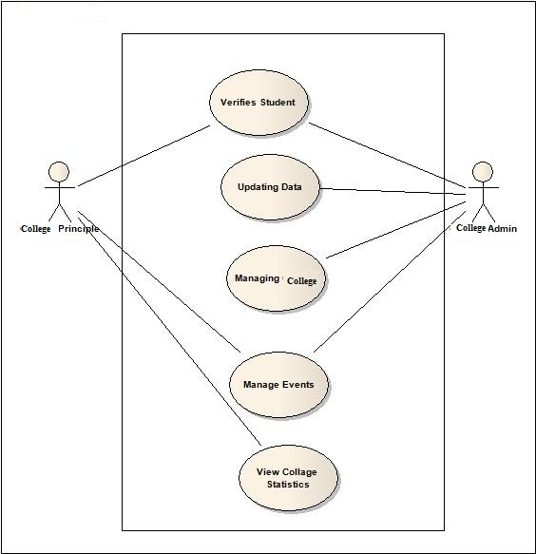
Use-Case Diagram

Slide 21
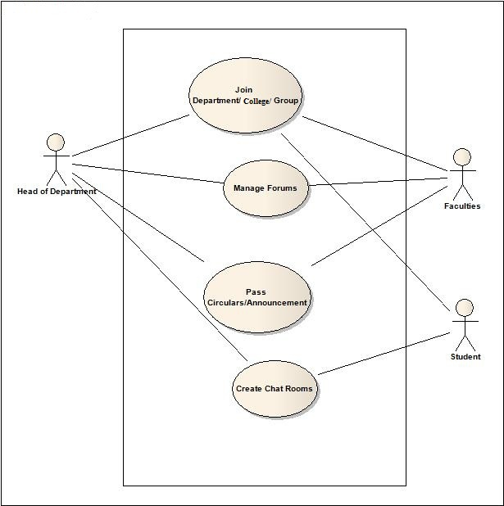
Use-Case Diagram

Slide 22
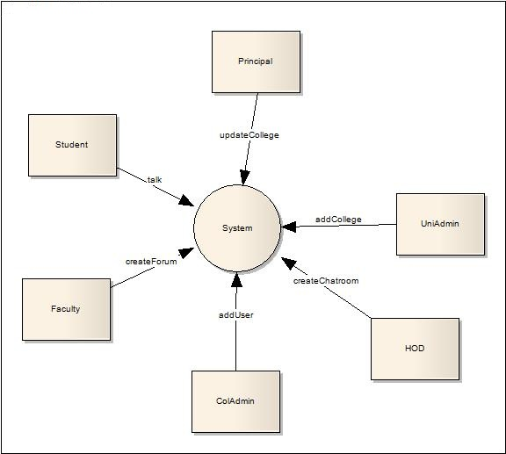
Dataflow Diagram

Slide 23
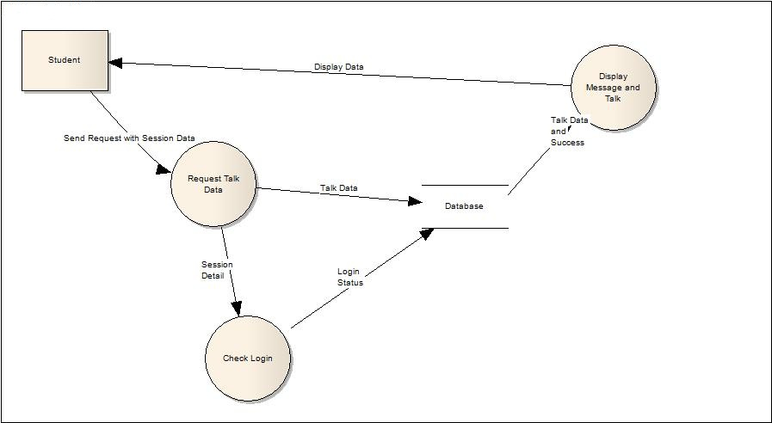
Dataflow Diagram

Slide 24
Dataflow Diagram

Slide 25
Conclusion
The Project Presentation entitled “eduConnect” has come to a partial fulfilment. Our team will try its best to develop the system with their level best and provide a platform to its user with great media to communicate with each other and share their knowledge.
This system will provide a great medium to Students to get help from faculties, their classmates or any persons which are connect to this system. Real time chat will allow
discussions in real time or to have online meetings. Forum can be used for discussions, share information or for any type of public announcements to university.
Implementation phase will start from vacation and all other phase will be carried our upto the next semester’s term end. Some time will be allocated for future extensions also.

