Slide 1
Finetuned Language Models (FLAN) Are Zero-Shot Learners
- Karamjeet Singh Gulati

Slide 2
Topics to be covered:
Shot Learning
Zero Shot
What is Flan?
Tasks and Templated used to Train FLAN
How does 0-shot FLAN compare to few-shot GPT3?
What Factors are important for zero factor instruction tuning?
What factors are important for zero factor instruction tuning?
What is the impact of few shot examples and prompt tuning on instruction tuning?

Slide 3
Shot Learning
Techniques where models are trained to make decisions with limited examples.
Crucial for tasks where collecting large datasets is impractical or impossible.
Four Types:
Zero-Shot
One-Shot Learning
Few-Shot Learning
Multi-Shot Learning

Slide 4
Zero-Shot Learning
AI models making accurate predictions for tasks they haven't explicitly seen during training.
Ability to understand and categorize completely new information.
Example : A text classification model categorizing articles into genres not present in its training data, like predicting 'climate change' as a category after being trained only on 'sports', 'politics', and 'technology'.
Challenges: Requires sophisticated understanding of abstract concepts.
Benefits: Highly adaptable to new tasks without needing additional data.

Slide 5
One-Shot, Few-Shot, Multi-Shot Learning
One-Shot :
Training models with only one example per category.
Learning to generalize from a single instance.
Example: A facial recognition system learning to recognize a person from just one photo.
Few-Shot :
Training models with a small number of examples. Typically involves 5-20 examples per category.
Example: A language model learning to translate a rare language using only a handful of sentences.
Requires careful balancing between learning effectively and not overfitting.
Multi-shot:
Conventional ML approach using extensive datasets.
Relies on abundant data for accurate predictions.
Example: An image recognition system trained on thousands of labeled images to identify everyday objects.

Slide 6
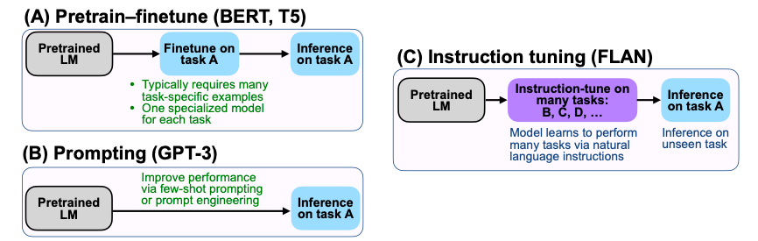
What is FLAN (Finetuned LAnguage Net?
Decoder only model finetuned over 137B LaMDA-PT using 60 NLP dataset
By using supervision to teach an LM to perform tasks described via instruction, the LM will learn to follow instructions and do so even for unseen tasks
Fig. Comparing instruction tuning with pretrain - finetune and prompting
https://arxiv.org/abs/2109.01652

Slide 7
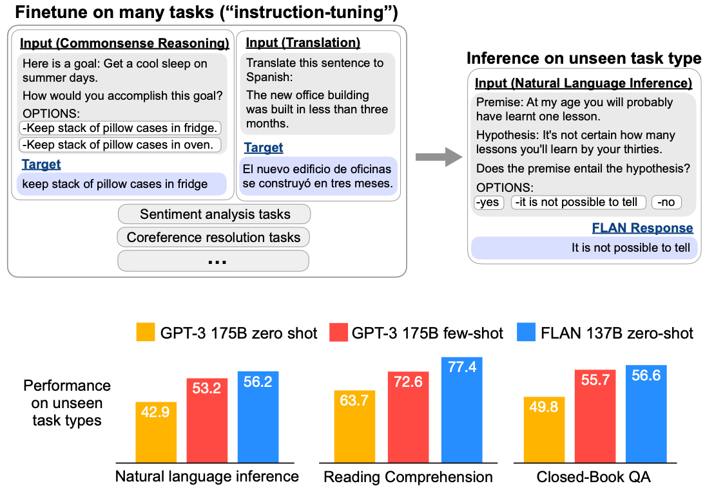
What is FLAN (Finetuned LAnguage Net?
Group NLP Datasets into clusters based on their task type
Hold each cluster for evaluation while instruction tuning FLAN on all other clusters
0-shot FLAN > 0-shot LaMDA-PT
0-shot FLAN > 0-shot 175B GPT-3 on 20/25 datasets.
0-shot FLAN > few-shot GPT-3 on NLI (ANLI, RTE), Reading comprehension (BoolQ, OpenbookQA), AI2-ARC, and StoryCloze.
0-shot FLAN > 0-shot GLaM on 13/19 datasets and 1-shot
https://arxiv.org/abs/2109.01652

Slide 8
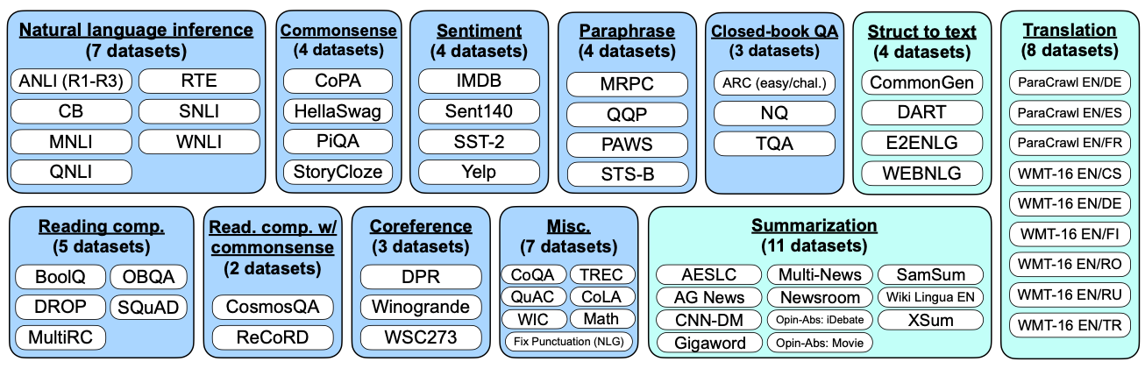
Tasks and templates used to train FLAN
Fig. Multiple instruction templates describing a natural inference task
12 task clusters. 62 text datasets (blue=NLU; teal=NLG). Max #training examples per dataset is 30K
10 unique templates/dataset that use natural language instructions to describe the task for that dataset
﻿﻿For each dataset, ≤ 3 templates that "turned the task around," (e.g., for sentiment classification we include templates asking to generate a movie review).
https://arxiv.org/abs/2109.01652

Slide 9
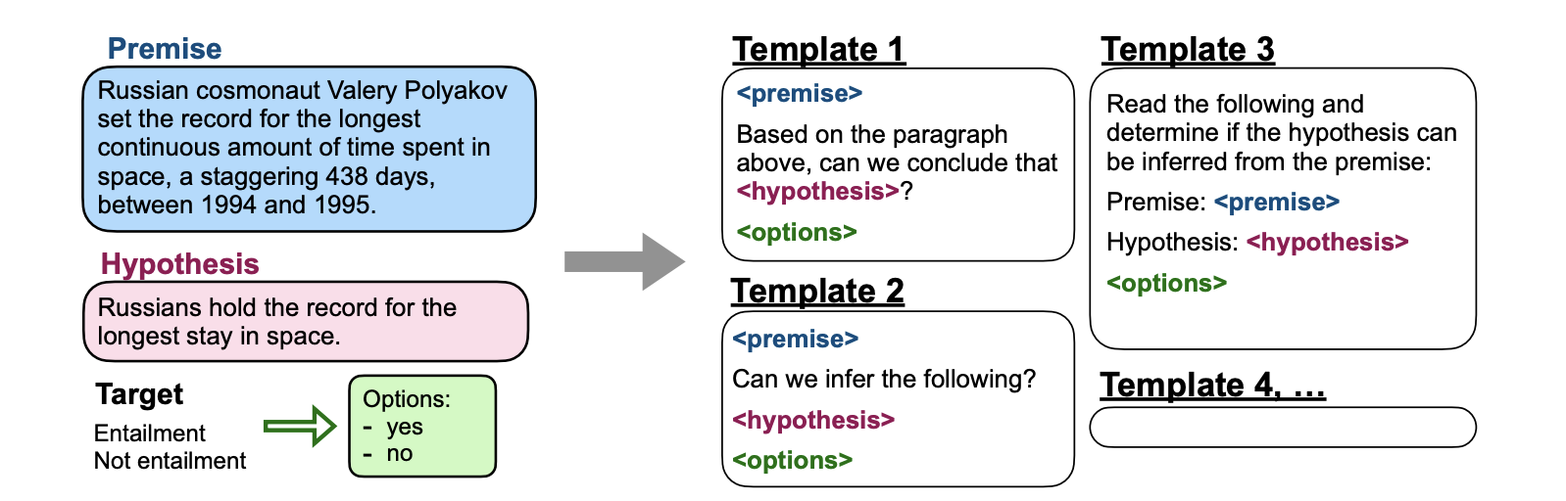
Tasks and templates used to train FLAN
Fig. Multiple instruction templates describing a natural inference task
﻿﻿For each example, randomly choose template.
﻿﻿Consider dataset D unseen at evaluation time if no datasets from any task clusters that D belongs to were seen during instruction tuning.
﻿﻿Output space for a given task is either one of several classes (classification) or free text (generation).
﻿﻿Instruction tuning takes ~60 hours on a TPUv3 with 128 cores.
https://arxiv.org/abs/2109.01652

Slide 10
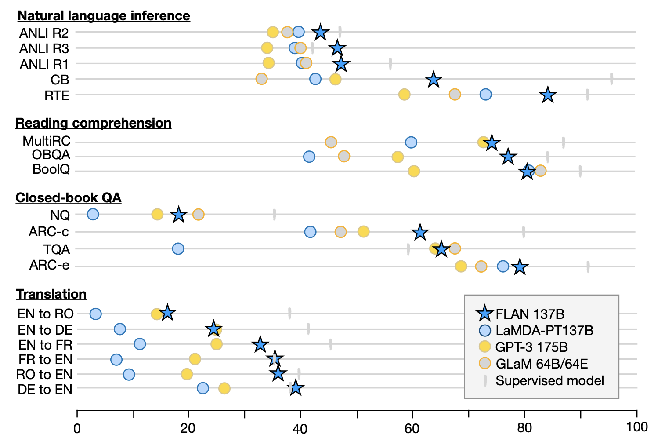
How does 0-shot FLAN compare with few-shot GPT3?
﻿﻿Very effective on tasks naturally verbalized as instructions (e.g., NLI, QA, translation, struct-to-text)
﻿﻿Less effective on tasks directly formulated as language modeling, where instructions would be largely redundant (e.g., commonsense reasoning and coreference resolution tasks that are formatted as finishing an incomplete sentence or paragraph).
Fig. Zero Shot Performance
https://arxiv.org/abs/2109.01652

Slide 11
How does Zero-shot FLAN compare with few-shot GPT3?
﻿﻿How do the FLAN instructions differ from GPT-3 or T5 prompts?
T5 prompt: cb hypothesis: At my age you will probably have learnt one lesson. premise: It's not certain how many lessons you'11 learn by your thirties.
GPT-3 prompt: At my age you will probably have learnt one lesson. question: It's not certain how many lessons you'11 learn by your thirties. true, false, or neither? Answer:
FLAN prompt: Premise: At my age you will probably have learnt one lesson. Hypothesis: It's not certain how many lessons you'11 learn by your thirties. Does the premise entail the hypothesis?
https://arxiv.org/abs/2109.01652

Slide 12
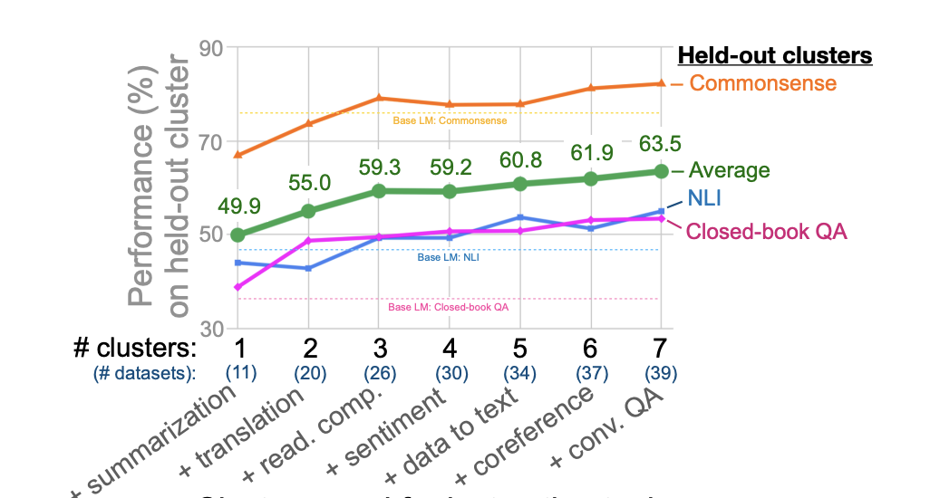
What factors are important for zero factor instruction tuning?
Number of fine tuning datasets, model scale, and natural language instructions.
FLAN's fine tuning: "Please translate this sentence to French: 'The dog runs.".
Fig. Clusters used for instruction tuning
https://arxiv.org/abs/2109.01652

Slide 13
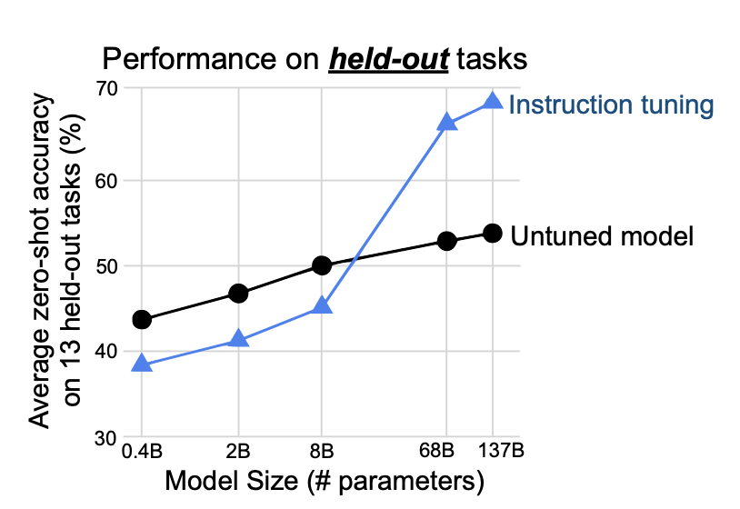
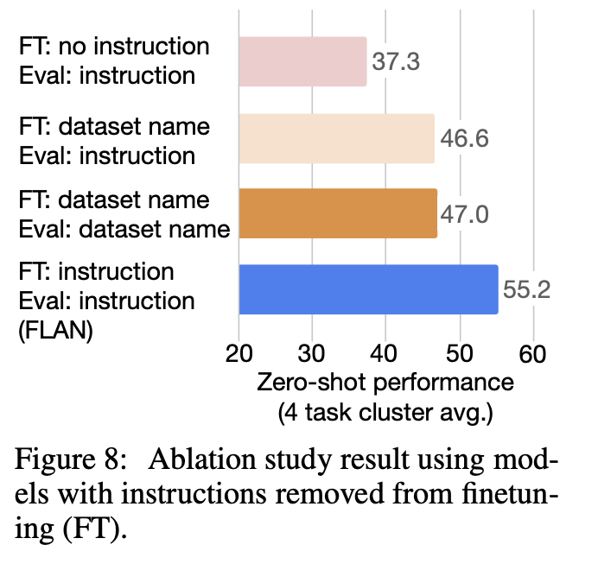
What factors are important for zero factor instruction tuning?
No template setup: only inputs and outputs were given(e.g., for translation the input would be “The dog runs.” and the output would be “Le chien court.”
Dataset name setup, each input is prepended with the name of the task and the dataset (e.g., for translation into French the input would be “[Translation: WMT’14 to french] The dog runs)”.
Fig. Model Size (#Parameters)
Fig. Ablation study result using models with instructions removed from fine tuning (FT).
https://arxiv.org/abs/2109.01652

Slide 14
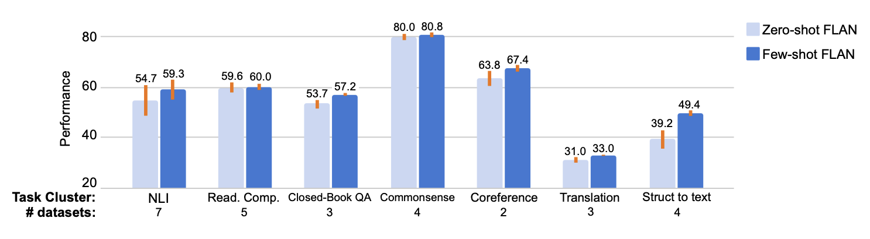
What is the impact of few shot examples and prompt tuning on instruction tuning?
Fig. Adding few-shot exemplars to FLAN is a complementary method for improving the performance of instruction-tuned models. The orange bars indicate standard deviation among templates, averaged at the dataset level for each task cluster.
Exemplars are especially effective for tasks with large/complex output spaces such as struct to text, translation, and closed book QA, potentially because exemplars help the model better understand the output format.
﻿﻿Standard deviation among templates is lower for few-shot FLAN, indicating reduced sensitivity to prompt engineering.
https://arxiv.org/abs/2109.01652

Slide 15
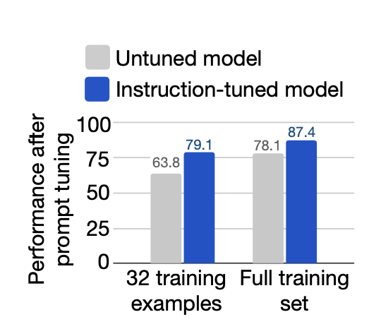
What is the impact of few shot examples and prompt tuning on instruction tuning?
FLAN is better than LaMDA-PT when performing inference using soft prompts, represented by prepended continuous variables optimized via prompt tuning
﻿﻿We train continuous prompts for each of the super Glue tasks
Fig. Instruction-tuned models respond better to continuous inputs from prompt tuning. When prompt tuning on a given dataset, no tasks from the same cluster as that dataset were seen during instruction tuning. Performance shown is the average on the SuperGLUE dev set.
https://arxiv.org/abs/2109.01652

Slide 16
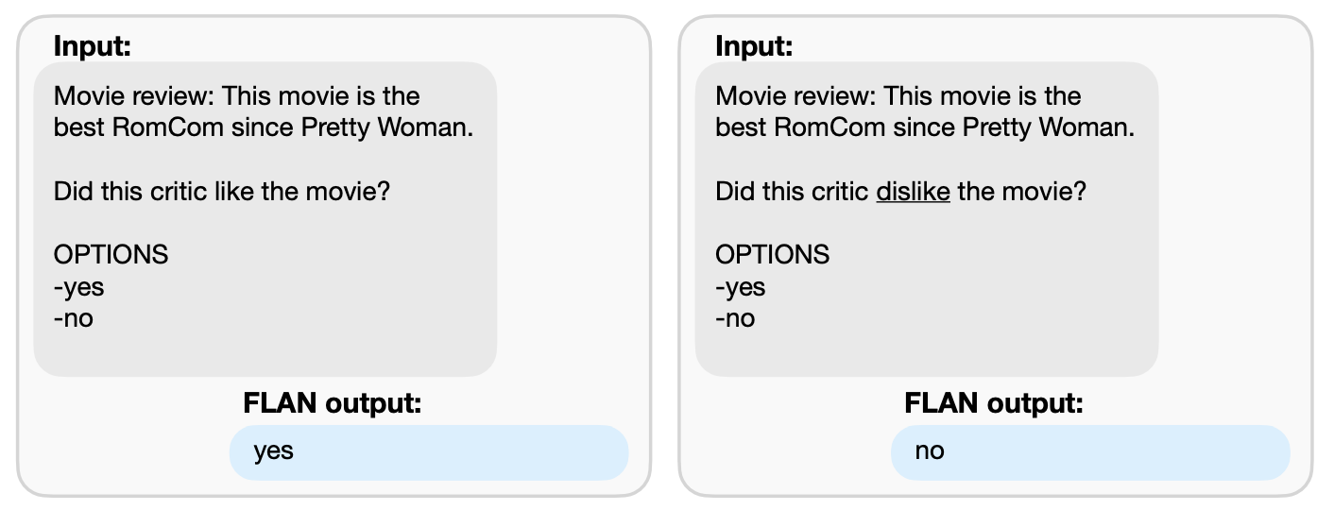
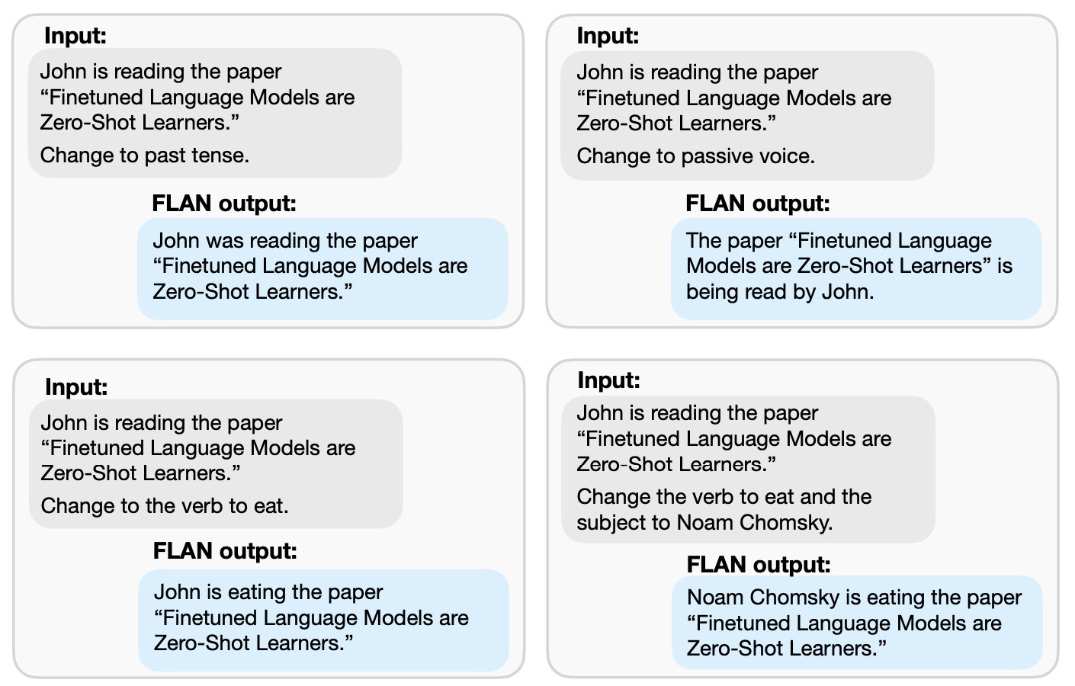
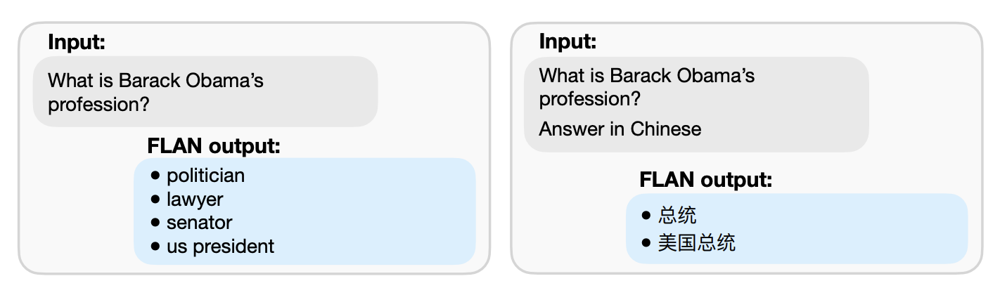
Some FLAN Output Examples
Fig. For sentiment analysis, FLAN changes the answer appropriately when the question is flipped.
Fig. For question answering, FLAN can answer a question in another language when instructed to do so. Multiple FLAN outputs are generated via random sampling with a temperature of 0.9 and top k of 40.
Fig. For question answering, FLAN can answer a question in another language when instructed to do so. Multiple FLAN outputs are generated via random sampling with a temperature of 0.9 and top k of 40.

Slide 17
Thank You
Any Question?

