Slide 1
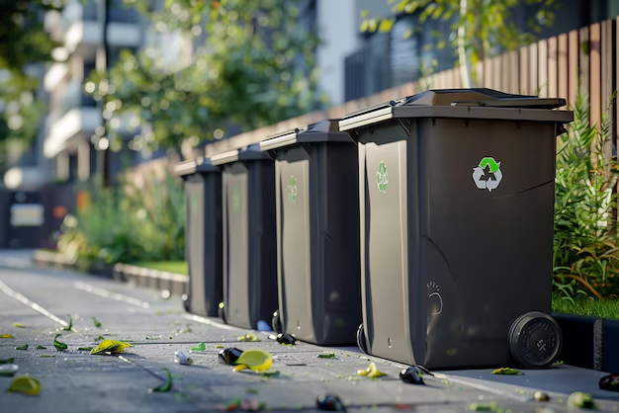
SMART WASTE
MANAGEMENT SYSTEM
COE-IOT-4:
Sensor-based waste collection optimization
Batch no: 02
Guide details:
Group members:
Dr. T. Rajesh
Assistant Professor
23251A0568 - Amogha Sri K
23251A0594 - S Vyshnavi
23251A0595 - Sri Harshita K

Slide 2
Introduction
A Smart Waste Management System leverages technology for efficient waste handling.
Utilizes smart bins equipped with sensors to detect fullness.
Sends real-time data to mobile through web application
Automatically segregate wet and dry waste
Includes a mobile or web app for waste management:
- Monitor bin levels.
- segregate wet and dry waste
- Ensure cleaner surroundings.

Slide 3
Literature Survey
Title | Year | Journal/ Conference | Method | Limitation
Smart Waste Management 4.0: The Transition from a Systematic Review to an Integrated Framework | 2024 | The Journal Waste Management | Introduces SWM 4.0 by integrating Industry 4.0 technologies into waste management processes. | Focuses on theoretical framework; lacks empirical validation.
An IoT-Based Smart Waste Management System for Municipalities or City Corporations | 2024 | IEEE Xplore, ResearchGate, and arXiv | Combines IoT-enabled smart bins with mobile applications for interactive waste management. | Survey-based study; practical implementation details are limited.
Optimizing Waste Management with Advanced Object Detection for Garbage Classification | 2024 | arXiv preprint | Applies YOLO V5 object detection model for classifying various types of waste. | Focuses on model accuracy; integration into existing waste management systems not addressed.

Slide 4
Literature Survey
Title | Year | Journal/ Conference | Method | Limitation
ConvoWaste: An Automatic Waste Segregation Machine Using Deep Learning | 2023 | 3rd ICREST'23 | Utilizes deep convolutional neural networks for automatic waste classification and segregation. | High accuracy in controlled settings; performance in diverse environments untested.
GULP: Solar-Powered Smart Garbage Segregation Bins with SMS Notification and Machine Learning Image Processing | 2023 | arXiv preprint | Develops smart bins that use machine learning for waste segregation and SMS notifications for maintenance. | Limited to prototype stage; real-world scalability not tested.

Slide 5
Existing System & Drawbacks
The current waste management system has several problems:
1. Fixed collection schedules ignore real-time bin fill levels.
2. No automatic segregation of dry and wet waste in traditional systems.
3. Manual lid opening decreases hygiene and increases health risks.
4. Bin status is checked manually, leading to delayed pickups.
5. No web-based monitoring for real-time bin data or alerts
6. Overflowing bins in busy areas, underused bins in others.
7. Mixed waste reduces recycling and increases landfill load.
8. Faulty or full bins go unnoticed due to lack of smart alerts.
9. Low public engagement due to no user-friendly reporting or tracking

Slide 6
Proposed System:
Smart Waste Management Solution
Our Smart Waste Management System solves the problems in the existing system by using IoT-based smart bins, real-time monitoring, and automated waste collection optimization.
Main Features:
1. Automatic lid opening using motion sensors.
2. Dry and wet waste segregation using sensors.
3. Real-time bin level monitoring with ultrasonic sensors.
4. Web application to display bin status levels.
5. Alert notifications when bins are full.
6. Hygienic and touch-free operation.
7. Enhanced recycling and sustainability.

Slide 7
Problem Statement
Traditional waste management systems rely on fixed schedules, manual bin monitoring, and lack proper segregation of dry and wet waste. This leads to overflowing bins, unhygienic conditions, inefficient collection, and low recycling rates. There is a need for a smart, automated system that can monitor bin levels in real-time, segregate waste efficiently, and provide timely alerts through a web-based platform to improve cleanliness, sustainability, and public health.

Slide 8
Objectives
1. Automate lid opening for hygienic, touch-free waste disposal.
2. Segregate dry and wet waste automatically using sensors.
3. Monitor bin levels in real-time using ultrasonic sensors.
4. Displays when bins are full or need attention.
5. Display data on a web application for easy access.
6. Improve waste collection efficiency with data-driven decisions.

Slide 9
Hardware & Software Requirements
Hardware -
Ultrasonic Sensors (HC-SR04), Microcontroller (Arduino), Servo Motors, Soil Moisture Sensor, Jumper wires, breadboard and Waste Bin with Mounting Setup.
Software -
Embedded C (Arduino IDE), Web Dashboard (HTML, CSS, Flask).

Slide 10
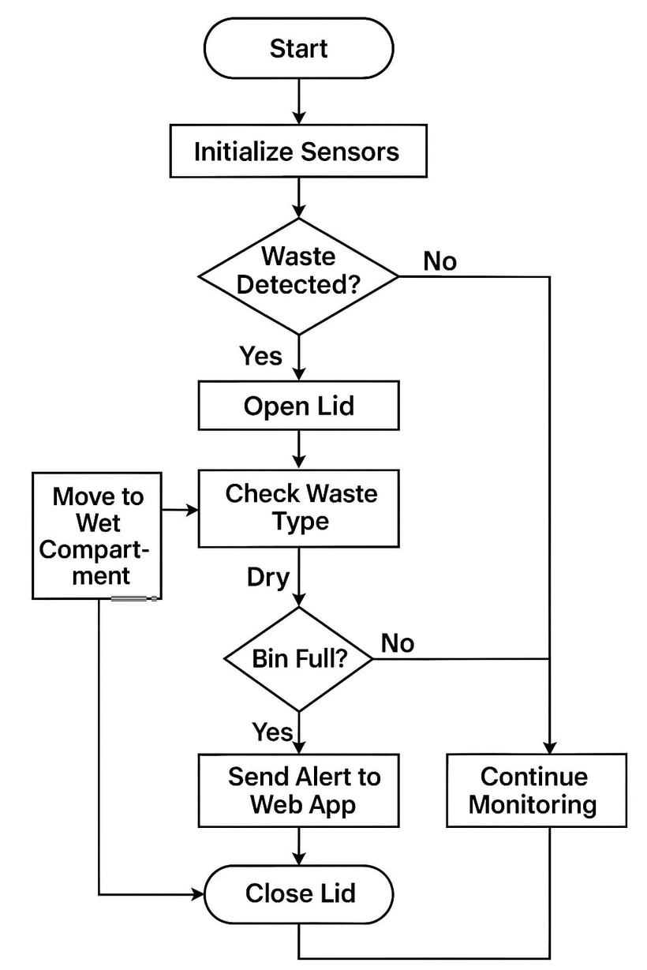
Architecture Diagram:

Slide 11
Methodology
1. System Architecture Design: The Smart Waste Management System consists of smart bins equipped with an ultrasonic sensor for waste level detection, an Arduino microcontroller for control logic, and data transmission.
2. Hardware Integration: The Arduino board connects to the ultrasonic sensor for measuring waste levels, and integrated servo motors. Testing of circuit connections is done using breadboards before final assembly.

Slide 12
Methodology
3. Software Development: Firmware development using Arduino IDE includes initializing sensors, measuring waste levels, sending live-data to the web application, and displays when bins are full. Conditional logic defines the waste level states based on sensor readings.
4. Cloud Integration and Data Monitoring: A cloud IoT platform is employed to display live-data, visualize waste levels, and show when bins are full.
5. Mobile/Web Application Interface and Testing: A dashboard for monitoring live-time status, displaying alerts, and assisting in route optimization for collection vehicles is developed by using XAMPP, PHP and HTML. The system undergoes testing in a limited area to evaluate sensor accuracy, data transmission, power consumption, and environmental durability.

Slide 13
Implementation
✅ Smart bins detect and report waste levels in real-time.
✅ Alerts prevent overflow, keeping areas clean and hygienic.
✅ Encourages recycling and public participation.
This system makes waste management smarter, cleaner, and more efficient! 🚮♻️

Slide 14
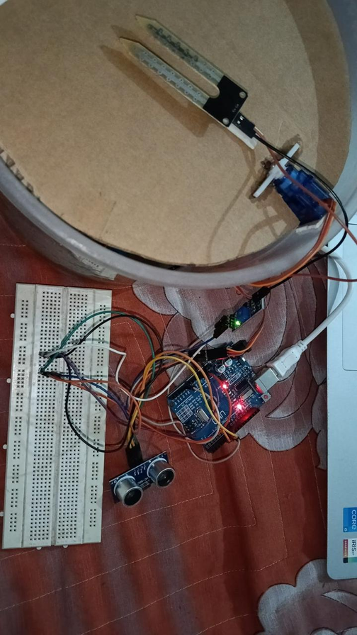
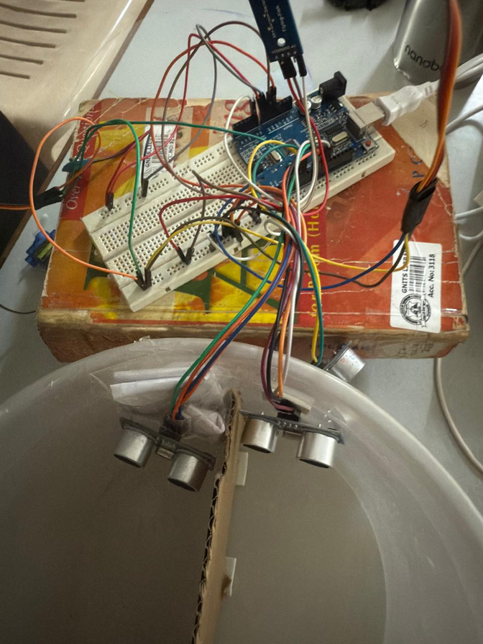
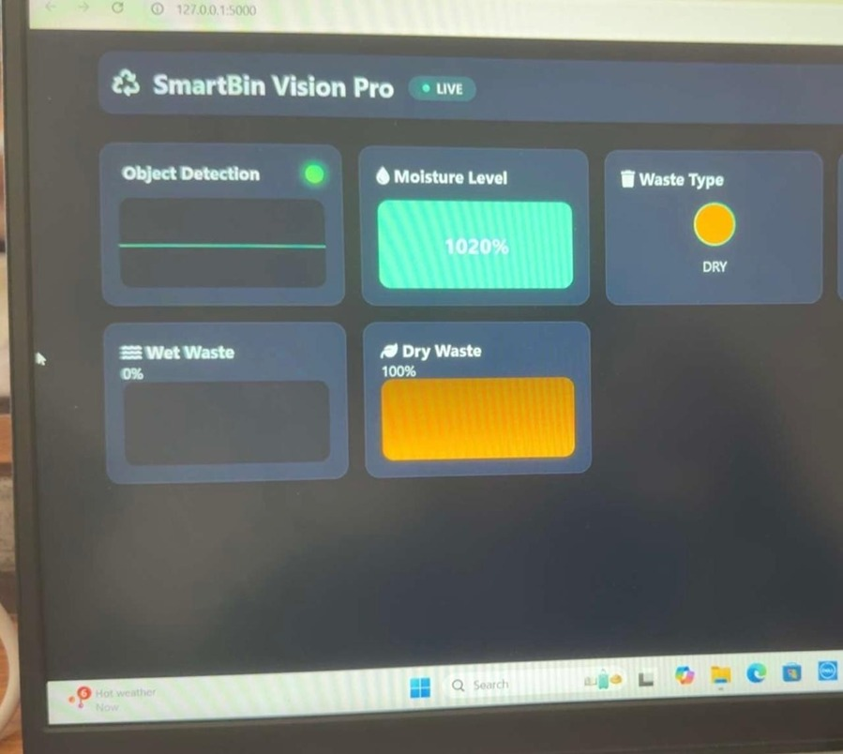
Result

Slide 15
Limitations
• Power Dependency: The system relies on a battery or an external power source. In remote areas, this might be impractical unless solar power is implemented.
• Sensor Reliability: Ultrasonic and moisture sensors can give inaccurate readings due to environmental conditions (e.g., wet dustbins, sensor misalignment, obstructed surfaces).
• Moisture Detection Ambiguity: Moisture level alone might not always accurately classify waste as wet or dry (e.g., a wet plastic wrapper).
• Usability: Each bin is different from our prototype. Trying to achieve a city-wide level requires more infrastructure for managing hundreds of bins.

Slide 16
Conclusion
In conclusion, this project illustrates the integration of creativity, technical expertise, and problem-solving skills to develop a tangible solution for waste management.
By leveraging low-cost technologies, we’ve created an intelligent dustbin system that enhances sanitation practices and optimizes waste collection processes. The journey highlighted the significant potential of IoT in simplifying our daily challenges.
While there is always room for improvement, such as incorporating solar power and machine learning for waste classification, this initiative lays a solid foundation for further innovations in creating smarter and more sustainable waste management solutions in the future.

Slide 17
Future Enhancements
1. Solar Power: Autonomous operation with solar panels.
2. AI Classification: Automated waste type sorting for better recycling.
3. Mobile App: Real-time bin status alerts for users and collectors.
4. Route Optimization: Dynamic collection routes based on bin fill levels.
5.Durable Design: Weatherproof enclosures for outdoor use.
6. Accessibility: Audio prompts and LED signals for user assistance.
7. Multi-bin Sorting: Automatic waste sorting at disposal points.

Slide 18
References
• Arduino Uno Datasheet.
• HC-SR04 Ultrasonic Sensor Manual.
• ThingSpeak IoT Cloud Documentation.
• Research on Smart Waste Bins using IoT – IJERT, 2023.
• Smart Waste Monitoring Systems – IEEE Xplore, 2022.

Slide 19
Thank you!

