Slide 1

Non-Maximum Suppression for Removal of Overlapped Bounding Boxes in
Steel Surface Defect Detection
경북대학교 인공지능학과
Computer Vision & Learning Theory LAB
2021226599
석사과정 강성환

Slide 2
Contents
Introduction
Related Work
Proposed Method
Experiments and Results
Discussion
Additional Methods
Conclusion

Slide 3
1. Introduction

Slide 4
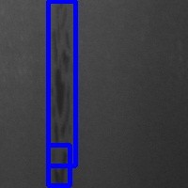
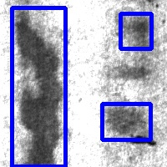
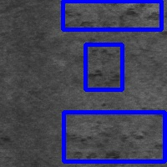
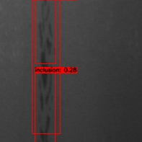
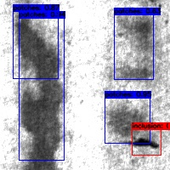
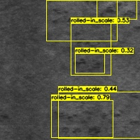
1.1. Motivation
Ground Truth
Indicators Dataset | Number of BBox | Number of Overlapped
MS-COCO | 36,781 | 44,146
NEU-DET | 854 | 202
Class Image | Inclusion | Patches | Rolled-in_Scale
GT
Pred
Prediction
Indicators Dataset | Number of Total FP | Number of Overlapped FP
MS-COCO | 7,594 | 2,622(34.5%)
NEU-DET | 1,162 | 893(76.8%)
[Table 1] Difference between Ground-Truth and Prediction of YOLOv4
[Figure 1] Difference between Ground-Truth and Prediction of YOLOv4
NEU-DET[1] has less overlap than MS-COCO[2] on Ground Truth but more on Prediction.
This paper aims to improve the performance of the object detector in a realistic factory environment by enhancing the NMS that can suppress overlap.

Slide 5
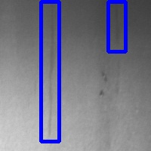
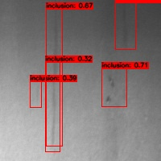
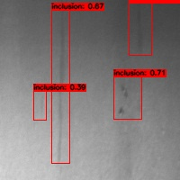
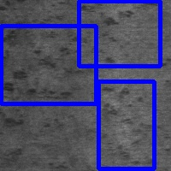
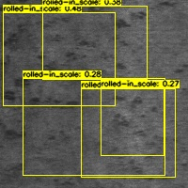
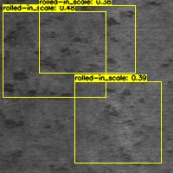
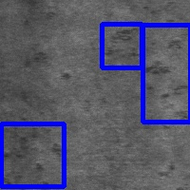
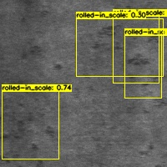
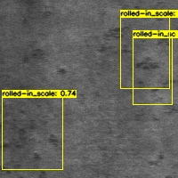
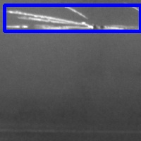
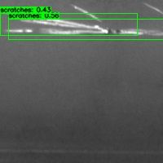
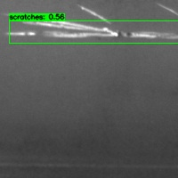
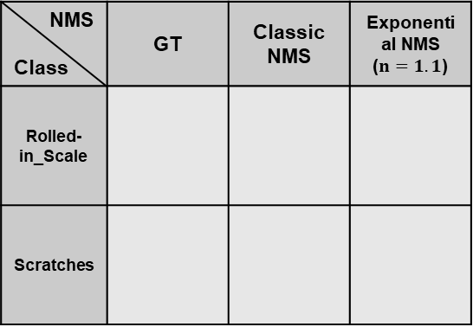
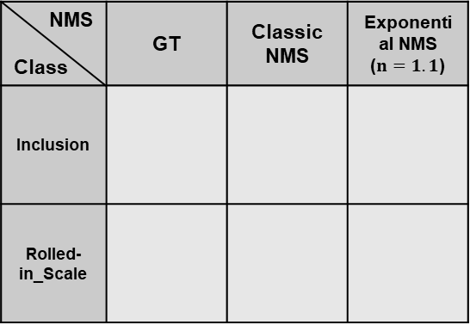
1.2. Contribution
NMS Class | GT | Classic NMS | Exponential NMS ($n=1.1$)
Inclusion
Rolled-in_Scale
NMS Class | GT | Classic NMS | Exponential NMS ($n=1.1$)
Rolled-in_Scale
Scratches
[Figure 2] Images using YOLOv4 with Suggested NMS Method
[Figure 3] Images using EfficientDet with Suggested NMS Method
Because of the trade-off between precision and recall, changing the threshold alone can not achieve high performance in object detection tasks.
In this paper, I suggest Exponential NMS. > It is the first NMS specialized in steel surface defect detection. > Exponential NMS is the first method to calculate IoU by changing the size of Bbox. > Like Soft NMS[3], Exponential NMS does not require additional training and can be implemented with simple modifications to the Classic NMS. > Using Exponential NMS can improve the Precision and F1-Score of the model compared to existing NMS.

Slide 6
2. Related Work

Slide 7
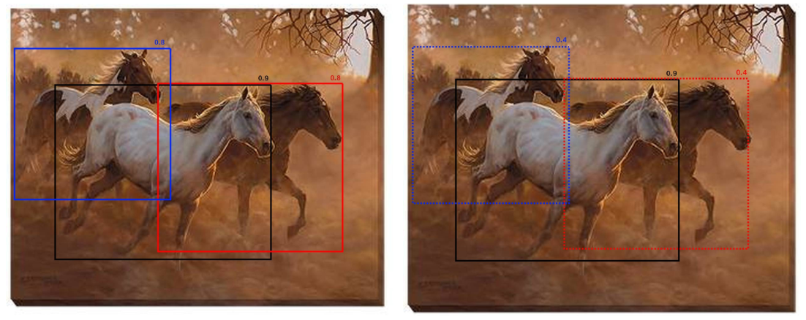

2.1. Soft NMS
[Figure 4] Example Image of Soft NMS
In real-world
Soft NMS[3] lowers the Confidence Score before suppressing boxes that IoU exceeds the IoU threshold.
Suppress boxes when the degraded Confidence Score is less than the Score threshold.
Therefore, more boxes will remain as the final prediction result.
Depending on the model, performance improvements of 1.1% and 1.3% were achieved on the MS-COCO dataset.

Slide 8
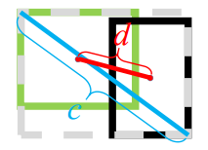
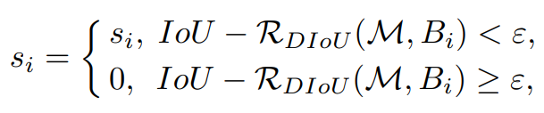

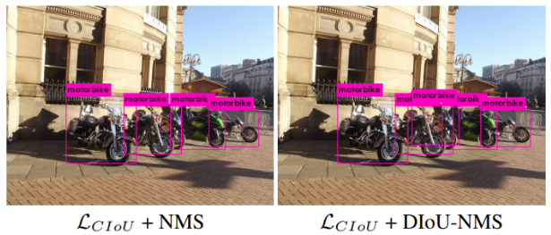






2.2. DIoU NMS[4]
$$green box= b^{gt}$$
$$black box=b$$
$$d=ρ(b,b^{gt})$$
$$c is the diagonal length covering two boxes$$
[Figure 5] Result Image of DIoU NMS
$$b,b^{gt}$$
$ℛ_{DIoU}(b,b^{gt}$)
$$b,b^{gt}$$
[Figure 6] Result Image of DIoU NMS

Slide 9
3. Proposed Method

Slide 10
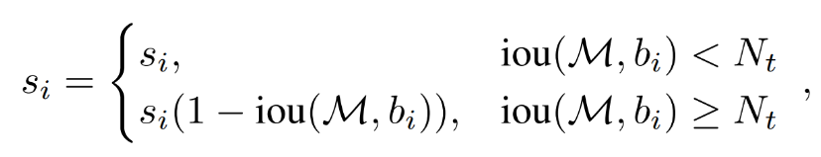

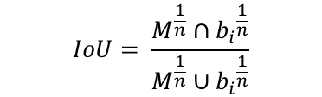

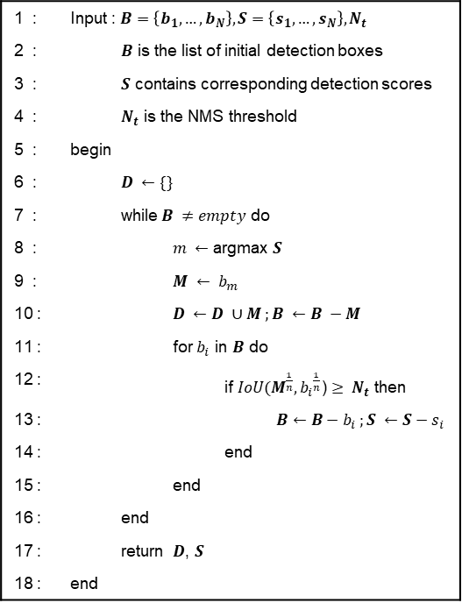
3. Proposed Method
1 : | Input : $B=\left\{b_{1}, …, b_{N}\right\}, S=\left\{s_{1}, …, s_{N}\right\}, N_{t}$
2 : |  | $B$ is the list of initial detection boxes
3 : |  | $S$ contains corresponding detection scores
4 : |  | $N_{t}$ is the NMS threshold
5 : | begin
6 : |  | $D ←\{\}$
7 : |  | while$B ≠empty$ do
8 : |  |  | $m ←$ argmax $S$
9 : |  |  | $$M ← b_{m}$$
10 : |  |  | $$D ←D ∪M ;B ←B −M$$
11 : |  |  | for $b_{i}$ in $B$ do
12 : |  |  |  | if $IoU{(M}^{\frac{1}{n}}, {b_{i}}^{\frac{1}{n}}$) $≥ N_{t}$ then
13 : |  |  |  |  | $$B←B−b_{i} ;S ←S−s_{i}$$
14 : |  |  |  | end
15 : |  |  | end
16 : |  | end
17 : |  | return $D$, $S$
18 : | end
$$IoU= \frac{M∩b_{i}}{M∪b_{i}}$$
0,
[Equation 1] The IoU calculation process of Classic NMS
$$IoU= \frac{M^{\frac{1}{n}}∩{b_{i}}^{\frac{1}{n}}}{M^{\frac{1}{n}}∪{b_{i}}^{\frac{1}{n}}}$$
$$(M^{\frac{1}{n}}, {b_{i}}^{\frac{1}{n}})$$
$$(M^{\frac{1}{n}}, {b_{i}}^{\frac{1}{n}})$$
0,
[Equation 2] The IoU calculation process of Exponential NMS
[Algorithm 1] Pseudo Code of Suggested NMS

Slide 11
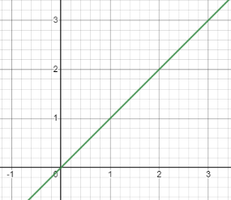
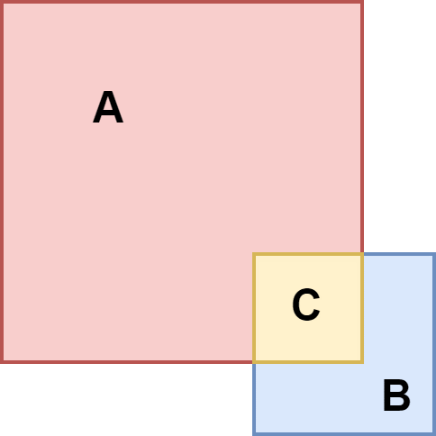
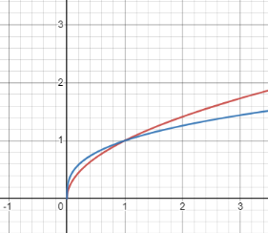











3. Proposed Method
$$M$$
$$y=x$$
$$b_{i}$$
$$M∩b_{i}$$
$$M$$
$$b_{i}$$
$$M^{\frac{1}{n}}$$
$${b_{i}}^{\frac{1}{n}}$$
$$y=x^{\frac{1}{2}}$$
$$y=x^{\frac{1}{3}}$$
$$M^{\frac{1}{n}}∩{b_{i}}^{\frac{1}{n}}$$
[Figure 7] Difference between proposed NMS and Classic NMS

Slide 12
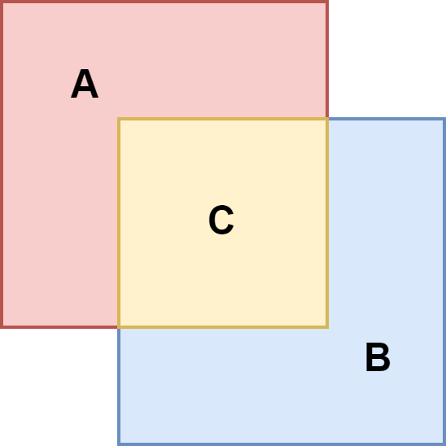












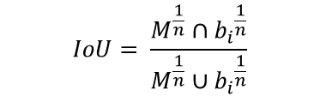
3. Proposed Method
$$M$$
$$M$$
$$b_{i}$$
$$IoU= \frac{M∩b_{i}}{M∪b_{i}}$$
$$M∩b_{i}$$
$$b_{i}$$
$$M^{\frac{1}{n}}$$
$${b_{i}}^{\frac{1}{n}}$$
$$M^{\frac{1}{n}}$$
$$M^{\frac{1}{n}}∩{b_{i}}^{\frac{1}{n}}$$
$$IoU= \frac{M^{\frac{1}{n}}∩{b_{i}}^{\frac{1}{n}}}{M^{\frac{1}{n}}∪{b_{i}}^{\frac{1}{n}}}$$
$$M^{\frac{1}{n}}∩{b_{i}}^{\frac{1}{n}}$$
$${b_{i}}^{\frac{1}{n}}$$
[Figure 8] Difference between proposed NMS and Classic NMS

Slide 13
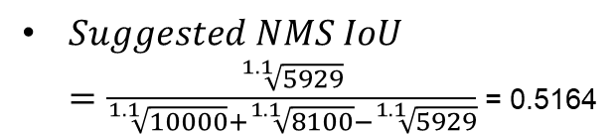
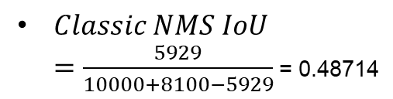
3. Proposed Method
$Classic NMS IoU$ $=\frac{5929}{10000+8100−5929}$= 0.48714
$Suggested NMS IoU$ $=\frac{\sqrt[1.1]{5929}}{\sqrt[1.1]{10000}+\sqrt[1.1]{8100}−\sqrt[1.1]{5929}}$= 0.5164
100
90
77
[Figure 9] Example results of the proposed NMS and Classic NMS

Slide 14
4. Experiments and Results

Slide 15
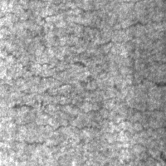
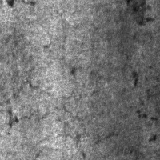
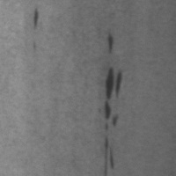
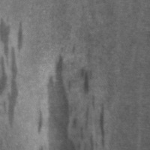
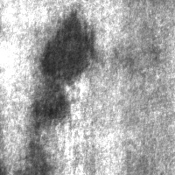
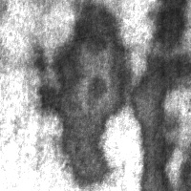
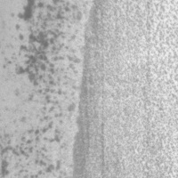
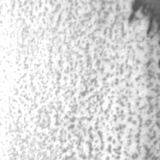




4.1. DataSet
Crazing | Inclusion | Patches
Pitted_Surface | Rolled-in_Scale | Scratches
[Figure 10] Example Images of NEU-DET Dataset
A surface defect database named the Northeastern University (NEU) surface defect database was constructed in 2013
Each class consists of 300 images of 200x200 size.
A total of 1,440 images, 240 per class, were used in training, and a total of 360 images, 60 per class, were used in the evaluation.

Slide 16


4.2. Model and Hyperparameter Settings
Hyperparameter | Value
Batch Size | 8
Start Learning Rate | $${10}^{−4}$$
End Learning Rate | $${10}^{−5}$$
Warmup Epoch | 5
Total Epoch | 120
NMS IoU Threshold | 0.5
NMS Score Threshold | 0.25
BoF(Bag of Freebies) & BoS(Bag of Specials) | Cosine annealing scheduler[7], SPP[8], PAN[9], Mish activation[10]
Hyperparameter | Value
Model Size | d0
Batch Size | 8
Start Learning Rate | $${10}^{−4}$$
Learning Rate Decay | $${10}^{−2}$$
Warmup Epoch | 5
Total Epoch | 120
NMS IoU Threshold | 0.5
NMS Score Threshold | 0.25
Learning Rate Scheduler | Cosine annealing scheduler
[Table 2] Hyperparameters of YOLOv4 model
[Table 3] Hyperparameters of EfficientDet model
In this paper, YOLOv4[5] and EfficientDet[6] models are used.
BoF and BoS are used to improve the learning performance of YOLOv4
The size of EfficientDet model is determined to be d0 considering size of the dataset.

Slide 17


4.3. Evaluation Metrics
 | Precision | Recall | F1-Score
Definition | $$\frac{TP}{TP+FP}$$ | $$\frac{TP}{GT}$$ | $$2∗\frac{Precision∗Recall}{Precision+Recall}$$
[Table 4] Definition of Precision, Recall, and F1-Score
 | Micro Avg. | Macro Avg.
Features | $Precision \text{and} Recall$ are calculated as Sum of TP, FP, and GT values across all classes | $Precision$ : The average value of $Precision$ by class $Recall$ : The average value of $Recall$ by class
[Table 5] Definition of Micore Avg., and Macro Avg.

Slide 18

4.4. Quantitative Evaluation
Model Indicator | Classic NMS | DIoU NMS | Soft NMS ($σ=0.6$) | Exponential NMS ($n=1.1$)
Micro-Avg. Precision | 0.3637 | 0.3496 | 0.3555 | 0.3916
Micro-Avg. Recall | 0.7763 | 0.7787 | 0.7552 | 0.7728
Micro-Avg. F1-Score | 0.4953 | 0.4826 | 0.4835 | 0.5198
Macro-Avg. Precision | 0.4019 | 0.3912 | 0.3631 | 0.4274
Macro-Avg. Recall | 0.7781 | 0.7799 | 0.7564 | 0.7736
Macro-Avg. F1-Score | 0.5300 | 0.5210 | 0.4906 | 0.5506
(0.028~
0.042)
(-0.006~
0.017)
(0.025~
0.037)
(0.025~
0.064)
(-0.006~
0.017)
(0.020~
0.060)
[Table 6] Results using YOLOv4 with Various NMS Methods
The above table is the result of verifying NMS using the YOLOv4 model.
The Recall is degraded in both Micro Avg. and Macro Avg.. The Precision is increased in both Micro Avg. and Macro Avg..
The trade-off between Recall and Precision increases the F1-Score in both Micro Avg. and Macro Avg..

Slide 19

4.4. Quantitative Evaluation
Model Indicator | Classic NMS | DIoU NMS | Soft NMS ($σ=2.0$) | Exponential NMS ($n=1.1$)
Micro-Avg. Precision | 0.4730 | 0.4641 | 0.5148 | 0.5298
Micro-Avg. Recall | 0.8009 | 0.8032 | 0.7716 | 0.7681
Micro-Avg. F1-Score | 0.5948 | 0.5883 | 0.6176 | 0.6271
Macro-Avg. Precision | 0.4921 | 0.4851 | 0.5328 | 0.5416
Macro-Avg. Recall | 0.7987 | 0.8011 | 0.7693 | 0.7675
Macro-Avg. F1-Score | 0.6090 | 0.6043 | 0.6296 | 0.6350
(0.015~
0.066)
(-0.003~
-0.035)
(0.009~
0.039)
(0.009~
0.056)
(-0.002~
-0.034)
(0.005~
0.030)
[Table 7] Results using EfficientDet with Various NMS Methods
The above table is the result of verifying NMS using the EfficientDet model.
The Recall is degraded in both Micro Avg. and Macro Avg.. The Precision is increased in both Micro Avg. and Macro Avg..
The trade-off between Recall and Precision increases the F1-Score in both Micro Avg. and Macro Avg..

Slide 20








4.5. Qualitative Evaluation
NMS Class | GT | Classic NMS | DIoU NMS | Soft NMS ($σ=0.6$) | Exponential NMS ($n=1.1$)
Inclusion
Pitted_Surface
Rolled-in_Scale
[Figure 11] Images using YOLOv4 with Various NMS Methods

Slide 21







4.5. Qualitative Evaluation
NMS Class | GT | Classic NMS | DIoU NMS | Soft NMS ($σ=2.0$) | Exponential NMS ($n=1.1$)
Patches
Rolled-in_Scale
Scratches
[Figure 12] Images using EfficientDet with Various NMS Methods

Slide 22
5. Discussion

Slide 23


5. Discussion
[Figure 13] Graphs by YOLOv4 model
[Figure 14] Graphs by EfficientDet model
By adjusting the bounding box suppression only by changing the IoU threshold during the NMS process, Recall, Precision, and F1-Score can be changed.
It can be seen that at any threshold, Exponential NMS achieves the highest Precision and F1-Score.

Slide 24
6. Additional Methods

Slide 25



6.1. Additional Methods
 | Equation
Threshold Adjust Method
Combination of Methods
[Table 8] Equation of Additional Methods

Slide 26

6.2. Quantitative Evaluation
Model Indicator | Exponential NMS ($n=1.1$) | Threshold Adjust Method | Soft NMS ($σ=0.6$) + Exponential NMS ($n=1.1$) | DIoU NMS +Exponential NMS ($n=1.1$)
Micro-Avg. Precision | 0.3916 | 0.4351 | 0.3742 | 0.3757
Micro-Avg. Recall | 0.7728 | 0.7423 | 0.7529 | 0.7775
Micro-Avg. F1-Score | 0.5198 | 0.5486 | 0.5000 | 0.5066
Macro-Avg. Precision | 0.4274 | 0.4822 | 0.3818 | 0.4137
Macro-Avg. Recall | 0.7736 | 0.7393 | 0.7541 | 0.7786
Macro-Avg. F1-Score | 0.5506 | 0.5837 | 0.5070 | 0.5403
[Table 9] Results using YOLOv4 with Various NMS Methods
The above table is the result of verifying NMS using the YOLOv4 model.

Slide 27

6.2. Quantitative Evaluation
Model Indicator | Exponential NMS ($n=1.1$) | Threshold Adjust Method | Soft NMS ($σ=2.0$) + Exponential NMS ($n=1.1$) | DIoU NMS +Exponential NMS ($n=1.1$)
Micro-Avg. Precision | 0.5298 | 0.6059 | 0.5232 | 0.4905
Micro-Avg. Recall | 0.7681 | 0.7131 | 0.7634 | 0.7915
Micro-Avg. F1-Score | 0.6271 | 0.6551 | 0.6209 | 0.6057
Macro-Avg. Precision | 0.5416 | 0.6226 | 0.5396 | 0.5098
Macro-Avg. Recall | 0.7675 | 0.7088 | 0.7615 | 0.7891
Macro-Avg. F1-Score | 0.6350 | 0.6629 | 0.6316 | 0.6194
[Table 10] Results using EfficientDet with Various NMS Methods
The above table is the result of verifying NMS using the EfficientDet model.

Slide 28








6.3. Qualitative Evaluation
NMS Class | GT | Classic NMS | Exponential NMS ($n=1.1$) | Threshold Adjust Method | Soft NMS ($σ=0.6$) + Exponential NMS ($n=1.1$) | DIoU NMS +Exponential NMS ($n=1.1$)
Inclusion
Pitted_Surface
Rolled-in_Scale
[Figure 15] Images using YOLOv4 with Various NMS Methods

Slide 29








6.3. Qualitative Evaluation
NMS Class | GT | Classic NMS | Exponential NMS ($n=1.1$) | Threshold Adjust Method | Soft NMS ($σ=0.6$) + Exponential NMS ($n=1.1$) | DIoU NMS +Exponential NMS ($n=1.1$)
Patches
Rolled-in_Scale
Scratches
[Figure 16] Images using EfficientDet with Various NMS Methods

Slide 30
7. Conclusion

Slide 31












7.1. Conclusion
$$M$$
$$M$$
$$y=x^{\frac{1}{2}}$$
$$b_{i}$$
$$M∩b_{i}$$
$$y=x^{\frac{1}{3}}$$
$$b_{i}$$
$$M^{\frac{1}{n}}$$
$$M^{\frac{1}{n}}$$
$${b_{i}}^{\frac{1}{n}}$$
$$IoU= \frac{M^{\frac{1}{n}}∩{b_{i}}^{\frac{1}{n}}}{M^{\frac{1}{n}}∪{b_{i}}^{\frac{1}{n}}}$$
$$M^{\frac{1}{n}}∩{b_{i}}^{\frac{1}{n}}$$
$$M^{\frac{1}{n}}∩{b_{i}}^{\frac{1}{n}}$$
$${b_{i}}^{\frac{1}{n}}$$
[Figure 17] Progress of Exponential NMS
In this work, I propose Exponential NMS, which mitigates overlapped bounding boxes.

Slide 32


7.1. Conclusion
NMS Class | GT | Classic NMS | DIoU NMS | Soft NMS ($σ=0.6$) | Exponential NMS ($n=1.1$)
Inclusion
Pitted_Surface
Rolled-in_Scale
Model Indicator | Classic NMS | DIoU NMS | Soft NMS ($σ=0.6$) | Exponential NMS ($n=1.1$)
Micro-Avg. Precision | 0.3637 | 0.3496 | 0.3555 | 0.3916
Micro-Avg. Recall | 0.7763 | 0.7787 | 0.7552 | 0.7728
Micro-Avg. F1-Score | 0.4953 | 0.4826 | 0.4835 | 0.5198
Macro-Avg. Precision | 0.4019 | 0.3912 | 0.3631 | 0.4274
Macro-Avg. Recall | 0.7781 | 0.7799 | 0.7564 | 0.7736
Macro-Avg. F1-Score | 0.5300 | 0.5210 | 0.4906 | 0.5506
[Table 6] Results using YOLOv4 with Various NMS Methods
[Figure 11] Images using YOLOv4 with Various NMS Methods
By comparing various NMS methods with YOLOv4 and EfficienDet, improvement of the proposed method is verified in precision and F1-Score.

Slide 33


7.1. Conclusion
NMS Class | GT | Classic NMS | DIoU NMS | Soft NMS ($σ=2.0$) | Exponential NMS ($n=1.1$)
Patches
Rolled-in_Scale
Scratches
Model Indicator | Classic NMS | DIoU NMS | Soft NMS ($σ=2.0$) | Exponential NMS ($n=1.1$)
Micro-Avg. Precision | 0.4730 | 0.4641 | 0.5148 | 0.5298
Micro-Avg. Recall | 0.8009 | 0.8032 | 0.7716 | 0.7681
Micro-Avg. F1-Score | 0.5948 | 0.5883 | 0.6176 | 0.6271
Macro-Avg. Precision | 0.4921 | 0.4851 | 0.5328 | 0.5416
Macro-Avg. Recall | 0.7987 | 0.8011 | 0.7693 | 0.7675
Macro-Avg. F1-Score | 0.6090 | 0.6043 | 0.6296 | 0.6350
[Table 7] Results using EfficientDet with Various NMS Methods
[Figure 12] Images using EfficientDet with Various NMS Methods
By comparing various NMS methods with YOLOv4 and EfficienDet, improvement of the proposed method is verified in precision and F1-Score.

Slide 34
7.1. Conclusion
[Figure 13] Graphs by YOLOv4 model
[Figure 14] Graphs by EfficientDet model
It can be seen that at any threshold, Exponential NMS achieves the highest Precision and F1-Score.

Slide 35


7.2. Future Works
Model Indicator | Classic NMS | DIoU NMS | Soft NMS ($σ=0.6$) | Exponential NMS ($n=1.1$)
Micro-Avg. Precision | 0.3637 | 0.3496 | 0.3555 | 0.3916
Micro-Avg. Recall | 0.7763 | 0.7787 | 0.7552 | 0.7728
Micro-Avg. F1-Score | 0.4953 | 0.4826 | 0.4835 | 0.5198
Macro-Avg. Precision | 0.4019 | 0.3912 | 0.3631 | 0.4274
Macro-Avg. Recall | 0.7781 | 0.7799 | 0.7564 | 0.7736
Macro-Avg. F1-Score | 0.5300 | 0.5210 | 0.4906 | 0.5506
Model Indicator | Classic NMS | DIoU NMS | Soft NMS ($σ=2.0$) | Exponential NMS ($n=1.1$)
Micro-Avg. Precision | 0.4730 | 0.4641 | 0.5148 | 0.5298
Micro-Avg. Recall | 0.8009 | 0.8032 | 0.7716 | 0.7681
Micro-Avg. F1-Score | 0.5948 | 0.5883 | 0.6176 | 0.6271
Macro-Avg. Precision | 0.4921 | 0.4851 | 0.5328 | 0.5416
Macro-Avg. Recall | 0.7987 | 0.8011 | 0.7693 | 0.7675
Macro-Avg. F1-Score | 0.6090 | 0.6043 | 0.6296 | 0.6350
[Table 6] Results using YOLOv4 with Various NMS Methods
[Table 7] Results using EfficientDet with Various NMS Methods
Exponential NMS reduced the overall number of bounding boxes and caused a slight decline in Recall. But the proposed method increased the Precision.
Therefore, future study is necessary to find the optimal point of Recall and Precision.

Slide 36



7.2. Future Works
1 : | Input : $B=\left\{b_{1}, …, b_{N}\right\}, S=\left\{s_{1}, …, s_{N}\right\}, N_{t}$
2 : |  | $B$ is the list of initial detection boxes
3 : |  | $S$ contains corresponding detection scores
4 : |  | $N_{t}$ is the NMS threshold
5 : | begin
6 : |  | $D ←\{\}$
7 : |  | while$B ≠empty$ do
8 : |  |  | $m ←$ argmax $S$
9 : |  |  | $$M ← b_{m}$$
10 : |  |  | $$D ←D ∪M ;B ←B −M$$
11 : |  |  | for $b_{i}$ in $B$ do
12 : |  |  |  | if $IoU{(M}^{\frac{1}{n}}, {b_{i}}^{\frac{1}{n}}$) $≥ N_{t}$ then
13 : |  |  |  |  | $$B←B−b_{i} ;S ←S−s_{i}$$
14 : |  |  |  | end
15 : |  |  | end
16 : |  | end
17 : |  | return $D$, $S$
18 : | end
1 : | Input : $B=\left\{b_{1}, …, b_{N}\right\}, S=\left\{s_{1}, …, s_{N}\right\}, N_{t}$
2 : |  | $B$ is the list of initial detection boxes
3 : |  | $S$ contains corresponding detection scores
4 : |  | $N_{t}$ is the NMS threshold
5 : | begin
6 : |  | $D ←\{\}$
7 : |  | while$B ≠empty$ do
8 : |  |  | $m ←$ argmax $S$
9 : |  |  | $$M ← b_{m}$$
10 : |  |  | $$D ←D ∪M ;B ←B −M$$
11 : |  |  | for $b_{i}$ in $B$ do
12 : |  |  |  | $$s_{i}← s_{i}f(IoU\left(M,b_{i}\right))$$
13 : |  |  | end
14 : |  | end
15 : |  | return $D$, $S$
16 : | end
[Algorithm 1] Pseudo Code of Suggested NMS
[Algorithm 2] Pseudo code of Soft NMS
In this work, only the IoU calculation process is changed, which might not be enough to find the optimal point.
Hence, in addition to modifying the IoU calculation process, improving the NMS algorithm process will be an interesting research topic in the future.

Slide 37
Thank you

Slide 38
Reference
Song, K., & Yan, Y., “A noise robust method based on completed local binary patterns for hot-rolled steel strip surface defects,” Applied Surface Science, vol. 285, pp. 858-864, 2013.
Lin, T. Y., Maire, M., Belongie, S., Hays, J., Perona, P., Ramanan, D., ... & Zitnick, C. L., “Microsoft coco: Common objects in context,“ In European conference on computer vision, Springer, Cham., pp. 740-755, September., 2014.
Bodla, N., Singh, B., Chellappa, R., & Davis, L. S. “Soft-NMS--improving object detection with one line of code,“ In Proceedings of the IEEE international conference on computer vision, Venice, Italy, pp. 5561-5569, Oct., 2017
Zheng, Z., Wang, P., Liu, W., Li, J., Ye, R., & Ren, D., “Distance-IoU loss: Faster and better learning for bounding box regression,“ In Proceedings of the AAAI conference on artificial intelligence, New York, United States, pp. 12993-13000, February, 2020.
Bochkovskiy, A., Wang, C. Y., & Liao, H. Y. M., “Yolov4: Optimal speed and accuracy of object detection,“ arXiv preprint arXiv:2004.10934. 2020.
Tan, M., Pang, R., & Le, Q. V., “Efficientdet: Scalable and efficient object detection,“ In Proceedings of the IEEE/CVF conference on computer vision and pattern recognition, Washington, United States, pp. 10781-10790, June., 2020.
Ilya Loshchilov and Frank Hutter, ”SGDR: Stochastic gradient descent with warm restarts,“ arXiv preprint arXiv:1608.03983, 2016.
Kaiming He, Xiangyu Zhang, Shaoqing Ren, and Jian Sun., ”Spatial pyramid pooling in deep convolutional networks for visual recognition,“ IEEE Transactions on Pattern Analysis and Machine Intelligence (TPAMI), vol. 37, no. 9, pp. 1904–1916, 2015.

Slide 39
Shu Liu, Lu Qi, Haifang Qin, Jianping Shi, and Jiaya Jia., “Path aggregation network for instance segmentation,“ Proceedings of the IEEE Conference on Computer Vision and Pattern Recognition (CVPR), Utah, United States, pp. 8759–8768, June, 2018.
Diganta Misra, ”Mish: A self regularized nonmonotonic neural activation function,“ arXiv preprint arXiv:1908.08681, 2019.

