Slide 1


E-LEARNING
By-Kshitij Gupta

Slide 2
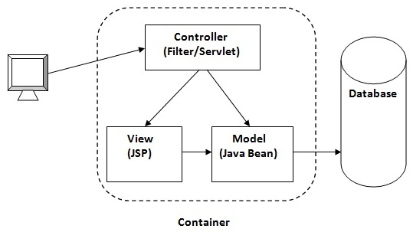
ARCHITECTURE USED:MVC
Model View Controller
Model: Java Bean
View: JSP
Controller: Servlet
Database: MYSQL

Slide 3
EXECUTION STEPS:
Create an Eclipse Dynamic Web Project
Add Dependencies
Project Structure
MySQL Database Setup
Create a JavaBean – User.java
Create a UserDao.java
Create a UserServlet.java
Create a userregister.jsp
Create a userdetail.jsp
Git Link: https://github.com/ksh2515/regstration

Slide 6
Thank you!

