Slide 1
Word2vec
박준형
데이터인텔리전스 연구실
irish07@korea.ac.kr

Slide 2
Class Lab - Schedule & Assignment
Neural Network Introduction (~10/14)
2. Skip-gram / CBOW (~10/30)
(Basic) Softmax
3. Hierarchical Softmax / Negative sampling (~11/13)
Subsampling

Slide 3
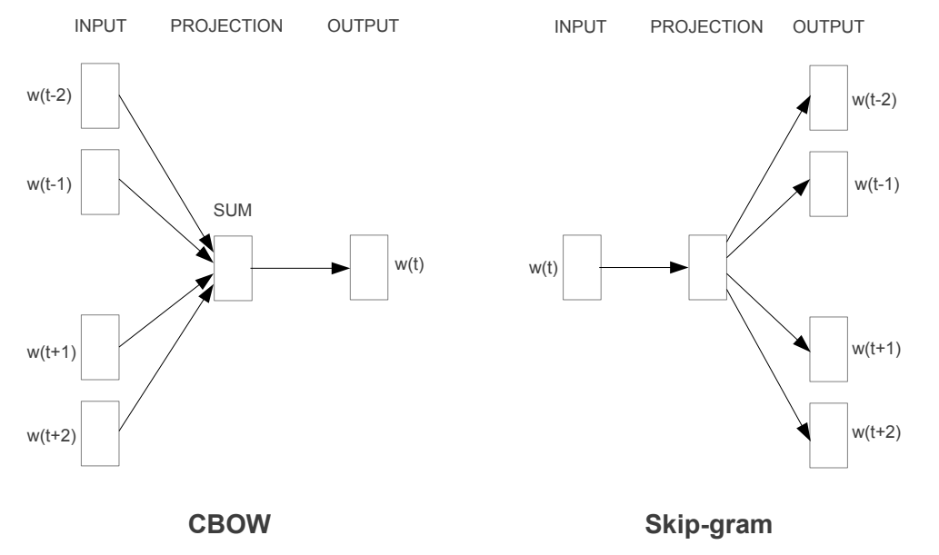
Class Lab - Schedule & Assignment
T. Mikolov, K. Chen, G. Corrado, J. Dean, “Efficient Estimation of Word Representations in Vector Space”, ICLR 2013

Slide 4
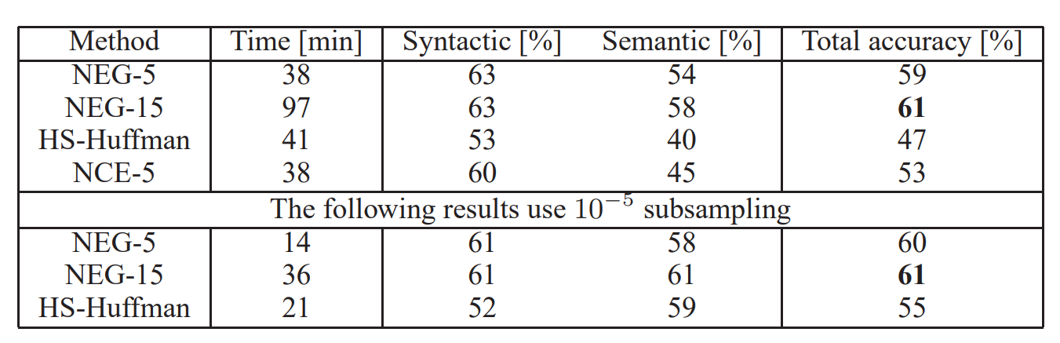
Class Lab - Schedule & Assignment
T. Mikolov, I. Sutskever, K. Chen, G. Corrado, J. Dean, “Distributed Representations of Words and Phrases and their Compositionality”, NIPS 2013

Slide 5
Word2Vec
Determine forms of input and output
Define loss function
Training

Slide 6
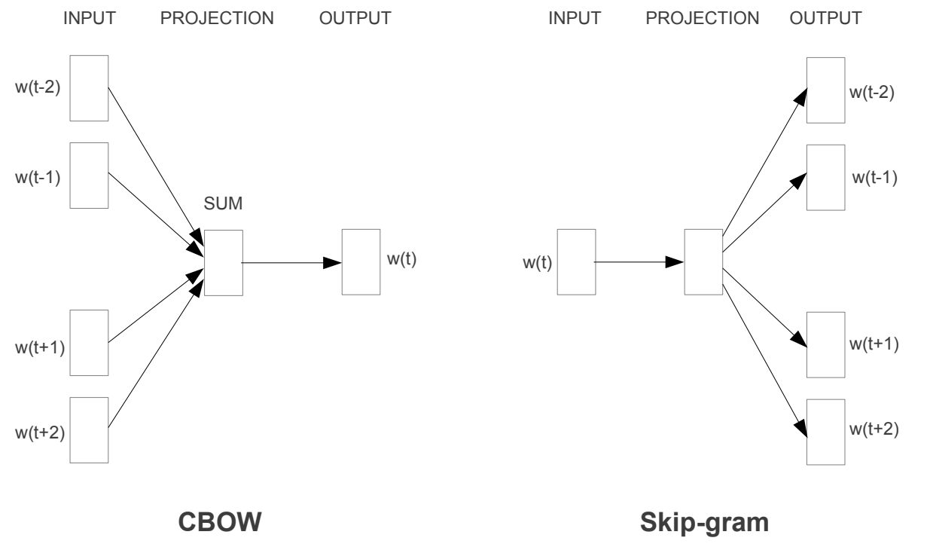
Word2Vec

Slide 7
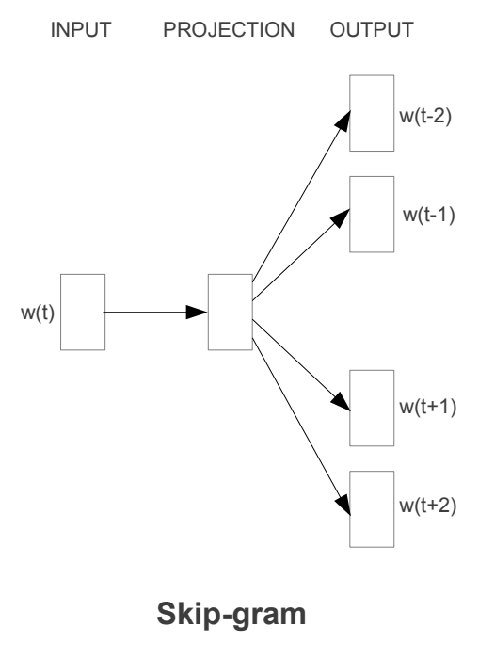
Word2Vec
Skip-gram
Predict context words using a center word
I eat an orange every day.
context words
context words
Predict the probability
???
???
???
orange
???
???

Slide 8
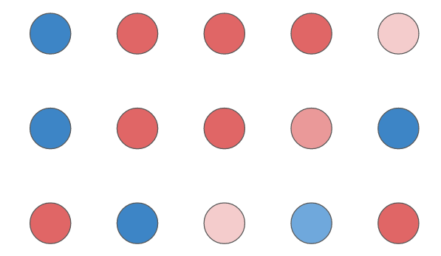
Word2Vec
Skip-gram
1. Word encoding
I eat an orange every day.
orange
Parameterize
Word vector

Slide 9
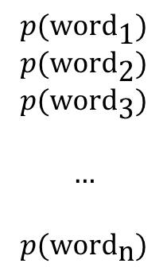
Word2Vec
Skip-gram
HW1
2. Predict
Weight Matrix
$$p(\text{wor}{\text{d}}_{\text{1}})$$
$$p(\text{wor}{\text{d}}_{\text{2}})$$
$$p(\text{wor}{\text{d}}_{\text{3}})$$
$$…$$
$$p(\text{wor}{\text{d}}_{\text{n}})$$
softmax
Word vector
Probabilities
Each element represent probability of a word

Slide 10
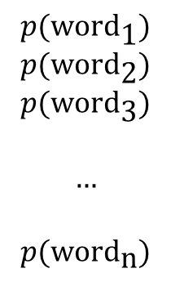
Word2Vec
Skip-gram
3. Update
I eat an orange every day.
Answer: I
$$p(\text{wor}{\text{d}}_{\text{1}})$$
$$p(\text{wor}{\text{d}}_{\text{2}})$$
$$p(\text{wor}{\text{d}}_{\text{3}})$$
$$…$$
$$p(\text{wor}{\text{d}}_{\text{n}})$$
HW1
Weight Matrix
Negative Log Likelihood Loss
Backpropagation
Stochastic Gradient Descent
Probabilities

Slide 11
Word2Vec
Skip-gram
3. Update
I eat an orange every day.
Answer: eat
$$p(\text{wor}{\text{d}}_{\text{1}})$$
$$p(\text{wor}{\text{d}}_{\text{2}})$$
$$p(\text{wor}{\text{d}}_{\text{3}})$$
$$…$$
$$p(\text{wor}{\text{d}}_{\text{n}})$$
HW1
Weight Matrix
Negative Log Likelihood Loss
Backpropagation
Stochastic Gradient Descent
Probabilities

Slide 12
Word2Vec
Skip-gram
3. Update
I eat an orange every day.
Answer: an
$$p(\text{wor}{\text{d}}_{\text{1}})$$
$$p(\text{wor}{\text{d}}_{\text{2}})$$
$$p(\text{wor}{\text{d}}_{\text{3}})$$
$$…$$
$$p(\text{wor}{\text{d}}_{\text{n}})$$
HW1
Weight Matrix
Negative Log Likelihood Loss
Backpropagation
Stochastic Gradient Descent
Probabilities

Slide 13
Word2Vec
Skip-gram
3. Update
I eat an orange every day.
Answer: every
$$p(\text{wor}{\text{d}}_{\text{1}})$$
$$p(\text{wor}{\text{d}}_{\text{2}})$$
$$p(\text{wor}{\text{d}}_{\text{3}})$$
$$…$$
$$p(\text{wor}{\text{d}}_{\text{n}})$$
HW1
Weight Matrix
Negative Log Likelihood Loss
Backpropagation
Stochastic Gradient Descent
Probabilities

Slide 14
Word2Vec
Skip-gram
3. Update
I eat an orange every day.
Answer: day
$$p(\text{wor}{\text{d}}_{\text{1}})$$
$$p(\text{wor}{\text{d}}_{\text{2}})$$
$$p(\text{wor}{\text{d}}_{\text{3}})$$
$$…$$
$$p(\text{wor}{\text{d}}_{\text{n}})$$
HW1
Weight Matrix
Negative Log Likelihood Loss
Backpropagation
Stochastic Gradient Descent
Probabilities

Slide 15
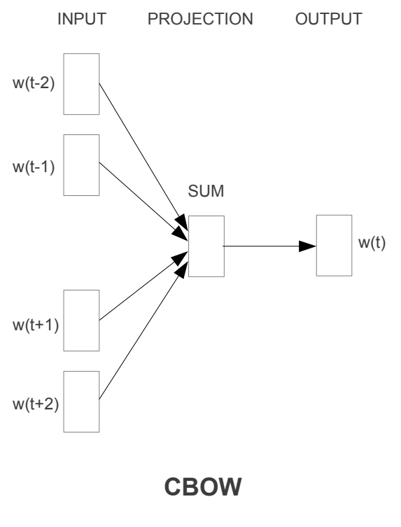
Word2Vec
Continuous Bag of Words
How frequent the center word occurs in some context?
I eat an orange every day.
center word
Predict the probability
I eat an ??? every day.

Slide 16
Word2Vec
Continuous Bag of Words
1. Context encoding
I
eat
an
every
day
I eat an ??? every day.
Context

Slide 17
Word2Vec
Continuous Bag of Words
1. Context encoding
word
I
eat
an
every
day
I eat an ??? every day.
Context

Slide 18
Word2Vec
Continuous Bag of Words
1. Context encoding
I
eat
an
every
day
I eat an ??? every day.
Parameterize
Context

Slide 19
Word2Vec
Continuous Bag of Words
1. Context encoding
I
eat
an
every
day
I eat an ??? every day.
sum
Context
Context vector

Slide 20
Word2Vec
Continuous Bag of Words
2. Prediction
HW1
Weight Matrix
$$p(\text{wor}{\text{d}}_{\text{1}})$$
$$p(\text{wor}{\text{d}}_{\text{2}})$$
$$p(\text{wor}{\text{d}}_{\text{3}})$$
$$…$$
$$p(\text{wor}{\text{d}}_{\text{n}})$$
softmax
Context vector
Probabilities
Each element represent probability of a word

Slide 21
Word2Vec
Continuous Bag of Words
3. Update
I eat an ??? every day.
Answer: orange
$$p(\text{wor}{\text{d}}_{\text{1}})$$
$$p(\text{wor}{\text{d}}_{\text{2}})$$
$$p(\text{wor}{\text{d}}_{\text{3}})$$
$$…$$
$$p(\text{wor}{\text{d}}_{\text{n}})$$
HW1
Weight Matrix
Negative Log Likelihood Loss
Backpropagation
Stochastic Gradient Descent
Probabilities

Slide 22




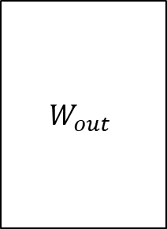
Word2Vec
$$y=softmax\left(W_{out}h\right)$$
$$W_{out}$$
$$h$$
$$W_{out}$$
o
$$=$$
Word/Context
Embedding
(V x 1)
(V x D)
(D x 1)
Word probabilities
V: vocabulary size
h: embedding dimension

Slide 23


Word2Vec
$$y=softmax\left(W_{out}h\right)$$
$$W_{out}$$
o
o’
y
exp
norm
Word/Context
Embedding
Word probabilities

Slide 24












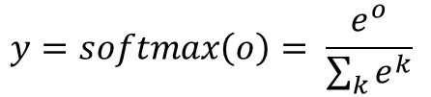


Word2Vec
*Xin Rong. word2vec Parameter Learning Explained
CBOW
Skip-gram
$$o=W_{out}h$$
$$h= w_{k}$$
$$h= w_{a}+w_{b}+w_{c}+w_{d}$$
$$y=softmax\left(o\right)= \frac{e^{o}}{\sum_{k}{e^{k}}}$$
$\frac{∂h}{∂w_{a}}$, $\frac{∂h}{∂w_{b}}$, $\frac{∂h}{∂w_{c}}$, $\frac{∂h}{∂w_{d}}=1$
$$w_{k}=w_{k}−η\frac{∂L}{∂h}$$
$$L=NLL\left(y, t\right)=−\log\left(y_{t}\right)$$
$$w_{a}=w_{a}−η\frac{∂L}{∂w_{a}}$$
$$W_{out}=W_{out}−η\frac{∂L}{∂W_{out}}$$
$$w_{b}=w_{b}−η\frac{∂L}{∂w_{b}}$$
$$\frac{∂L}{∂h}=W_{out} e$$
$$w_{c}=w_{c}−η\frac{∂L}{∂w_{c}}$$
$$\frac{∂L}{∂W_{out}}=he^{T}$$
$$w_{d}=w_{d}−η\frac{∂L}{∂w_{d}}$$
$$W_{out}=W_{out}−η\frac{∂L}{∂W_{out}}$$

Slide 25
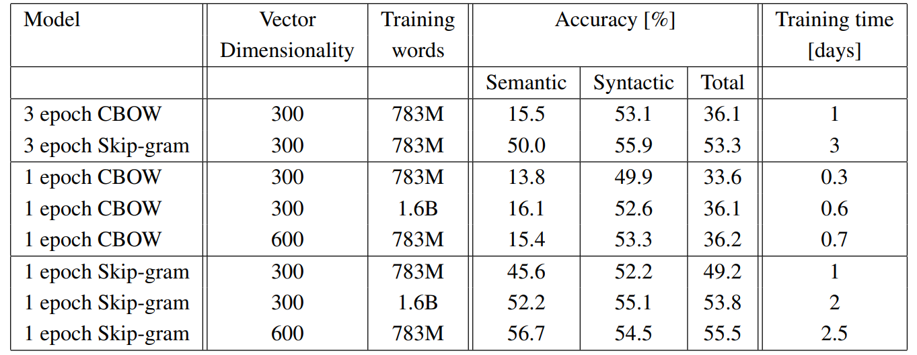
Word2Vec
CBOW vs Skip-gram

Slide 26
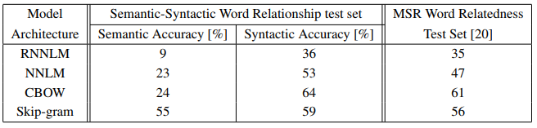
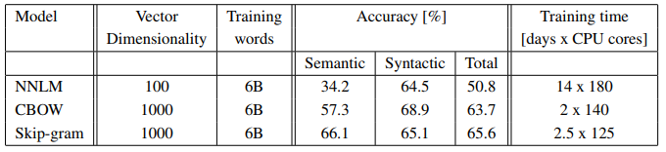
Word2Vec
Better and Faster

Slide 27
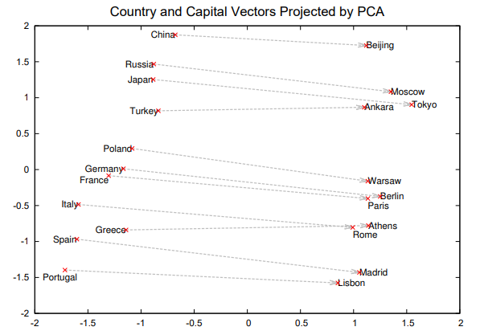
Word2Vec
Additive Compositionality
vec(“Paris”) - vec(“France”)
= vec(“Berlin”) - vec(“Germany”)

Slide 28
Word2Vec
Word2vec is very slow…
Why?

Slide 29


Word2Vec
No overhead(just load a vector instead of matrix multiplication)
$$W_{emb}$$
$$W_{out}$$

Slide 30
Word2Vec
Heavy overhead
$$W_{emb}$$
$$W_{out}$$

Slide 31


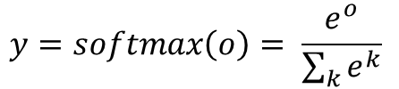
Word2Vec
Heavy overhead
The reason is…
Softmax function needs all values of the output vector
$$y=softmax\left(o\right)= \frac{e^{o}}{\sum_{k}{e^{k}}}$$
$$W_{emb}$$
$$W_{out}$$

Slide 32
Word2Vec
Heavy overhead
The reason is…
Output dimension : V
Feature dimension : D
Complexity : O(V x D)
$$W_{emb}$$
$$W_{out}$$

Slide 33
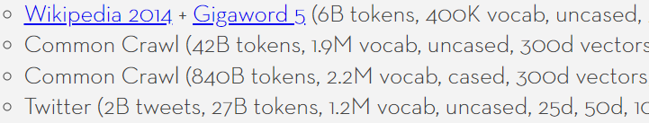
Word2Vec
Heavy overhead
The reason is…
Output dimension : V
Feature dimension : D
Complexity : O(V x D)
$$W_{emb}$$
$$W_{out}$$

Slide 34
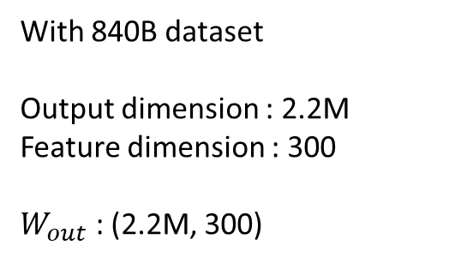
Word2Vec
Heavy overhead
With 840B dataset
Output dimension : 2.2M
Feature dimension : 300
$W_{out}$ : (2.2M, 300)
$$W_{emb}$$
$$W_{out}$$

Slide 35
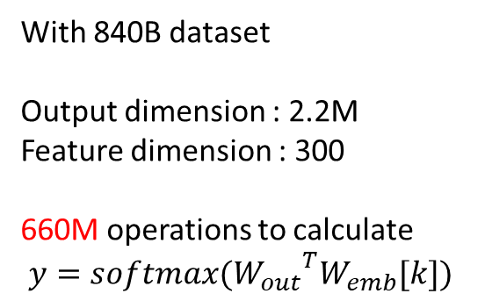
Word2Vec
Heavy overhead
With 840B dataset
Output dimension : 2.2M
Feature dimension : 300
660M operations to calculate
$y={softmax(W_{out}}^{T}W_{emb}[k])$
$$W_{emb}$$
$$W_{out}$$

Slide 36
Word2Vec
Heavy overhead
With 840B dataset
Output dimension : 2.2M
Feature dimension : 300
840B tokens with window size 5
10 training pairs each word
660M x 8.4 trillion operations an epoch
$$W_{emb}$$
$$W_{out}$$

Slide 37
Word2Vec
Heavy overhead
The reason is…
Output dimension : V
Feature dimension : D
Complexity : O(V x D)
$$W_{emb}$$
$$W_{out}$$
The idea is…
Use a portion of the output vector

Slide 38
Word2Vec
Hierarchical Softmax
1. Give every word a binary code (Huffman coding recommended)
ex) apple : 000
banana : 001
cherry : 010
…

Slide 39
Word2Vec
Hierarchical Softmax
2. Make a binary tree whose leaf nodes are the words
ex) apple : 000
banana : 001
cherry : 010
…
Suppose that 0 is the left and 1 is the right
0
1
2
3
4
5
6
apple
banana
cherry
…

Slide 40

Word2Vec
Hierarchical Softmax
3. Predict probability of “each non-leaf node”
0
0
1
2
1
2
$$W_{out}$$
3
4
5
3
4
5
6
6
apple
banana
cherry
…

Slide 41

Word2Vec
Hierarchical Softmax
3. Predict probability of “each non-leaf node”
0
0
1
sigmoid activation function instead of softmax
2
1
2
$$σ\left(x\right)=\frac{1}{1+e^{−x}}=\frac{e^{x}}{e^{x}+1}$$
3
4
5
3
4
5
6
6
apple
banana
cherry
…

Slide 42







Word2Vec
Hierarchical Softmax
4. The probability of a word is the product of nodes on the way
0
0
1
$$σ(y_{0})$$
$$1−σ(y_{0})$$
2
$p\left(apple\right)= σ(y_{0})$ $σ(y_{1})$ $σ(y_{3})$
1
2
3
$$σ(y_{1})$$
$$1−σ(y_{1})$$
4
5
3
4
5
6
6
$$σ(y_{3})$$
apple

Slide 43






Word2Vec
Hierarchical Softmax
4. The probability of a word is the product of nodes on the way
0
0
1
$$σ(y_{0})$$
$$1−σ(y_{0})$$
2
1
2
$p\left(cherry\right)= σ(y_{0})$ $(1−σ\left(y_{1}\right))$ $σ(y_{4})$
3
$$σ(y_{1})$$
$$1−σ(y_{1})$$
4
5
3
4
5
6
6
$$σ(y_{4})$$
cherry

Slide 44
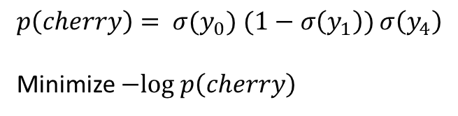
Word2Vec
Hierarchical Softmax
5. Maximize the probability by gradient descent on negative log likelihood
0
0
1
$$σ(y_{0})$$
$$1−σ(y_{0})$$
2
1
2
$p\left(cherry\right)= σ(y_{0})$ $(1−σ\left(y_{1}\right))$ $σ\left(y_{4}\right)$
Minimize $−log p\left(cherry\right)$
3
$$σ(y_{1})$$
$$1−σ(y_{1})$$
4
5
3
4
5
6
6
$$σ(y_{4})$$
cherry

Slide 45





Word2Vec
Hierarchical Softmax
Apple
Banana
Cherry
…
Watermelon
0
0
0
1
1
$$σ(y_{0})$$
$$1−σ(y_{0})$$
2
2
1
2
3
3
$$σ(y_{1})$$
$$1−σ(y_{1})$$
4
4
5
5
3
4
5
6
6
6
$$σ(y_{4})$$
cherry
Naïve Softmax
Vocabulary
Hierarchical Softmax
Hierarchical Tree

Slide 46


Word2Vec
Hierarchical Softmax
6. Weights connected to the activated nodes are updated
X
$$W_{emb}$$
$$W_{out}$$

Slide 47

Word2Vec
Hierarchical Softmax
6. Weights connected to the activated nodes are updated
$p\left(cherry\right)= σ(y_{0})$ $(1−σ\left(y_{1}\right))$ $σ\left(y_{4}\right)$
$L=−log p\left(cherry\right)$
$=−log σ\left(y_{0}\right)−log \left(1−σ\left(y_{1}\right)\right)−log σ\left(y_{4}\right)$
$\frac{∂L}{∂y_{0}}=σ\left(y_{0}\right)−1$
$\frac{∂L}{∂y_{1}}=σ\left(y_{1}\right)$
$\frac{∂L}{∂y_{4}}=σ\left(y_{4}\right)−1$
0
1
2
3
4
5
6

Slide 48



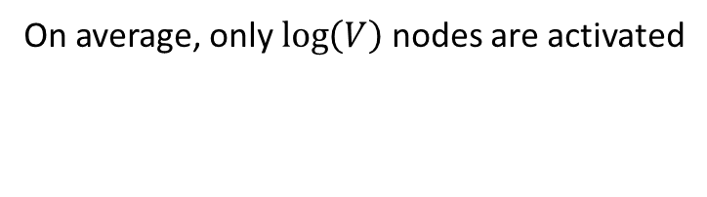



Word2Vec
Hierarchical Softmax
0
0
On average, only $\log\left(V\right)$ nodes are activated
1
$$σ(y_{0})$$
$$1−σ(y_{0})$$
With 840B dataset
Output dimension : 2.2M
Feature dimension : 300
Average activated nodes : 21
6.3k operation to calculate
$y={softmax(W_{out}}^{T}W_{emb}[k])$
Basic softmax : 660M
2
1
2
3
$$σ(y_{1})$$
$$1−σ(y_{1})$$
4
5
3
4
5
6
6
$$1−σ(y_{3})$$
banana

Slide 49
Word2Vec
Word2vec is still slow…

Slide 50
Word2Vec
Negative Sampling
0
1
2
1 of positive sample
V-1 of negative samples
Approximate the softmax function
only using k negative samples
3
4
5
6

Slide 51

Word2Vec
Negative Sampling
How many samples
1?
5-10?
Half of the negatives?
0
1
2
Sigmoid output
k negative samples
3
$$σ\left(x\right)=\frac{1}{1+e^{−x}}=\frac{e^{x}}{e^{x}+1}$$
1
2
4
How to sample
Uniformly?
Linearly?
With some heuristic function?
4
5
6

Slide 52
Word2Vec
Negative Sampling
How many samples
5~15 samples recommended
3~5 samples enough on big corpus
0
1
2
Sigmoid output
k negative samples
3
$$σ\left(x\right)=\frac{1}{1+e^{−x}}=\frac{e^{x}}{e^{x}+1}$$
1
2
4
How to sample
Frequency^(3/4)
4
5
6

Slide 53

Word2Vec
Negative Sampling
Design loss function to maximize the positive and to minimize the negatives
L = -log( ) - log((1- )(1- )(1- ))
5
1
2
4
1 positive sample
Then the gradient descent algorithm optimizes the network
5
0
1
$L$ $=−log σ\left(y_{5}\right)−log \left(1−σ\left(y_{1}\right)\right)−log \left(1−σ\left(y_{2}\right)\right)−log \left(1−σ\left(y_{4}\right)\right)$
$\frac{∂L}{∂y_{5}}=σ\left(y_{5}\right)−1$
$\frac{∂L}{∂y_{1}}=σ\left(y_{1}\right)$
$\frac{∂L}{∂y_{2}}=σ\left(y_{2}\right)$
$\frac{∂L}{∂y_{4}}=σ\left(y_{4}\right)$
k negative samples
2
3
1
2
4
4
5
6

Slide 54

Word2Vec
Negative Sampling
With 840B dataset
Output dimension : 2.2M
Feature dimension : 300
Average activated nodes : 1 + 5
1.8k operation to calculate
$y={softmax(W_{out}}^{T}W_{emb}[k])$
Basic softmax : 660M
Hierarchical softmax : 6.3k
0
1
2
Only k nodes are activated
3
4
5
6

Slide 55
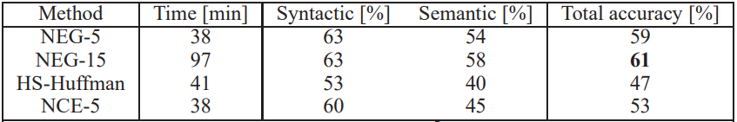
Word2Vec
Even faster but..
With 840B dataset
Window size : 5
Basic softmax : 660M x 8.4T
Hierarchical softmax : 6.3k x 8.4T
Negative Sampling : 1.8k x 8.4T

Slide 56
Word2Vec
Another idea is…
The orange is the fruit of the citrus species Citrus × sinensis in the family Rutaceae. It is also called sweet orange, to distinguish it from the related Citrus × aurantium, referred to as bitter orange. The sweet orange reproduces asexually varieties of sweet orange arise through mutations.
Highly frequent words are actually meaningful?

Slide 57
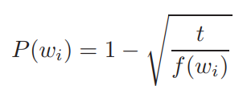
Word2Vec
Subsampling
The orange is the fruit of the citrus species Citrus × sinensis in the family Rutaceae. It is also called sweet orange, to distinguish it from the related Citrus × aurantium, referred to as bitter orange. The sweet orange reproduces asexually varieties of sweet orange arise through mutations.
Discard frequent words with probability

Slide 58
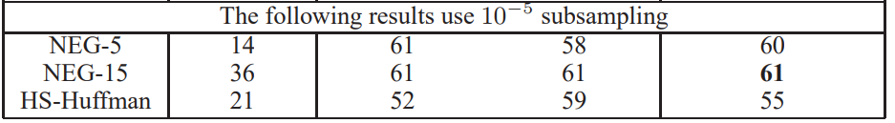
Word2Vec
Subsampling

Slide 59
Assignment 3
Word2Vec Implementation
Hierarchical Softmax
Assign binary code(Huffman coding)
Train with only weights connected to the activated nodes
Return : cost value and gradient of two word vectors
Negative Sampling
Frequency table
Random sampling during training
Return : cost value and gradient of two word vectors
Subsampling
Read(preprocess) corpus and make dictionary
Subsample corpus in every epoch

Slide 60
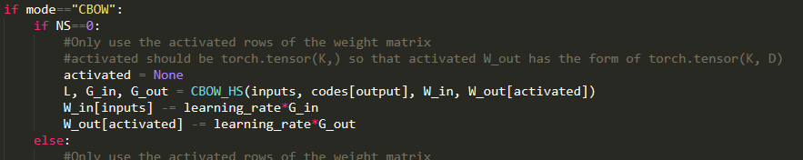
Assignment 3
Activated Weight Matrix
Recommend to use a portion of W_out for the computational efficiency

Slide 61
Assignment 3
Hierarchical Softmax
Use given “huffman.py”
How to use
HuffmanCode().build(frequency)
Input: Dictionary(key: word, value: frequency)
Output: Dictionary(key: word, value: code), Dictionary(key: code, value: ID number)

Slide 62
Assignment 3
Negative Sampling
Use a table instead of random sampling functions
size: 20
0 | 1 | 1 | 1 | 2 | 2 | 2 | 2 | 2 | 2 | 3 | 3 | 3 | 3 | 3 | 3 | 3 | 4 | 4 | 4
Probabilities
word0: 0.05
word1: 0.15
word2: 0.3
word3: 0.35
word4: 0.15
Generate a random integer x [0,19]
Pick the xth element

Slide 63
Assignment 3
Word2Vec Experiment
Analogical reasoning task[1][2]
“Germany” : “Berlin” :: “France” : ?
vec(x) =vec(“Berlin”) - vec(“Germany”) + vec(“France”)
Find the word x using cosine similarity
Note: text8 only includes lower cases
[1] http://code.google.com/p/word2vec/source/browse/trunk/questions-words.txt
[2] Tomas Mikolov et al. Distributed Representations of Words and Phrases and their Compositionality, 2013

Slide 64
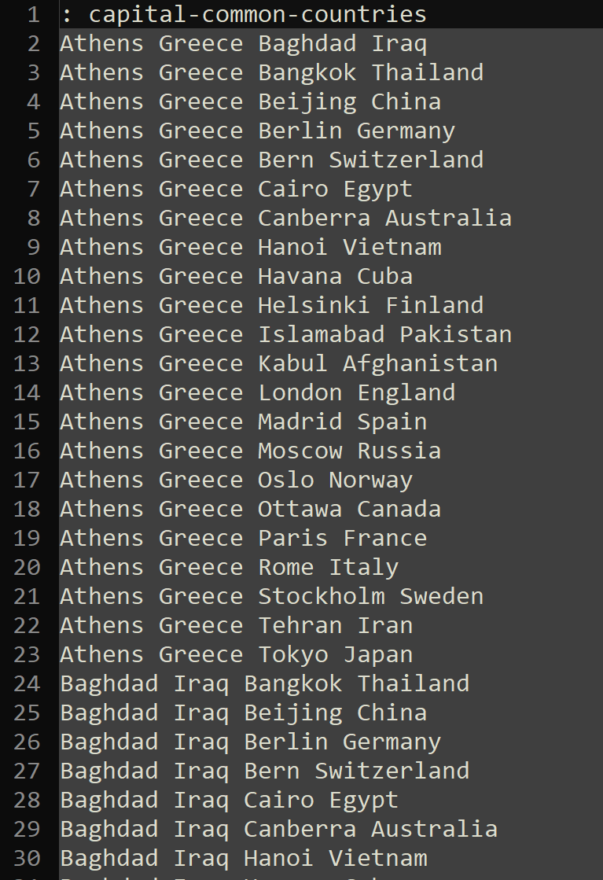
Assignment 3
Word2Vec Experiment
Analogical reasoning task[1]
“Germany” : “Berlin” :: “France” : ?
vec(x) =vec(“Berlin”) - vec(“Germany”) + vec(“France”)
Find the word x using cosine similarity
Note: text8 only includes lower cases
[1] http://code.google.com/p/word2vec/source/browse/trunk/questions-words.txt
[2] Tomas Mikolov et al. Distributed Representations of Words and Phrases and their Compositionality, 2013

Slide 65
Assignment 3
Word2Vec Experiment
Analogical reasoning task[1][2]
CBOW or Skip-gram
Hierarchical Softmax or Negative Sampling or Basic Softmax
Subsampling or not
Corpus : text8, 1B tokens corpus(optional)
[1] http://code.google.com/p/word2vec/source/browse/trunk/questions-words.txt
[2] Tomas Mikolov et al. Distributed Representations of Words and Phrases and their Compositionality, 2013

Slide 66
Submission 3
Due Date : ~11/13(수) 23:59
Submission : Submission : Online submission on blackboard
word2vec.py + Report with analysis of word analogy task(.docx / .hwp)
You must implement the components yourself!
File name : StudentID_Name.zip

Slide 67
Q&A
Data intelligence lab.
irish07@korea.ac.kr (박준형)
saga9017@korea.ac.kr (이욱진)

