Slide 1
Chrono support for human-in-the-loop simulation
Kyle Sha
Simulation-Based Engineering Lab
University of Wisconsin - Madison
1

Slide 2
What this talk covers
1. What counts as human-in-the-loop, and what it demands of a simulator. A definition we will hold every demo against.
2. The clock. Why pacing comes first, and the levers Chrono gives you for buying enough slack to pace at all.
3. Getting a person's input into the state. The driver surface, the input devices Chrono already speaks, and what to do about the ones it does not.
4. Reaching into the scene. Picking a body, pulling on it, and a one-line gap in PyChrono that this talk closes.
Four demos along the way, and the code is all in one repository you can clone.
The order is deliberate. The clock comes before the input, because input into a simulation that cannot hold real time is not human-in-the-loop, whatever else it is.
University of Wisconsin - Madison
2

Slide 3
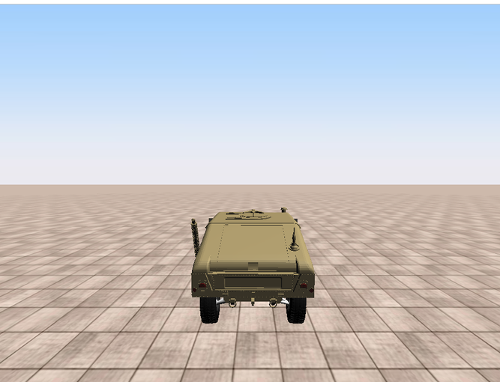
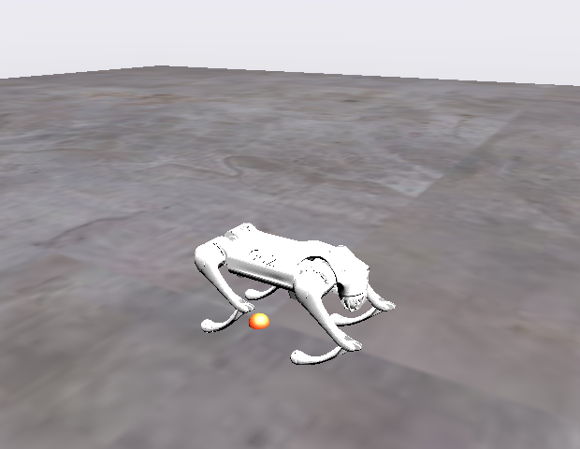
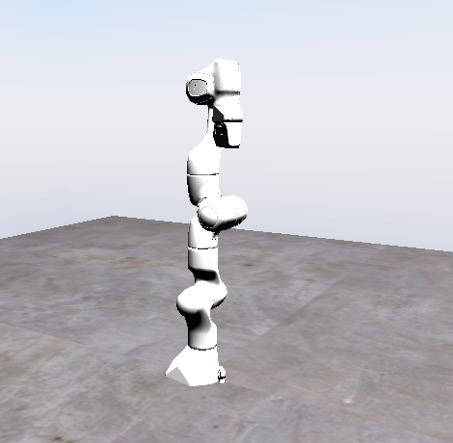
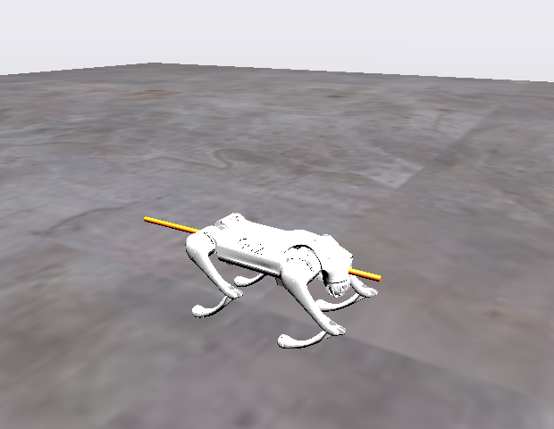
The four demos
1. Does the clock matter. The same drive twice, paced and unpaced.
2. A person driving. Keyboard into a vehicle, the textbook case.
3. Reaching in. Drag a quadruped's leg while a trained locomotion policy fights you, and a Franka arm with the motors on or off.
4. How hard can you shove it. A measured impulse at a point you choose, and the magnitude where recovery stops.
University of Wisconsin - Madison
3

Slide 4
What counts as human-in-the-loop
the definition this tutorial works to, and the three things it demands of a simulator
University of Wisconsin - Madison
4

Slide 5
The definition this tutorial works to
A simulation is human-in-the-loop when all three of these hold:
  1. a person's action changes the state of a RUNNING simulation,
  2. the simulation's response changes what that person does next, and
  3. the cycle closes fast enough that they can keep reacting.
Each clause is load-bearing:
  drop 1 and you have a visualisation - you are watching, not acting
  drop 2 and the person is driving blind - open loop, not a loop
  drop 3 and you have a batch job with a joystick attached
Nothing in that definition mentions vehicles. That is the whole point of the tutorial: a car, a crane, a gearbox and a quadruped's leg all satisfy it, and they satisfy it the same way.
University of Wisconsin - Madison
5

Slide 6
What a person in the loop is for
Measuring the person. Human factors: what does an operator do when the controls are delayed, when an assist takes authority, when a hazard appears late?
Training the person. Here the simulator IS the product, and the fidelity bar is whether it feels like the real thing.
Collecting data from the person. Demonstrations for imitation learning, driver models, reference trajectories no controller would have produced.
Testing the machine against a person. Someone perturbs a controller in ways a scripted test would never have thought to try.
Judging the machine by feel. Reach in, pull on it, see whether it behaves plausibly. Faster than any metric at answering 'something is wrong here'.
Designing shared control. When authority is split between a person and a controller, neither half can be evaluated alone.
Two different jobs hide in that list. Sometimes the person is the SUBJECT being measured; sometimes the person is the CONTROLLER, because nothing else can do the task. Either way the simulator has to hold wall-clock time, or you are measuring the simulator instead of the person.
University of Wisconsin - Madison
6

Slide 7
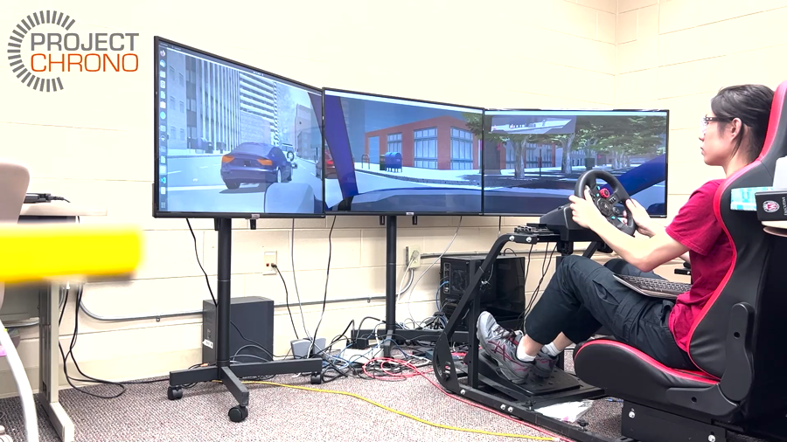
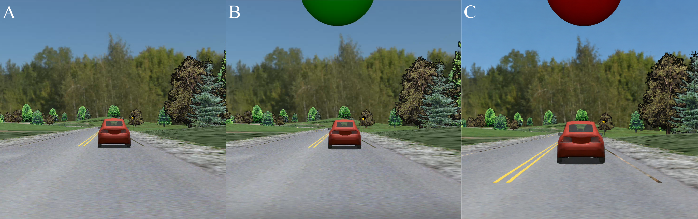
A study Chrono has already carried
Remote car-following under latency. Forty participants, four groups of ten. Uplink delayed their inputs, downlink delayed the video back.
Chrono::Vehicle ego and lead dynamics, SynChrono between the two nodes, Chrono::Sensor for the forward camera on three monitors at 60 Hz, Chrono::HIL for a Logitech G29 wheel and pedals.
Mitigation cut driving incidents 72%, though not significantly, and significantly lowered steering entropy at high speed. Adaptation across the three latency trials dominated the effect.
Ma, McDonald, Sha, Zhang, Xu, Negrut. "Evaluating a delay-compensated shared-control system in high- and low-speed remote car-following."
University of Wisconsin - Madison
7

Slide 8
The loop, and the clock around it
steering, a force, a click
position, speed, contact
Person
sees, decides, acts
Chrono
DoStepDynamics(step)
Screen + telemetry
what came back
what they see changes what they do next - this arrow is what makes it a LOOP
and every lap has to fit inside one wall-clock step
Break the first arrow and it is a movie. Break the return arrow and it is a recording session. Break the clock and the person cannot stay in the loop at all, which is why the clock comes first in this tutorial.
University of Wisconsin - Madison
8

Slide 9
Not everything interactive is in the loop
IN the loop - a person's input is a term in the dynamics, every step
  driving the HMMWV; dragging a robot's limb while its controller resists
ON the loop - a person configures and triggers, then watches it play out
  the push rig: you choose where and how hard, the impulse itself is scripted
Neither - interactive, but nothing is reacting
  the top-down placement tool: kinematic, no dynamics, a scene-authoring tool
Worth saying out loud, because 'interactive' and 'in the loop' get used interchangeably and only one of them has a clock in it. All three are useful. Only the first two are what the phrase means.
University of Wisconsin - Madison
9

Slide 10
Requirement 3 comes first: the clock
it decides whether the other two requirements are worth anything
University of Wisconsin - Madison
10

Slide 11
What real time means in Chrono
Chrono integrates as fast as it can. It has no notion of wall-clock time.
RTF = wall time / simulated time
  RTF < 1 - faster than real time. You have slack, and can sleep.
  RTF = 1 - exactly real time.
  RTF > 1 - slower than real time. No amount of sleeping fixes this.
So holding the clock is two separate problems:
  do not run FAST - sleep off the slack (easy, one call)
  do not run SLOW - make the step cheap enough to have slack (the real work)
University of Wisconsin - Madison
11

Slide 12
Holding wall-clock time: the pacing surface
// chrono/core/ChRealtimeStep.h
class ChRealtimeStepTimer : public ChTimer {
void Spin(double step); // sleep off whatever is left of `step`
};
// chrono_vehicle/ChVehicle.h -- same policy, applied inside Advance()
void ChVehicle::EnableRealtime(bool val);
double ChVehicle::GetRTF() const; // wall / simulated, per step
// The pattern, whatever is being simulated:
// while running:
// inputs = read_human() # never blocking
// sys.DoStepDynamics(step)
// if time to draw: render()
// timer.Spin(step) # give the wall clock its due
# ---- and how this tutorial calls it (tutorial_HIL_driver.py, lines 832 to 836) ------
# PART 1: spin in place for real time to catch up
if realtime_mode == "per_step":
rt_timer.Spin(step_size)
elif realtime_mode == "cumulative":
cum_timer.spin(system.GetChTime())
Two calls. Everything else about real time is arithmetic around them.
Per-step timers never recover time lost on a slow step. If you need the sim to catch up after a stall, pace against TOTAL elapsed time instead, which is the third mode in this tutorial.
University of Wisconsin - Madison
12

Slide 13
Demo Time: does the clock actually matter
WHAT the same scripted drive twice, once pacing to wall clock and once not
WHY it turns the real-time requirement from an assertion into a column you can watch run away
REALTIME = "none": watch the drift column run away
REALTIME = "vehicle": drift pinned near zero, RTF at 1
Same physics in both runs. The only difference is whether the process sleeps.
The drift column is the honest one. RTF can look fine on average while the sim has already lost a second of wall clock.
University of Wisconsin - Madison
13

Slide 14
You can only sleep if you have slack
Holding the clock is two problems, and only one of them is a call:
  do not run FAST - sleep off the slack
  do not run SLOW - make the step cheap enough to HAVE slack
The budget is fixed: one step of wall clock, minus what you spend drawing, minus what you leave as margin for a bad step.
What follows is the set of levers Chrono gives you for the second problem, in rough order of how much they usually buy.
Reach for them in this order. People tend to start at the solver, which is near the bottom of the list and the easiest place to spend an afternoon for nothing.
University of Wisconsin - Madison
14

Slide 15
The levers, in rough order of payoff
1. Step size. Everything scales with steps per second. The largest step that stays stable is the single biggest lever there is.
2. Collision geometry. Primitives beat convex hulls beat triangle meshes, by a lot. Most imported assets arrive as the slowest option.
3. Which pairs are tested at all. Families and masks remove whole classes of pair from the broadphase, including self-collision.
4. Active domains. Let the expensive physics happen only where it matters: deformable terrain near the wheels, fluid near the hull.
5. Solver type and iteration cap. Iterations buy convergence and cost time, and you pay out of the same step you wanted to sleep in.
6. Threads, sleeping bodies, and model reduction for elastic subassemblies.
7. Render less often than you step. Drawing is not free, and the eye does not need 500 Hz.
None of this is specific to having a human in the loop. It becomes urgent when there is one, because a batch job that runs at 0.6x real time is merely slow, and an interactive one is broken.
University of Wisconsin - Madison
15

Slide 16
The levers, by name
// the step, and how it is integrated
sys.DoStepDynamics(step);
sys.SetTimestepperType(ChTimestepper::Type::...);
// the solver: type, and how long it is allowed to work
sys.SetSolverType(ChSolver::Type::BARZILAIBORWEIN);
sys.GetSolver()->AsIterative()->SetMaxIterations(n);
// what the collision system is asked to do
model->SetFamily(i); model->SetFamilyMask(mask); // skip whole pairs
ChCollisionModel::SetDefaultSuggestedEnvelope(e); // contact envelope
ChCollisionModel::SetDefaultSuggestedMargin(m);
// where the expensive physics is allowed to happen
SCMTerrain::AddActiveDomain(body, ...); // deform near the wheels only
ChFsiSystemSPH::SetActiveDomain(box); // fluid where it matters only
// spend less on what is not moving, or not detailed
sys.SetNumThreads(n_chrono, n_collision, n_eigen); // three pools
sys.SetSleepingAllowed(true); // bodies at rest drop out
ChModalAssembly::DoModalReduction(...); // internal DOFs -> a few modes
Every one of these is a real-time decision before it is a fidelity decision, and most of them are one line.
University of Wisconsin - Madison
16

Slide 17
Requirement 1: a path into the state
how a person's action actually reaches the equations
University of Wisconsin - Madison
17

Slide 18
Three ways a person's input enters a Chrono simulation
As driver inputs
ChDriver / ChInteractiveDriver
steering, throttle, braking
As a force or constraint
AccumulateForce, ChLinkTSDA
on any body, any scene
As a pose you set
SetPos / SetRot
kinematic placement
the vehicle demos (Parts 2-4)
the drag and push demos (Parts 9-10)
the placement tool
IN the loop
IN the loop
not in the loop
The left column is the privileged one, and it is privileged for a reason: vehicles are this lab's bread and butter, so they are what got a purpose-built human-input class. That machinery lives in Chrono::Vehicle, so a crane or a robot cannot reach it.
The middle column is the general one, and it is how everything that is not a vehicle gets a person into its loop.
The right-hand column is honest about itself: nothing reacts to a pose you set, so nothing closes the loop.
University of Wisconsin - Madison
18

Slide 19
Feeding driver input: the ChDriver surface
// chrono_vehicle/ChDriver.h -- what EVERY driver exposes, human or not
class ChDriver {
void SetSteering(double s); // -1 .. +1
void SetThrottle(double t); // 0 .. 1
void SetBraking(double b); // 0 .. 1
void SetClutch(double c); // 0 .. 1
DriverInputs GetInputs() const;
virtual void Synchronize(double time); // read the world
virtual void Advance(double step); // advance own state
};
// Two ways in, and the vehicle cannot tell them apart:
// subclass ChDriver and write the setters from your own device, or
// take ChInteractiveDriver and let it read a keyboard or a joystick.
// Either way the vehicle only ever sees a DriverInputs struct.
# ---- and how this tutorial calls it (tutorial_HIL_driver.py, lines 603 to 605) ------
if KEYBOARD_MODE == "held":
if hasattr(veh.ChInteractiveDriver, "KeyboardMode_HELD"):
driver.SetKeyboardMode(veh.ChInteractiveDriver.KeyboardMode_HELD)
Note WHERE this lives: ChDriver and ChInteractiveDriver are in Chrono::VEHICLE, not in core. Vehicles are what this lab does most, so vehicles are what got a first-class human-input class, a keyboard mode, and a joystick mapping. Nothing else in Chrono has one.
Query the driver BEFORE Synchronize: the human's numbers have to be in hand before the modules read each other for this step.
KeyboardMode: CUMULATIVE nudges an input and leaves it there; HELD follows the keys currently down, like a driving game. HELD was added to Chrono for this tutorial and ships in build 1187.
University of Wisconsin - Madison
19

Slide 20
Driving something that is NOT a vehicle
# Nothing outside Chrono::Vehicle has a driver abstraction, so this
# is a pattern rather than an API. Three decisions:
#
# 1. NORMALISE THE INPUT. A few bounded numbers a device produces
# and a plant consumes, so one console drives any of them.
# 2. BIND THEM TO ACTUATION. The only plant-specific part.
# 3. SEND SOMETHING BACK, or the person is driving open loop.
class Plant: # every plant, one shape
def apply(self, inputs): ... # THE BINDING
def synchronize(self, t, inputs): ...
def advance(self, step): ...
def speed(self): ...; def status(self): ...
# A crane's entire input surface: two motors and a setpoint each.
self.long_motor = chrono.ChLinkMotorLinearSpeed()
self.long_speed = chrono.ChFunctionSetpoint()
self.long_motor.SetSpeedFunction(self.long_speed)
# ---- and how this tutorial calls it (hil_plants.py, lines 335 to 338) ------
# Throttle drives forward, braking drives back: two pedals, one axis.
long_cmd = (inputs.m_throttle - inputs.m_braking) * self.MAX_LONG_SPEED
self.long_speed.SetSetpoint(long_cmd, t)
self.cross_speed.SetSetpoint(inputs.m_steering * self.MAX_CROSS_SPEED, t)
ChFunctionSetpoint is the piece worth knowing. A Chrono motor is driven by a ChFunction of time, and a human's input is not a function of time anyone can write down in advance. The setpoint function is the adapter: push a value in each step, the motor reads it as the current one.
The convention costs something, and the crane shows the bill: it has one travel axis and was handed two pedals, so it computes throttle - braking. No crane operator would recognise that.
University of Wisconsin - Madison
20

Slide 21
Input devices Chrono already speaks
ChInteractiveDriver covers two CLASSES of device, not two devices:
  InputMode_KEYBOARD - with KeyboardMode_HELD or _CUMULATIVE
  InputMode_JOYSTICK - anything the windowing layer enumerates as one
A joystick is mapped by a JSON file, not by code: SetJoystickConfigFile(path)
  mapped axes: steering, throttle, brake, CLUTCH
  mapped buttons: shift up/down, reverse, gears 1-9, manual-gearbox toggle, plus one user callback
Four configs ship in data/vehicle/joystick/: Default, Logitech RumblePad 2, Xbox One, and Wheel+Pedals+Shifters
Each control names its own DEVICE, so a wheel, a pedal box and an H-shifter enumerating as three separate USB devices all map at once
Not hypothetical: the remote-driving study on slide 5 ran on a Logitech G29 wheel and pedal set through this path
So a G923-class rig is a config file, not a port. The mapping and the semantics are Chrono's and cross-platform; enumerating the device is delegated to the windowing layer, so which platforms see your wheel follows that layer, and I have not tested it here.
All of it is exposed to PyChrono.
University of Wisconsin - Madison
21

Slide 22
And for a device Chrono does not know about
Subclass ChDriver, read whatever you like, and obey three rules:
1. NEVER BLOCK. A simulation that waits on a human is not real-time. Late input means hold the last value, not stall the loop.
2. SAMPLE ONCE PER STEP, THEN HOLD. Read at the top of the step and reuse that value for the whole step, or the physics sees inputs change for reasons the operator can neither perceive nor reproduce.
3. SEND SOMETHING BACK. With no return path the operator is driving open loop, which is not human-in-the-loop by our definition.
Obey those and the transport does not matter: a socket, a serial port, shared memory, a ROS topic, another simulator.
This tutorial ships one of these, an operator console on UDP, so a second machine can drive the simulation and watch telemetry come back.
University of Wisconsin - Madison
22

Slide 23
Demo Time: a person driving the vehicle
WHAT keyboard straight into ChInteractiveDriver, HMMWV on rigid terrain
WHY the whole definition satisfied in one window, and the baseline every other demo is measured against
INPUT_SOURCE = "keyboard", KEYBOARD_MODE = "held"
W/A/S/D drive. The arrow keys are the chase camera, not the car.
Try "cumulative" and feel the difference a key-state API makes.
This is the whole definition satisfied in one window: input reaches the state, the state comes back on screen, and the timer holds the pace.
University of Wisconsin - Madison
23

Slide 24
Reaching into the scene with a mouse
what Chrono provides today, the one line it is missing, and what that buys
University of Wisconsin - Madison
24

Slide 25
What Chrono gives you today
ChRealtimeStepTimer - the pacing, exposed to Python
ChInteractiveDriver - keyboard and joystick input, with KeyboardMode::HELD
ChCollisionSystem::RayHit - click-to-pick, exposed to Python
AccumulateForce, ChLinkTSDA - a human's pull as a term in the dynamics
ChVisualSystemIrrlicht::AddUserEventReceiver(IEventReceiver*) - the socket for any input device, and it IS bound in Python
What is NOT there: any built-in mouse pick-and-drag. No module in the tree implements one.
That last line is the gap this tutorial walks into. Everything needed to build one is already exposed; what is missing is the ability to receive the mouse event in the first place.
University of Wisconsin - Madison
25

Slide 26
The gap, and the one line that closes it (native_pick.py lines 10 to 26)
# chrono_swig/interface/irrlicht/ChModuleIrrlicht.i
+%feature("director") irr::IEventReceiver;
%include "IEventReceiver.h"
# The module ALREADY compiles with directors enabled:
# %module(directors="1", threads="1") irrlicht
# and AddUserEventReceiver is ALREADY bound. Without the
# director, though, Python gets an abstract class:
# >>> ci.IEventReceiver()
# AttributeError: No constructor defined - class is abstract
# so there is a socket, and nothing you can plug into it.
class MouseReceiver(irr.IEventReceiver):
"""No Quartz, no CGWindowList, no NSEvent. No macOS. Just Irrlicht."""
def __init__(self):
super().__init__()
self.x = self.y = 0
self.down = False
self.pressed = False # edge, consumed by the loop
self.keys = set()
def OnEvent(self, ev):
if ev.EventType == irr.EET_MOUSE_INPUT_EVENT:
self.x, self.y = ev.MouseInput.X, ev.MouseInput.Y
if ev.MouseInput.Event == irr.EMIE_LMOUSE_PRESSED_DOWN:
self.down = self.pressed = True
elif ev.MouseInput.Event == irr.EMIE_LMOUSE_LEFT_UP:
self.down = False
Without it, reading the mouse means going around Chrono to the operating system: 135 lines, macOS only, and it breaks when another window takes focus.
With it, the same capability is 56 lines of ordinary PyChrono. Upstream PR to follow this talk.
University of Wisconsin - Madison
26

Slide 27
Turning a click into a body: the ray-cast surface
// chrono/collision/ChCollisionSystem.h
struct ChRayhitResult {
bool hit;
ChVector3d abs_hitPoint; // where, in world coordinates
ChVector3d abs_hitNormal; // the surface normal there
double dist_factor; // 0 .. 1 along the segment
ChCollisionModel* hitModel; // -> CastToChBody() for the body
};
virtual bool RayHit(const ChVector3d& from,
const ChVector3d& to,
ChRayhitResult& result) const;
// A ray sees COLLISION geometry, never visual geometry. A link you
// can see but whose collision is off is invisible to every click.
// That one sentence accounted for every 'it will not pick' bug here.
# ---- and how this tutorial calls it (hil_manipulate.py, lines 338 to 349) ------
def pick_along_ray(system, start, end):
"""The primitive a mouse click would use. Returns (body, world_point) or None."""
res = chrono.ChRayhitResult()
system.GetCollisionSystem().RayHit(start, end, res)
if not res.hit:
return None
body = chrono.CastToChBody(res.hitModel.GetContactable())
if body is None:
return None
p, nrm = res.abs_hitPoint, res.abs_hitNormal
return (body, chrono.ChVector3d(p.x, p.y, p.z),
chrono.ChVector3d(nrm.x, nrm.y, nrm.z))
Exposed in PyChrono already, and exact: the same primitive a native mouse handler would call. Screen pixel to ray is your arithmetic; ray to body is Chrono's.
University of Wisconsin - Madison
27

Slide 28
Turning a pull into physics: force, or constraint
// A human pulling on something is one of exactly two things.
// 1. A FORCE, when you want a push of known size (chrono/physics/ChBody.h)
unsigned int idx = body->AddAccumulator(); // ONCE per body
body->EmptyAccumulator(idx); // your job, EVERY step
body->AccumulateForce(idx, force, appl_point, local);
body->AccumulateTorque(idx, torque, local);
// 2. A CONSTRAINT, when you want a hand (chrono/physics/ChLinkTSDA.h)
spring->Initialize(handle, body, local, point1, point2);
spring->SetRestLength(0.0);
spring->SetSpringCoefficient(k); // k = m*w^2 scale with the MASS
spring->SetDampingCoefficient(c); // c = 2*m*w critically damped
sys.AddLink(spring);
# ---- and how this tutorial calls it (hil_manipulate.py, lines 488 to 502) ------
omega = getattr(self.system, "grab_omega", GRAB_OMEGA)
m = max(body.GetMass(), 1e-3)
k = m * omega * omega
c = 2.0 * m * omega * GRAB_ZETA
# Belt and braces against tunnelling: a grabbed body may not move faster
# than contact detection can keep up with at this step size.
self._had_limit = body.GetLimitSpeed() if hasattr(body, "GetLimitSpeed") else False
body.SetLimitSpeed(True)
body.SetMaxLinVel(GRAB_MAX_SPEED)
self.spring = chrono.ChLinkTSDA()
self.spring.Initialize(self.handle, body, False, point, point)
self.spring.SetRestLength(0.0)
self.spring.SetSpringCoefficient(k)
self.spring.SetDampingCoefficient(c)
self.system.AddLink(self.spring)
Chrono never clears an accumulator for you, and AddAccumulator() appends, so calling it per push leaks a slot and every stale slot keeps contributing.
Gains must scale with what is being pulled. A stiffness tuned on a 0.154 kg Go2 calf gave a 2.7 kg Panda link 21,870 N/m, which is 24,300 m/s^2: through the floor in a single step.
University of Wisconsin - Madison
28

Slide 29
Demo Time: reaching in and pulling on a robot
WHAT click a link and drag it while its controller keeps working
WHY human input as a FORCE rather than as driver inputs, which is how everything that is not a vehicle gets a person in its loop
Go2, driven by a trained locomotion policy: pull on a leg and it steps to keep its feet.
Franka, hand-guided: the motors hold position, and the arm follows your hand and returns when you let go.
Franka, unactuated: the motors are off, so it collapses under gravity and you can pose the dead weight by hand.
University of Wisconsin - Madison
29

Slide 30
Taking the human out of the part that must repeat
# The pattern, not the API: decide which half of the human's input
# has to be repeatable, and script only that half.
#
# the person keeps: WHERE on the body, and WHICH DIRECTION
# the machine keeps: a constant force F held for a fixed window dt
#
# impulse J = F * dt both printed, both logged
#
# A freehand drag cannot answer 'how hard can I shove it', because
# no two drags are the same: the force depends on how fast a hand
# moved and how long a button was held. There is no number at the end.
# Script the magnitude and you get one you can put in a report.
# ---- and how this tutorial calls it (hil_push.py, lines 264 to 283) ------
def fire(self, cfg, t):
body = cfg.body
self.active = (body, cfg.force(), chrono.ChVector3d(cfg.local_point),
t + cfg.duration)
self.fired_at = t
return self._slot(body)
def update(self, t):
"""Call every step, BEFORE DoStepDynamics. Returns True while pushing."""
if self.active is None:
return False
body, force, local, t_end = self.active
idx = self._slot(body)
body.EmptyAccumulator(idx) # Chrono never clears these for you
if t >= t_end:
self.active = None
return False
# The point travels with the link: a shove on the shoulder stays on the
# shoulder even as the shoulder is being shoved away.
body.AccumulateForce(idx, force, body.TransformPointLocalToParent(local),
This is the human-ON-the-loop half of the taxonomy: the person sets up the experiment and reads the verdict, and is deliberately not in the inner loop, because being in it would destroy repeatability.
University of Wisconsin - Madison
30

Slide 31
Demo Time: how hard can you shove it
WHAT click a point on the robot, set a direction and a magnitude, and fire an impulse of fixed duration
WHY it turns 'is this controller robust' into a number, which is something you can put in a report and somebody else can reproduce
The panel reports the impulse, the peak tilt, how far the robot was carried, and how long it took to settle.
Sweep the magnitude and it finds the threshold. With the locomotion policy driving: 1850 N recovers, 1900 N does not. Sideways is weaker, at 1100 N/1200 N.
Change the controller and the threshold moves. The same robot held by a PD stance instead tips at 325 N, because a stance can only stiffen while the policy steps into the push.
Where you click matters too: the same impulse 5 cm higher up the torso can flip the verdict.
University of Wisconsin - Madison
31

Slide 32
Where to go next
This tutorial github.com/ksha23/chrono-hil-tutorial
  every part, the demos, and the SWIG director patch under experimental/
Chrono projectchrono.org github.com/projectchrono/chrono
  conda install -c projectchrono pychrono
Chrono::HIL github.com/zzhou292/chrono-HIL
  driving rigs, steering wheels, multi-user sessions, the same three floats
Joystick and wheel mappings data/vehicle/joystick/
  copy the nearest config, change the axis and button numbers
The gap this talk found is small and specific, which is the good kind: one line to let Python receive the event, and a utility on top of primitives Chrono already exposes. Upstream PR to follow.
University of Wisconsin - Madison
32

Slide 33
Thank you.
github.com/ksha23/chrono-hil-tutorial
University of Wisconsin - Madison
33

