Slide 1
CS 566 COMPUTER VISION · FINAL PROJECT
How far off the recorded path can a Gaussian-splat driving simulator be trusted?
Kyle Sha and Allen Xia · University of Wisconsin–Madison · Fall 2026
Kyle Sha, Allen Xia · CS 566 Fall 2026 · Data: Para-Lane (CC BY-NC 4.0), HUGSIM/nuScenes, EUVS/MARS
1 / 8
Notes:
Driving software is increasingly tested in simulators rebuilt from real drives. We ask how far the simulated car can leave the recorded path before those simulators stop being trustworthy, and whether AI repair models fix that.

Slide 2
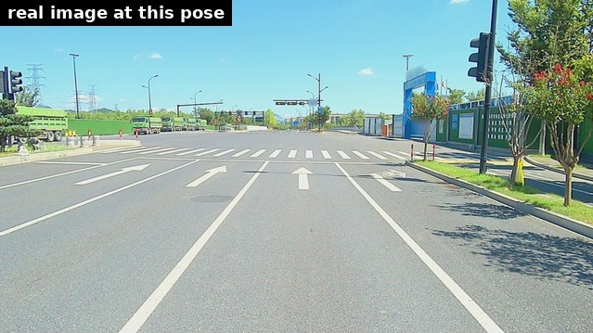
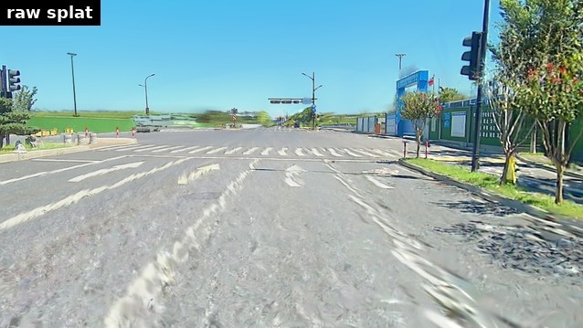
PROBLEM
A splat is accurate only where the car actually drove
A Gaussian splat rebuilt from one lane, rendered 3 m to the side: real photo (left) vs. render (right).
Generative fixers (e.g., NVIDIA Difix) make such renders look realistic. We measure whether they also make them correct.
Kyle Sha, Allen Xia · CS 566 Fall 2026 · Data: Para-Lane (CC BY-NC 4.0), HUGSIM/nuScenes, EUVS/MARS
2 / 8
Notes:
The recorded video becomes a 3D Gaussian splat: millions of small colored ellipsoids that can be rendered from any camera position. Near the recorded path it is accurate. One lane over, the road texture smears and lane lines break up. Diffusion-based fixers such as Difix clean these renders up. Looking better is not the same as being right, so we test them against real photos.

Slide 3
SETUP
Real ground truth from three parallel lanes
Lane A: recorded, splat built here
Para-Lane scans the same roads in three parallel lanes. We build the splat from one lane and render it at the other lanes' recorded poses.
Trust = do a lane detector (CLRNet) and a vehicle detector (YOLO11) see the same thing in the render and in the real photo?
Hallucination = lane paint or vehicles in the render that the real photo does not have.
8 held-out test roads · 2,825 images at ≈3 m · 1,386 at ≈6 m · 95% bootstrap intervals.
Lane B (≈3 m): real photos exist
Lane C (≈6 m): real photos exist
Kyle Sha, Allen Xia · CS 566 Fall 2026 · Data: Para-Lane (CC BY-NC 4.0), HUGSIM/nuScenes, EUVS/MARS
3 / 8
Notes:
What makes this measurable is Para-Lane: the same roads driven in three parallel lanes. So one lane over and two lanes over we have a real photo at exactly the rendered pose. Trust is detector agreement between the render and that photo; we also count invented paint and cars.

Slide 4
METHODS
What we compare, and what we built
Image fixers
Fix the 3D scene
Built and validated
• Released Difix (NVIDIA)
• NVIDIA Fixer (driving data)
• Difix training, re-implemented by us from the paper, trained on lane pairs
• Difix fine-tuned on our pairs
• Small U-Net from scratch
• Progressive update: fixed views added back into the splat (Difix3D+)
• Road-surface prior from LiDAR (ViSE, re-implemented; no generation)
• Our Difix trainer beats the official one at equal budget (DL3DV: LPIPS 0.218 vs 0.237)
• Our own splat projection: matches gsplat to 90.8 dB, gradients cos ≥ 0.99996
Kyle Sha, Allen Xia · CS 566 Fall 2026 · Data: Para-Lane (CC BY-NC 4.0), HUGSIM/nuScenes, EUVS/MARS
4 / 8
Notes:
We compare per-image fixers, including our own re-implementation of the Difix training procedure, with methods that repair the 3D scene itself. We validated our Difix trainer against NVIDIA's official code on their kind of data, and we wrote our own splat projection code and checked that it matches gsplat.

Slide 5
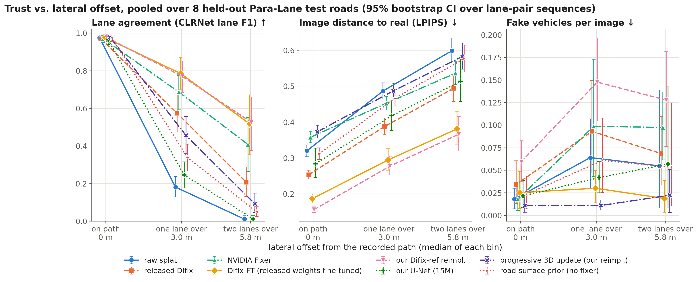
RESULT 1
Trust collapses one lane over; trained fixers recover part of it
Lane agreement, raw render: 0.98 on path → 0.18 at 3 m → 0.01 at 6 m. Best fixers at 3 m: 0.77–0.79.
Kyle Sha, Allen Xia · CS 566 Fall 2026 · Data: Para-Lane (CC BY-NC 4.0), HUGSIM/nuScenes, EUVS/MARS
5 / 8
Notes:
Left: lane agreement with the real photo. The raw render drops from 0.98 on the path to 0.18 one lane over and almost zero two lanes over. Released Difix recovers to 0.57, NVIDIA Fixer 0.69, and the fixers trained on our lane pairs about 0.78. Middle: perceptual distance. Right: fake vehicles per image, where our re-implementation is the worst.

Slide 6
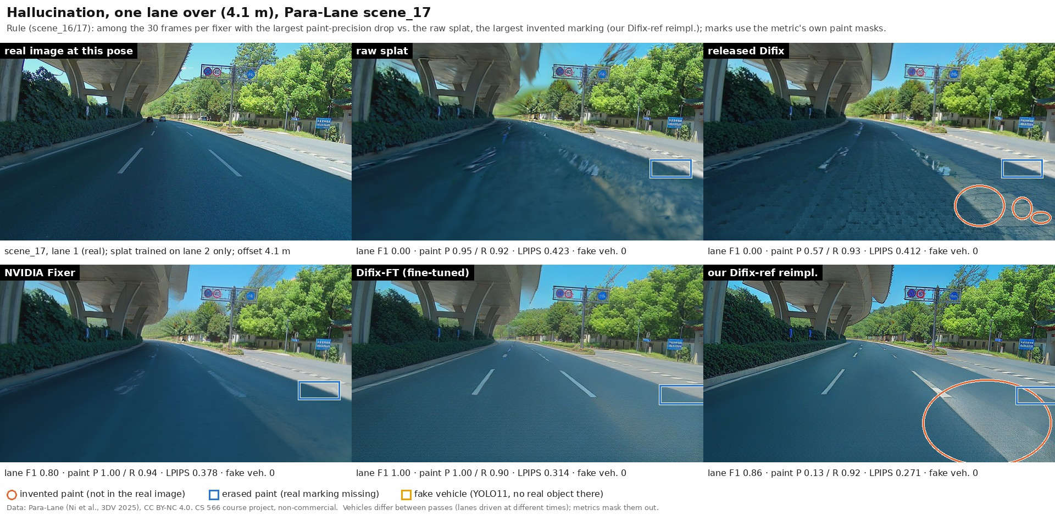
RESULT 2
Better-looking is not the same as correct
Our Difix paints a wide stripe that is not on the real road: paint precision 0.13 vs 0.95 raw, while its lane score stays high.
Fake vehicles: our re-implementation adds them on 8 of 8 roads (+0.09 per image); fine-tuning NVIDIA's weights does not.
Refining the 3D scene invents almost nothing (0.01 per image) but helps less far off the path.
Kyle Sha, Allen Xia · CS 566 Fall 2026 · Data: Para-Lane (CC BY-NC 4.0), HUGSIM/nuScenes, EUVS/MARS
6 / 8
Notes:
Orange circles are invented paint, blue boxes erased paint. Our re-implementation restores lanes well but also paints a marking that does not exist, and it adds vehicles on every road. Methods that repair the 3D model instead of each image cannot invent a per-frame car, so they hallucinate least.

Slide 7
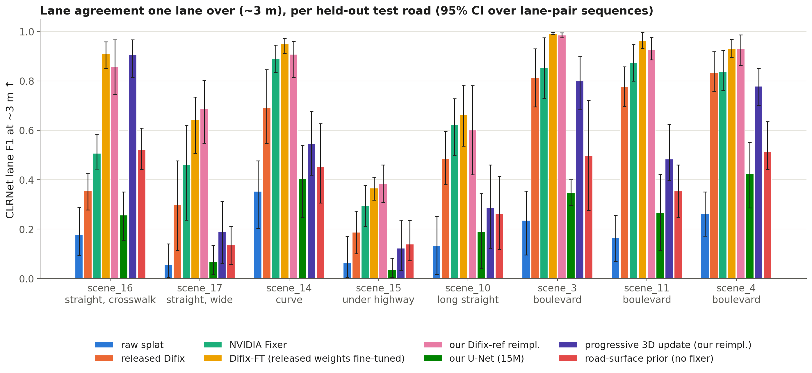
RESULT 3
It depends on the road, and gains do not carry into driving
Per road: best fixer 0.95 on a curve, ≤ 0.39 under a highway; two lanes over there, every fixer draws a plausible but wrong road.
Camera height ±1 m: −5 to −7 dB on the road; turning ±15° barely matters.
Other cities (EUVS, MV2): fixers trained on our roads do not transfer.
Closed loop (HUGSIM, 75 runs): no fixer improves the driving score (0.408 without; changes −0.05 to 0.00).
Kyle Sha, Allen Xia · CS 566 Fall 2026 · Data: Para-Lane (CC BY-NC 4.0), HUGSIM/nuScenes, EUVS/MARS
7 / 8
Notes:
The ranking of methods is stable across eight roads, but the level is not: a curved boulevard is easy, a shaded road under a highway defeats everyone. Raising or lowering the camera hurts about as much as a sideways shift. Fixers trained on our roads do not transfer to US or Indian roads, and in closed-loop driving none of them improves the policy's score; seed-to-seed variation is larger than any fixer effect.

Slide 8
TAKEAWAYS
1. A splat-based simulator is trustworthy only near the recorded path: lane agreement falls from 0.98 to 0.18 one lane over.
2. Fixers trained on real neighboring-lane pairs recover most of it at 3 m (0.77–0.79), much less at 6 m (≈0.5).
3. Realism and correctness diverge: fixers invent lane paint and vehicles; repairing the 3D scene invents least.
4. Gains depend strongly on the road and do not transfer to other cities or to closed-loop driving scores.
Code, videos and all results: project webpage.
Kyle Sha, Allen Xia · CS 566 Fall 2026 · Data: Para-Lane (CC BY-NC 4.0), HUGSIM/nuScenes, EUVS/MARS
8 / 8
Notes:
To summarize: trust drops fast off the path; trained fixers recover a lot at one lane but less beyond; they trade correctness for realism in specific, measurable ways; and the benefits are road-specific. Thank you.

