Slide 1

Plastics Classification
Karan Shah

Slide 2
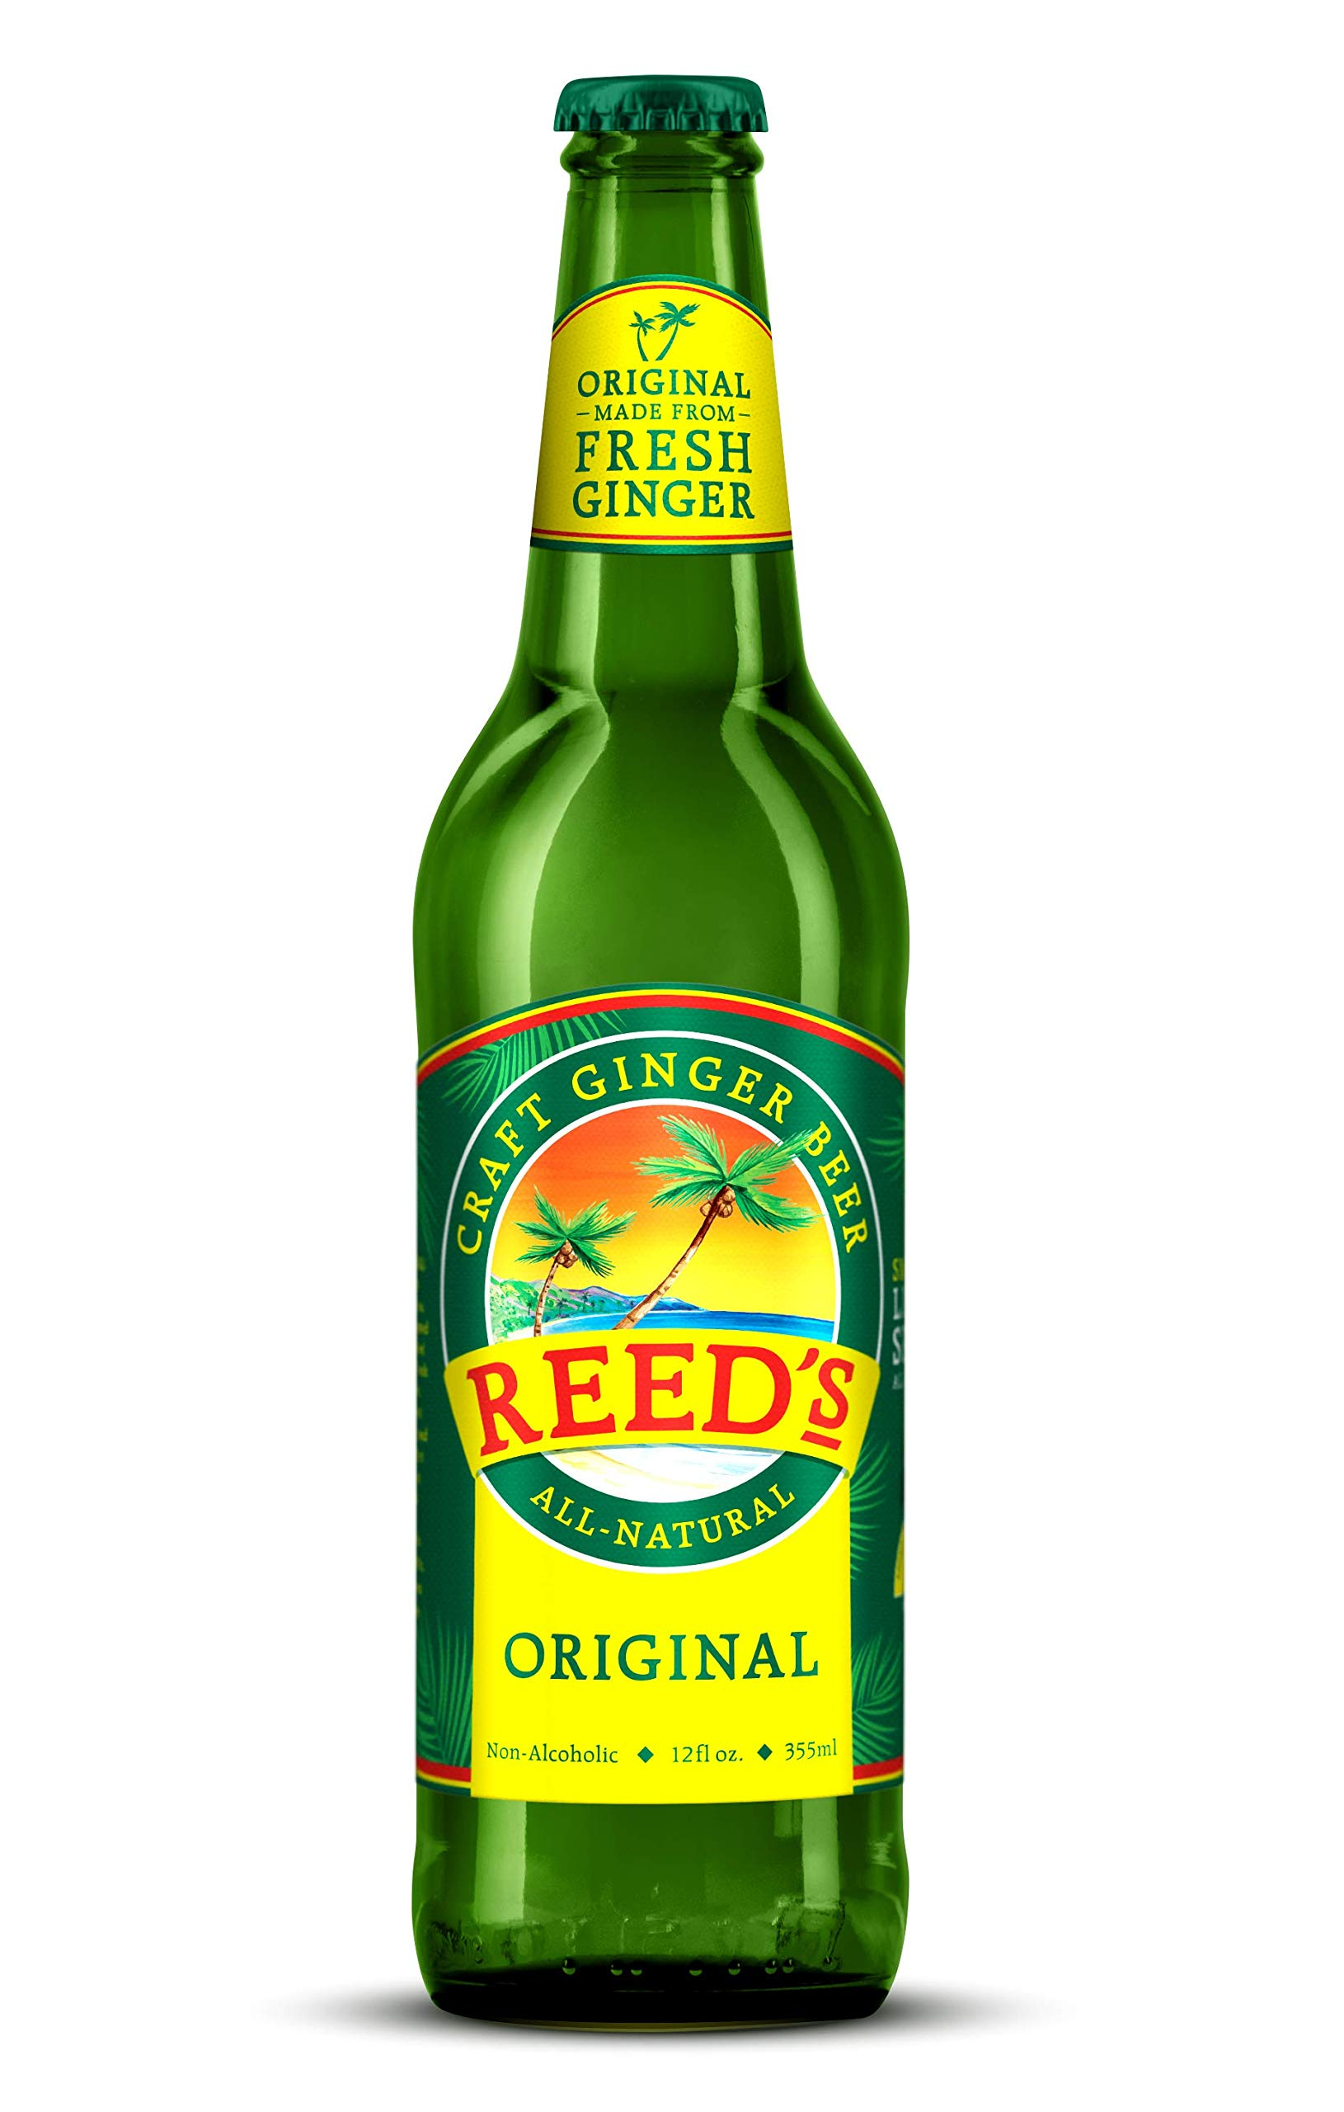

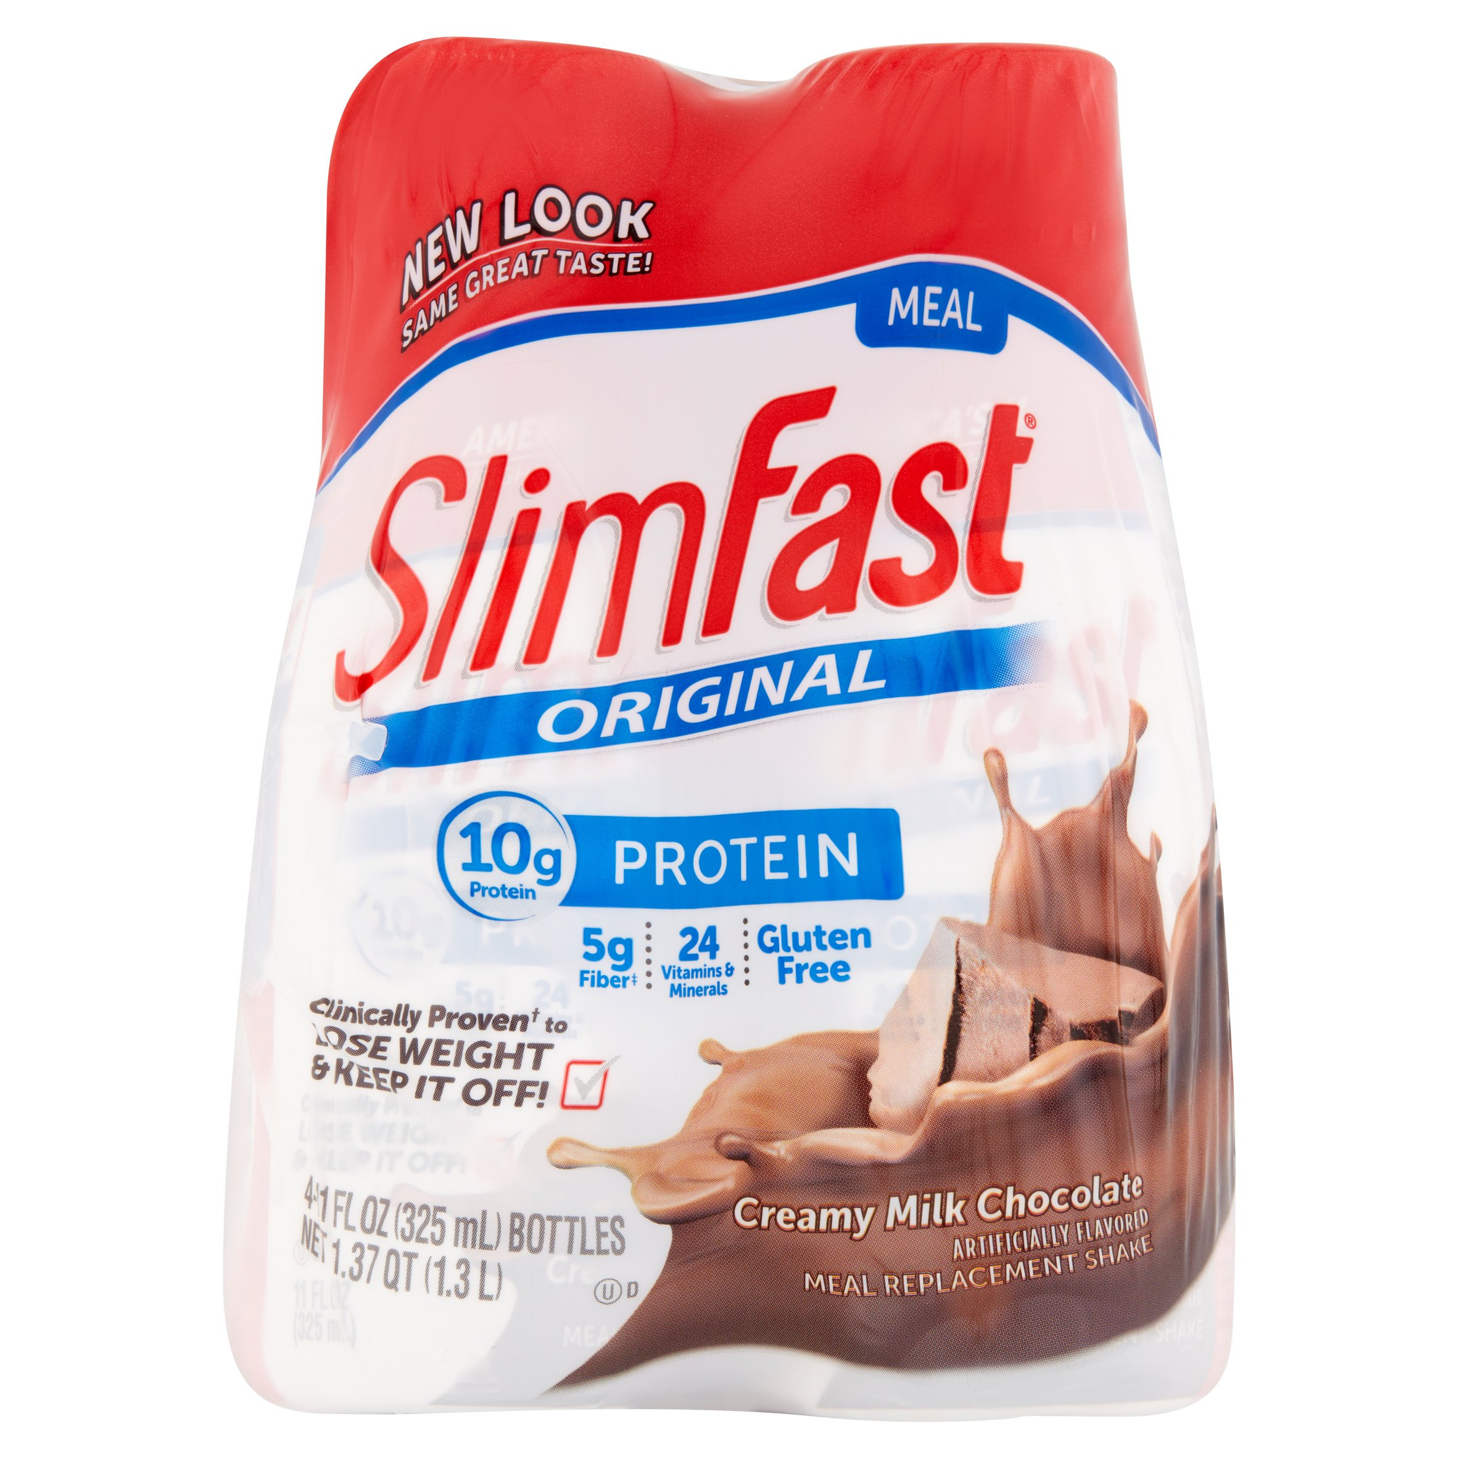
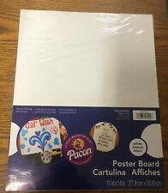
Plastics Classification
Heavy Plastic
Some Plastic
No Image
No Plastic

Slide 3

Data Wrangling
70% Training
20% Validation
10% Test
Some plastic
No plastic
No image
Heavy plastic
Some plastic
No plastic
No image
Heavy plastic
Some plastic
No plastic
No image
Heavy plastic

Slide 4
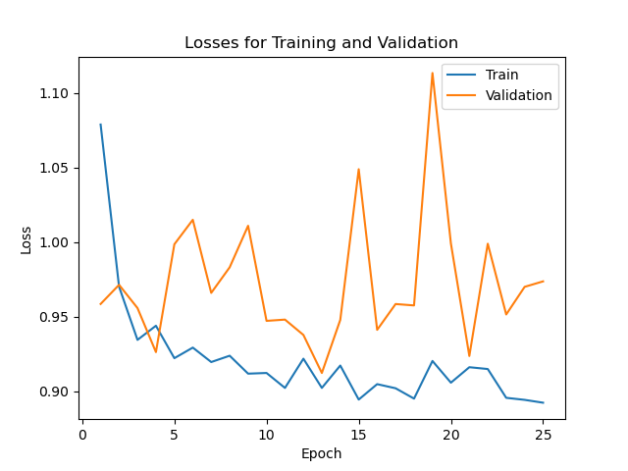
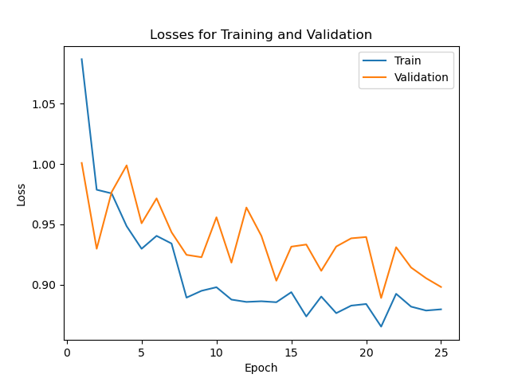
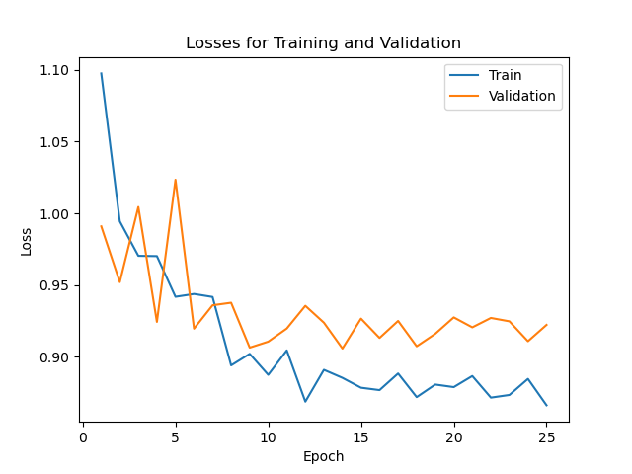
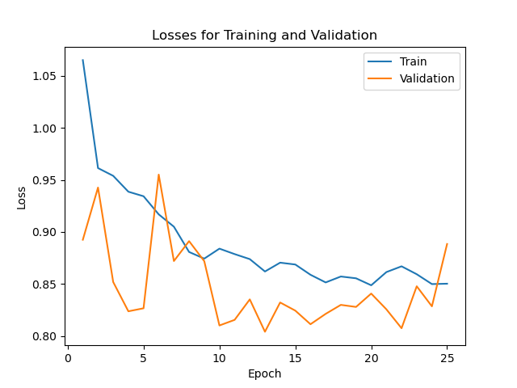
Losses
Densenet121
Resnet18
Resnet34
Resnet50

Slide 5
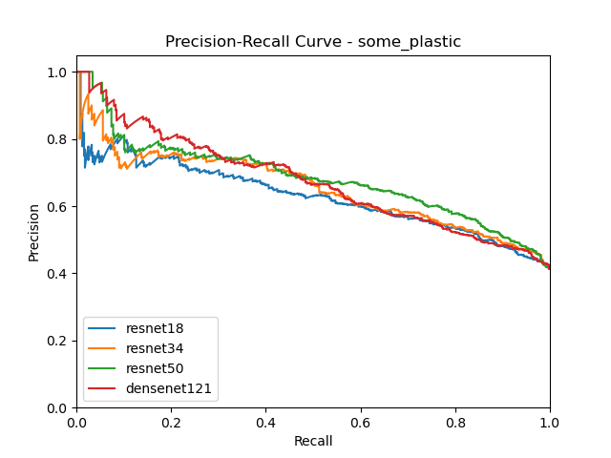
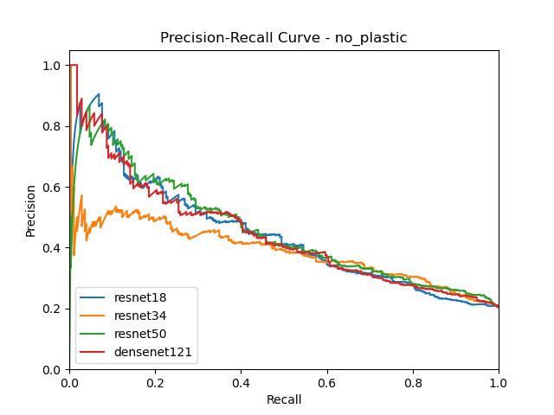
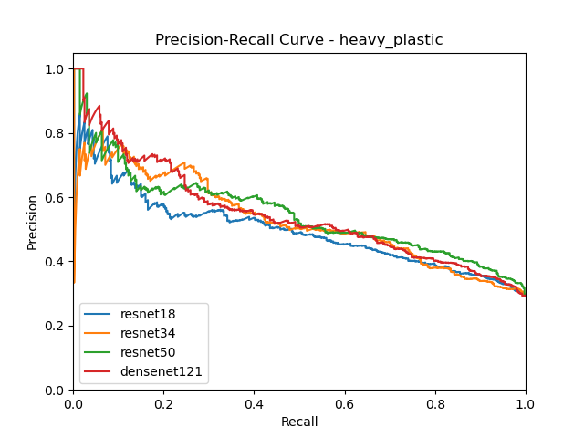
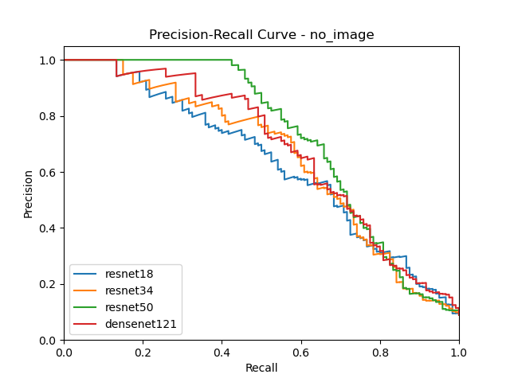
Precision + Recall PER Class

Slide 6
Test Performance
Best Model
Resnet50
Accuracy on Test Set
61.87 %
Training complete in 70m 6s

Slide 7
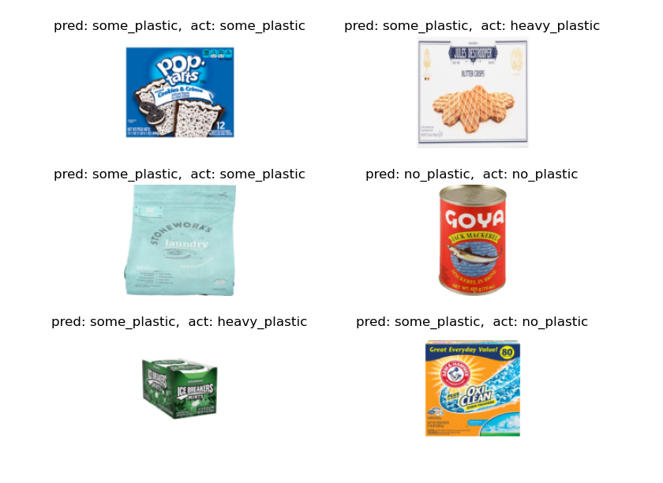
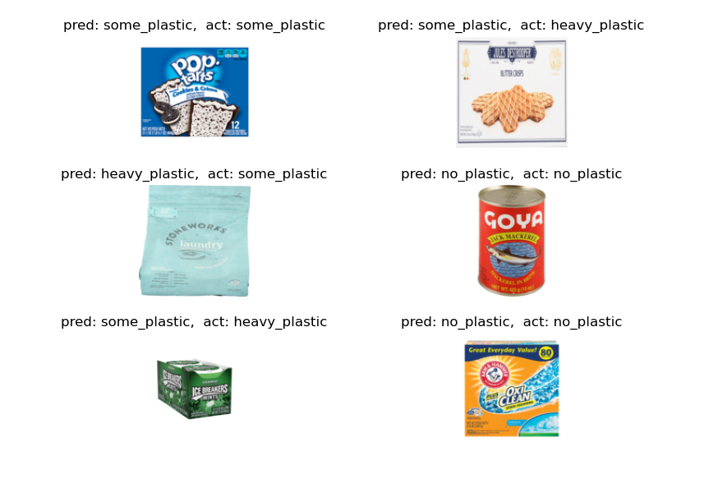
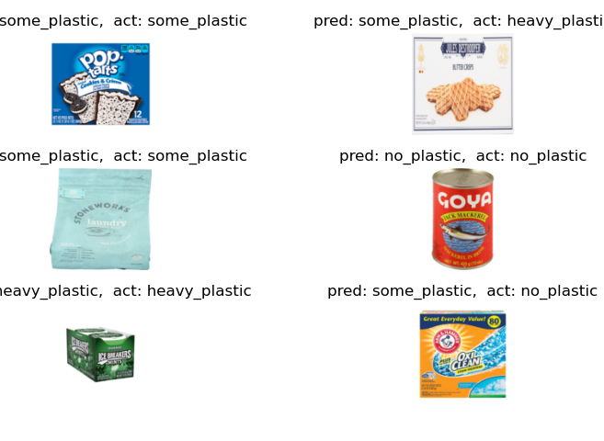

Visual Test Results
ResNet18
ResNet34
ResNet50
DenseNet121

