Slide 1
Community Forum
Team : Pegasus
Vinutha Muthyala
Santhosh Murarishetti
Sravan Kumar Appana
Vikesh Padarthi

Slide 2
ABSTRACT
The Community forum will help Users to post the questions and at the same time they can answer the other queries which were posted by other Users in the organization.
To answer any question or check the questions which were posted by them they need to login into the website.
Without login, they can check all the previously asked questions and check for particular question/answer with the help of search bar given.

Slide 3
Features :
Users can specify the question category while posting their question.
Users can search already existing questions and their answers with the help of search box provided.
Users can search by Author , category and Question content.
Users can check all the questions that are posted and answeres.

Slide 4
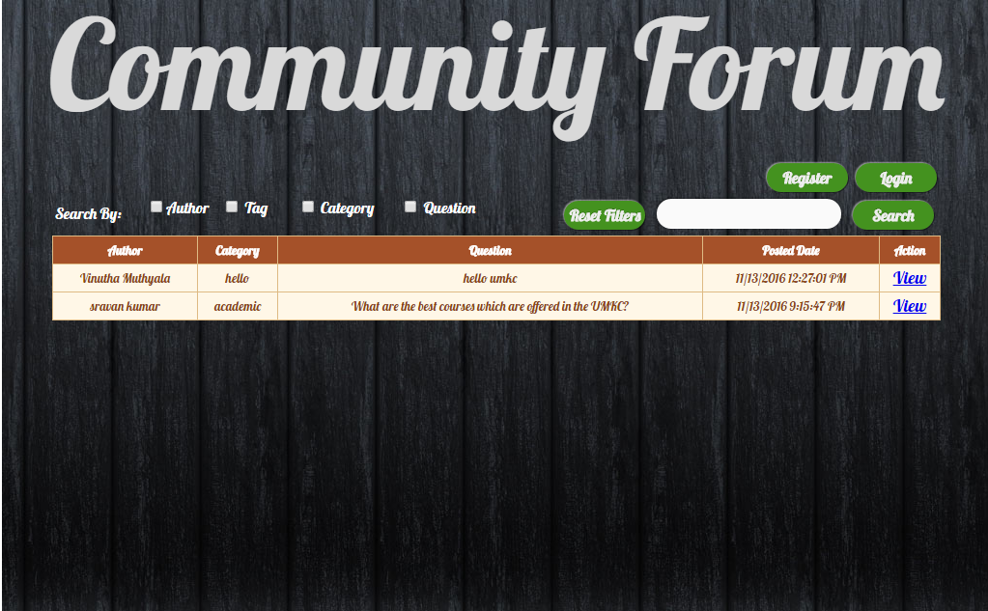
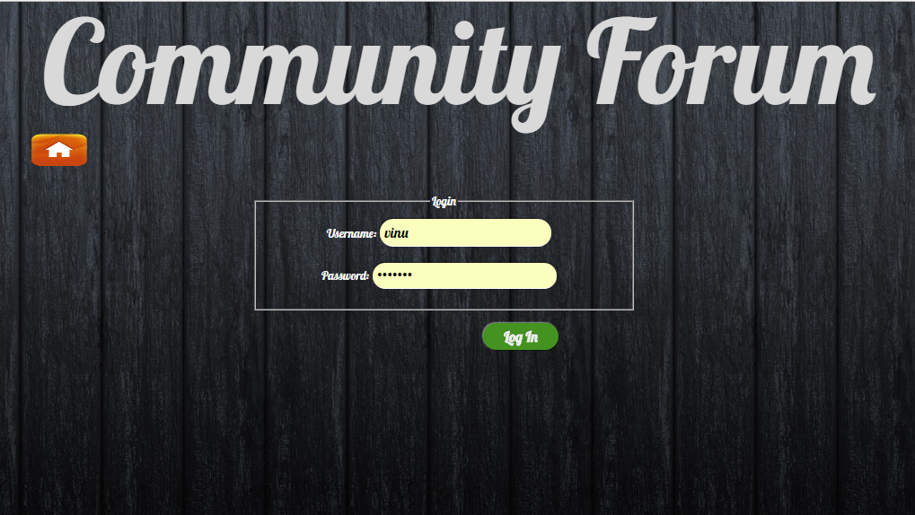
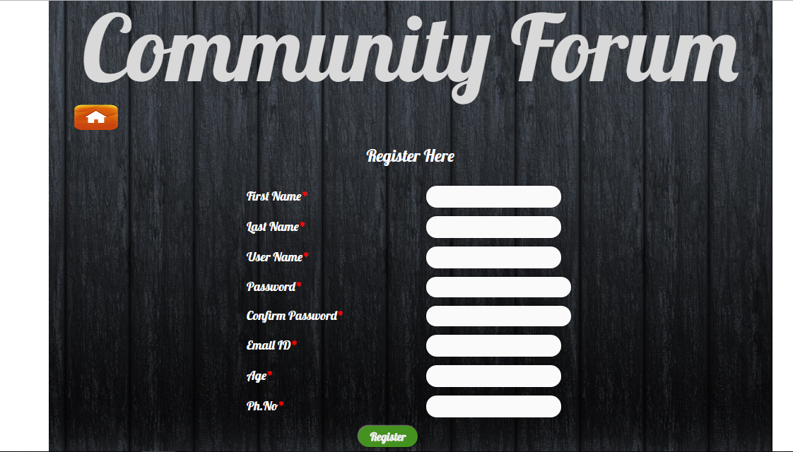
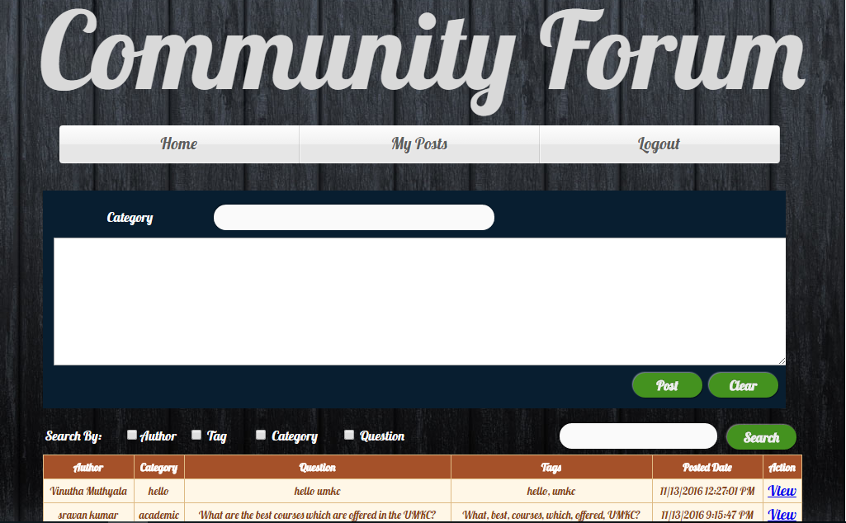
Preview :

Slide 5
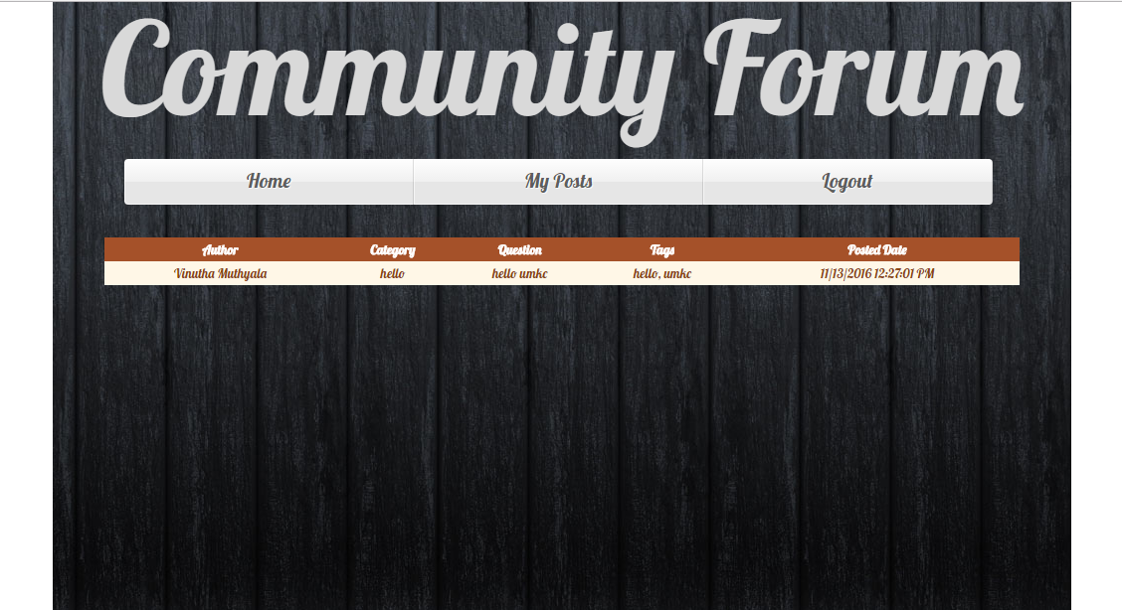
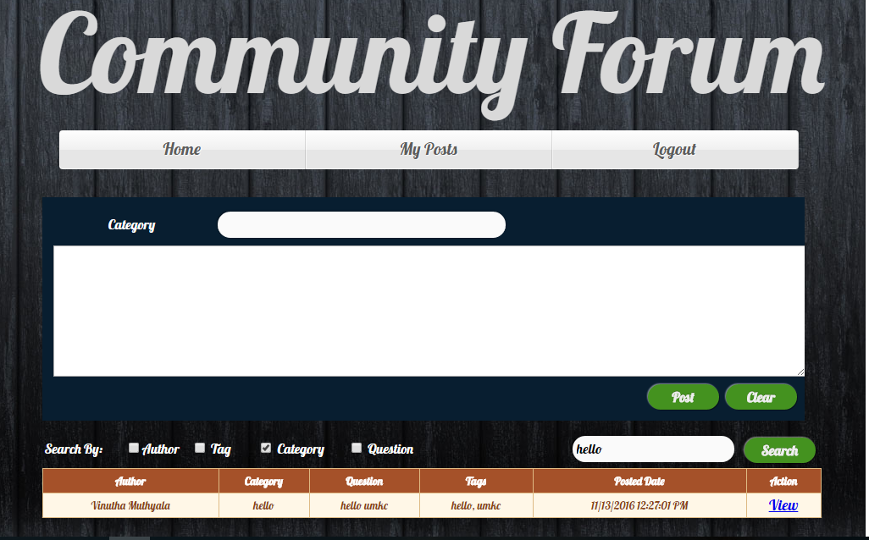
Thank You

