Slide 1
Digital Portfolio
STUDENT NAME: SHAMUTHRA.K
REGISTER NO AND NMID: 2428B0317/78ED0668EDD063BAA64F66A81DC40B0
DEPARTMENT: B.SC CSDA
COLLEGE: KPR COLLEGE OF ARTS AND SCIENCE AND RESEARCH

Slide 2
PROJECT TITLE SOFT SKILLS AND TEAMWORK STRENGHTS

Slide 3


AGENDA
Problem Statement
Project Overview
End Users
Tools and Technologies
Portfolio design and Layout
Features and Functionality
Results and Screenshots
Conclusion
Github Link
3/21/2024 Annual Review

Slide 4

PROBLEM STATEMENT
1. Problem Statement
In many professional and academic environments, technical expertise alone is not enough to ensure success. The lack of strong soft skills and effective teamwork can lead to poor communication, low morale, and project delays. This project aims to identify, analyze, and enhance soft skills and teamwork capabilities that contribute to a collaborative and productive working environment

Slide 5

PROJECT OVERVIEW
2. Project Overview
This project explores the importance of soft skills—such as communication, adaptability, problem-solving, and leadership—and their integration into effective teamwork. It includes self-assessment, peer feedback, and practical applications through group activities or projects. The goal is to develop a better understanding of how these skills contribute to team success.

Slide 6

WHO ARE THE END USERS?
STUdents and professionals aiming to improve their interpersonal and collaborative abilities
Teams looking to increase productivity and synergy
HR and management teams focused on team-building initiatives
Educators incorporating teamwork training in curricula

Slide 7

TOOLS AND TECHNIQUES
Collaboration Tools: Microsoft Teams, Slack, Zoom, Trello
Feedback Tools: Google Forms, Peer Review Templates
Assessment Frameworks: SWOT Analysis, Johari Window, MBTI or DISC personality tests
Presentation Tools: Canva, PowerPoint, Google Slides

Slide 8
POTFOLIO DESIGN AND LAYOUT
The portfolio is designed with the following sections:
Introduction to Soft Skills & Teamwork
Self-Assessment Reports
Team Project Case Studies
Peer Feedback Summaries
Reflection and Action Plan
Visuals (infographics, screenshots, charts)
8

Slide 9
FEATURES AND FUNCTIONALITY
Interactive Self-Assessments
Peer Feedback Collection & Analysis
Reflection Logs
Team Task Tracking and Role Assignment
Visual Representation of Growth
Case Study Highlights of Effective Collaboration

Slide 10
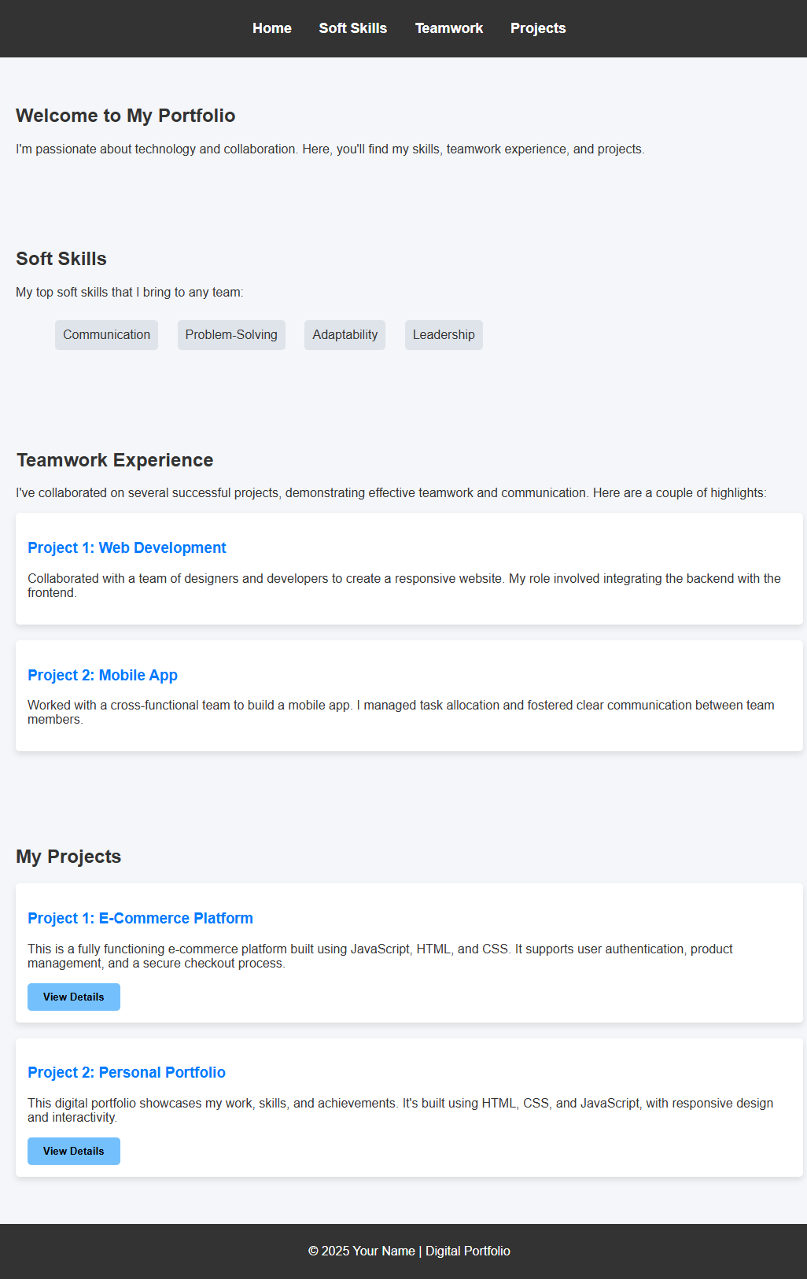

RESULTS AND SCREENSHOTS
3/21/2024 Annual Review
10

Slide 11
CONCLUSION
Developing strong soft skills and fostering teamwork is essential for personal and group success. This project highlighted that with the right tools, awareness, and practice, individuals and teams can significantly enhance their collaboration, communication, and overall performance. Continued learning and real-world application are key to long-term growth.
11

Slide 12
GITHUB LINK
https://kshamuthra-ctrl.github.io/shamuthra/

