Slide 1
Analytics-R’-Us Schema Integration and Justification Team Demand Prediction Analysis DSE 203 Presentation #5 12/8/2017
Team:
Josh Wilson
Amisha Bhanage
Ken Kroel
Mai Huynh

Slide 2
Agenda
Part I – Schema, Query Unfolding, Unit Testing
Part II – Demo
Part III – Reflections, Challenges

Slide 3
Assumptions and Constraints
Goal was to support five queries
ML queries for training and prediction
Three analytical queries
Adhering to datalog standards per
http://logic.stanford.edu/reports/LG-2012-01.pdf
https://pages.iai.uni-bonn.de/manthey_rainer/IIS_1718/manualDES4.1.pdf

Slide 4
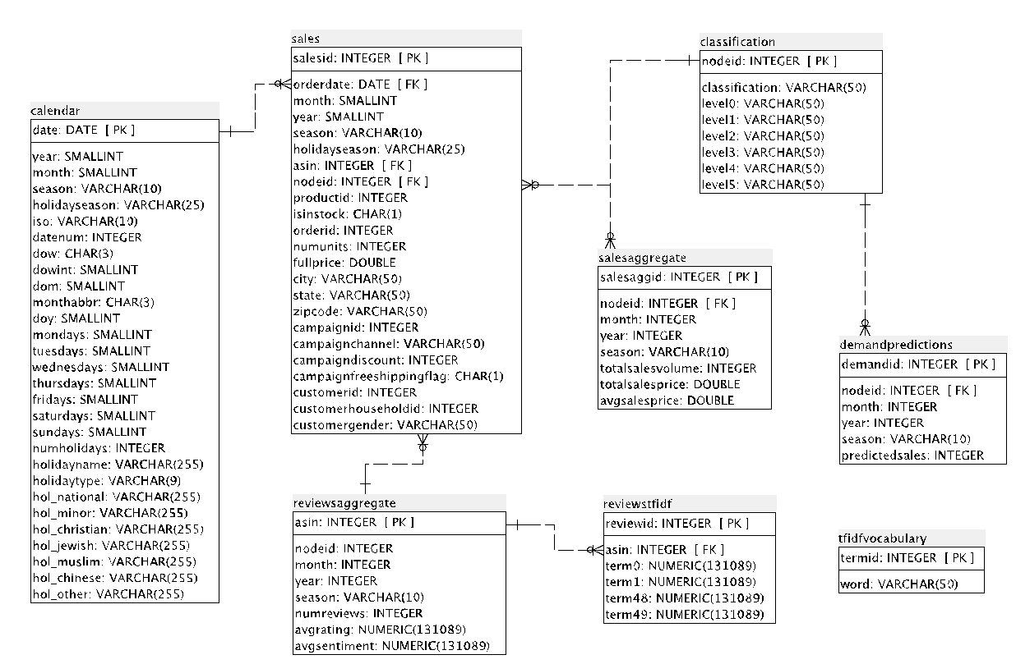
Presentation 4 Mediated Schema

Slide 5
Additional Schema Info
Source views used to support mediated schema
Sales
Reviewsaggregate
Salesaggregate
Mediated schema relations
mlfeatures
reviews_agg_yrmn
sales_agg_mn
sales_agg_yr
sales_agg_yrmn
classification
Optimization
Added FK and Indexes to source tables
Added materialized view mv_ml_features

Slide 7
Data Flow Diagram
ML
Schema
Query
Postgres (S1)
Asterix (S2)
Solr
(S3)
Ans(x,y,z,w):-
table(x,y,z,w),
conds
Ans(x,y,z,w):-
S1.table1(x,y),
S2.table2(z),
S3.table3(w),
conds
Validate
Unfold
Optimize
Query sources
Query table1(x,y)
table1(x,y)
Query table2(z)
table2(z)
Query table3(w)
table3(w)
Ans(x,y,z,w)
Combine results

Slide 8
Query Unfolding Process
Receive Datalog Query
Step 1: Validate Query
Step 2: Reformulate Query
Step 3: Optimize Query
Return Unfolded Datalog Query
Mediator supports unfolding of group_by, order_by, top, and multi-step queries

Slide 9
Query Unfolding Process (cont.) Step 1: Validate Query
Correct number of atoms in mediated schema relations
Ans (nodeid, sales, vol) :- sales_agg_mn (nodeid, mn, sales, vol, _, _, rank_vol, EXTRA), mn=12, rank_vol<=3
Head attributes must appear in datalog body
Ans (nodeid, sales, vol, EXTRA) :- sales_agg_mn (nodeid, mn, sales, vol, _, _, rank_vol), mn=12, rank_vol<=3
Condition attributes must appear in datalog body
Ans (nodeid, sales, vol) :- sales_agg_mn (nodeid, mn, sales, vol, _, _, _ ), mn=12, rank_vol<=3

Slide 10
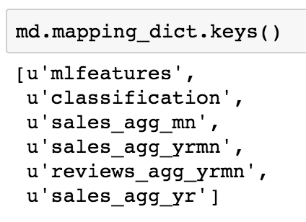
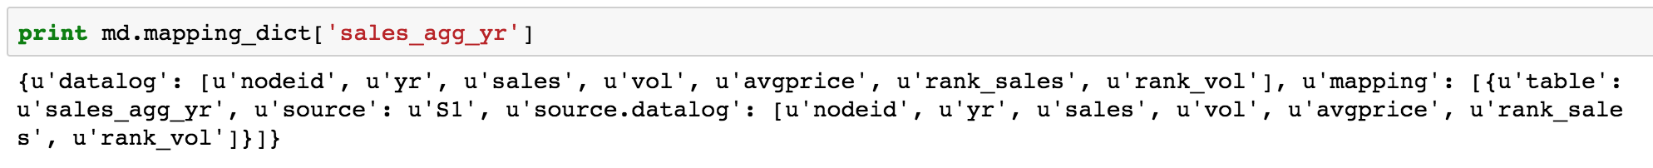
Query Unfolding Process (cont.) Step 2: Reformulate Query
Uses mapping dictionary
Dictionary keys are mediated schema relations
For each key (relation)
“datalog” = list of datalog atoms
“mapping” = list of {source, relation, [atoms]} to which each “datalog” unfolds
Unfolding process remaps from atoms in “datalog” to atoms in “mapping”
Notes:
Speaker notes:
- mlfeatures maps to two sources – has two {source, relation, [atoms]} elements
- Mapping dictionary was developed jointly with query team

Slide 11
Query Unfolding Process (cont.) Step 3: Optimize Query
Eliminates unnecessary relations after unfolding
Unnecessary relations have no atoms that do not appear in other relations
Example: Unfolding query for ML features with no sentiment info
Ans (nodeId, yr, mn, sales, vol, pm_sales, pm_vol, p3m_sales, p3m_vol, p12m_sales, p12m_vol, pm_numreviews, pm_avgrating, p3m_numreviews, p3m_avgrating, p12m_numreviews, p12m_avgrating) :- mlfeatures (nodeId, yr, mn, sales, vol, pm_sales, pm_vol, p3m_sales, p3m_vol, p12m_sales, p12m_vol, pm_numreviews, pm_avgrating, p3m_numreviews, p3m_avgrating, p12m_numreviews, p12m_avgrating, _, _, _ )
Naive mapping unfolds to both S1 and S2 sources, per mapping dictionary:
Optimizer removes unnecessary S2.mlview relation because S1 source is sufficient:
Sentiment features from second source

Slide 12
Query Unfolding Process (cont.) Handling Group_by, Order_by, Top
Subgoals within group_by, order_by, top are extracted and unfolded in previous (added) step(s): 1. Input datalog:
Ans(a1,a2,total_a3) :- group_by(M.R(a1,a2,a3),[a1,a2], total_a3=sum(a3))
2. Datalog with subgoal extracted:
Unfold_subgoal(a1,a2,a3) :- M.R(a1,a2,a3). Ans(a1,a2,total_a3) :- group_by(Unfold_subgoal (a1,a2,a3),[a1,a2], total_a3=sum(a3)) * subgoal replaced with head of newly added step
3. Output datalog:
Unfold_subgoal(a1,a2,a3) :- S1.T1(a1, a2), S1.T2(a2, a3). Ans(a1,a2,total_a3) :- group_by(Unfold_subgoal (a1,a2,a3),[a1,a2], total_a3=sum(a3))
Benefits
Never have to unfold and optimize subgoals within group_by, order_by, top
Simplification of translation to source data query language
Notes:
Speaker notes:
Not needed for our five datalog queries
Would enable processing of more complex queries

Slide 13
Query Unfolding Walkthrough Query 1 – ML Training
Obtain all features needed for ML team to train prediction model
Datalog input:
Ans ( nodeid, yr, mn, sales, vol, pm_sales, pm_vol, p3m_sales, p3m_vol, p12m_sales, p12m_vol, pm_numreviews, pm_avgrating, p3m_numreviews, p3m_avgrating, p12m_numreviews, p12m_avgrating, pm_avgsntp, p3m_avgsntp, p12m_avgsntp ) :- mlfeatures ( nodeid, yr, mn, sales, vol, pm_sales, pm_vol, p3m_sales, p3m_vol, p12m_sales, p12m_vol, pm_numreviews, pm_avgrating, p3m_numreviews, p3m_avgrating, p12m_numreviews, p12m_avgrating, pm_avgsntp, p3m_avgsntp, p12m_avgsntp ), nodeid in (15, 45, 121)
Datalog output:
Ans(nodeid,yr,mn,sales,vol,pm_sales,pm_vol,p3m_sales,p3m_vol,p12m_sales,p12m_vol,pm_numreviews,pm_avgrating,p3m_numreviews,p3m_avgrating,p12m_numreviews,p12m_avgrating,pm_avgsntp,p3m_avgsntp,p12m_avgsntp):-S1.mv_ml_features(nodeid,yr,mn,sales,vol,pm_sales,pm_vol,p3m_sales,p3m_vol,p12m_sales,p12m_vol,pm_numreviews,pm_avgrating,p3m_numreviews,p3m_avgrating,p12m_numreviews,p12m_avgrating), S2.mlview(nodeid,yr,mn,pm_avgsntp,p3m_avgsntp,p12m_avgsntp), nodeid in (15,45,121)

Slide 14
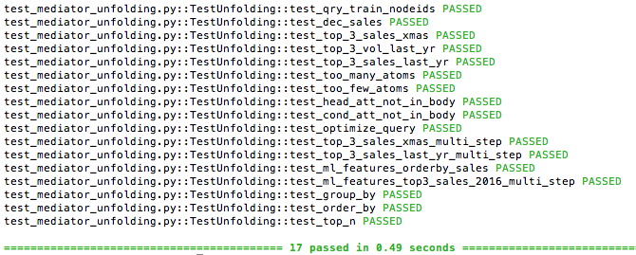
Unit Testing
Five agreed upon queries
Validation and optimization
Group_by, order_by, top, and multi-step queries

Slide 15
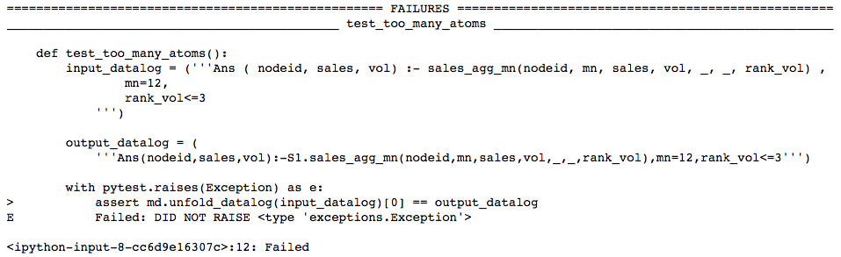
Unit Testing Example of Failing Test

Slide 16
Demo

Slide 17
Schema Team Collaboration
Services provided by Schema team
Design mediated schema and create mediated schema views in PostgreSQL Developed mediator to validate, unfold, and optimize datalog queries Actively support ML team and Query team on any change request to the mediated schema
Team | Interaction highlights
TAs | Seek for technical guidance and clarifications
Data exploration | Understand the source data at start Seek for expertise of data exploration on the classification level Confirm the mediated schema accuracy compared to the source data
Query | Collaborated to define mapping dictionary Collaboratively agreed upon set of standards for datalog syntax Co-developed common datalog parsing library Worked together to modify initial schema design to meet final requirements
Machine learning | Understand ML user-scenario and implementation requirements Worked together to modify initial schema design to meet final requirements Coordinate the weekly face-to-face meeting

Slide 18
Challenges
Overlapping and interdependent team roles and responsibilities
Communication
Different interpretations of requirements
Game of “telephone” effect
Configuration management
Local files, team GitHub, multi-team GitHub, team share drive,class share drive, files on Trello, emailed files
Solutions
Establishing communication protocols between teams
POCs emerged for separate duties

Slide 19
In the end...ta da...we make it

Slide 20
Q & A
Thank you!

