Slide 1
Engine
Car
Third
Class
Dining
Car
Second Class
Bathroom
First Class
First Class: 10 passengers per car
Second Class: 24 passengers per car
Third Class: 50 passengers per car
Minimize the number of class intermixing
Maximize profit
Fitness: profit = ticket prices+cost of engines-discount
Percent happy customers = max(100,percent happy*100+minutes_early)

Slide 2
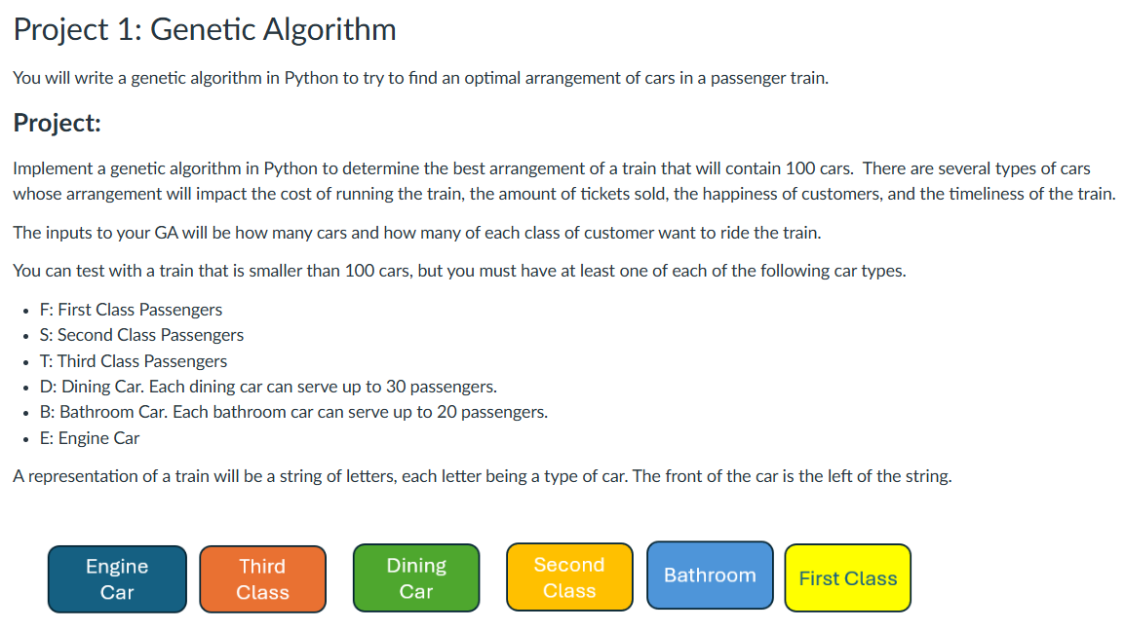

Slide 3
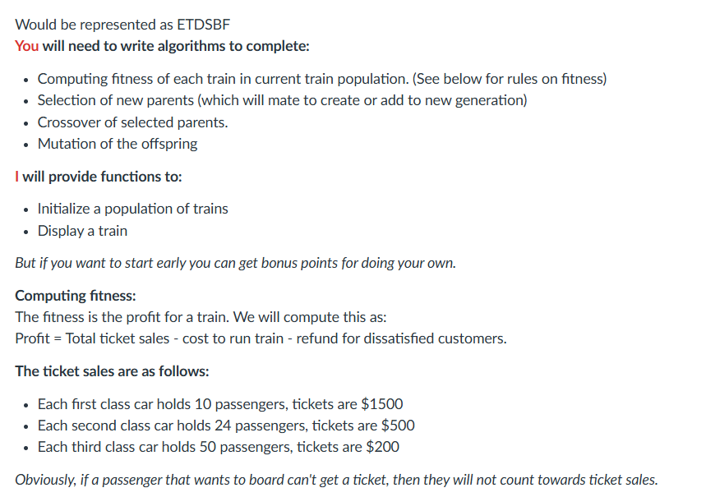

Slide 4
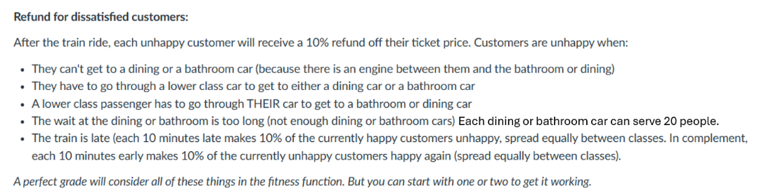
Each dining or bathroom car can serve 20 people.

