Slide 1
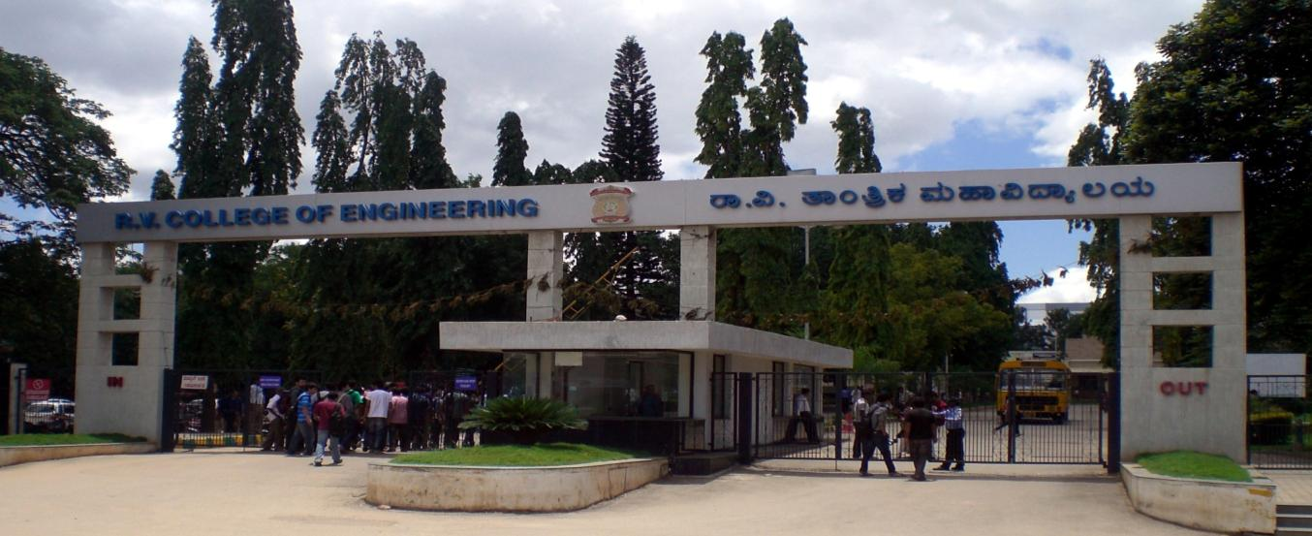
6th Sem Self Study Phase - 2 Evaluation
Predicting Travel Time with Machine Learning using TensorFlow
Dundigalla Ravi 1RV16CS046
I. Rohit Satya 1RV16CS059
K. Sharath Krishna 1RV16CS067
Department of Computer Science & Engineering
R V College of Engineering, Bangalore

Slide 2
Presentation Outline
Review of Problem
Use of Rapid Development Tools
Complexity of Implementation
Experimental Analysis and Presentation of Result
Demonstration
Conclusion and Future work
References (Recent IEEE/Springer/ACM/Elsevier papers to be referred)

Slide 3
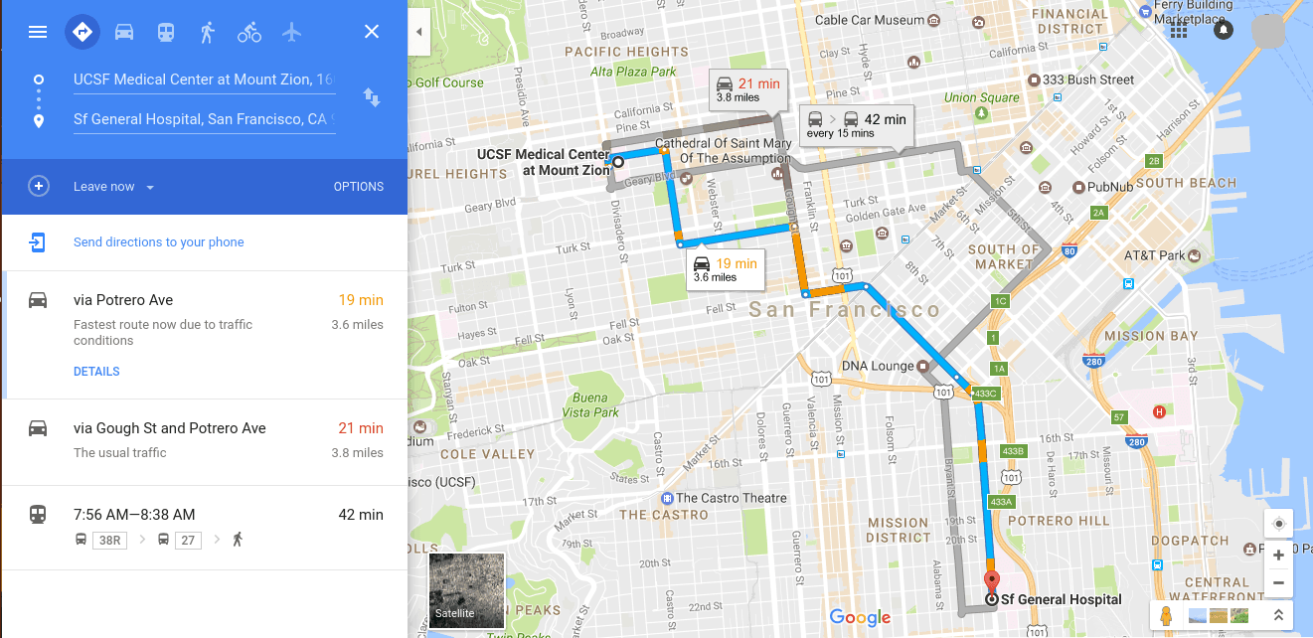
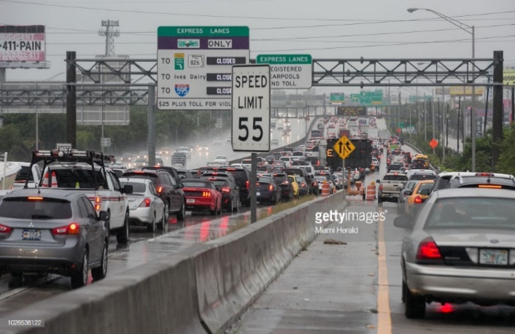
Review of Problem
Design Problem Statement –
The prediction of travel time by trip makers constitutes an important component of the complex daily dynamics of commuter behaviour. Within a region, the travel time between two points depends on many dynamic factors along with the demographics such as time of the day, weather conditions, day of the week and accident occurrence rate.
We plan on solving the given problem statement using the k-NN routines of Tensorflow. The result is to be displayed on static webpages.

Slide 4
Use of Rapid Development Tools
Techniques Used: k-NN Algorithms
Tools:
- Anaconda Navigator
- Sublime Text Editor
- HTML, CSS, JavaScript, Bootstrap (Web Development tools)
- PyCharm IDE
Skills:
TensorFlow API is an open-source software library for dataflow and differentiable programming across a range of tasks. It is also used for machine learning applications such as neural networks.
Flask Web Framework to create static yet responsive webpages

Slide 5
Complexity of Implementation
Complexity lies in obtaining an appropriate data set to model the problem and analysing all the dynamic factors which affect the travel time from and to various locations.
Providing data and analytics over accidents in the given routes, helping the commuters to choose a safer path.
We achieve this using the k-NN routines of Tensorflow.
In pattern recognition, the k-nearest neighbour algorithm (k-NN) is a non-parametric method used for classification and regression.
Another complexity in the implementation lies in representing the obtained data and communicating it to webpages over servers.

Slide 6
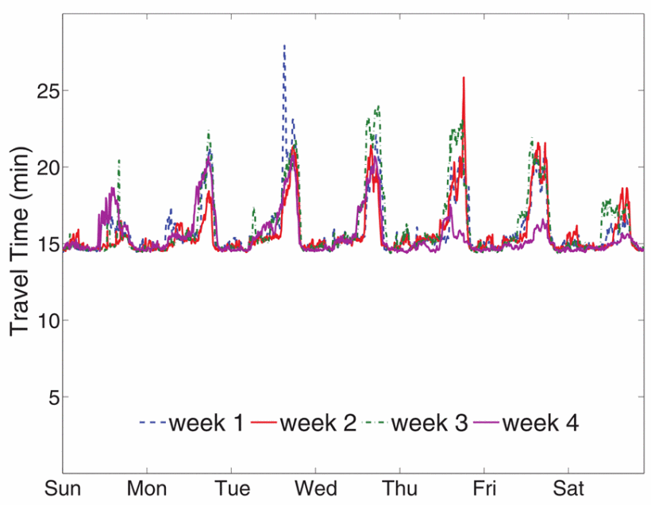
Experimental Analysis
The predicted travel time for paths between given three locations stays in accordance with the data sets provided.
We observed the effects of the change in various factors affecting travel time.
As the conditions get worse (due to change in factors), travel time tends to increase.

Slide 7
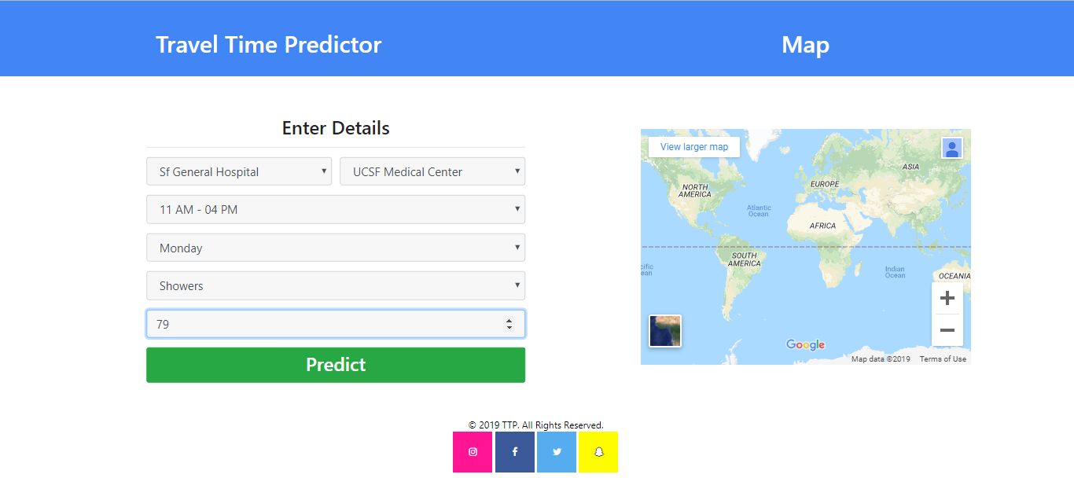
Demonstration
Screenshot showing submitted values in the webpage

Slide 8
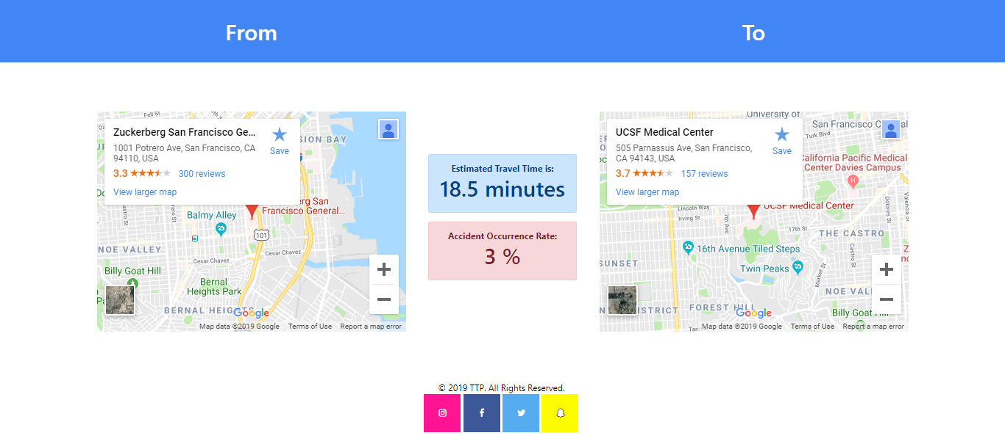
Demonstration
Screenshot showing predicted travel time in the webpage

Slide 9
Conclusion and Future Work
Created static webpages that show predicted time travel between two points in a city.
Main challenge was to collect data set relating to the problem and the chosen factors.
Obtain appropriate data set or change the factors that are involved in the computation of the travel time to match the available data sets.
To make the given system scalable and deployable to practical wider regions and possibly different modes of transportation.

Slide 10
References
[1] “Freeway Performance Measurement System (PeMS)” http://pems.eecs.berkeley.edu.
[2] X. Zhang and J. Rice, ”Short-Term Travel Time Prediction,” Transportation Research Part C, Vol. 11, 2003, pp. 187-210.
[3] J. M. Kwon and K. Petty, ”A Travel Time Prediction Algorithm Scalable to Freeway Networks With Many Nodes with Arbitrary Travel Routes,” Trasportation Research Record,” 2005.
[4] J. M. Kwon and P. Varaiya, ”Components of Congestion: Delay from Incidents, Special Events, Lane Closures, Weather, Potential Ramp Metering Gain, and Excess Demand”, Transportation Research Record, 2006.
[5] Malik Tubaishat, Qi Qi, Yi Shang, Hongchi Shi “Wireless Sensor-Based Traffic Light Control”
[6] https://www.tensorflow.org/get_started/get_started

Slide 11
Thank You

