Slide 1
SCMS Subsidized Canteen Management System

Slide 2
Introduction
Dual Admin provision
Three tier system
Token Generation for Breakfast,Lunch and Dinner
Bill and Reciept Generation
Provision for Customer Feedback and Ratings
Our objective is to deliver a robust and user-friendly software solution to the stakeholders.

Slide 3
Targets
CUSTOMER MANAGEMENT
Ease of creation,deletion and display of Customer details. Provision to validate and verify customer details. Customer can also place food orders.
TOKEN GENERATION
For Customers that possess valid credentials. Displayed along with timestamp
VENDOR AND WORKER MANAGEMENT
Separate segments for the login of vendor and worker. Post authentication Vendor can supply items to the inventory.
FEEDBACK MANAGEMENT
The collected food and service feedback is sorted by value. The values are analysed by plotting graphs

Slide 4



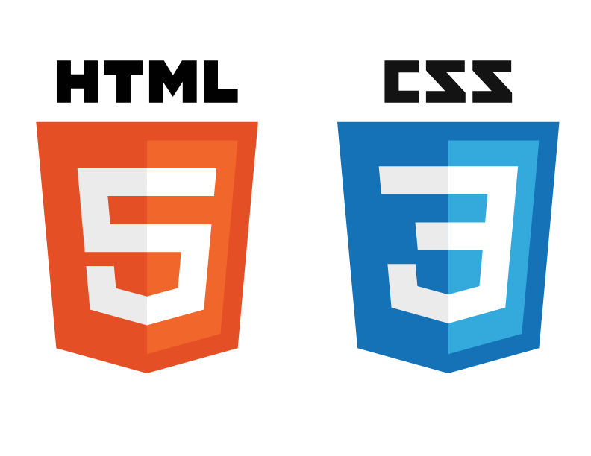


SOFTWARE REQUIREMENTS
4
4

Slide 5



HARDWARE REQUIREMENTS
4 GB RAM
300 MB Hard Disk Space
1024 × 768
Resolution
5
5

Slide 6
Our process is easy
Requirement Analysis
Development
Validation

Slide 7
Timeline Specification
 | Phase 0 | Phase 1 | Phase 2
Requirement Analysis | 6 | 7 | 5
Developement | 10 | 15 | 12
Validation | 4 | 6 | 7

Slide 8
UML DIAGRAMS
8
8

Slide 9
01
Use Case Diagrams
02
Class Diagram
03
Sequence Diagram
04
Text Title
Place your own text here

Slide 10
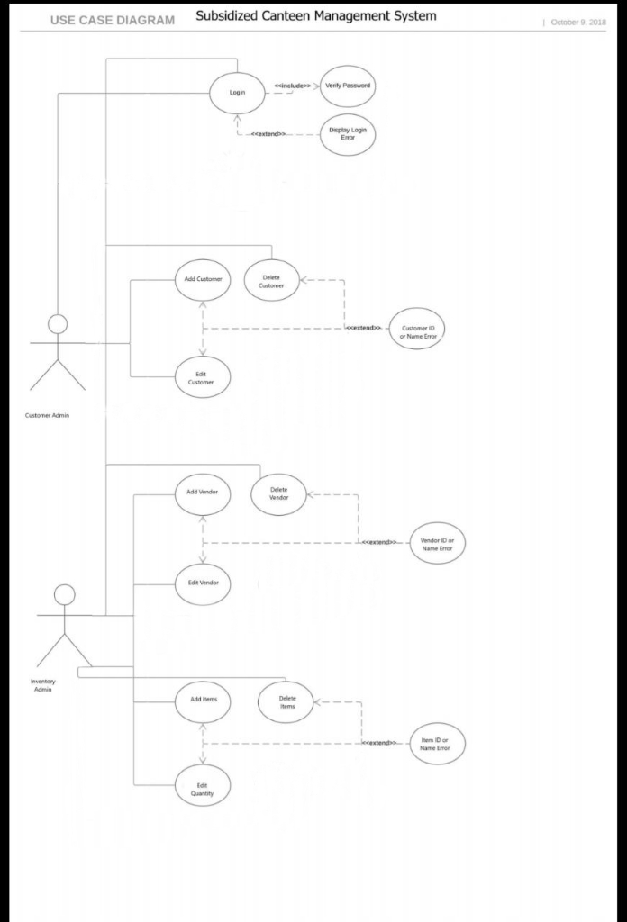
USE CASE DIAGRAMS

Slide 11
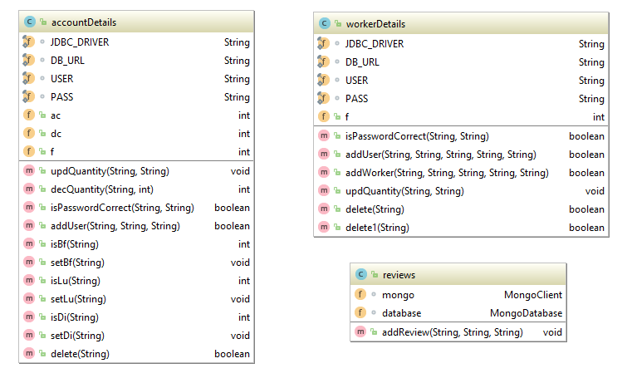
CLASS DIAGRAM

Slide 12
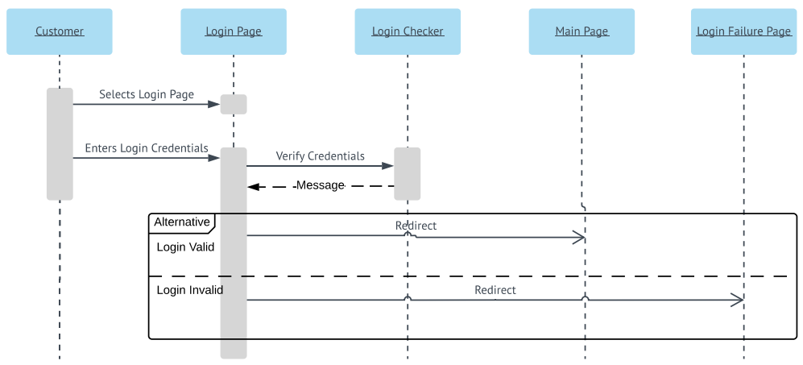
SEQUENCE DIAGRAM (LOGIN)

Slide 13
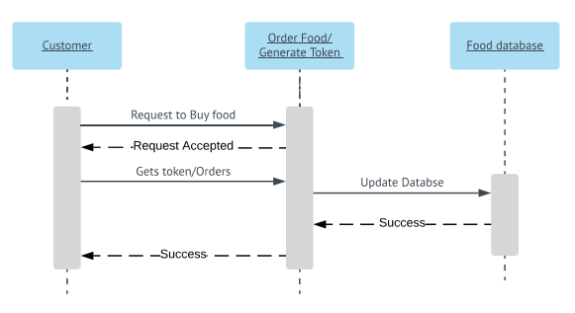
SEQUENCE DIAGRAM (ORDER)

Slide 14
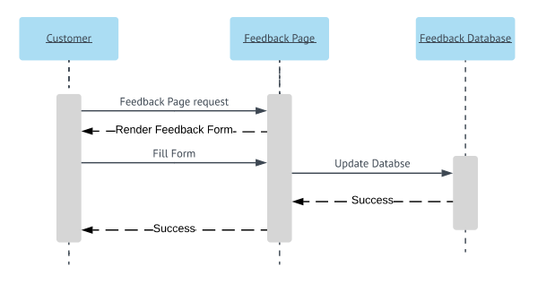
SEQUENCE DIAGRAM(FEEDBACK)

Slide 15
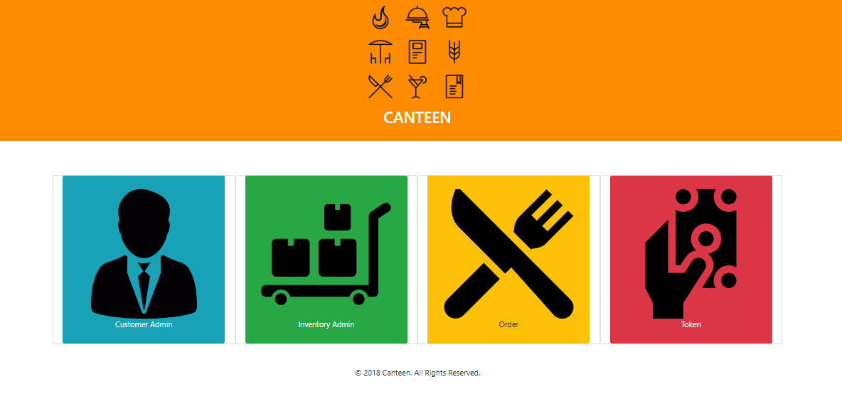
Results

Slide 16
Conclusion
REQUIREMENTS
All the requirements from the user end were analysed
DESIGN
A structured design architecture was built to effectively develop modules for the requirements
SCOPE
Can be extended by adding addition features such as in-app messaging and can be integrated with bigger system as a module for addition functionality
IMPLEMENTATION
Developed robust software implementation of system on Java using modern infrastructure
TESTING
Thoroughly tested system for a variety of test cases and dirty inputs

Slide 17
THANK YOU

