Slide 1
ShopEasy – Shopping Management System
- Harish Sivaprakash

Slide 2
Key Functionalities
1. Shopping cart for customers grouped by category and seller
2. Each shopping item will have image, description, name, stock quantity and price
3. Sign Up/ Sign In for customers
• Sign Up (Name, Email, Username, Password, Card Number(Optional))
• Sign In (Username, Password)
• Forget Password feature
• Password to be sent to the User Email Address, Password Recovery
• Password Show / Hide feature
• Username Validation (Check if username already exists in the DB, should be unique)

Slide 3
4. Product Information
5. Adding to Cart feature with quantity input from customer
6. Validation for Quantity input (display message if quantity input > stock quantity)
7. Cart View should have a table with these columns
• Product Name
• Model
• Price
• Quantity
Total Bill in the cart and a Buy feature.
8. Search feature for the customers to search for products
9. On Buy from Cart View, Enter delivery address modal window
10. Account Information of a user
11. Sign Out Feature
The application will be based on Spring MVC architecture and Hibernate.

Slide 4
Front End: React JS based Views for the store.
Middle Tier: Spring MVC Java Controller using annotations and Hibernate , Relational Mappings, Interceptors for logging purposes, Email confirmation for user
Data Tier: Relational Database – MSSQL

Slide 5
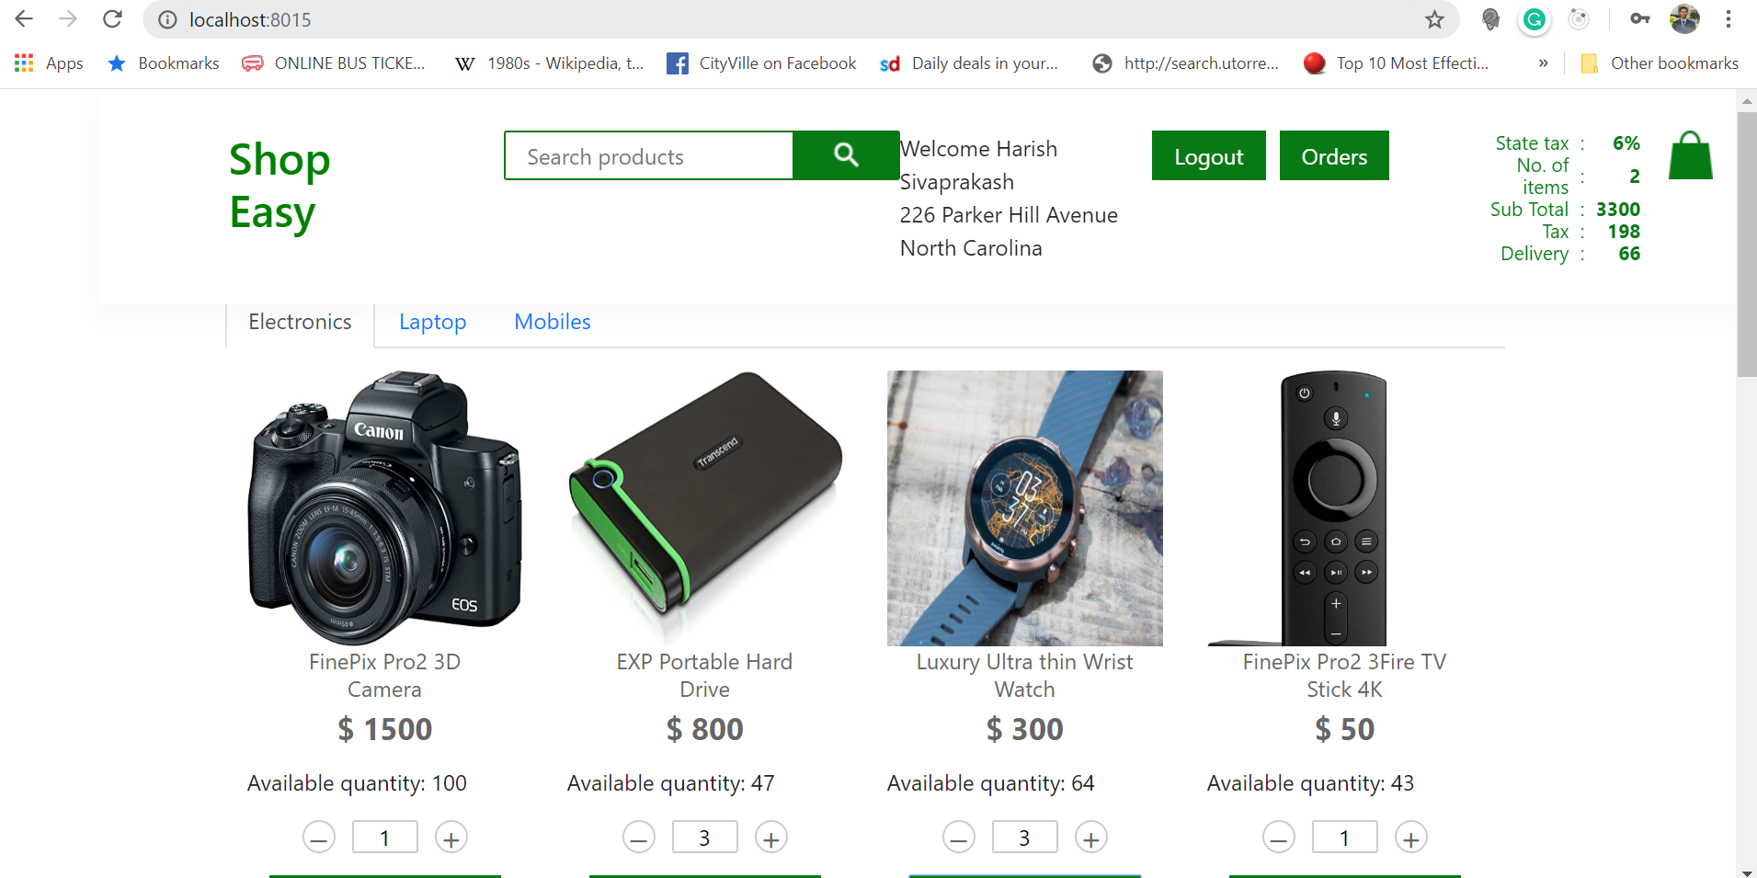

Slide 6
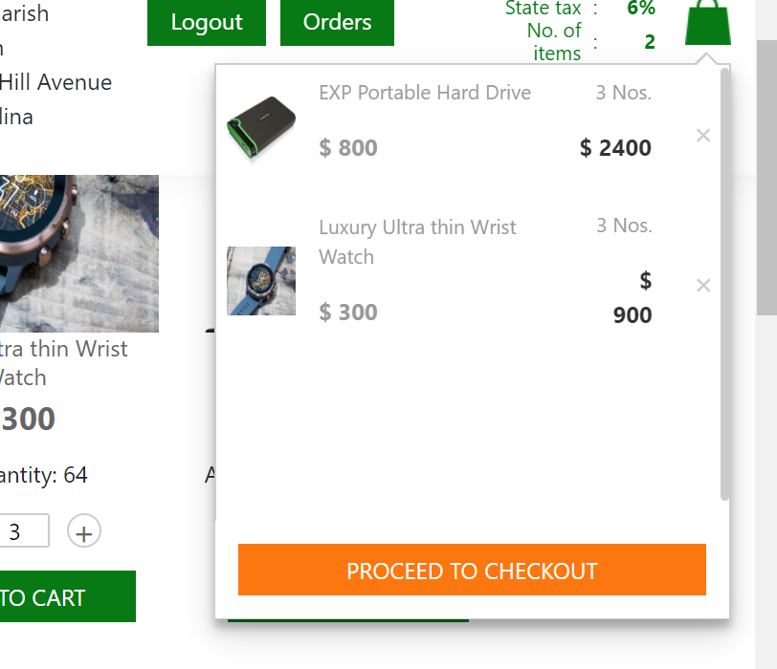

Slide 7
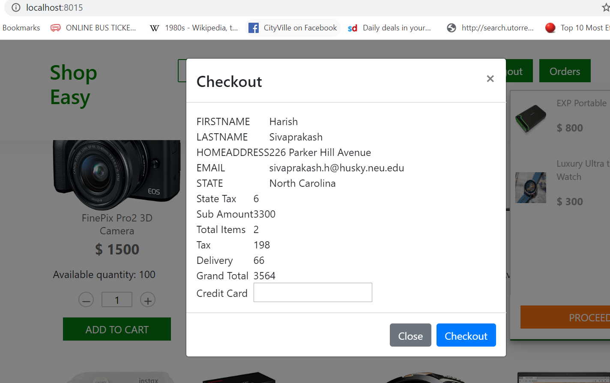

Slide 8
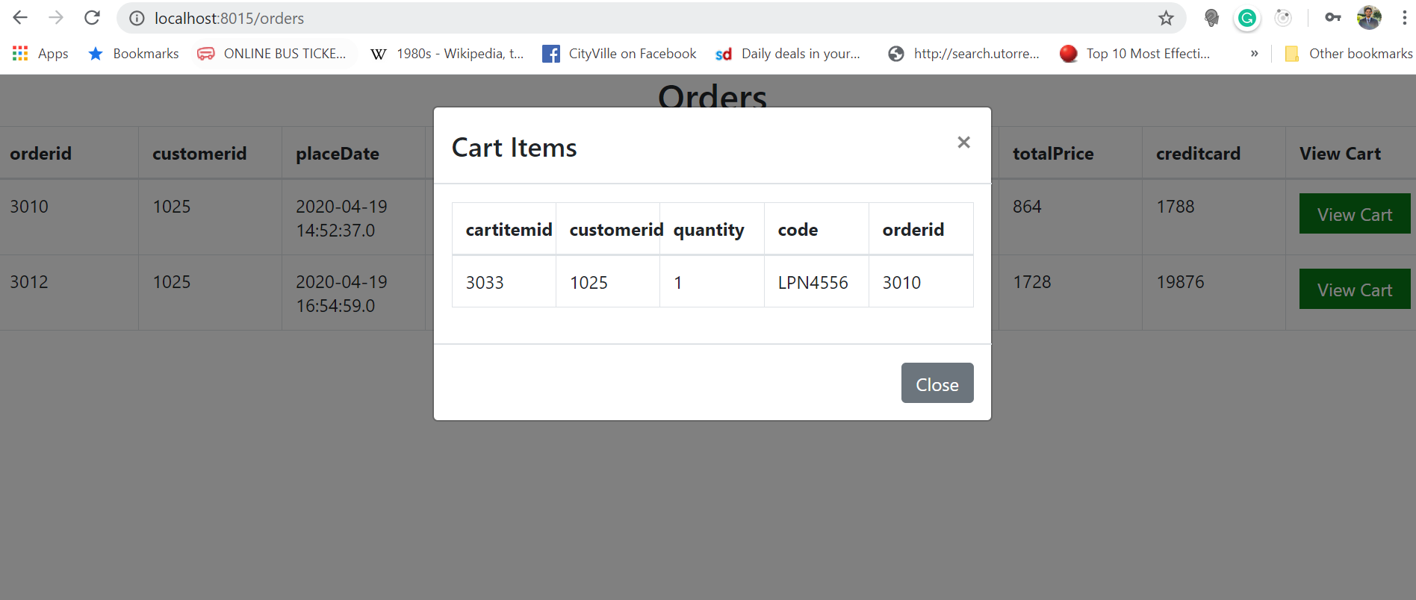

Slide 9
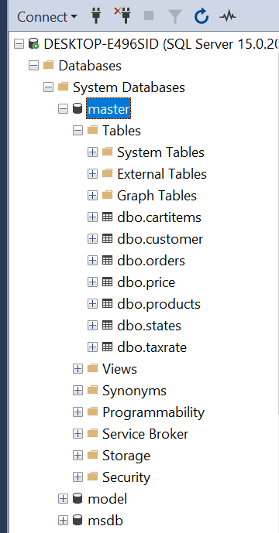
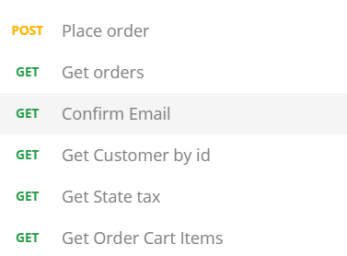
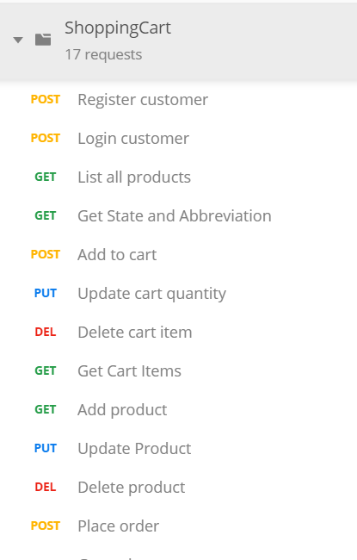
Backend APIs/Database

Slide 10
Controller
package shoppingcart.controller;
@CrossOrigin(origins = "*", allowedHeaders = "*")
@RestController
@RequestMapping(value = "/cart")
public class CartController {
@Autowired
CartService cartService;
@RequestMapping(value = "/add/{customerid}", method = RequestMethod.POST)
public String addCart(@PathVariable int customerid, @RequestBody CartItem cartitem) {
return cartService.addToCart(customerid, cartitem);
}

Slide 11
@RequestMapping(value = "/getCartItems/{customerid}", method = RequestMethod.GET)
public List<CartItem> getCartItems(@PathVariable int customerid) {
return cartService.getCartItems(customerid);
}
@RequestMapping(value = "/update/{customerid}", method = RequestMethod.PUT)
public void updateCart(@PathVariable int customerid, @RequestParam(value = "quantity") int quantity,
@RequestParam(value = "code") String code) {
cartService.updateCart(customerid, quantity, code);
}
@RequestMapping(value = "/delete/{customerid}", method = RequestMethod.DELETE)
public void deleteItemInCart(@PathVariable int customerid, @RequestParam(value = "code") String code) {
cartService.deleteItemInCart(customerid, code);
}
}

Slide 12
@CrossOrigin(origins = "*", allowedHeaders = "*")
@RestController
@RequestMapping(value = "/order")
public class OrderController {
@Autowired
OrderService orderService;
@RequestMapping(value = "/place/{customerid}", method = RequestMethod.POST)
public String placeOrder(@PathVariable int customerid, @RequestBody Price price) {
return orderService.placeOrder(customerid, price);
}
@RequestMapping(value = "/getOrders/{customerid}", method = RequestMethod.GET)
public List<Order> GetOrders(@PathVariable int customerid) {
return orderService.getOrders(customerid);
}
@RequestMapping(value = "/cartitems/{orderid}", method = RequestMethod.GET)
public List<CartItem> GetCartItems(@PathVariable int orderid) {
return orderService.getOrderCartItems(orderid);
}
}

Slide 13
@CrossOrigin(origins = "*", allowedHeaders = "*")
@RestController
@RequestMapping(value = "/pricing")
public class PricingController {
@Autowired
PricingService pricingService;
// gets all the states and corresponding abbreviations in US
@RequestMapping(value = "/region", method = RequestMethod.GET)
public HashMap<String, String> getStates() {
HashMap<String, String> states = pricingService.getStates();
return states;
}
// gets all the state taxes and corresponding abbreviations in US
@RequestMapping(value = "/tax", method = RequestMethod.GET)
public HashMap<String, Integer> getStateTax() {
HashMap<String, Integer> tax = pricingService.getStateTax();
return tax;
}
}

Slide 14
@CrossOrigin(origins = "*", allowedHeaders = "*")
@RestController
@RequestMapping(value = "/product")
public class ProductController {
@Autowired
ProductService productService;
@RequestMapping(value = "/list", method = RequestMethod.GET)
public Object[] listAllProducts() {
Object[] products = productService.listAllProducts();
return products;
}
@RequestMapping(value = "/add", method = RequestMethod.POST)
public void addProduct(@RequestBody Product product) {
productService.addProduct(product);
}

Slide 15
@RequestMapping(value = "/delete", method = RequestMethod.DELETE)
public void deleteProduct(@RequestParam(value = "code") String code) {
productService.deleteProduct(code);
}
@RequestMapping(value = "/update", method = RequestMethod.PUT)
public void updateProduct(@RequestParam(value = "code") String code, @RequestBody Product product) {
productService.updateProduct(code, product);
}
}

Slide 16
@CrossOrigin(origins = "*", allowedHeaders = "*")
@RestController
@RequestMapping(value = "/user")
public class UserController {
@Autowired
UserService userService;
@RequestMapping(value = "/registerCustomer", method = RequestMethod.POST)
public String registerCustomer(@RequestBody Customer customer) {
return userService.registerCustomer(customer);
}
@RequestMapping(value = "/loginCustomer", method = RequestMethod.POST)
public ResponseEntity<Object[]> loginCustomer(@RequestBody Customer customer) {
return userService.loginCustomer(customer);
}

Slide 17
@RequestMapping(value = "/confirmEmail/{customerid}", method = RequestMethod.GET)
public String confirmEmail(@PathVariable int customerid) {
return userService.confirmEmail(customerid);
}
@RequestMapping(value = "/getCustomer/{customerid}", method = RequestMethod.GET)
public ResponseEntity<Object[]> getCustomer(@PathVariable int customerid) {
return userService.getCustomer(customerid);
}
}

Slide 18
Thank You!

