Slide 1
ShopEasy – Shopping Management System

Slide 2
Key Functionalities
1. Shopping cart for customers grouped by category and seller
2. Each shopping item will have image, description, name, stock quantity and price
3. Sign Up/ Sign In for customers
• Sign Up (Name, Email, Username, Password, Card Number(Optional))
• Sign In (Username, Password)
• Forget Password feature
• Password to be sent to the User Email Address, Password Recovery
• Password Show / Hide feature
• Username Validation (Check if username already exists in the DB, should be unique)

Slide 3
4. Product Information
5. Adding to Cart feature with quantity input from customer
6. Validation for Quantity input (display message if quantity input > stock quantity)
7. Cart View should have a table with these columns
• Product Name
• Model
• Price
• Quantity
Total Bill in the cart and a Buy feature.
8. Search feature for the customers to search for products
9. On Buy from Cart View, Enter delivery address modal window
10. Account Information of a user
11. Sign Out Feature
The application will be based on Spring MVC architecture and Hibernate.

Slide 4
Front End: React JS based Views for the store.
Middle Tier: Spring MVC Java Controller using annotations and Hibernate , Relational Mappings, Interceptors for logging purposes, Email confirmation for user
Data Tier: Relational Database – MSSQL

Slide 5
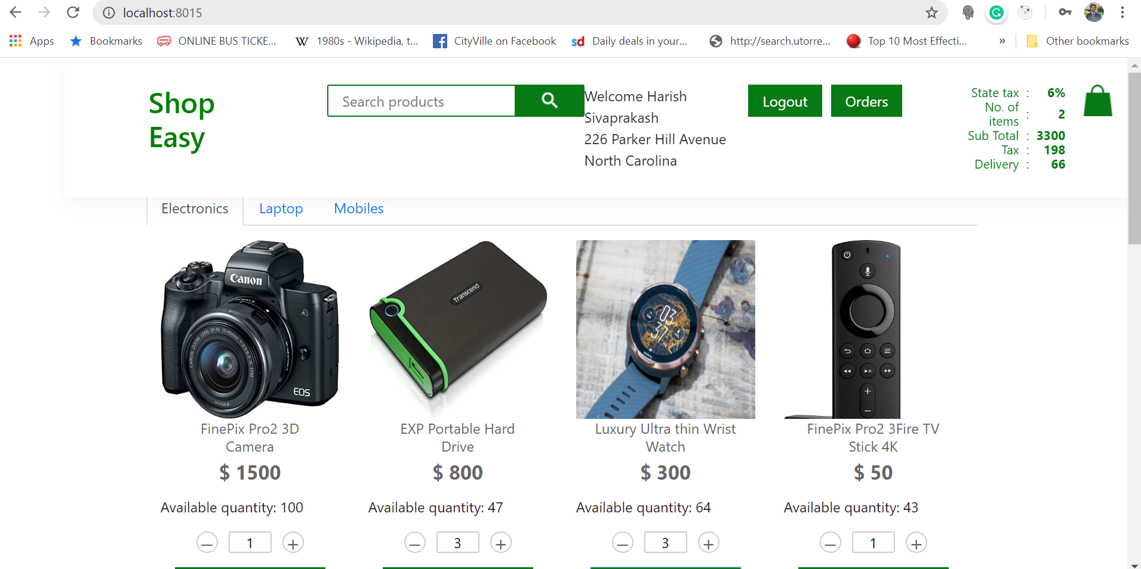

Slide 6
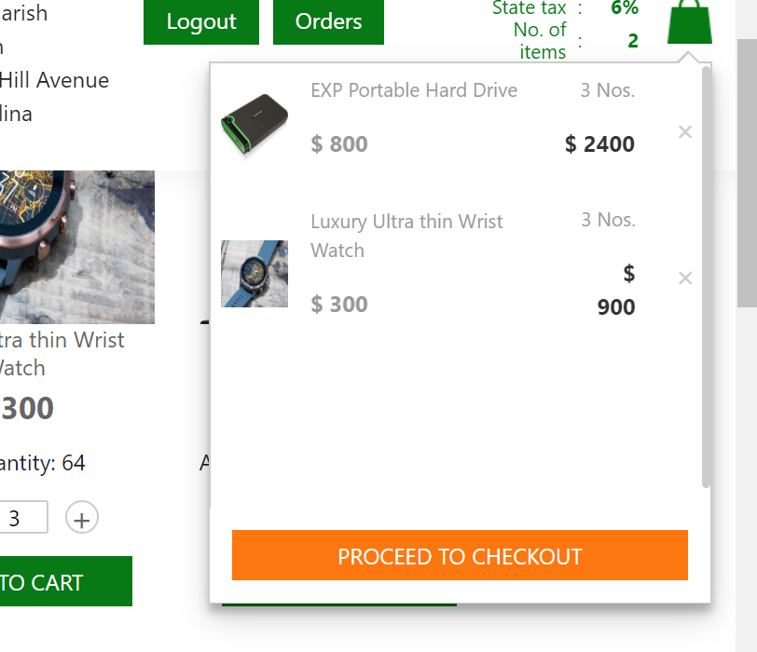

Slide 7
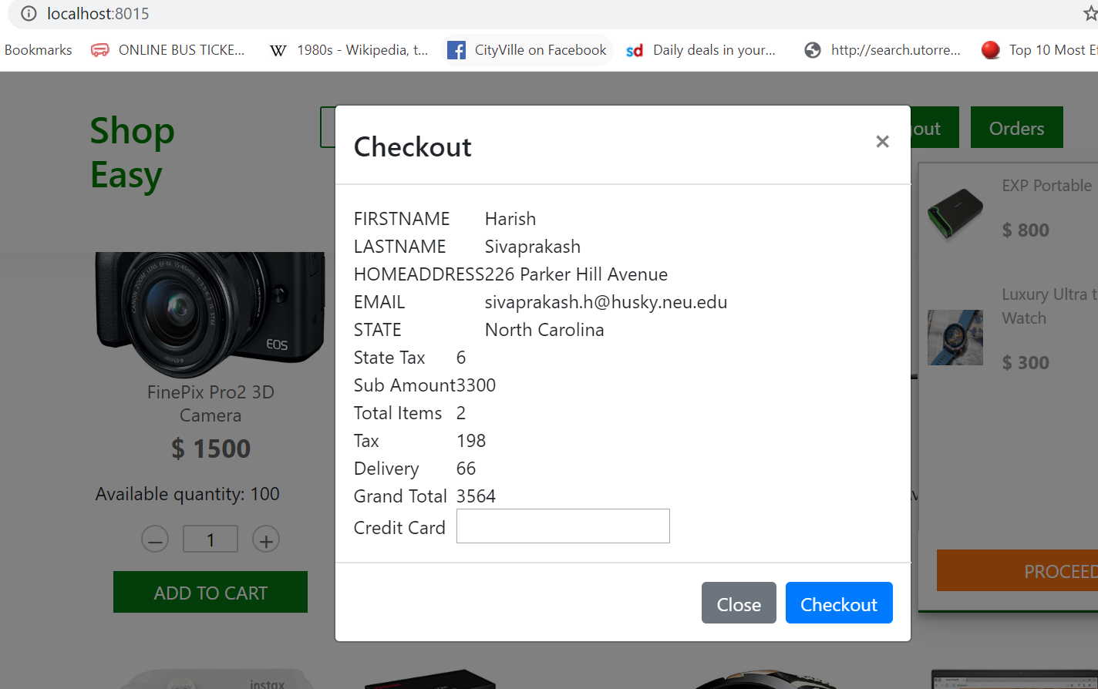

Slide 8
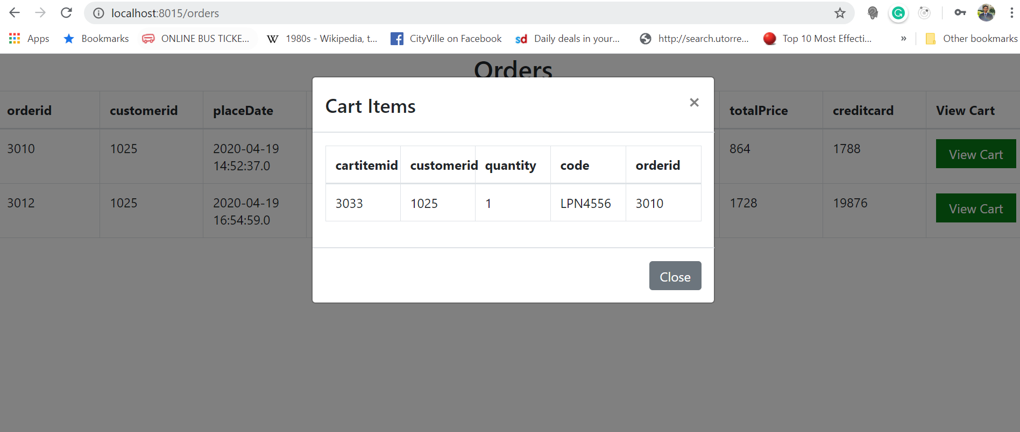

Slide 9
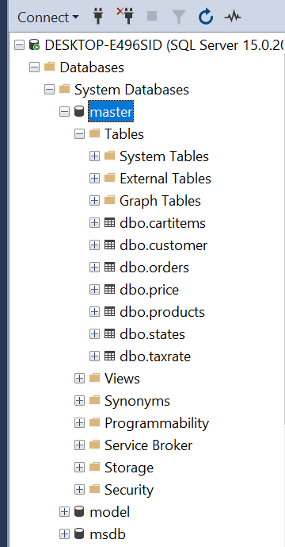
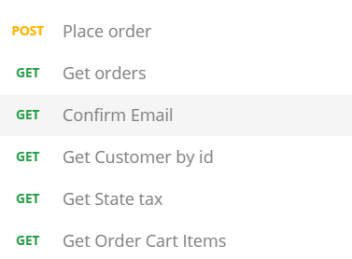
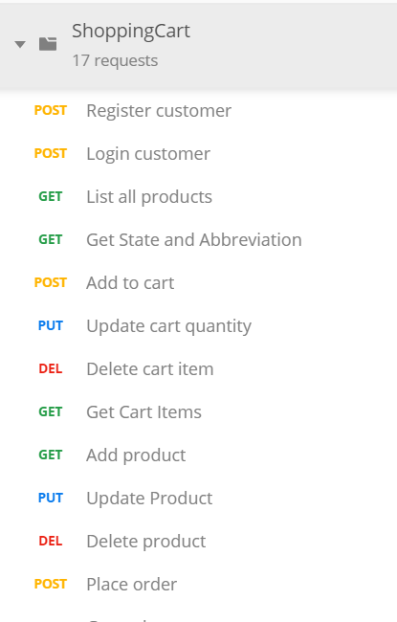
Backend APIs/Database

Slide 10
Thank You!

