Slide 1
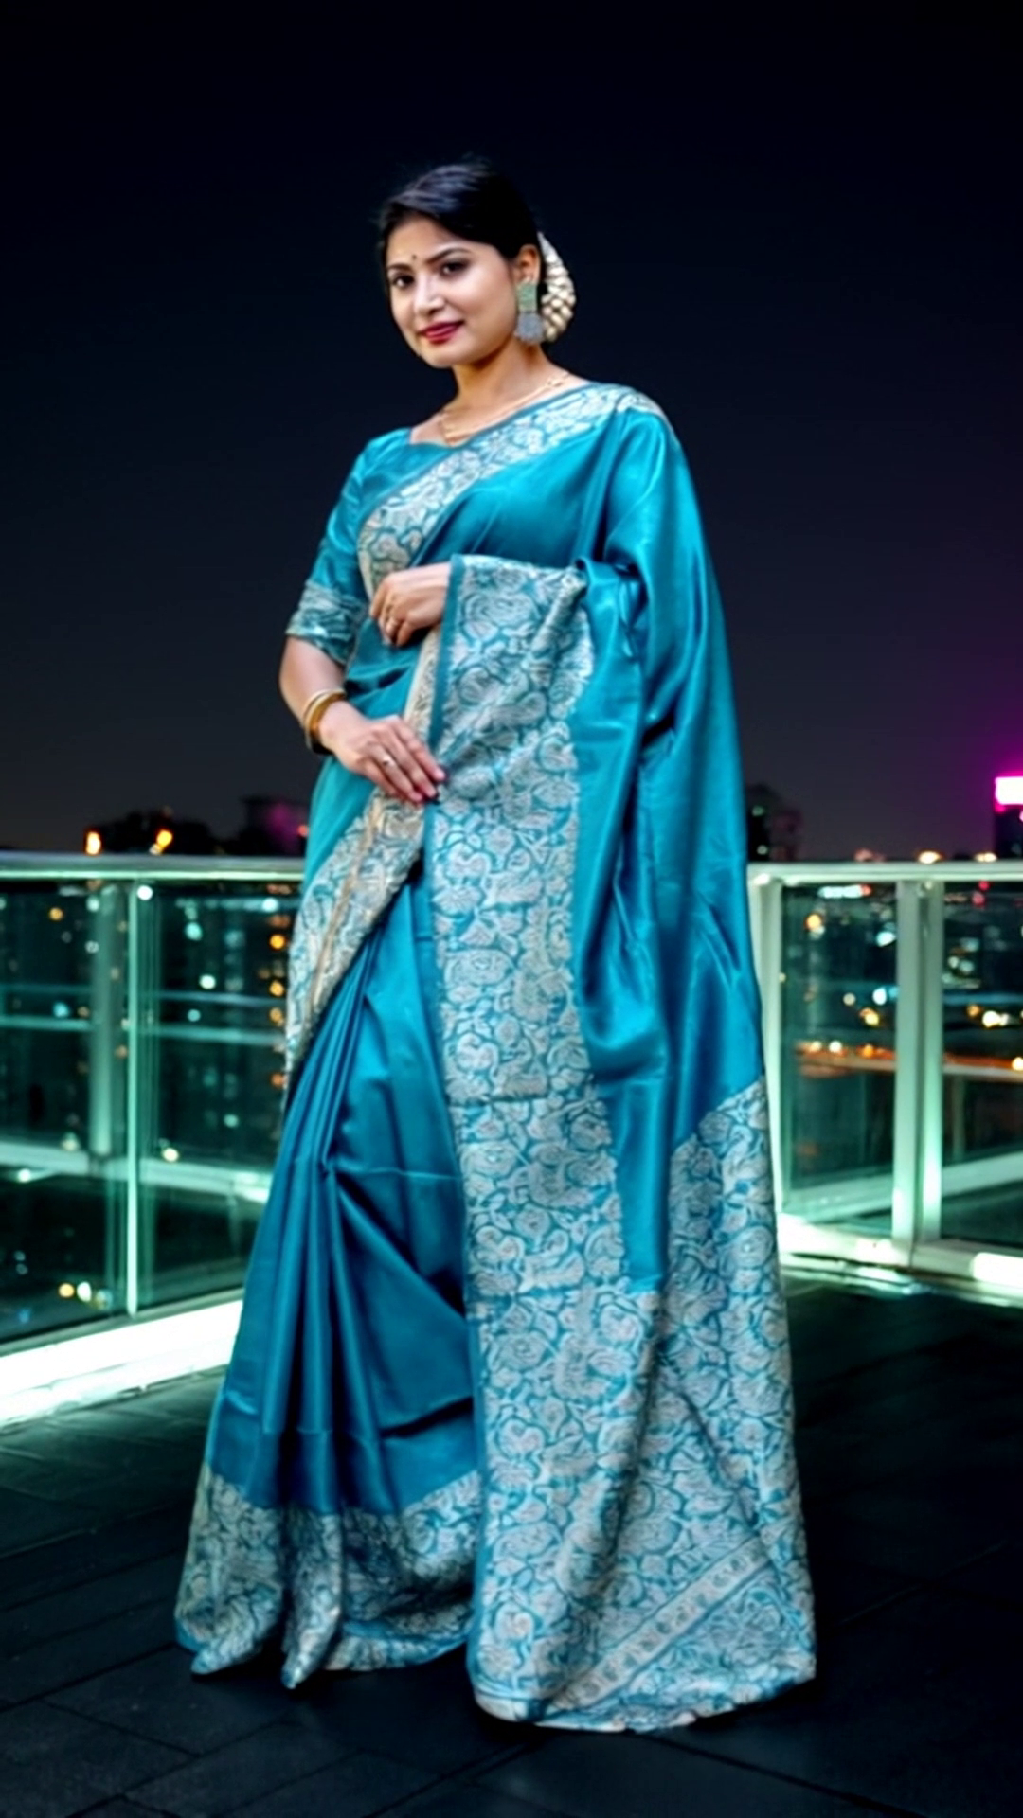


Product Fidelity Studio
Quality control for AI-generated fashion advertising
Team Code Blooded
3
Milestone 3 · GigPoint Hackathon, 22 August 2026
Problem 2 — AI Ad Generation · Client: Kaladhar
delivered ads
1080×1920 · 9:16
Notes:
One image in, multiple verified vertical ads out. We are the quality layer around an AI video generator, not another generator.

Slide 2
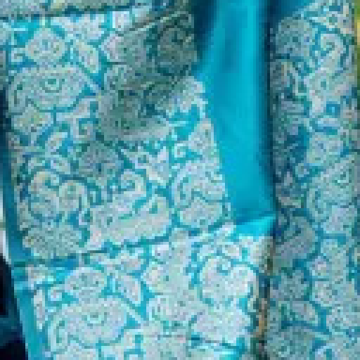
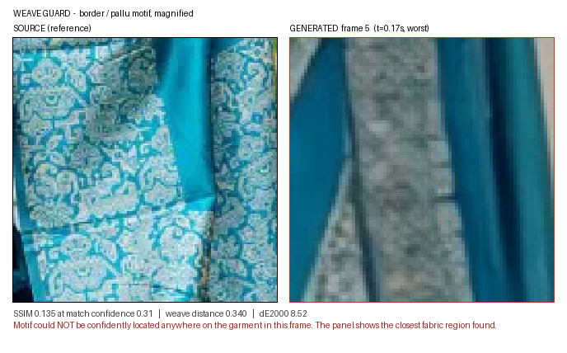
THE PROBLEM
Two failures make AI ad tools unusable
Kaladhar needs many ads per product but cannot reshoot for each one. AI video solves the cost — and introduces two new problems.
Source weave (left) vs a generated frame where the motif could not be found at all
Repetitive
Product drifts
Re-prompting one idea with different adjectives moves the render, not the concept. Ten outputs, one idea.
Colour shifts, weave flattens, the border is redrawn. The ad no longer shows what is being sold.
Client's hard constraint
“The generated advertisement should not misrepresent the product being sold.”
Notes:
The client named both failures. That is what makes this problem attackable — we are not guessing at requirements.

Slide 3

OUR SOLUTION
Maximum variation in the scene. Zero variation in the product.
The brief asks for two things that pull against each other. We split the frame into two zones with opposite rules and enforce each separately.
PRODUCT REGION
SCENE REGION
must not change
must change
Enforced by the Fidelity Lock — Gate 1
Enforced by the Diversity Engine — Gate 2
Consistency is measured, not asserted
Every video is scored per frame, inside the garment mask only
Thresholds are calibrated from the product's own image, not chosen
Anything that drifts too far is rejected before it can ship
We are a QC layer around a generator — not another generator
Source, then the same saree in four generated scenes
Notes:
This is the whole pitch in one line. The two zones have opposite rules, and each has its own gate.

Slide 4
HOW IT WORKS
Eight stages, automated either side of one manual step
1
2
3
4
5
6
7
8
Upload
Analyse
Briefs
Ekly
Import
Fidelity
Diversity
Export
validate source
mask + signature
5-axis matrix
MANUAL — no API
probe every file
Gate 1
Gate 2
1080×1920
Stage 4 is manual — and we say so
45.50
4 / 4
Ekly.ai exposes no API to us. Nothing in the product calls, queues, batches or polls it. The run pauses at AWAITING_CLIPS and resumes when real MP4s come back.
That is not a workaround. The client's problem is not that generation is unavailable — it is that output comes back repetitive and drifting. Both are solved before and after generation.
credits per generation (measured)
clips came back 2:3, not the 9:16 requested
221 s
20 / 20
automated pipeline, 4 clips
algorithm tests passing
Notes:
Judges always ask whether generation is automated. The answer is no, and we lead with it — the value is on either side of that step.

Slide 5
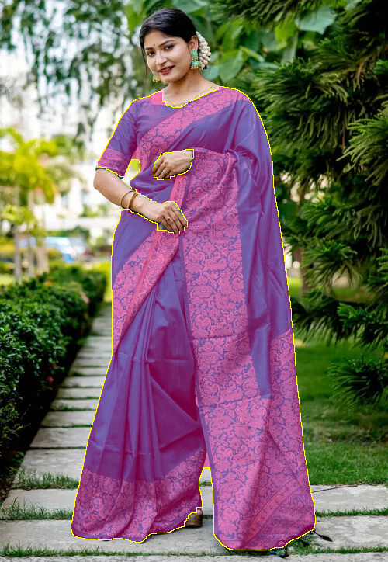
STAGE 2 — PRODUCT ANALYSIS
The product is fingerprinted before anything is generated
Reference signature
Computed once per product and reused for every video and every re-score.
Palette
5 dominant colours, CIELAB k-means, garment pixels only
Weave descriptor
27-d — Gabor bank + FFT radial profile + absolute HF energy
Identity vector
512-d CLIP embedding of the masked garment crop
Weave Guard region
The most texture-dense patch inside the mask, found automatically — no hardcoded coordinates. On a saree it lands on the pallu brocade.
Detail patch
128×128 highest-texture square inside the mask
Garment mask
Every fidelity metric is later measured against this — and only inside the mask, because the background is supposed to change completely.
rembg subject mask refined by a skin-chrominance heuristic. 35.73% of frame.
Notes:
Mask-only measurement is the key design decision. Measuring the whole frame would drown the drift signal in the scene change we asked for.

Slide 6
STAGE 3 — SCENE BRIEFS
Variation is structural, not verbal
Re-prompting one idea with different adjectives is exactly the failure the client complained about. Instead every brief is a point on a five-axis grid.
How the rule is guaranteed
6
Environment
mansion · mandap · palace · café · resort · rooftop
Environment assigned deterministically — all six always used
Camera and concept drawn without replacement
Three axes unique ⇒ every pair differs on ≥ 3 by construction
Incoherent pairings excluded (no candlelit overcast rooftop)
Sampler raises rather than quietly relaxing the rule
6
Lighting
softbox · golden hour · lamp · overcast · practicals · high-key
6
Camera
push-in · orbit · vertical reveal · static · rack focus · parallax
6
Concept
heritage · occasion · everyday · gifting · luxury · styling
4
Colour grade
neutral · warm gold · cool editorial · rich festive
Ekly exposes no API
5,184
4 of 5
≥ 3 of 5
Briefs are exported as a copy-paste operator sheet with the reference image. A human generates them. Expected cost: 273.00 credits for six.
distinct grid points
axes differ, minimum achieved
axes differ, hard rule enforced
Notes:
The ≥3-axis rule is not hoped for — it is guaranteed by construction and then verified. That is what makes 'genuinely different' a claim we can defend.

Slide 7
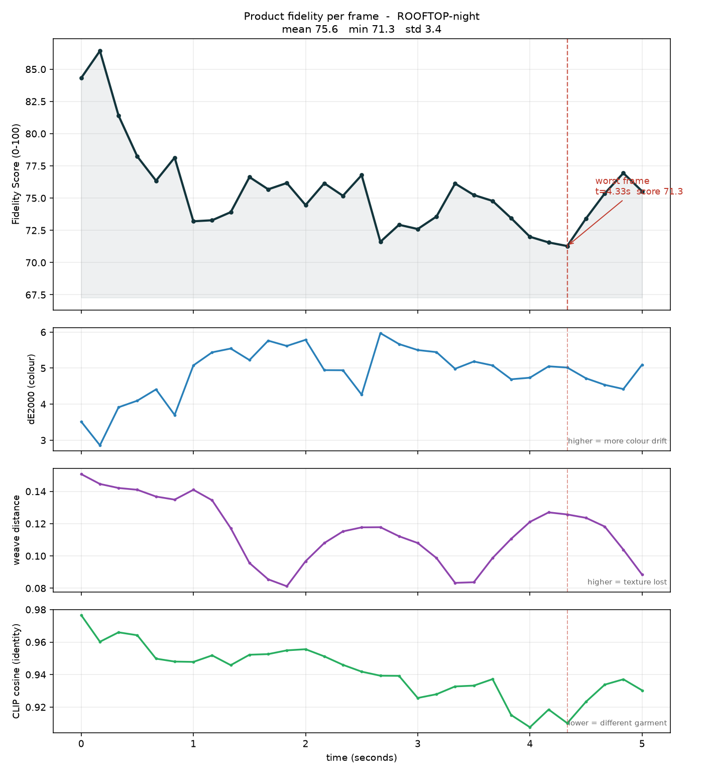
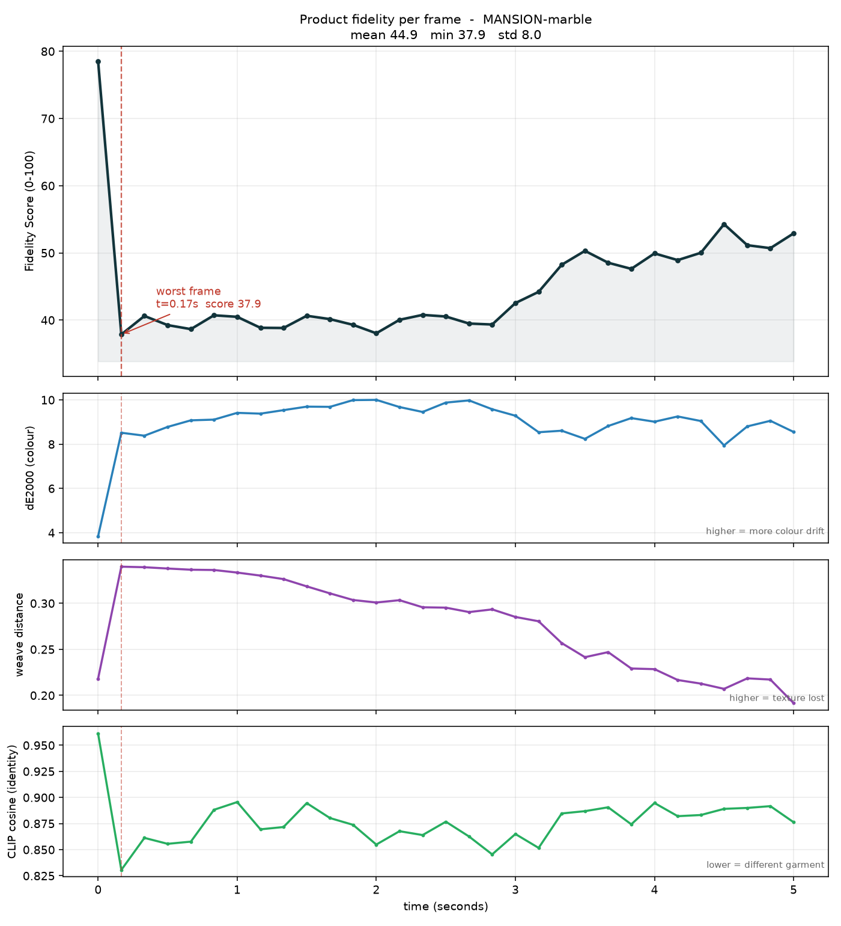
GATE 1 — FIDELITY LOCK
Four metrics, inside the mask, on every 5th frame
0.35
0.30
0.25
0.10
weight
weight
weight
weight
Colour
Identity
Weave
Structure
ΔE2000
CLIP cosine
Gabor + FFT
Aligned SSIM
Dye shift — what a customer notices on arrival
A different garment substituted entirely
Handloom rendered as flat plastic fabric
Border motif distorted or redrawn
PASS — ROOFTOP-night
REJECT — MANSION-marble
Why per frame, not per clip
Drift is transient. On our baseline clip fidelity starts at 87, dips to 61.1 at t = 2.83 s, then recovers. A single-frame check at t = 0 would have passed it.
31 of 153 frames scored per clip, at stride 5
Combined into a Fidelity Score of 0–100
Threshold calibrated from the product's own image
Motion check catches frozen clips and hard cuts
Notes:
The weights were set from how each metric actually behaved in testing, not from how good it sounded. Colour is highest because a shifted dye is the most commercially damaging failure.

Slide 8
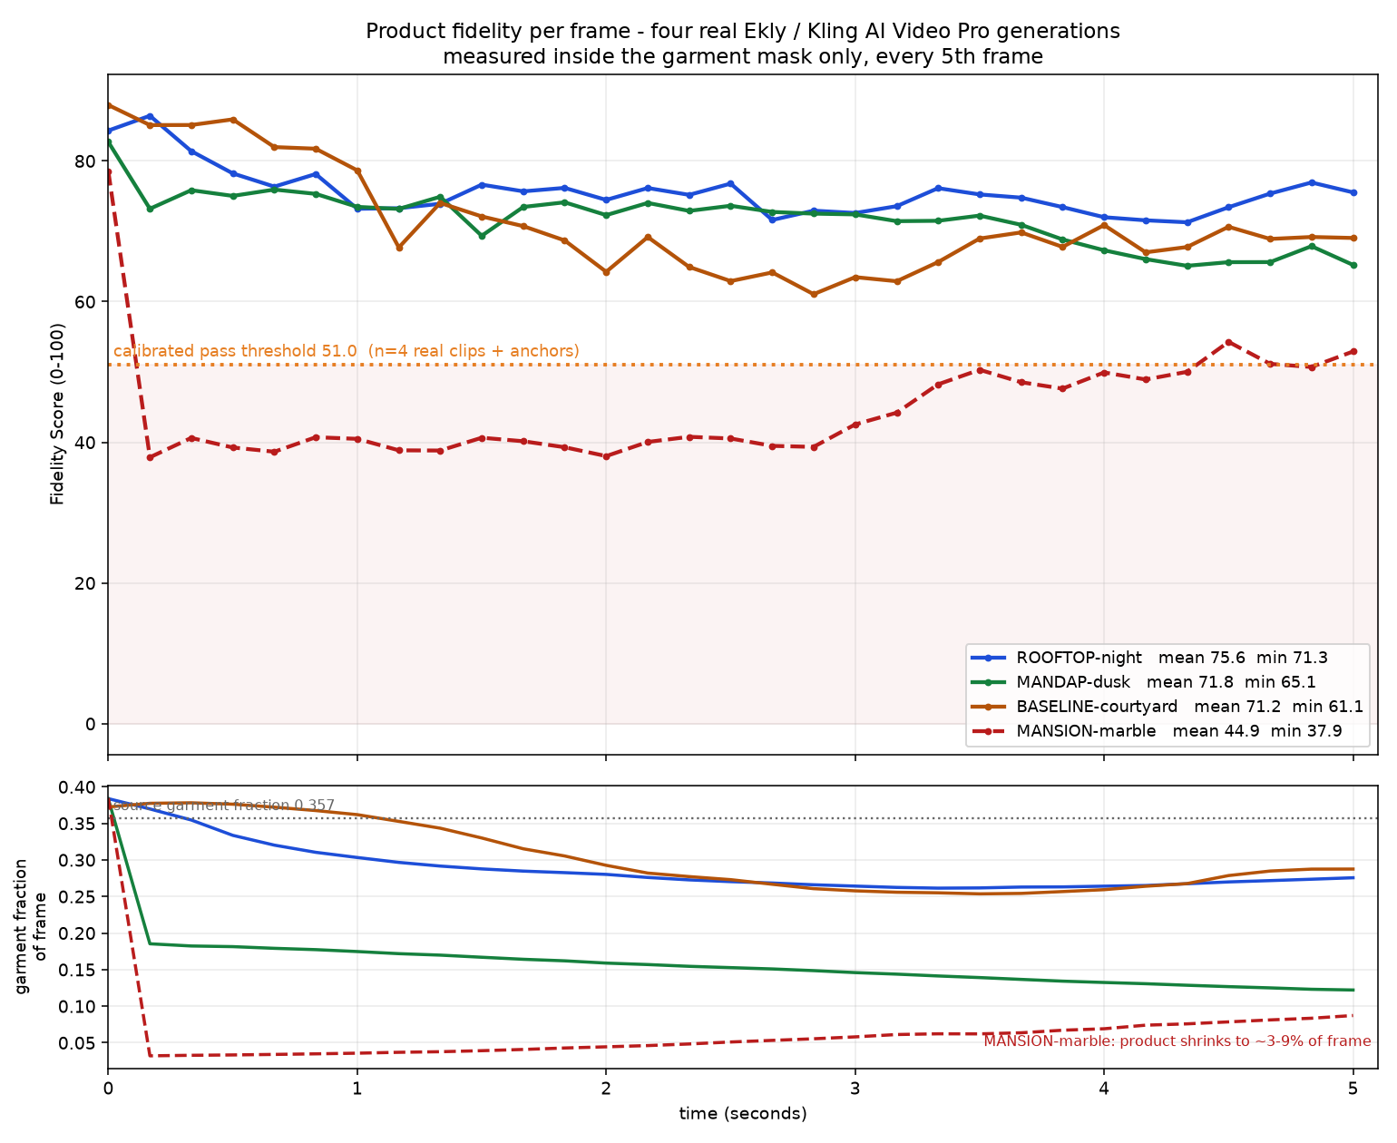
REAL RESULTS — SAREE
Four real generations. Three passed, one rejected.
Video | Mean | Min | Verdict
ROOFTOP-night | 75.57 | 71.28 | PASS
MANDAP-dusk | 71.77 | 65.09 | PASS
BASELINE-courtyard | 71.23 | 61.06 | PASS
MANSION-marble | 44.89 | 37.87 | REJECT
Pass mark 51.0, calibrated on this product
Why MANSION-marble was rejected
Fidelity 44.89 vs a 51.0 pass mark — below it for the whole clip
Motion spike 0.268 vs a 0.25 limit — a hard cut in the first 0.13 s
Garment occupancy collapsed from 38% of frame to 3–9%
Not primarily a dye failure. ΔE2000 reads 8.98, but with the garment at a few percent of frame that is not evidence of a dye change — frame inspection confirms the saree is still teal.
Per-frame fidelity for all four clips against the calibrated pass mark of 51.0. Garment occupancy underneath.
Notes:
Two independent checks caught this. And we checked frames before calling it — the colour number is real but it is not the reason.

Slide 9
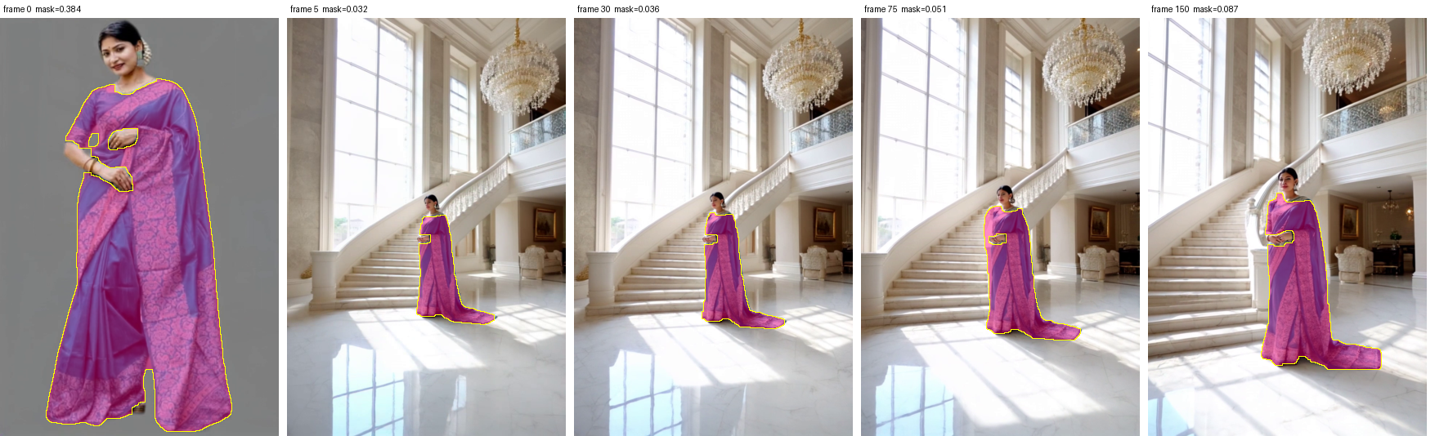
EVIDENCE — MANSION-MARBLE
The rejection, frame by frame
Frame 0 is a near-copy of the reference (38% of frame). After a hard cut the model is tiny in a marble hall for the remaining five seconds. The mask (pink) tracks correctly — the product really is that small.
44.89
37.87
0.268
38% → 3%
Rejected on two
independent grounds
fidelity mean vs 51.0 mark
worst frame, at t = 0.17 s
motion spike vs 0.25 limit
garment occupancy collapse
Notes:
This slide is the proof that the QC is real. A judge can see the product shrink and the mask following it correctly.

Slide 10
GATE 2 — DIVERSITY ENGINE
Being different is not the same as being usable
Two structurally different briefs can still render similarly, so diversity is measured on the result. Each video becomes one CLIP embedding averaged over sampled frames; pairwise cosine distance decides.
The result that justifies two gates
 | BASELINE | MANDAP | MANSION | ROOFTOP
BASELINE-courtyard | — | 0.1147 | 0.1999 | 0.0931
MANDAP-dusk | 0.1147 | — | 0.1412 | 0.1213
MANSION-marble | 0.1999 | 0.1412 | — | 0.1961
ROOFTOP-night | 0.0931 | 0.1213 | 0.1961 | —
0.1999
the largest pairwise distance in the set — BASELINE ↔ MANSION
The most visually distinct video in the set is the one Gate 1 rejected.
Optimising for variety alone would have shipped the video that misrepresents the product.
This came out of the measurements, not the design — and it is why the two gates are kept independent.
14.44
10.97
+0.00
diversity, all four videos
diversity, passing set
gain — nothing was dropped
Selection had nothing to remove: three videos passed Gate 1 against a request for six. The distances are real measurements; the filtering step was simply not exercised.
Notes:
This is our strongest single finding. It was not designed in — the numbers produced it.

Slide 11
MILESTONE 3.1 — PERFORMANCE
Where the time actually goes
Optimisations, and what each is worth
Frame sampling
31 of 153 frames scored — 4.9× fewer than a full pass. The largest lever.
Cached model sessions
Segmentation 4.70 → 0.59 → 0.51 s; CLIP 2.00 → 0.05 → 0.05 s across three calls.
Signature once per product
Mask, palette, texture and CLIP vector reused for every video and re-score.
Batched embeddings
Measured by the application while it ran, over four clips. Ekly generation time is excluded — a manual web step with no API, never measured.
CLIP runs 16 images per session call.
Reduced-resolution masks
221.2 s
81.4%
45.0 s
0.543 → 0.473 s — a 1.15× win, not the 8× an earlier note claimed.
total automated
is scoring alone
per 5-second clip
We corrected our own number: the earlier 8× claim compared a cold call including model load against a warm one.
Notes:
Scoring is the honest bottleneck at 81%. It is CPU inference — we did not optimise it away, and we say so.

Slide 12
MILESTONE 3.2 — PRODUCTION OUTPUT
Three validated ads, verified by reading the files back
Delivery specification
Resolution
1080 × 1920
Aspect
0.5625 (9:16)
Codec / format
H.264 · yuv420p · MP4
Frame rate
30 fps · 153 frames
Fit mode
crop — 100% of garment retained
Conforming
3 of 3
Read back from the written files, not taken from encoder settings.
BASELINE-courtyard
MANDAP-dusk
ROOFTOP-night
1080×1920 · 5.10 s · 6.37 MB
1080×1920 · 5.10 s · 6.99 MB
1080×1920 · 5.10 s · 3.70 MB
Crop or pad is decided per file from measurement — the system computes how much garment a centre crop would destroy. Crop removed 15.6% of width and 0.00% of the garment.
Notes:
All four inputs arrived at 768x1152, not the 9:16 the generator was told to produce. Conversion is an explicit stage and conformance is verified from the file.

Slide 13
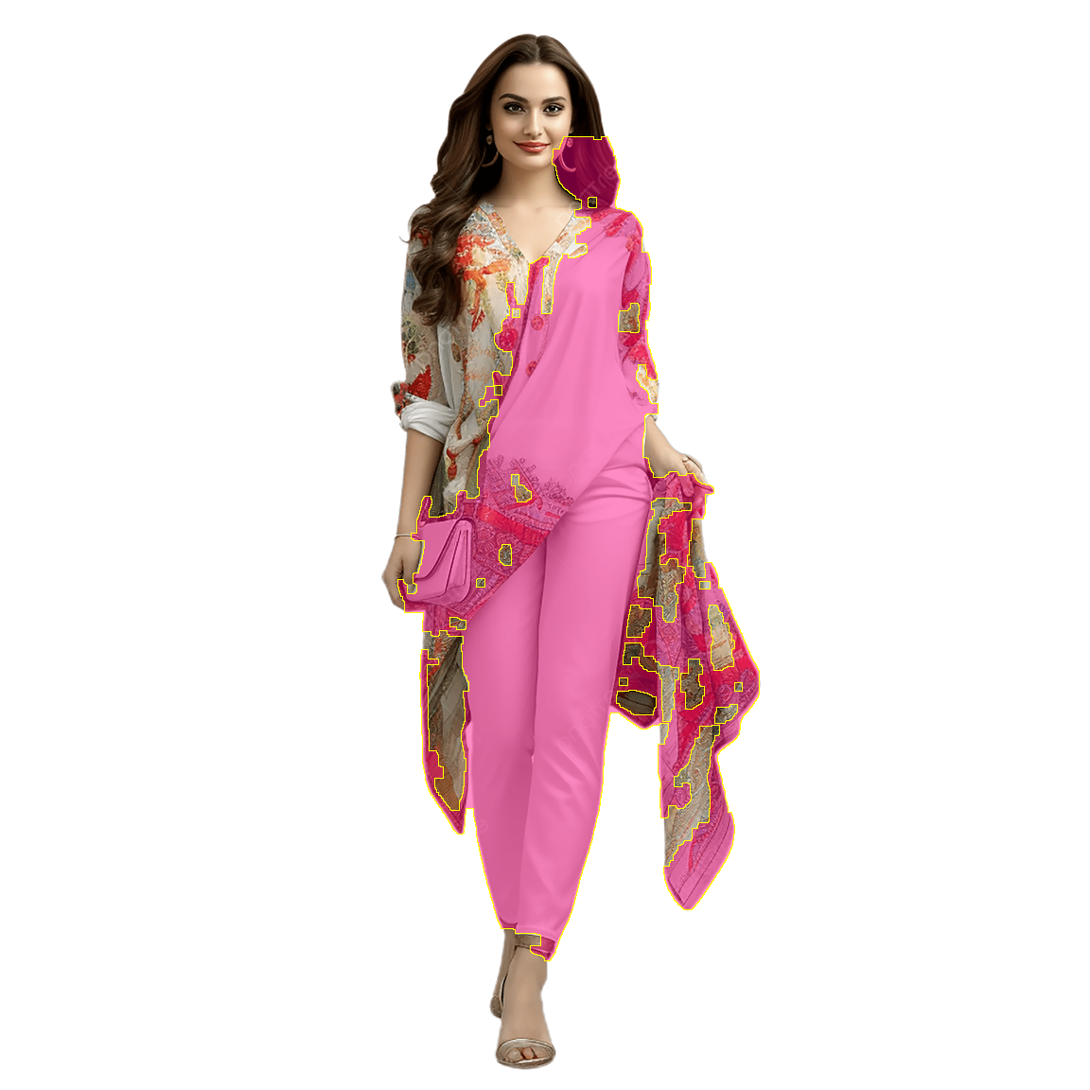
MILESTONE 3.3 — CROSS-PRODUCT TESTING
A second product — and a problem the testing found
Real kurti video scored through the identical pipeline
The finding
The kurti was judged against the saree's pass mark
Fidelity mean / min
55.04 / 38.67
Delivered
960×960 square
ΔE2000
5.00
51.0
PASS
Weave distance
0.2611
calibrated on the saree
CLIP identity
0.8479
63.2
REJECT
Motion max
0.0407
calibrated on the kurti
Kurti garment mask
Garment occupancy
6.6% – 8.7%
Printed panels retained after a fix to the skin filter, which had been deleting warm-toned print. Source 2500×2500, garment 10.95% of frame.
Same clip, 55.04, opposite verdicts. The kurti is mostly white, so a 10° hue shift costs it only 6.3 points against the saree's 23.9 — its floor is legitimately higher.
The pass mark is a property of the product, not of the system. We report this rather than quietly correcting it.
Export
1080×1920, conforms
Notes:
Good testing finds problems in your own process. This is the single most important thing to fix before a wider catalogue.

Slide 14
HONESTY
What we have not tested
Stating these is not a weakness in the submission — every one of them is a claim we refused to make.
Two product types only
Gate 2 never rejected anything
Saree and kurti on real video. Lehenga, dress and shirt are supported in code but untested.
The passing pool has always been smaller than the number of ads requested.
Safe Cut never fired on real footage
No human ground truth
Covered by 5 unit tests; no real clip has met the conditions for a trim.
The Fidelity Score has not been validated against human judgement of sameness.
Small calibration samples
Segmentation is a heuristic
4 saree clips, 1 kurti clip, plus controlled degradation anchors.
Not a trained garment segmenter; it keeps accessories such as the kurti model's handbag.
We also corrected two of our own errors mid-project: a weave metric that returned ~0.0001 for every frame, and an 8× speed-up claim that was really 1.15×.
Notes:
Judges test claims. Everything here is something we could have hidden and chose not to.

Slide 15
What we built
A generator can't tell you when it broke your product.
This can.
11
2
4 + 1
3
quality checks run on every video
independent gates before anything ships
real videos scored across two products
validated 1080×1920 ads delivered
Why it matters for Kaladhar
The result we'd point a judge at
Ads can be produced from one photograph instead of a reshoot — and every one that ships has been measured against the real product, per frame, inside the garment. Anything that misrepresents it is stopped before delivery.
The most visually distinct video in our set was the one the fidelity gate rejected. Chasing variety alone would have shipped the ad that misrepresents the saree. That is the case for two gates, and the measurements made it, not us.
Team Code Blooded · Product Fidelity Studio · Milestone 3
Notes:
Close on the two-gate finding. It is memorable, it is ours, and it came from the data.

