Slide 1
Introduction
Worked on IMBD data set as a part of a task and got insights from the data some of them are shown in following slides.

Slide 2
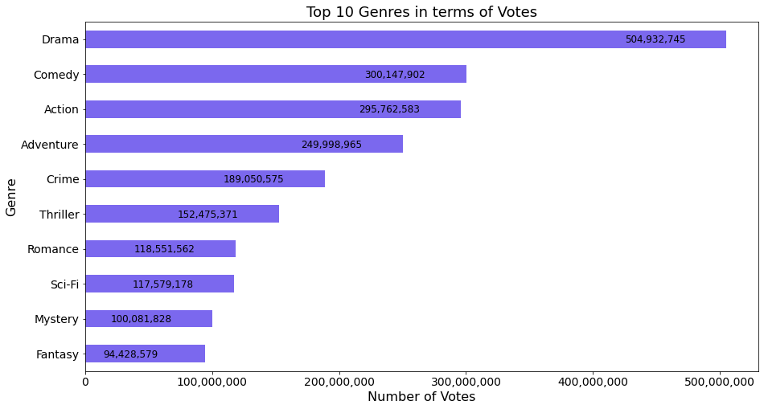
1. Which Genre gets the maximum votes?
Genre column has up to three genre for each title hence after merging genres table with ratings table it is exploded based on genres column then the resulting data frame is grouped by genres with sum to get number of votes for each genre type. It is found that Drama has got highest votes

Slide 3
2. Which actor - director pair is most successful (in terms of IMDB ratings)?
A rating of 10.0 is considered the highest rating. Titles with rating 10.0 are first extracted from ratings table and named top_title.
Form crew table it is found that Each title might have multiple directors and multiple actors.
Two Tables with only actors, their id and directors, their id for top_titles are created.
actors and directors table are merged by inner join and named as pairs
paris table is merged with names table to get top_pairs table which has names which when sorted by number of votes gives following top_pair
Director: Rian Johnson
Actors: Dean Norris, Bryan Cranston, Aaron Paul
For the title Ozymandias

Slide 4
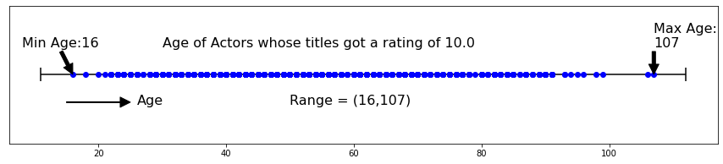
3. Male leads are most successful in which age bracket?
Success is assumed as Highest Average Rating which is 10.0.
If death year is absent then 2020 is taken to calculate age.
Male Lead roles is assumed to be actors.
Actors table from previous is merged with names table which has birth year and death years.
Rows with duplicate actor names are dropped.
After dropping rows with no data, age is calculated and following range is found

Slide 5
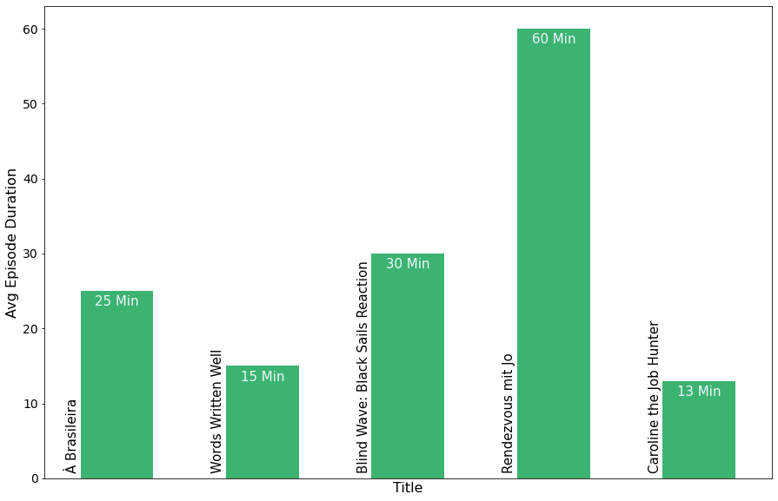
4. For TV shows, what is the avg episode duration of the best TV shows?
Best is defined by rating, which is equal to 10.0
From genre table titles with tvSeries titletype are extracted and named as tv_shows, which is merged with ratings table whose rating is 10.0 to get top_shows table.
From top_shows table we get following.

Slide 6
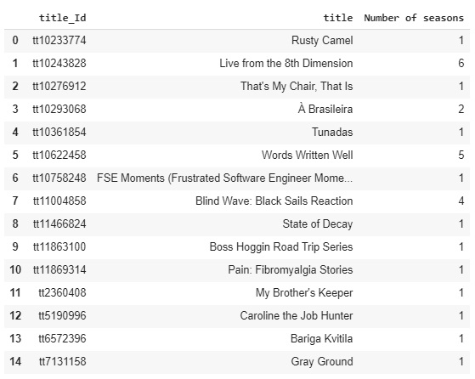
5. Best TV shows last for how many seasons?
The top_shows table from previous question is merged with episodes table which has seasonNumber.
table obtained above is grouped by titleId and max
rows whose data is not available are dropped to get following

Slide 7
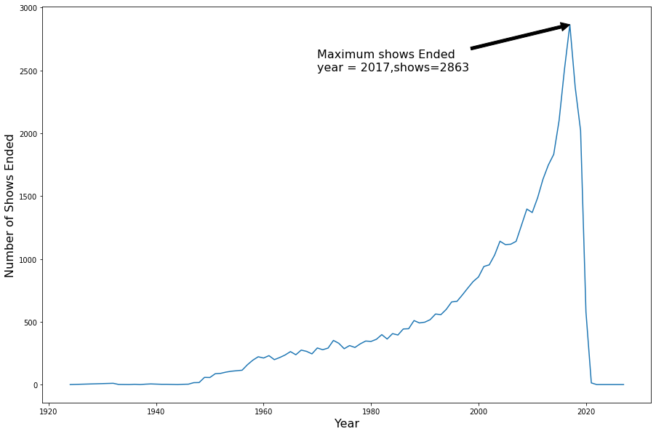
6. In which year maximum TV shows ended?
From genre table titles with tvSeries titletype are extracted and named as tv_shows also rows whose end year is not available are dropped.
Now, tv_shows table is grouped by ‘endyear’ and count to get table which has number of shows ended in each year.
Of these maximum ended in 2017 with 2863 tv shows

