Slide 1
B+ TREE DATABASE
CSCI 651- ALGORITHM CONCEPTS. DR. TAO ZHANG
SHASHI KUMAR K (1338369)
DHANA KRISHNA P (1325505)
NIDHISHA REDDY B (1324518)
KETHANA KATEPALLI (1321620)

Slide 2
INTRODUCTION
B+ trees are powerful tool for managing large amounts of data in disk based stored system. Designed to reduce the no.of disk access
B+ tree is commonly used in database management system and file system.
This is actually to store data in a tree structure, where each node in tree represents a range of keys.
The leaf nodes of the tree contain the actual data records.

Slide 3
INSERTION
The insertion process involves finding the correct leaf node where a new key value can be inserted and then adding it to the leaf node.
RULES OF INSERTION
Each node except root can have a maximum of m children and at least m/2 children.
The root has at least two children.
Each node can contain a maximum of m - 1 keys and a minimum of ⌈ m/2⌉ - 1 keys.
If the leaf is not full, insert the key into the leaf node in increasing order.
If the leaf is full, insert the key into the leaf node in increasing order and balance the tree in the following way.
Break the node at m/2th position.
Add m/2th key to the parent node as well.

Slide 4
DELETION
The deletion process involves finding the node that contains the key to be deleted in a particular node and removing it from the tree.
A node can have a maximum of m children.
A node can contain a maximum of m - 1 keys.
A node should have a minimum of ⌈m/2⌉ children.
A node (except root node) should contain a minimum of ⌈m/2⌉ - 1 keys.

Slide 5
SEARCH
For searching in B+ tree we need to traverse the tree from the root node to a leaf node that contains the key or to the end of the tree if the key is not present.
The tree is sorted every time, when a new value is inserted.
We need to compare the search key with the keys sorted in the current node.
If the search key is less than the smallest key in the node, move to the left child of the node.
If the search key is greater than or equal to the largest key in the node, move to the right child of the node.
If the search key falls between two keys in the node, move to the child node whose key range covers the search key.
Search the leaf node for the search key, if the key is found then return the value, if the key is not found then return null.

Slide 6
PROPERTIES
Insertion, Deletion and Search operations can be performed efficiently, even for large datasets.
The leaf nodes in a B+ tree are linked together in a linked list, which enables fast sequential access to the data stored in the tree.
Each node in a B+ tree can store multiple key-value pairs, which reduces the overall number of nodes in the tree and improves access performance.

Slide 7
ADVANTAGES
B+ trees offer good performance for insertion and deletion operations, as they only require local rebalancing of the tree rather than a full tree reorganization.
Accessing nodes in a B+ tree is likely to result in fewer cache misses, improving overall performance.
B+ trees are powerful data structure that offer many advantages for handling large amounts of data.
B+ trees offer fast search performance due to their balanced structure and the use of binary search within nodes.

Slide 8
APPLICATIONS
B+ trees are used in caching systems to store frequently accessed data in memory.
B+ trees are used in file systems to manage large files and directories efficiently.
B+ trees are commonly used in database management systems to index and retrieve data efficiently.
B+ trees are used in network routers to store routing tables and efficiently route network traffic.

Slide 9
CONCLUSION
The most difficult parts of the project were implementing insert and delete functionality. Insert would increase the size of the node by one, and we needed to keep the node to a specific size, so we had to figure out how to split it. Same with delete, except in that case, we needed a minimum size for the node, so we had to figure out how to combine it with another one.
Search functionality iterates over the whole tree index nodes and then displays the value of that key. Display functionality loads all the leaf nodes stored into a array and then dispalys 10 eachtime.

Slide 10
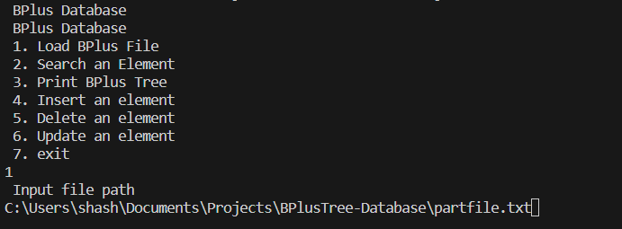
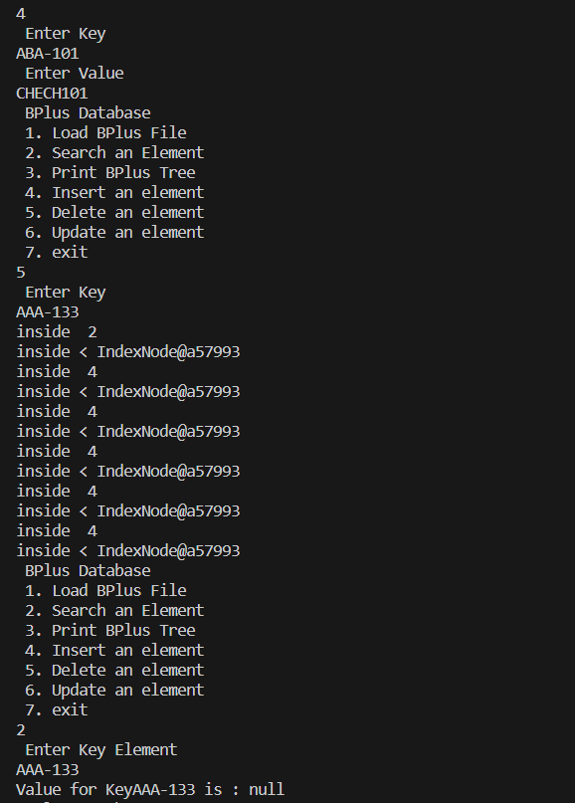
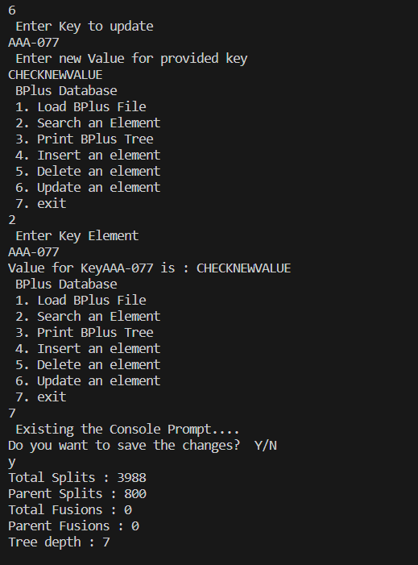
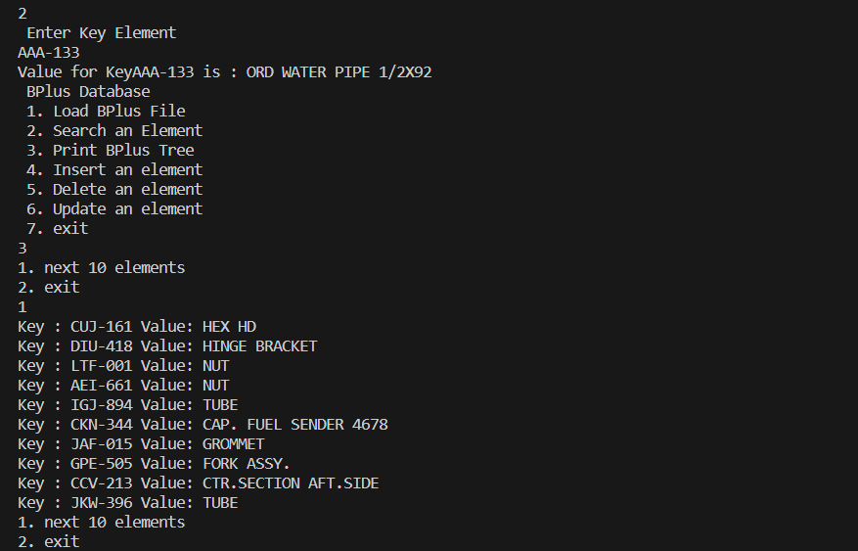
OUTPUT

