Slide 1

CASE FILE // MD-2026
CLASSIFICATION : HACKATHON
TEAM KALKI PRESENTS
AI / ML + GRAPH ANALYTICS
MULEDETECT
Intelligent Mule Account Detection & Financial Fraud Investigation Platform
AI / ML + Graph Analytics FOR CYBER-ENABLED FINANCIAL FRAUD
TEAM LEAD
SR
LEAD
CP
MEMBER
UK
MEMBER
AK
MEMBER
Shashi Ranjan Kumar
Chhavi Pandey
Utsav Kumar Chaudhary
Anurag Kumar
INSTITUTION
EVENT
National Institute of Electronics & Information Technology(NIELIT), Patna
CYBER HACKATHON 2026
8.8M TRANSACTIONS · 560,913 ACCOUNTS · 64 FEATURES · 7 MODELS · SHAP EXPLAINABILITY
Notes:
Good morning everyone. We are Team KALKI — I am Shashi Ranjan Kumar, team lead, with my teammates Chhavi Pandey, Utsav Kumar Chaudhary, and Anurag Kumar. Today we present MuleDetect — an intelligent platform for detecting mule bank accounts and investigating financial fraud using AI/ML and graph analytics.

Slide 2
01 — PROBLEM STATEMENT
Mule accounts are the backbone of cyber-enabled financial fraud
VICTIM
RECEIVES
MULE A
LAYERS
MULE B
WITHDRAWS
MULE C
CONCEALS ORIGIN
CRIMINAL
FUNDS DEBITED
COLLECTION LAYER
FORWARDING
CASH-OUT
TRAIL BROKEN
WHAT IS A MULE ACCOUNT?
THE SCALE OF THE PROBLEM
LIMITATIONS OF EXISTING METHODS
A bank account used to receive illicit funds from victims
Layer money through networks of accounts
Withdraw & conceal the true origin of funds
Digital fraud +30% (RBI Annual Report)
8.8M transactions analysed
0.69% are mule accounts — extreme class imbalance
Manual review takes days to weeks
Static thresholds — criminals use "structuring"
No network analysis — transactions seen in isolation
High false positives — investigators overwhelmed
Black-box models — no explainability
Delayed detection — funds already withdrawn
Victims: common citizens | Criminals: organised fraud rings
Notes:
Mule accounts are the backbone of cyber-enabled financial fraud. Criminals use them to receive stolen money from victims, pass it through layers of accounts, and withdraw it to hide the trail. Current detection methods rely on static thresholds — but criminals split money to stay below limits. Manual investigation takes days, by which time funds are gone. This is the problem we solve.

Slide 3
02 — SOLUTION ARCHITECTURE
A 5-layer AI/ML platform — from raw transactions to filed reports
01
DATA LAYER
8.8M transactions
560,913 accounts
SAML-D · 996MB
HI-SMALL · 475MB
BASE · 213MB
02
FEATURE ENGINEERING
64 features
total
BEHAVIOURAL (20)
GRAPH (9)
IDENTITY (35)
03
MULTI-MODEL ENSEMBLE
7 algorithms
compared
GB
BAGGING
XGB
RF
ET
DT
LR
04
FUSION + EXPLAINABILITY
HIGH ≥70
MED 40–69 · LOW <40
R = 0.50×B + 0.30×G + 0.20×I
SHAP REASON CODES
05
INVESTIGATION DASHBOARD
SAR-style output
TXT · HTML · PDF
RISK QUEUE
MONEY TRAIL
NETWORK
REPORTS
Notes:
Our solution has 5 layers. First, we load 3 datasets covering 8.8 million transactions. Second, we engineer 64 features across behavioural, graph, and identity domains. Third, we compare 7 ML algorithms in an ensemble. Fourth, we fuse scores with explainability. And fifth, we provide an investigation dashboard for real-world use.

Slide 4
03 — DATASETS & FEATURE ENGINEERING
Three benchmark datasets. 64 engineered features.
SAML-D
HI-SMALL
BASE
9,504,852
5,078,345
1,000,000
TRANSACTIONS
TRANSACTIONS
APPLICATIONS
0.107% fraud
0.105% fraud
1.103% fraud
MONEY LAUNDERING
AML BANK TRANSACTIONS
IDENTITY FRAUD
UK / INTERNATIONAL
US BANKS
DEVICE INTELLIGENCE
COMBINED
8.8M transactions analysed → 560,913 accounts
3,864 mule accounts · 0.69%
EXTREME IMBALANCE
BEHAVIOURAL — 20 FEATURES
GRAPH — 9 FEATURES
IDENTITY — 35 FEATURES
FAN-IN / FAN-OUT
PASS-THROUGH
VELOCITY
PAGERANK
BETWEENNESS
LOUVAIN COMMUNITIES
DEVICE REUSE
KYC VELOCITY
EMAIL SIMILARITY
STRUCTURING
DWELL TIME
DISTANCE-TO-BAD
PHONE VALIDITY
Notes:
We use 3 publicly available benchmark datasets. SAML-D has 9.5 million money laundering transactions with fan-in and fan-out patterns. HI-Small has 5 million bank-to-bank transactions. Base has 1 million identity fraud records. Combined, we analyse 8.8 million transactions covering 560,913 accounts, of which 3,864 are mule accounts — that's just 0.69%, an extremely imbalanced problem. We engineer 64 features across three domains.

Slide 5
04 — MODEL COMPARISON
7 algorithms benchmarked — ensembles dominate
MODEL | PR-AUC | ROC-AUC | F1 | P@50 | P@10 | TIME
01 Gradient Boosting | 0.5795 | 0.9796 | 0.5097 | 0.86 | 0.70 | 333s
02 Bagging | 0.5701 | 0.9558 | 0.4946 | 1.00 | 1.00 | 62s
03 XGBoost | 0.5497 | 0.9910 | 0.2655 | 0.88 | 1.00 | 22s
Decision Tree | 0.4193 | 0.9702 | 0.1652 | 0.64 | 0.80 | 3s
Random Forest | 0.3953 | 0.9895 | 0.1670 | 0.62 | 0.70 | 40s
Extra Trees | 0.2720 | 0.9853 | 0.2858 | 0.40 | 0.30 | 28s
Logistic Regression | 0.0744 | 0.9202 | 0.1233 | 0.20 | 0.70 | 24s
PR-AUC COMPARISON
GB
0.5795
BAG
0.5701
XGB
0.5497
DT
0.4193
RF
0.3953
ET
0.2720
LR
0.0744
METRIC CHOICE MATTERS · PR-AUC OVER ROC-AUC
✓
Ensemble methods (GB, Bagging, XGB) dramatically outperform simple models — LR is 7.8× worse
✓
PR-AUC reveals true gaps that ROC-AUC obscures on 0.69% prevalence
✓
P@50 = 1.00 for Bagging — zero false positives in the top-50 alert queue
Notes:
We compared 7 machine learning algorithms. Gradient Boosting achieved the highest PR-AUC of 0.58. Bagging achieved perfect Precision@50 of 1.0 — meaning all top-50 alerts are genuine mule accounts with zero false positives. XGBoost achieved the best ROC-AUC of 0.99 in just 22 seconds. Ensemble methods dramatically outperform simple models — Logistic Regression is 7.8 times worse.

Slide 6
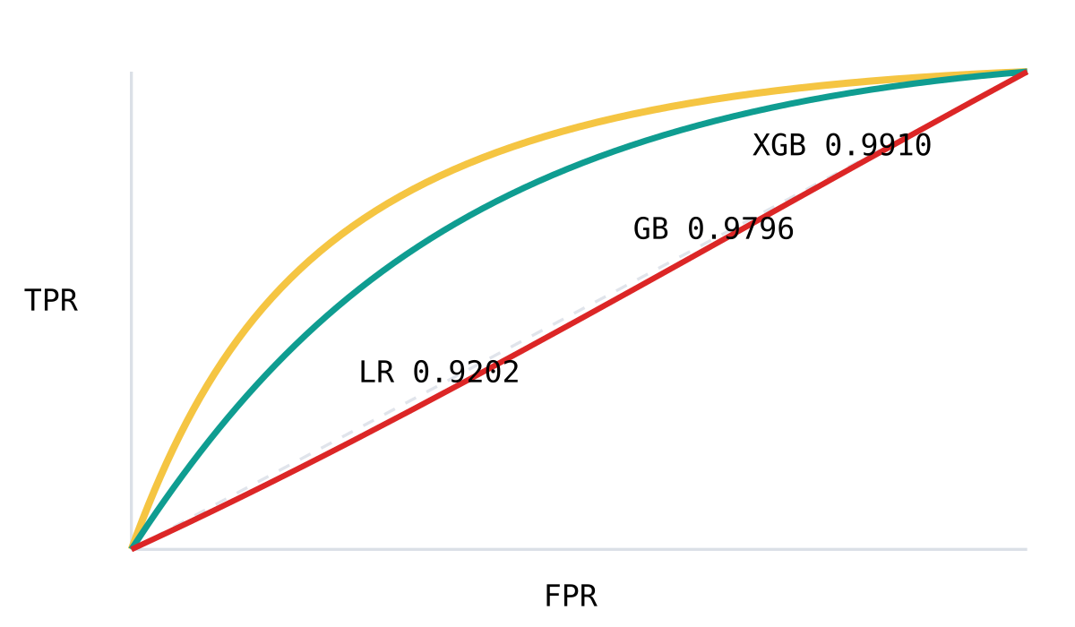
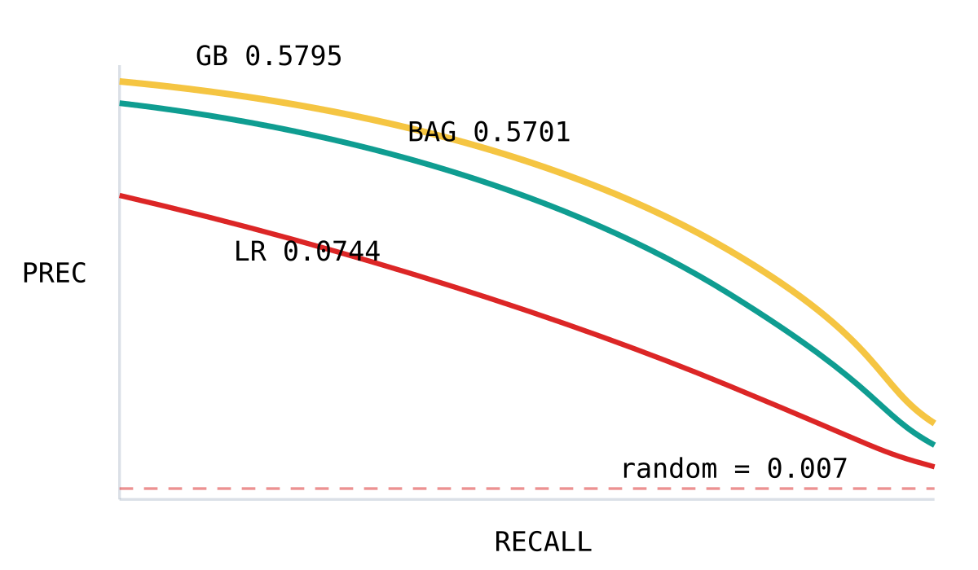
05 — KEY RESULTS
Production-grade accuracy on an extremely imbalanced problem
0.5795
1.00
0.9910
22s
PR-AUC · BEST (GB)
P@50 · BAGGING
ROC-AUC · BEST (XGB)
TRAINING · XGBOOST
80× better than random
Zero false positives
Near-perfect separation
Real-time ready
ROC CURVES
PR CURVES — THE HONEST METRIC
WHY THIS MATTERS
1
Investigators review 50 leads daily — all 50 are real mule accounts
2
XGBoost at 22s enables scoring of live transactions
3
PR-AUC 0.58 vs 0.007 random = 80× lift under 0.69% prevalence
Notes:
Let me highlight the key results. Gradient Boosting achieves PR-AUC of 0.58 — that's 80 times better than random guessing on this extremely imbalanced dataset. Bagging achieves perfect Precision@50 — if investigators review the top 50 alerts daily, every single one is a genuine mule account. XGBoost delivers near-optimal results in just 22 seconds, making it ideal for real-time deployment.

Slide 7
06 — EXPLAINABLE AI
Every risk score ships with human-readable reason codes
SHAP FEATURE IMPACT — TOP DRIVERS
WHY THIS ACCOUNT IS FLAGGED — ACC-4471
fan_in_score
+2.41
92.4
HIGH RISK
pass_through_ratio
+1.87
R = 0.50×B + 0.30×G + 0.20×I
peak_hour_burst
+1.12
+2.41
fan_in_score
structuring_ratio
+0.94
"Credits from many unrelated sources"
dist_to_bad_acct
+0.81
graph_pagerank
+0.62
+1.87
pass_through_ratio
"Funds passed through quickly (near 1:1)"
account_age
−0.34
+1.12
peak_hour_burst
← DECREASES RISK
INCREASES RISK →
"Transaction burst within 1 hour"
SOURCE: FIG_SHAP_SUMMARY.PNG · HELD-OUT TEST SET
−0.34
account_age
"Account age > 1 year"
✓
Every risk score has human-readable explanations
✓
Investigators understand WHY, not just WHAT
✓
GDPR-compliant "right to explanation" for evidence-based cases
Notes:
One unique feature of our platform is explainability. Every risk score comes with human-readable reason codes powered by SHAP. For example: 'Credits from many unrelated sources' with impact +2.41, or 'Funds passed through quickly' with impact +1.87. This means investigators don't just see a number — they understand exactly why an account is flagged. This is GDPR-compliant and essential for building evidence-based cases.

Slide 8
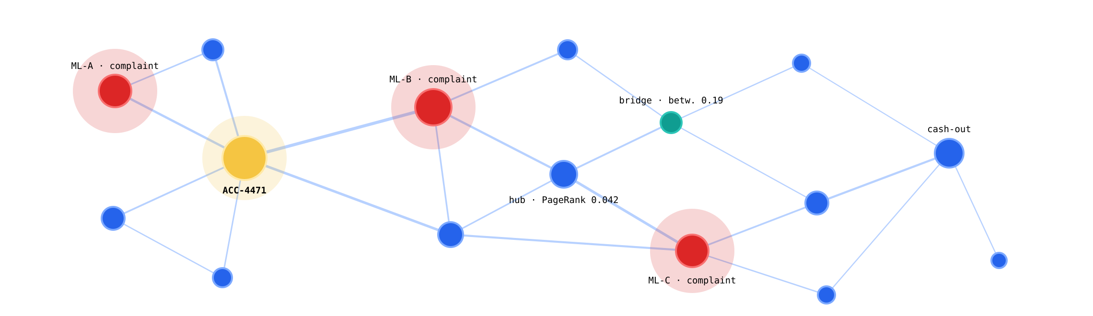
07 — GRAPH ANALYTICS
Suspicious network detection — rings, hubs and intermediaries
COMPLAINT-LINKED (SUSPICIOUS)
SELECTED ACCOUNT
CONNECTED ACCOUNT
BRIDGE / INTERMEDIARY
— EDGE THICKNESS = TRANSACTION AMOUNT
INTERACTIVE: ZOOM · PAN · CLICK TO INSPECT
◈
PageRank — identify hub accounts in money flow
◈
Betweenness — find key intermediary accounts
◈
Louvain communities — detect organised fraud rings
◈
Distance-to-bad — proximity to complaint-linked accounts
◈
Force-directed layout — visualise hidden patterns
Notes:
Our graph analytics engine visualises suspicious networks. Red nodes are complaint-linked accounts, amber is the selected account, and blue are connected accounts. The thickness of edges shows transaction amounts. We use PageRank to find hub accounts, betweenness to find intermediaries, and Louvain community detection to identify organised fraud rings. Investigators can zoom, pan, and click on any node to get details.

Slide 9
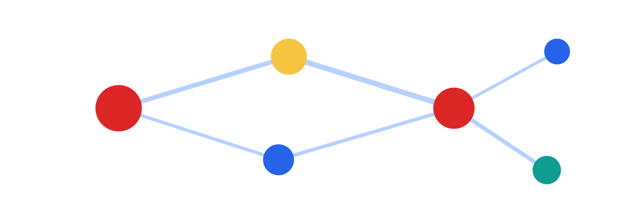
08 — PRODUCT
Investigation dashboard — detection to filed report
RISK QUEUE
SORTED BY SCORE
ACCOUNT PROFILE
SHAP REASONS
MONEY TRAIL
5 HOPS
ACC-4471
92.4
HIGH
4471
ACC-4471
92.4
ACC-1038
88.1
HIGH
opened 2024-03-11
fan_in +2.41
passthru +1.87
age −0.34
VICTIM
MULE A
MULE B
CASH
ACC-7723
61.5
MED
ACC-2290
47.2
MED
inflow
₹ 18,42,000
total traced
₹ 4,20,000
outflow
₹ 17,96,500
hops
3 / 5
ACC-9154
18.6
LOW
RANKED LEADS · COLOUR BANDS · FILTERS
EXPLAINABLE RISK INDICATORS
FUND FLOW TRACING
NETWORK VIEW
SVG ENGINE
REPORT VIEW
SAR-2026-0417
COMPLAINTS
HOTSPOTS
ML-A
14 complaints
ML-B
9 complaints
ML-C
6 complaints
TXT
HTML · PRINT
PDF ↓
correlation
r = 0.81
INTERACTIVE SVG GRAPH
SAR-STYLE REPORT + DOWNLOAD
HOTSPOT ACCOUNTS + CORRELATION
TECH
FastAPI backend · HTML/CSS/JS frontend · SVG graph engine
SECTIONS: RISK QUEUE · PROFILE · TRAILS · NETWORK · COMPLAINTS · REPORTS
EXPORT: TXT · HTML · PDF
Notes:
Our investigation dashboard is built with FastAPI backend and custom HTML/CSS/JavaScript frontend. It has 6 main sections. The Risk Queue ranks all accounts by AI risk score with colour-coded bands. Account Profile shows detailed SHAP explanations. Money Trail traces fund flows up to 5 hops. Network View provides interactive graph visualisation. Complaints shows hotspot accounts and correlations. And Reports generates downloadable SAR-style investigation reports in TXT, HTML, and PDF formats. [LIVE DEMO: Risk Queue → Account Profile → Network → Money Trail → Report Generate + Download]

Slide 10
09 — IMPACT & FUTURE SCOPE
From research benchmark to investigation-ready platform
KEY IMPACTS
FUTURE SCOPE
✓
8.8M transactions analysed automatically
→
Graph Neural Networks for higher-order relational patterns
✓
P@50 = 1.00 — zero false positives in the top-50 alert queue
→
Real-time streaming (Apache Kafka) for live scoring
✓
Explainable risk scores via SHAP reason codes
→
Federated learning across banks — privacy-preserving
✓
SAR reports in 3 formats — TXT / HTML / PDF
→
LSTM / Transformer models for time-aware detection
✓
End-to-end workflow — detection → report
→
Active learning with investigator feedback loops
✓
7 ML algorithms compared — 80× better than random
→
Mobile app for field investigators
TECH STACK
PYTHON
XGBOOST
SHAP
NETWORKX
SCIKIT-LEARN
FASTAPI
HTML / CSS / JS
SVG GRAPH ENGINE
THANK YOU.
QUESTIONS?
TEAM KALKI
SHASHI RANJAN KUMAR (LEAD) · CHHAVI PANDEY · UTSAV KUMAR CHAUDHARY · ANURAG KUMAR
Notes:
To summarise our impact: we analysed 8.8 million transactions automatically, achieved zero false positives in top-50 alerts with Bagging, provided explainable risk scores with SHAP, and built an end-to-end investigation platform with SAR report generation. For future work, we plan to explore Graph Neural Networks, real-time streaming, federated learning across banks, and mobile apps for field investigators. Thank you — this was Team KALKI. We're happy to take questions.

Slide 11
BONUS A — METHODOLOGY DEEP DIVE
Molecular signatures of a mule account
FAN_IN_SCORE
PASS_THROUGH_RATIO
unique_sources / in_count
outflow / inflow
≈ 1.0 → receiving from many unrelated people
Classic collection layer pattern
≈ 1.0 → receives money, immediately sends it out
Classic layering / forwarding pattern
STRUCTURING_RATIO
DIST_TO_BAD
txns just below thresholds
shortest path → complaint-linked acct
Clusters at 9,500–9,999 or 45,000–49,999
Classic evasion technique (smurfing)
1–2 hops → highly suspicious
Graph proximity to known-bad accounts
SCORE FUSION
R = 100 × ( 0.50×B + 0.30×G + 0.20×I )
HIGH ≥ 70
MEDIUM 40–69
LOW < 40
Notes:
Deep dive into feature engineering. fan_in_score captures the collection-layer pattern — money arriving from many unrelated sources. pass_through_ratio near 1.0 signals forwarding — money doesn't stay. structuring_ratio detects deliberate splitting just below reporting thresholds like 9,500-9,999. dist_to_bad uses graph shortest paths to known complaint-linked accounts — 1 to 2 hops is highly suspicious. We fuse the three domain scores: R = 100 × (0.50×B + 0.30×G + 0.20×I), and band accounts into HIGH, MEDIUM, LOW.

Slide 12
BONUS B — POSITIONING
How MuleDetect compares to existing approaches
CAPABILITY | RULE-BASED SYSTEMS | SINGLE ML MODEL | MULEDETECT
Network analysis | ✕ not modelled | ✕ transactions in isolation | ✓ Graph analytics (9 features)
Explainability | ✓ transparent rules | ✕ black box | ✓ SHAP reason codes
Adaptability | ✕ static thresholds | ✓ learns patterns | ✓ 7-model ensemble
False positives | High — alert fatigue | Medium | P@50 = 1.00
Multi-dataset validation | ✕ | ✕ | ✓ 3 benchmark datasets
Investigation dashboard | ✕ manual review | ✕ | ✓ full workflow
Report generation | Manual drafting | ✕ | ✓ auto SAR · TXT/HTML/PDF
Scoring speed | Fast | Medium | 22s (XGBoost)
★
Only approach combining graph features, ensemble ML and explainability
★
Built for investigators, not just data scientists
★
Benchmarked on public datasets — reproducible research
Notes:
Compared to rule-based systems, we add network analysis and learned adaptability while keeping explainability. Compared to single ML models, we add graph features, ensembles, and an end-to-end investigation workflow. The result is a platform that is accurate — P@50 of 1.00 — fast at 22 seconds, explainable with SHAP, and usable by investigators with automatic SAR report generation.

