Slide 1

COMPANY RESTRICTED

Slide 2
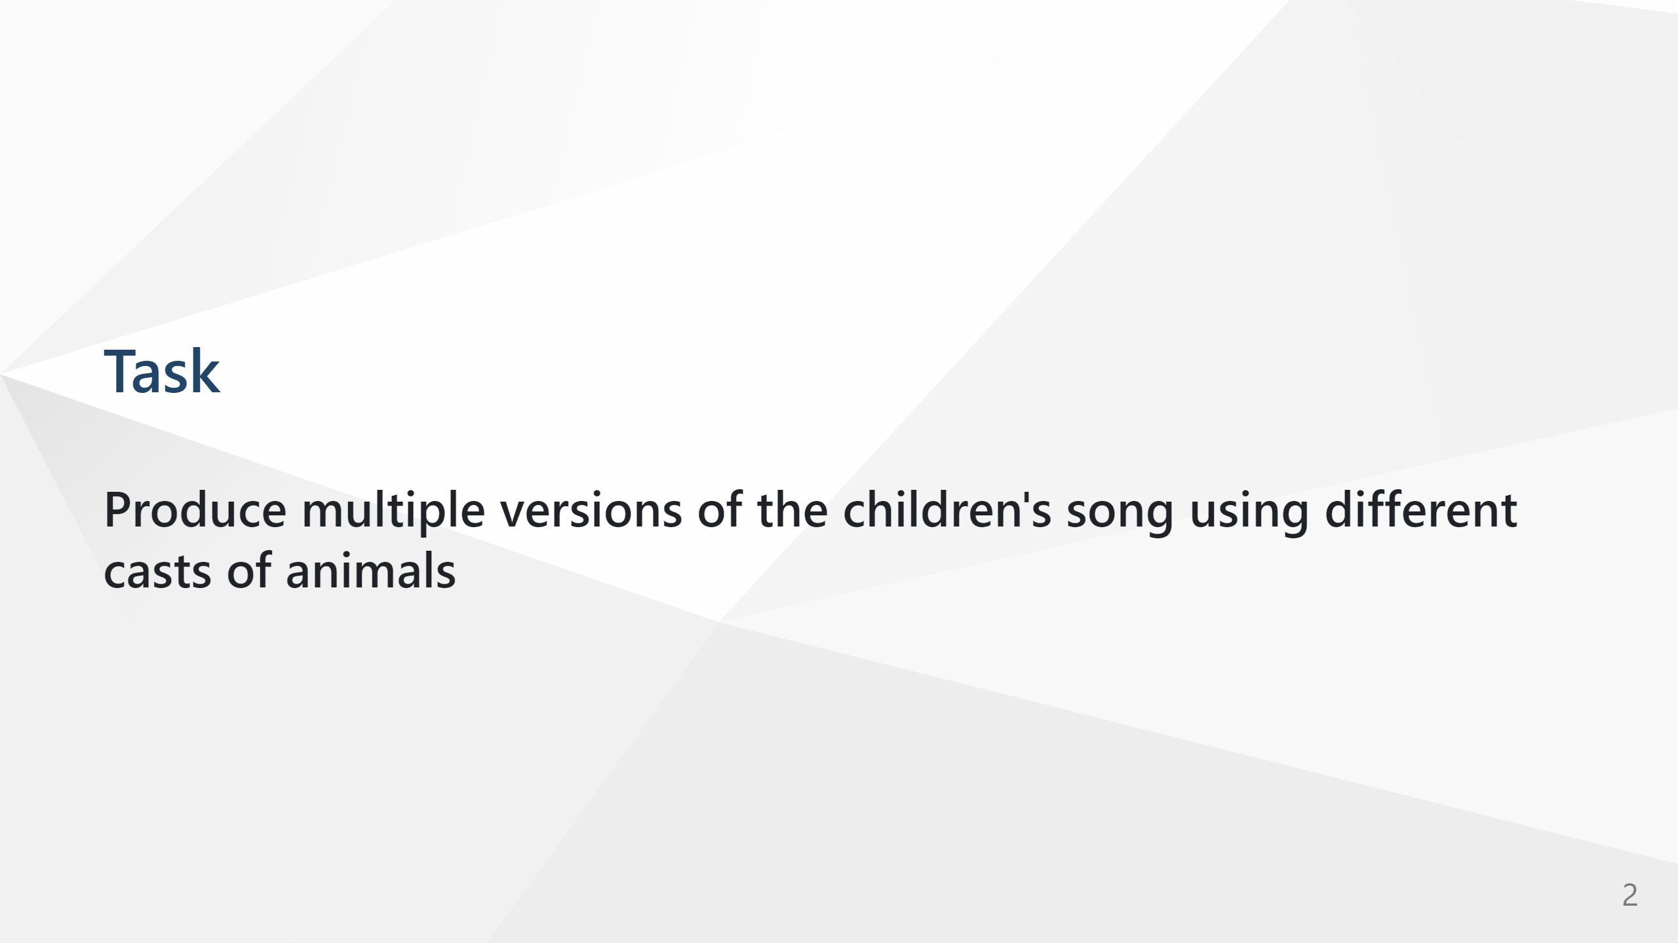
COMPANY RESTRICTED

Slide 3

COMPANY RESTRICTED

Slide 4

COMPANY RESTRICTED

Slide 5

COMPANY RESTRICTED

Slide 6
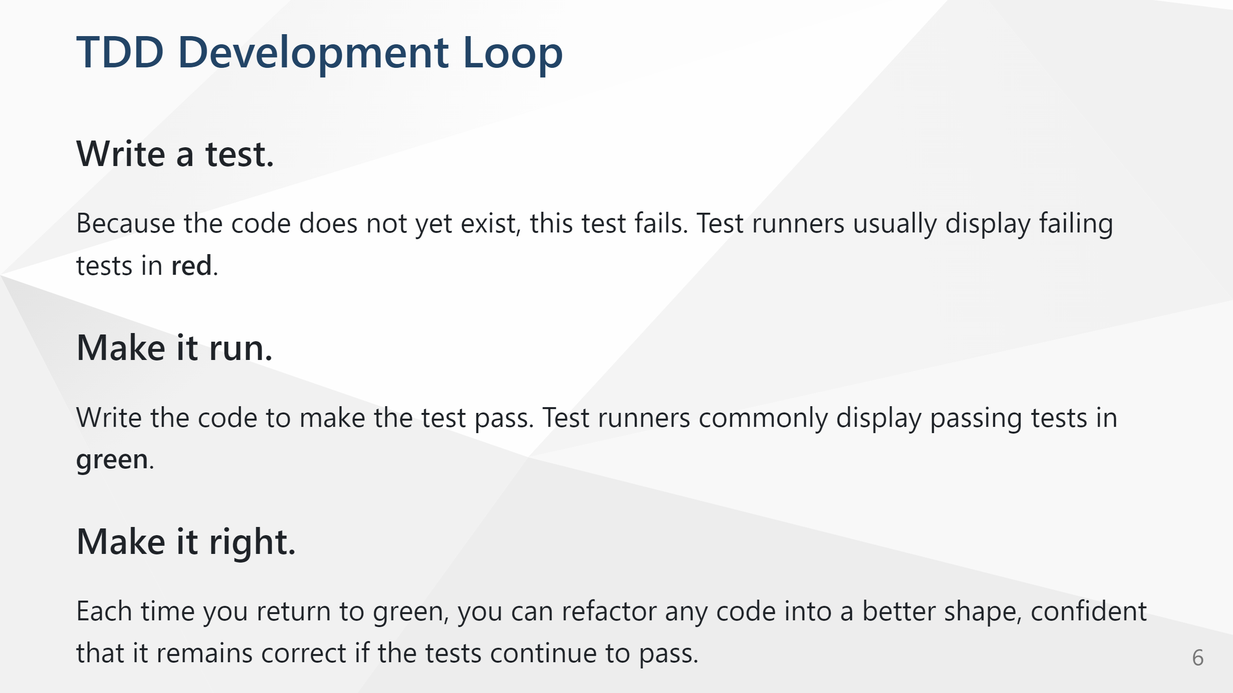
COMPANY RESTRICTED

Slide 7

COMPANY RESTRICTED

Slide 8
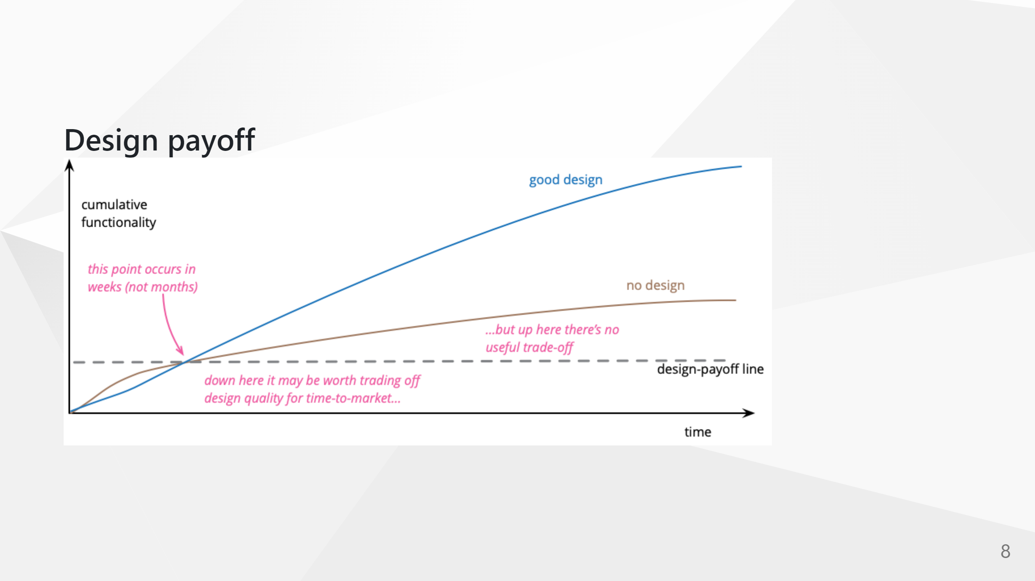
COMPANY RESTRICTED

Slide 9

COMPANY RESTRICTED

Slide 10

COMPANY RESTRICTED

Slide 11

COMPANY RESTRICTED

Slide 12
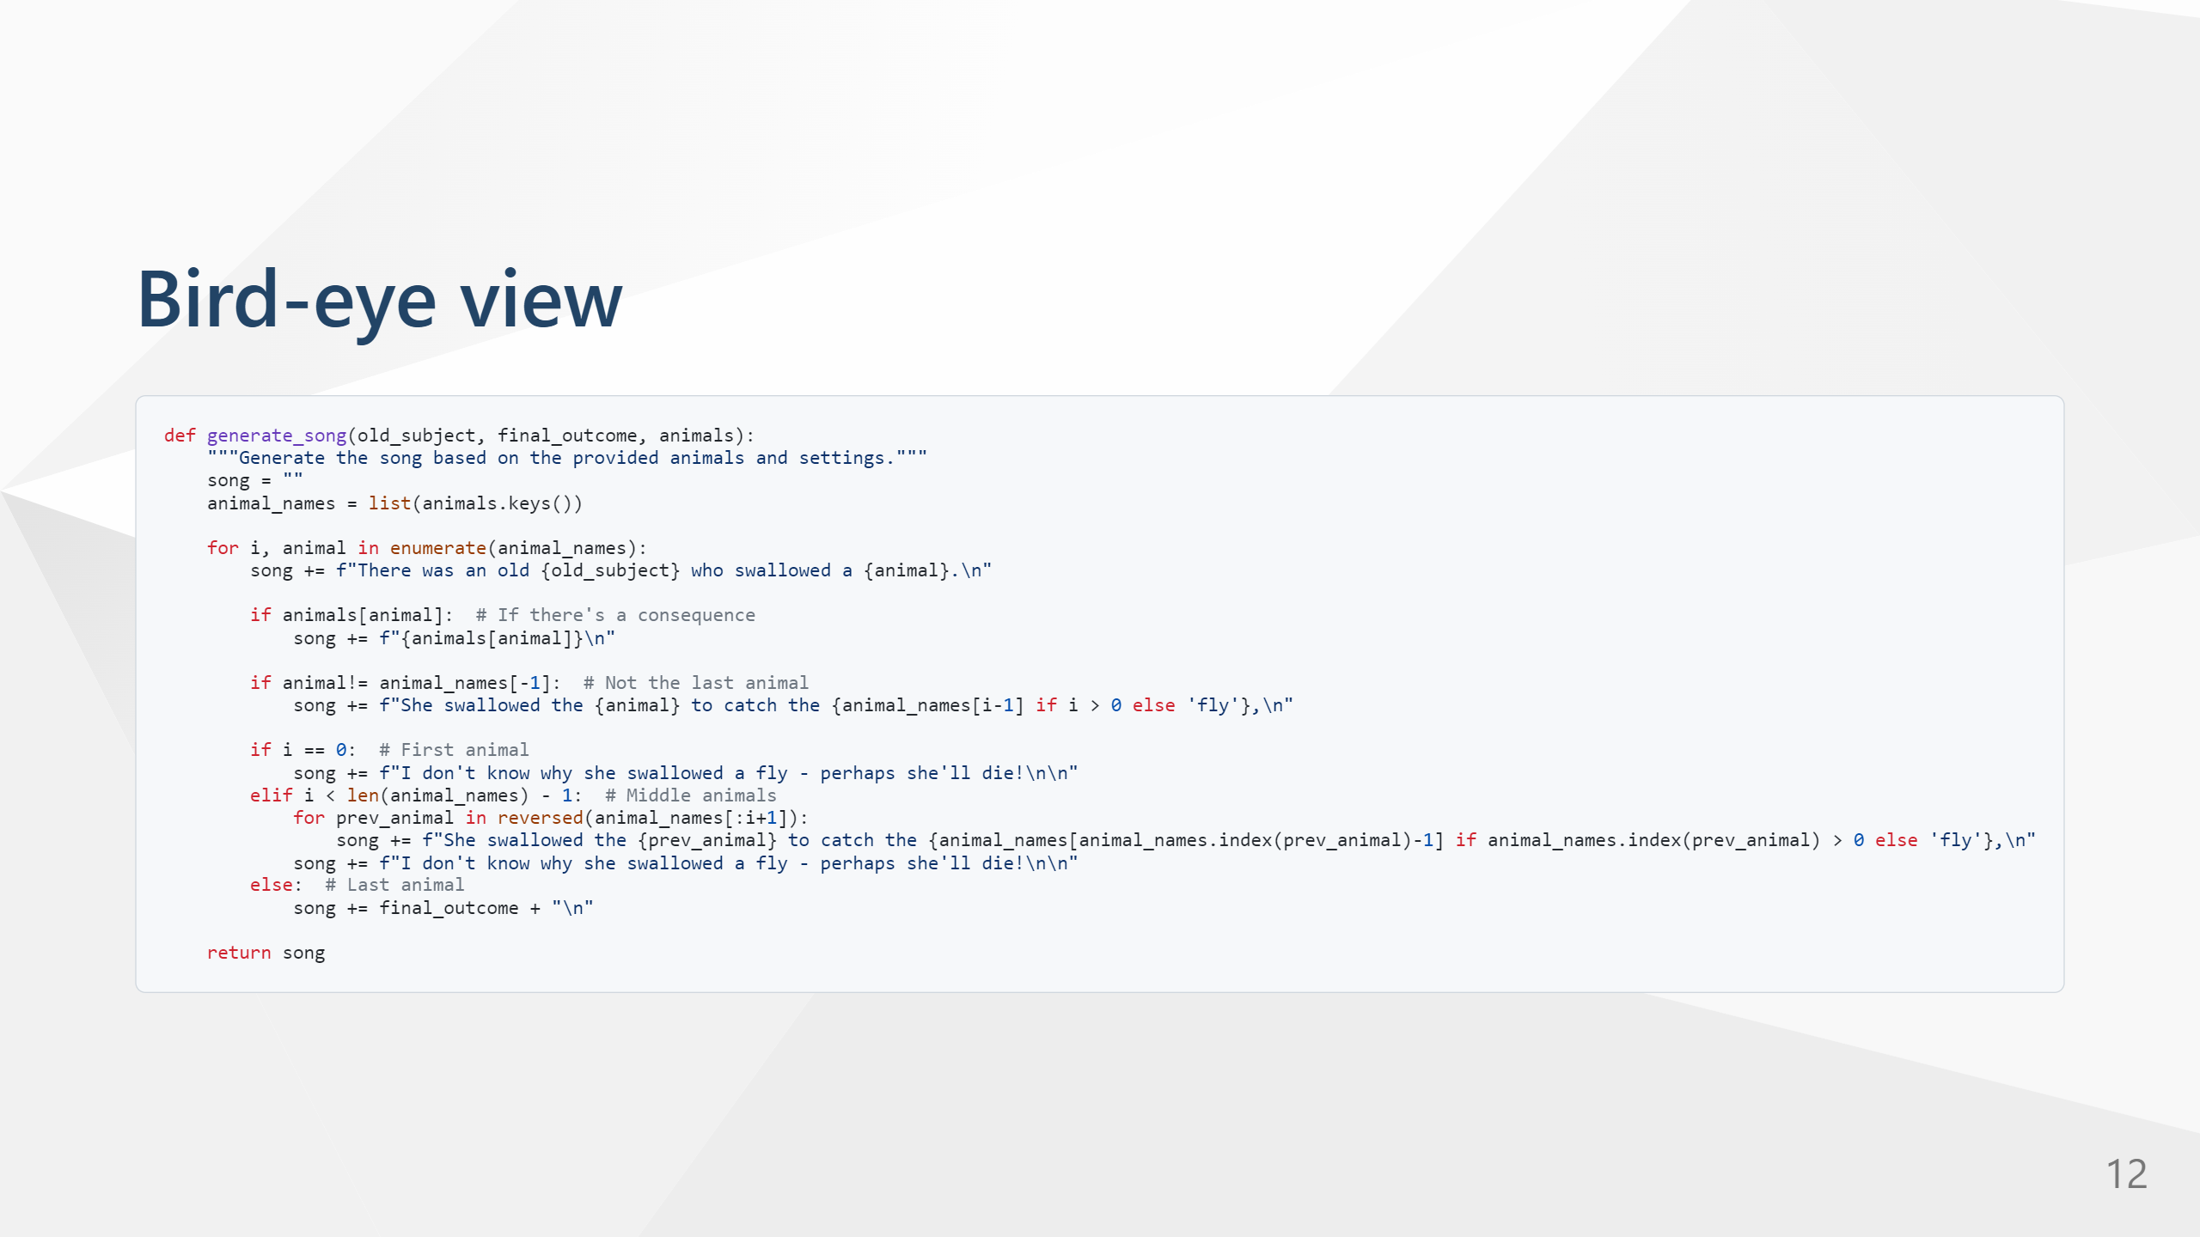
COMPANY RESTRICTED

Slide 13
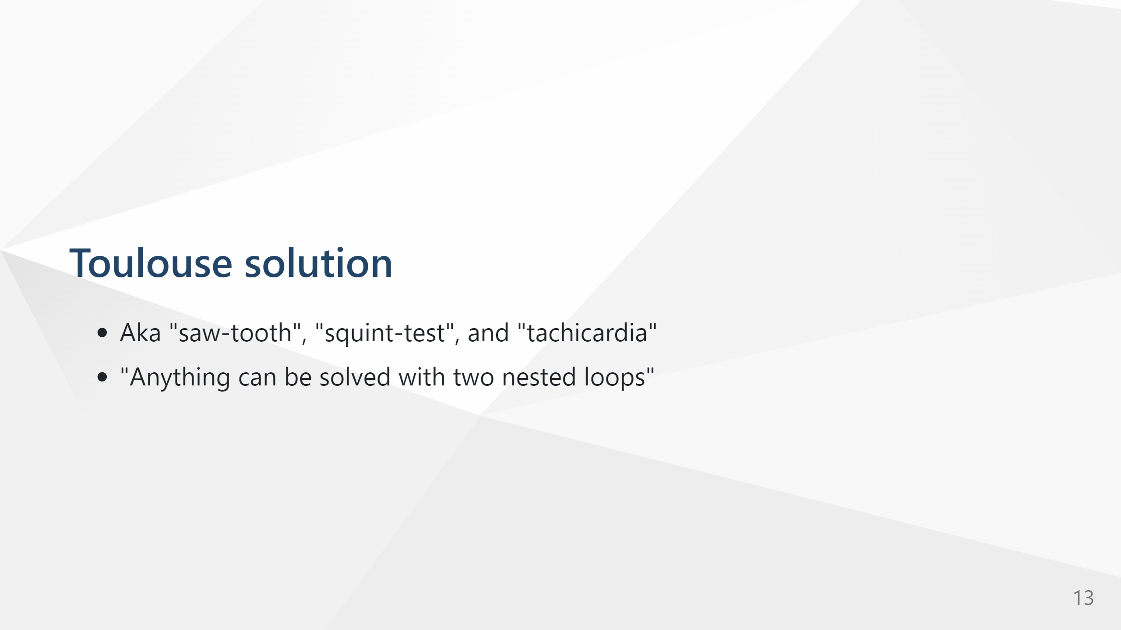
COMPANY RESTRICTED

Slide 14
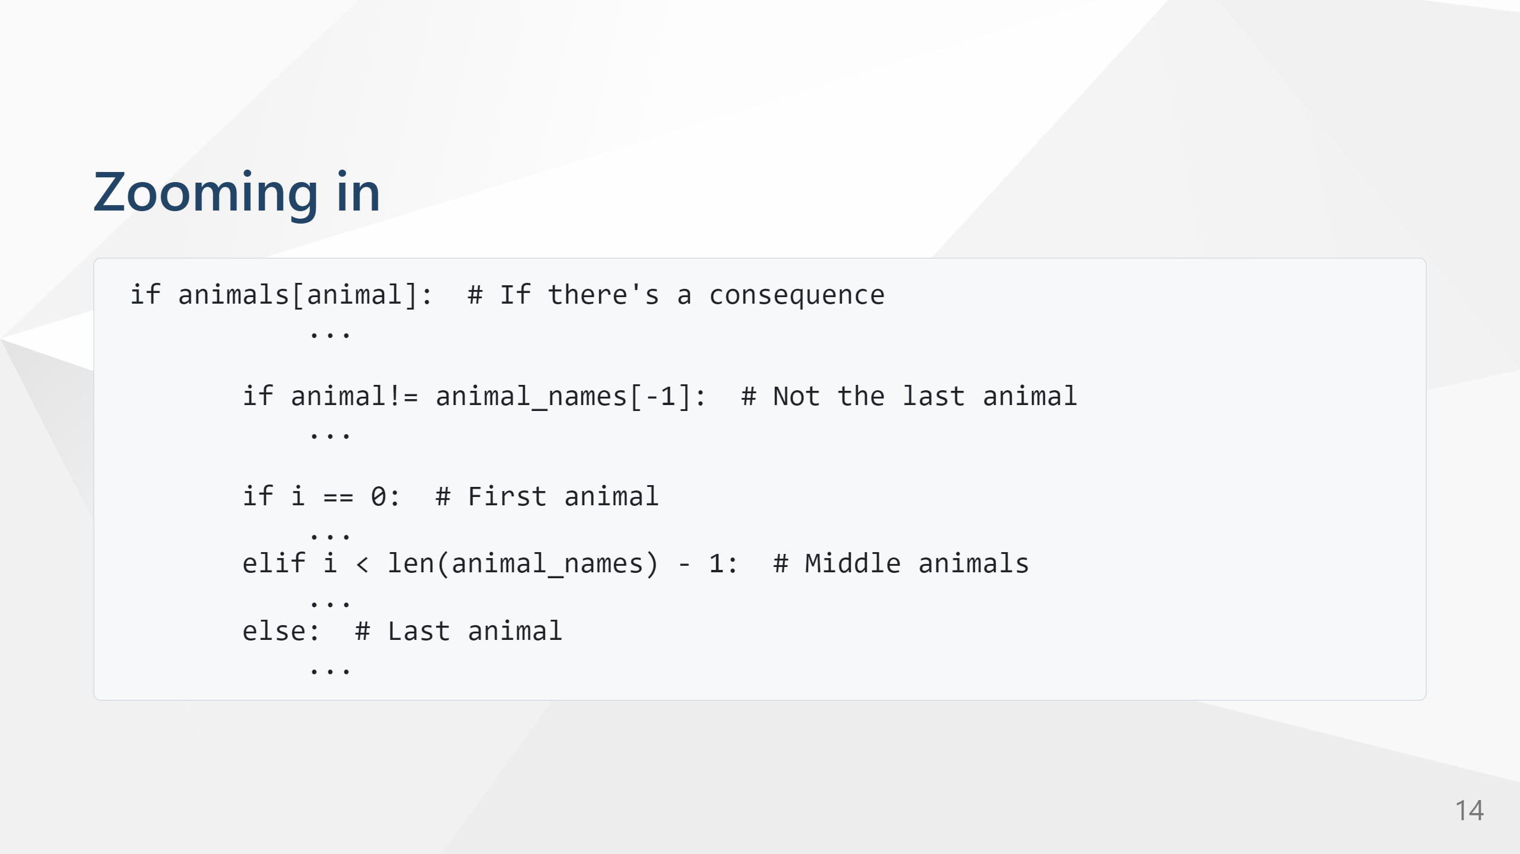
COMPANY RESTRICTED

Slide 15

COMPANY RESTRICTED

Slide 16

COMPANY RESTRICTED

Slide 17
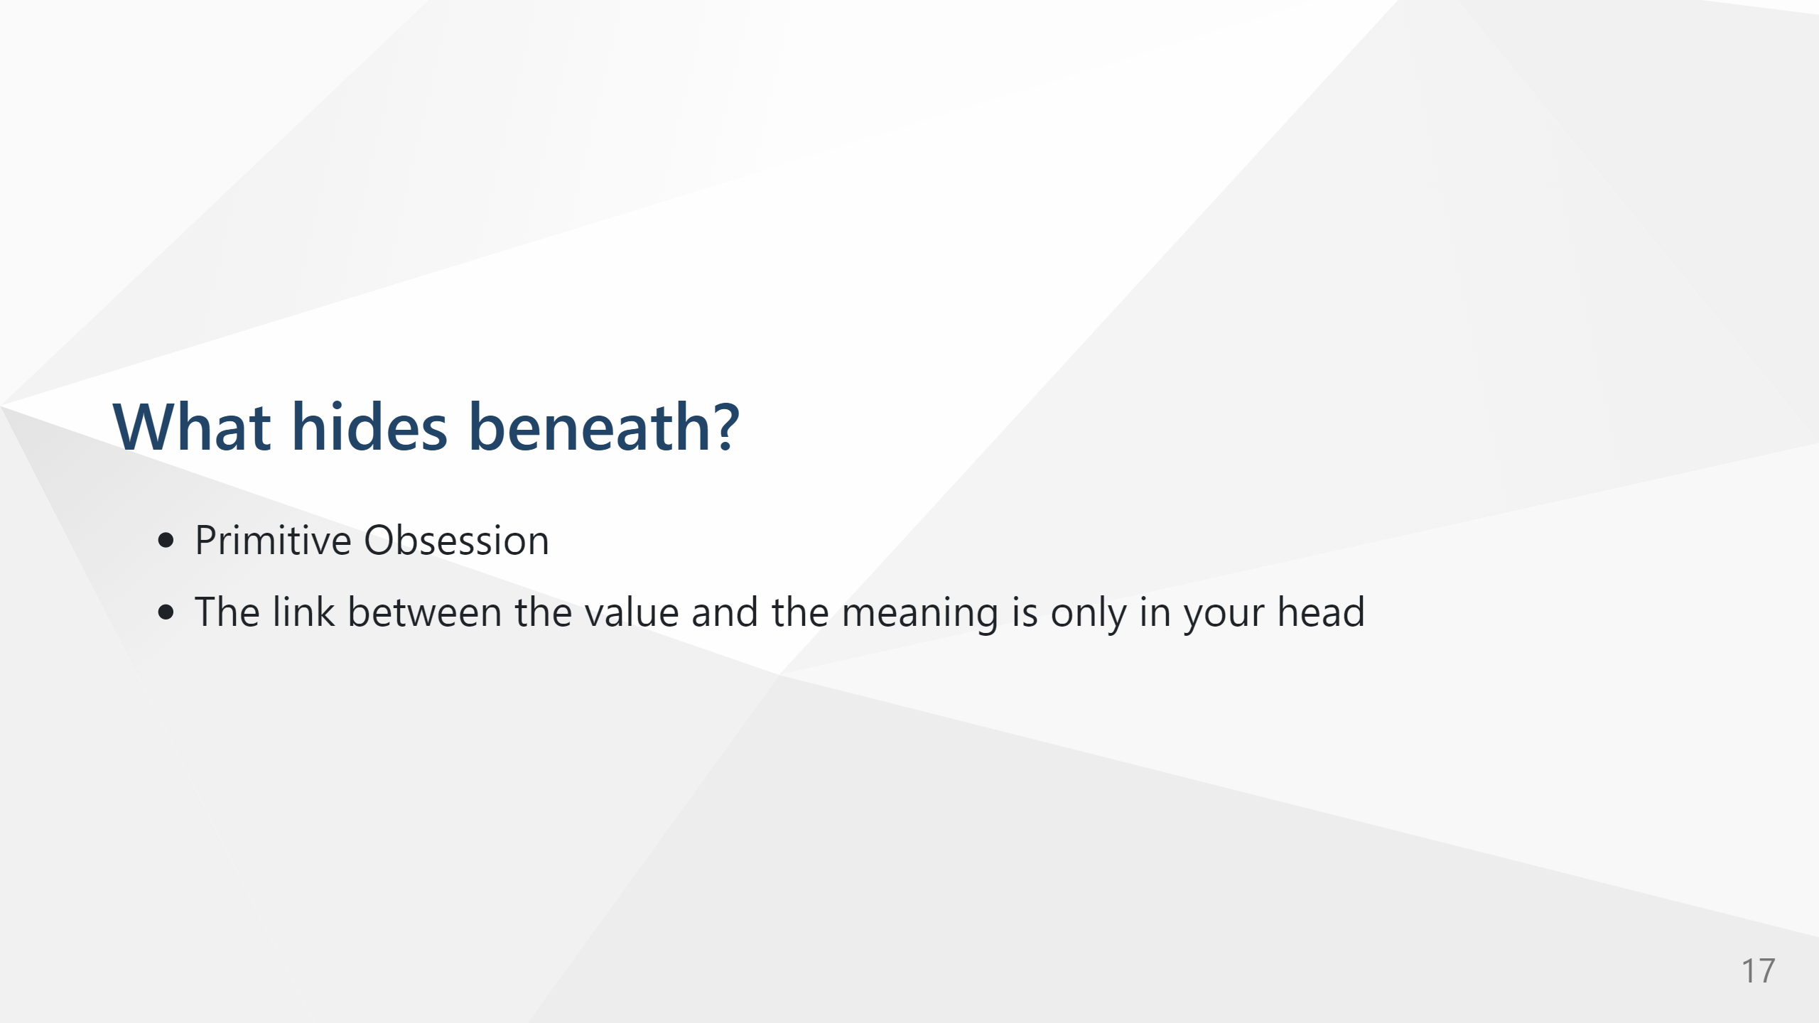
COMPANY RESTRICTED

Slide 18
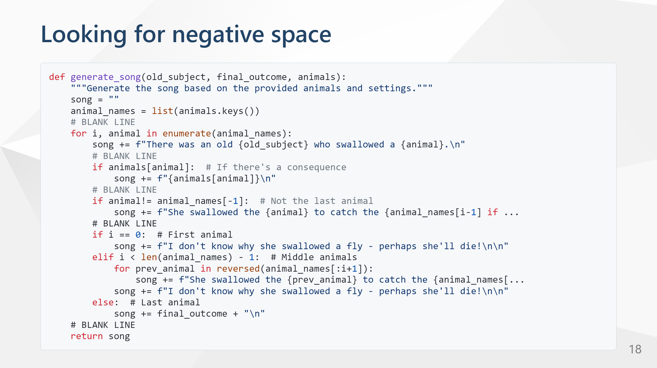
COMPANY RESTRICTED

Slide 19

COMPANY RESTRICTED

Slide 20
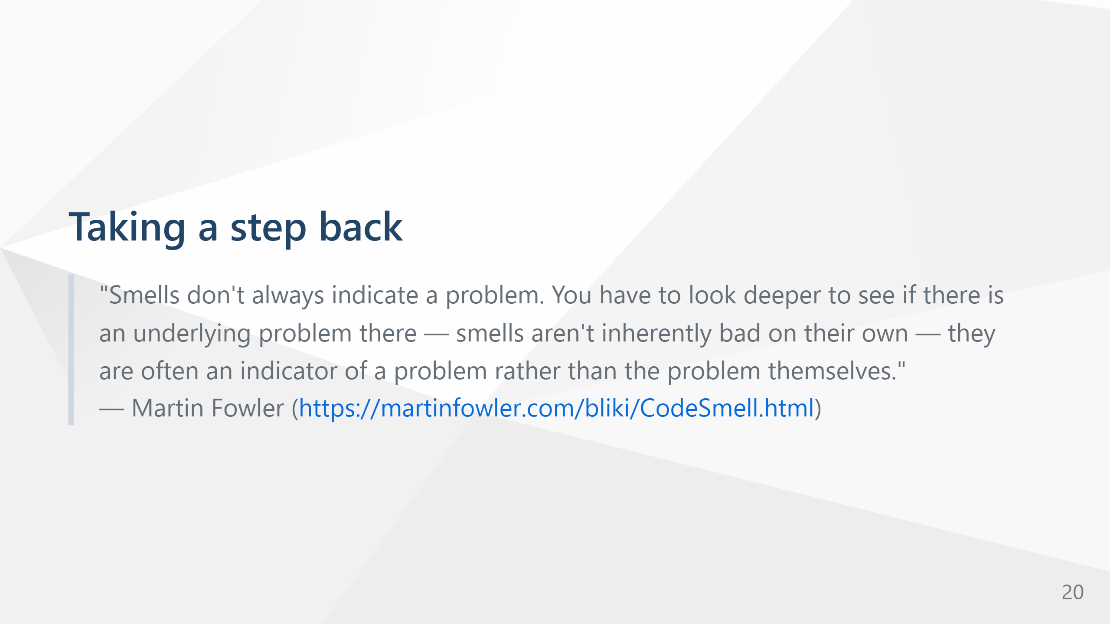
COMPANY RESTRICTED

Slide 21

COMPANY RESTRICTED

Slide 22
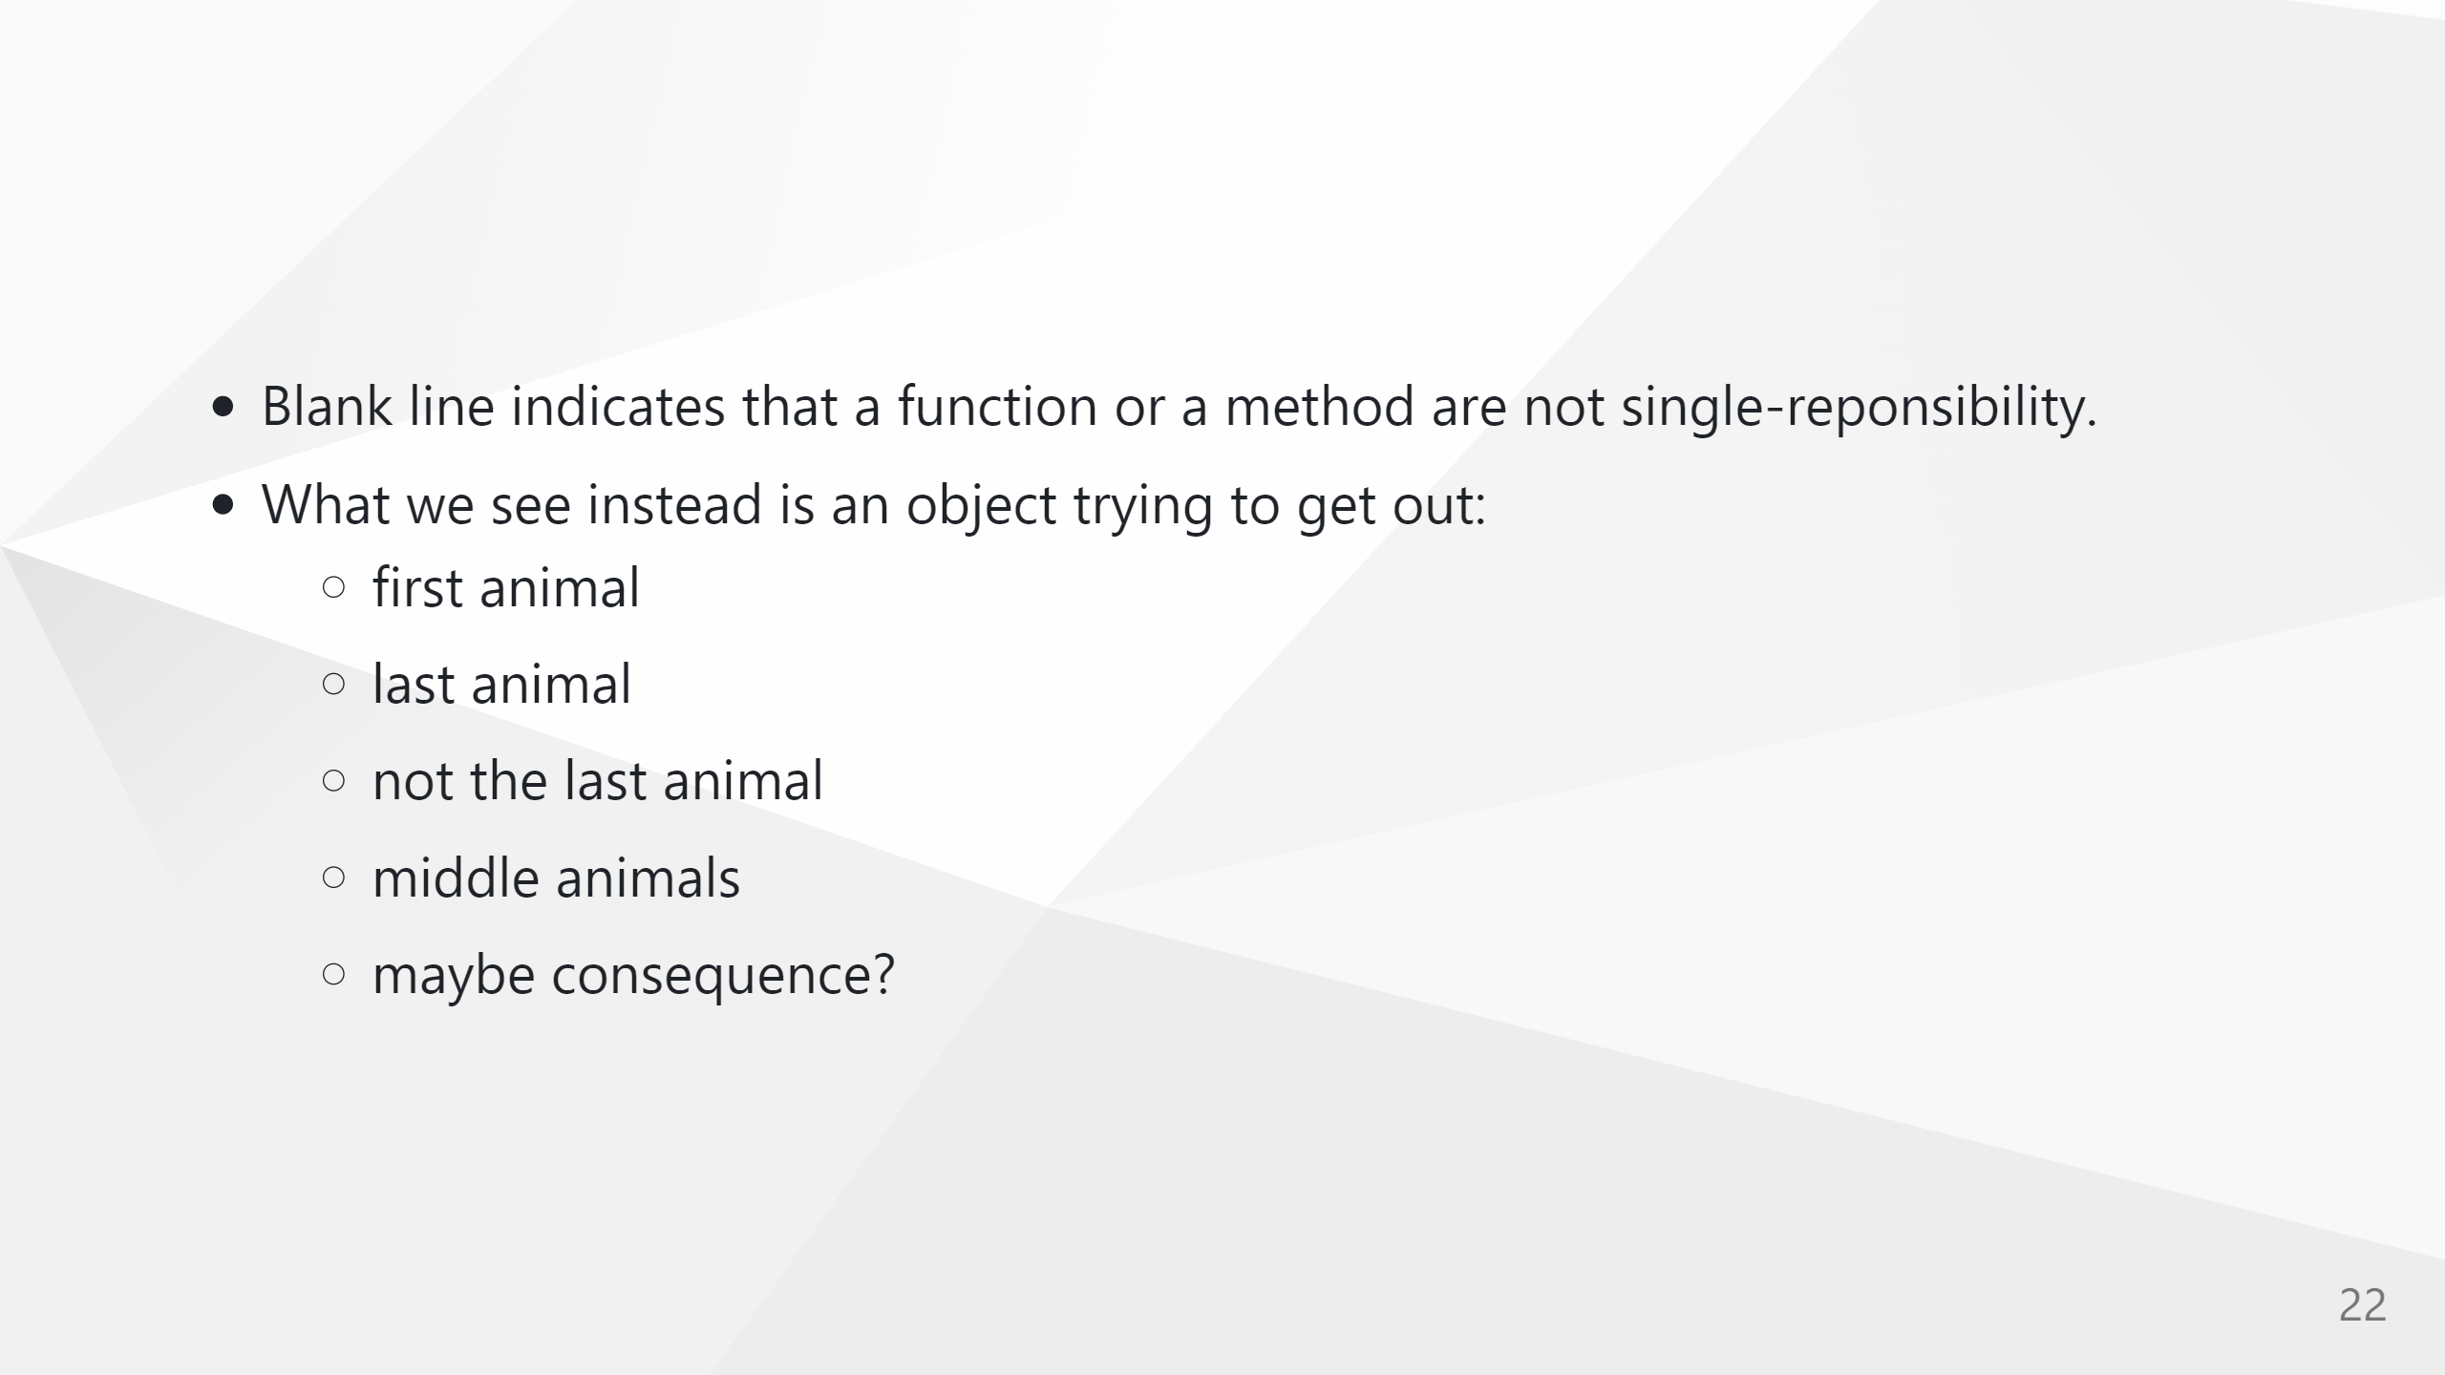
COMPANY RESTRICTED

Slide 23

COMPANY RESTRICTED

Slide 24

COMPANY RESTRICTED

Slide 25
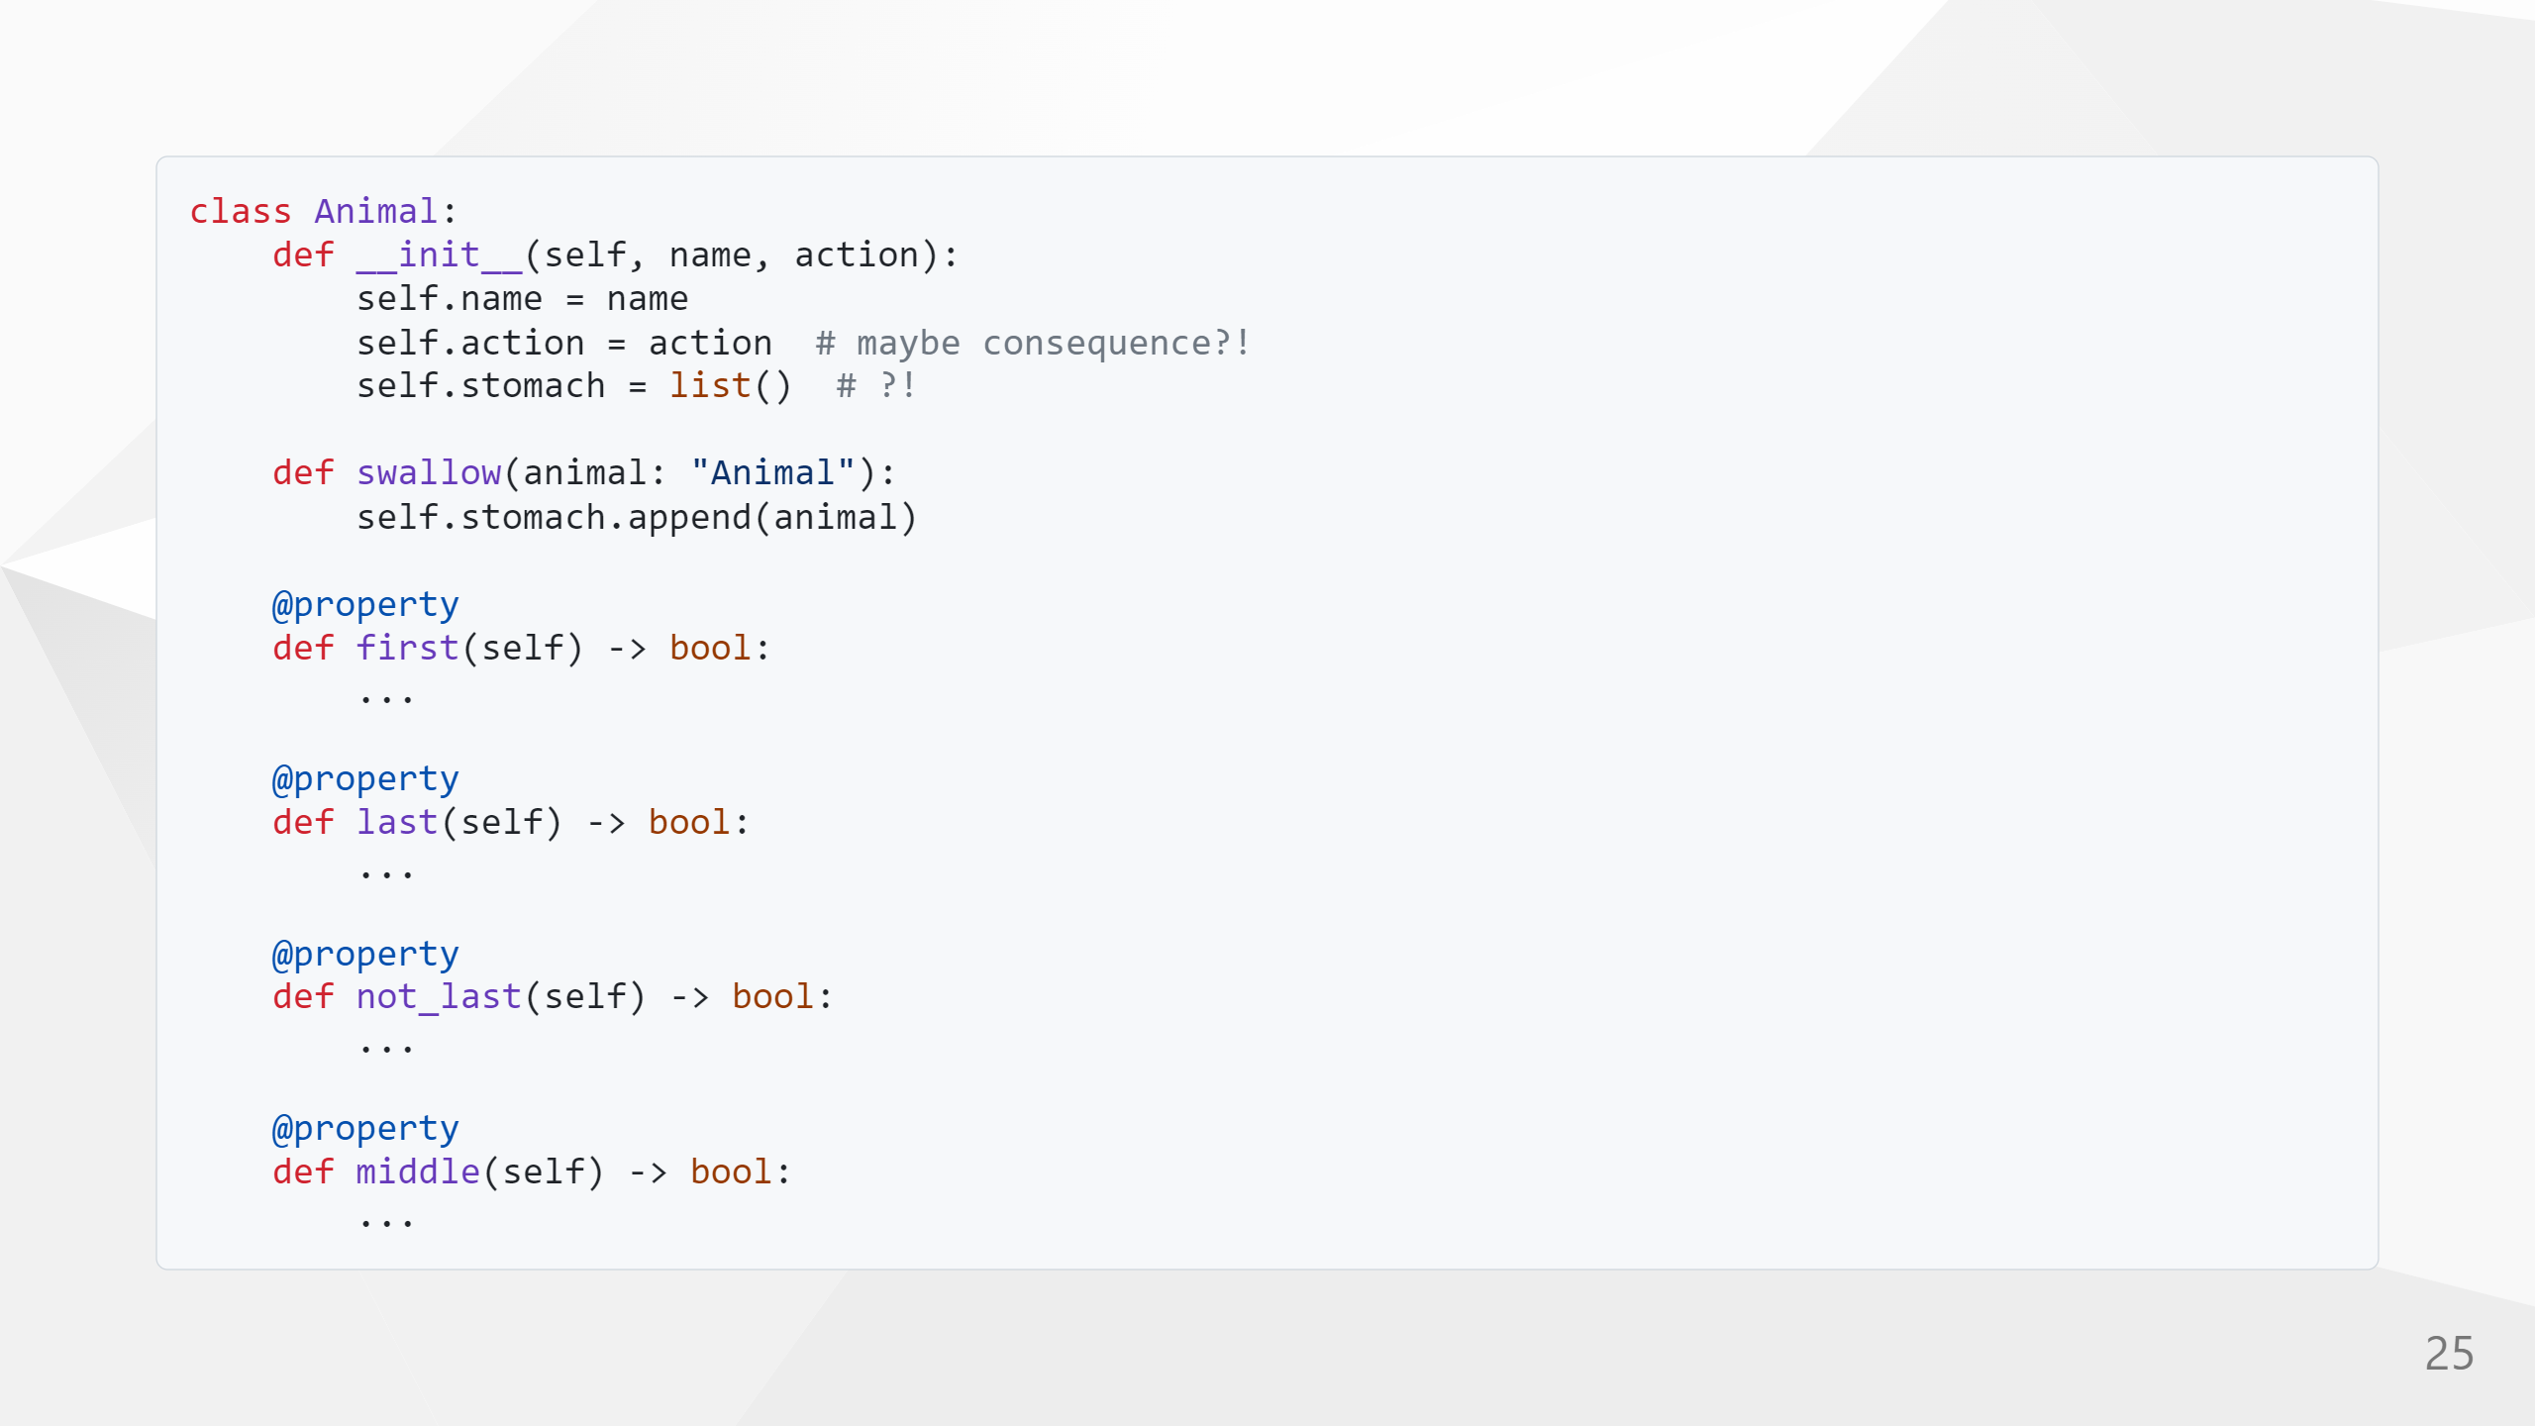
COMPANY RESTRICTED

Slide 26
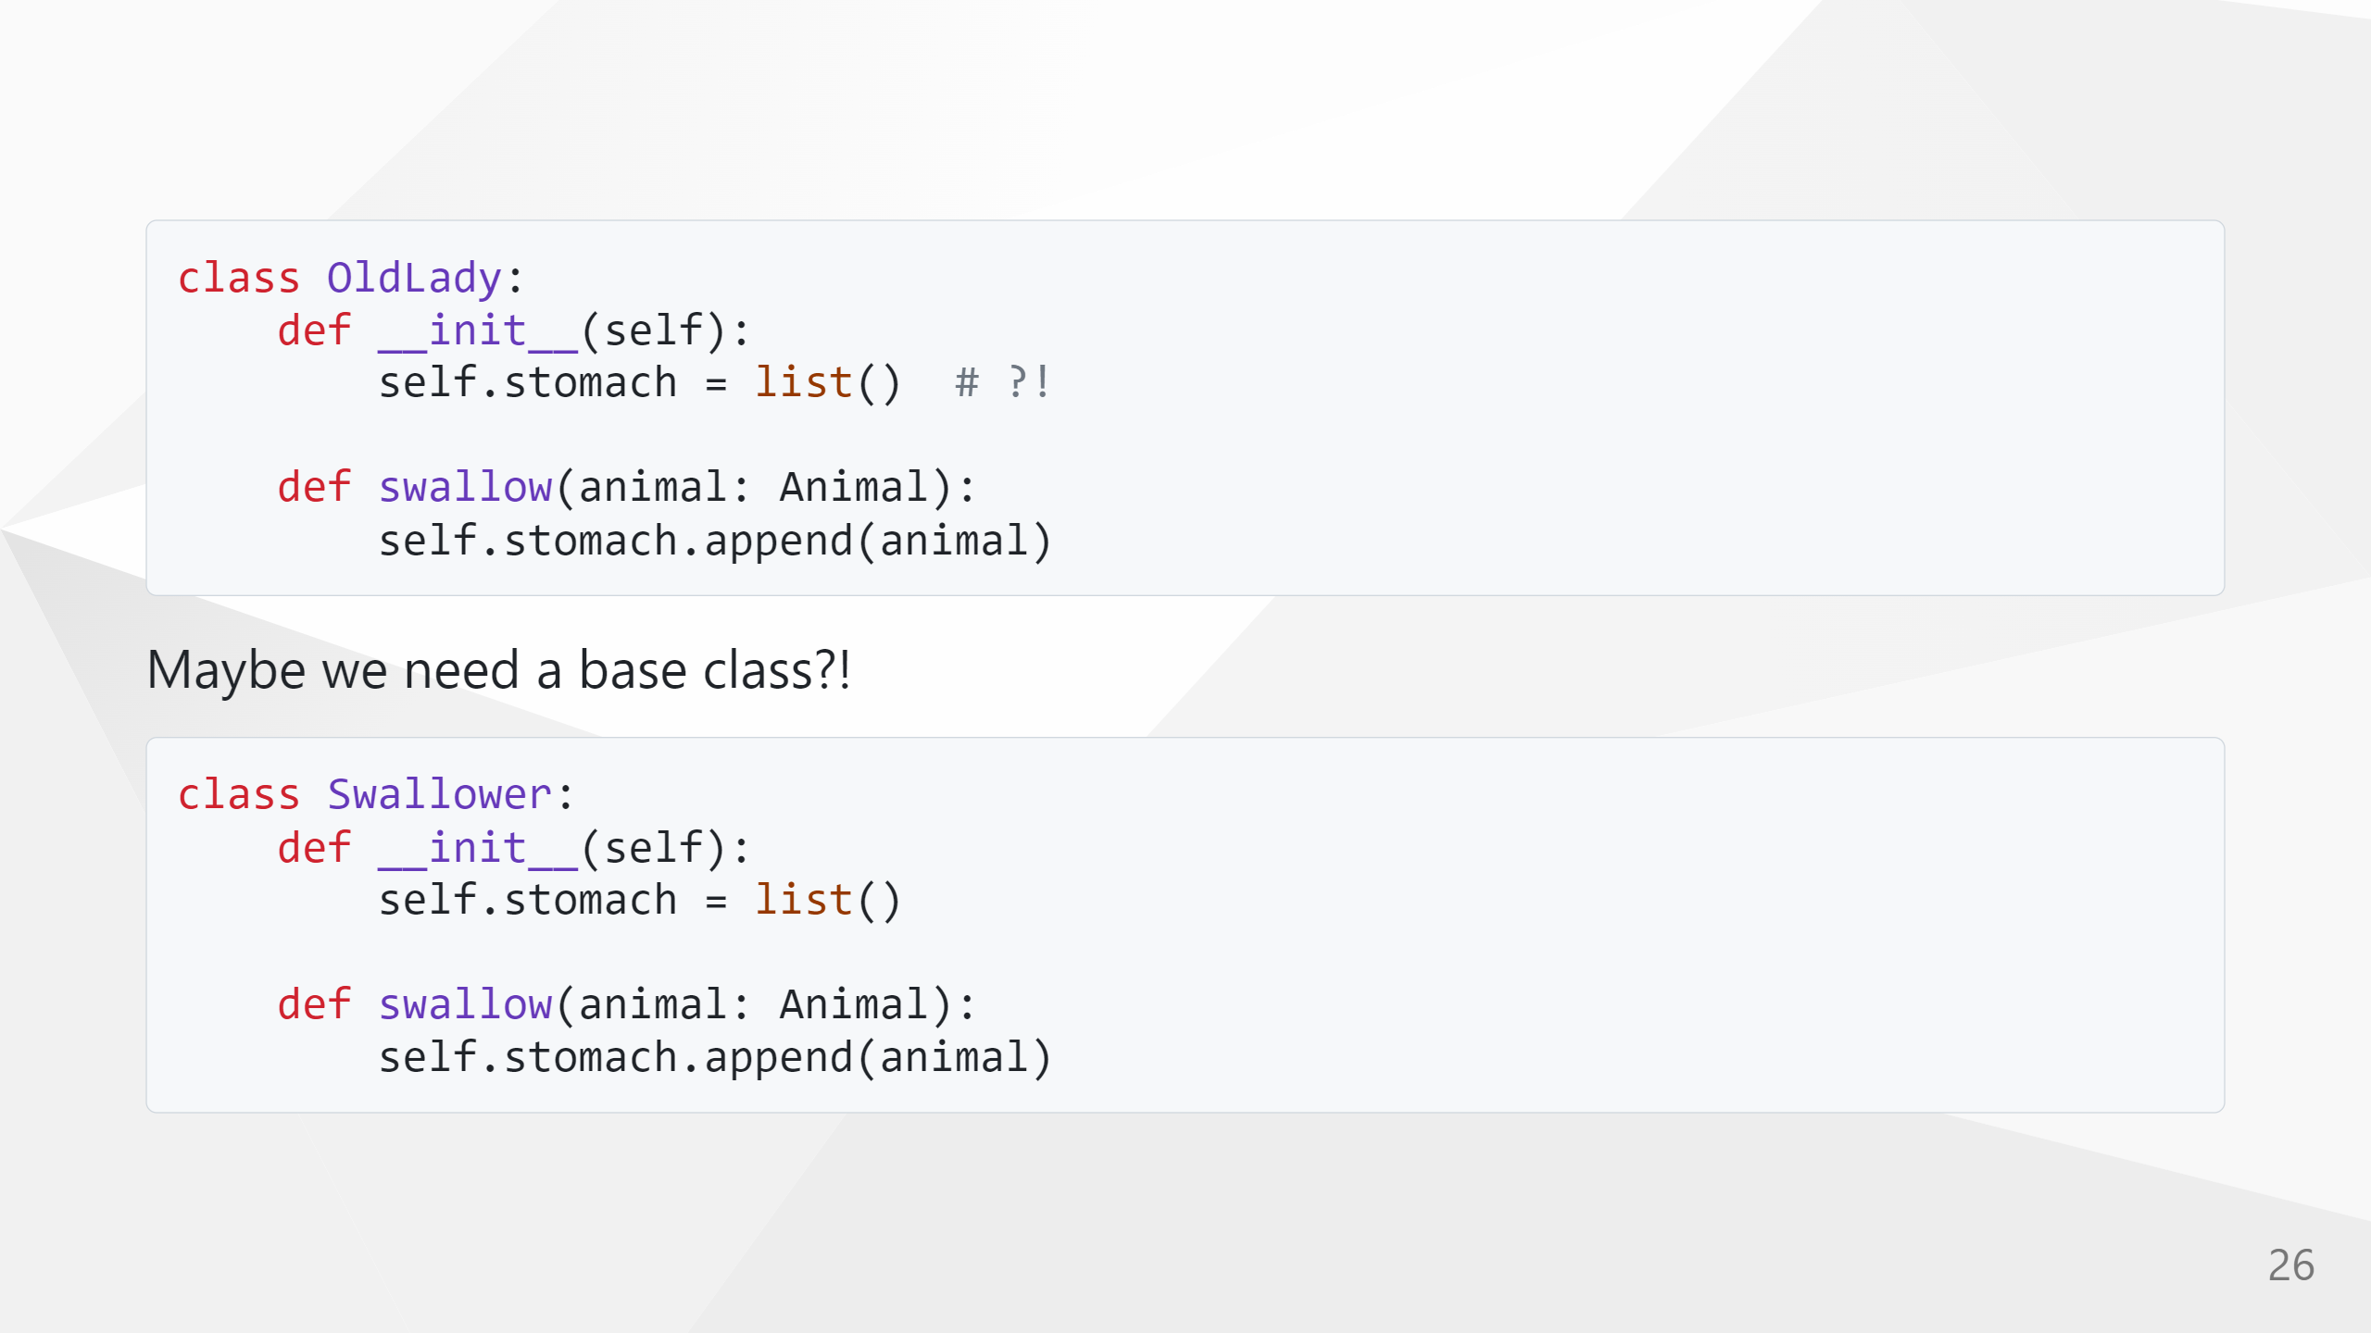
COMPANY RESTRICTED

