Slide 1
Prototype Design Pattern
A.K.A Clone
Created by. Mohammad Mousa

Slide 2
What is Prototype pattern
Prototype is one of the creational design pattern.
The purpose is to let you copy/clone an object without making your code dependent on their classes.

Slide 3


Slide 4
The problem
Let’s say you have an object how would you create an exact copy of that object?

Slide 5
First Solution
First thing comes to mind is to just make a new object and assign it’s properties from the desired object.

Slide 6
Problem with the 1st solution
Private fields
Extra code dependency

Slide 7
Prototype solution
Move the cloning process to the actual classes that are being cloned.

Slide 8
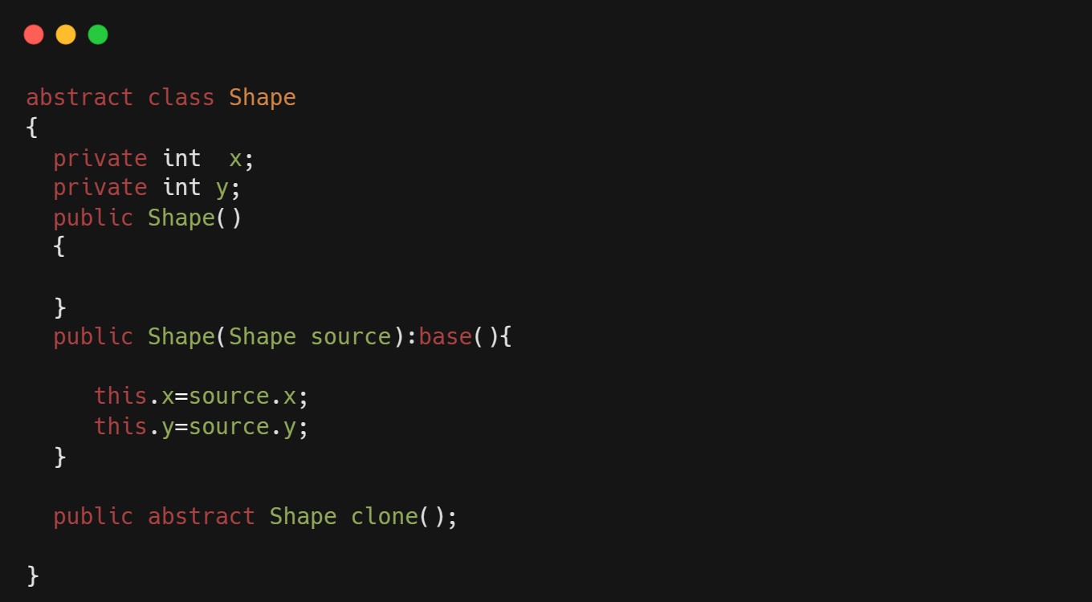
Prototype Example:

Slide 9
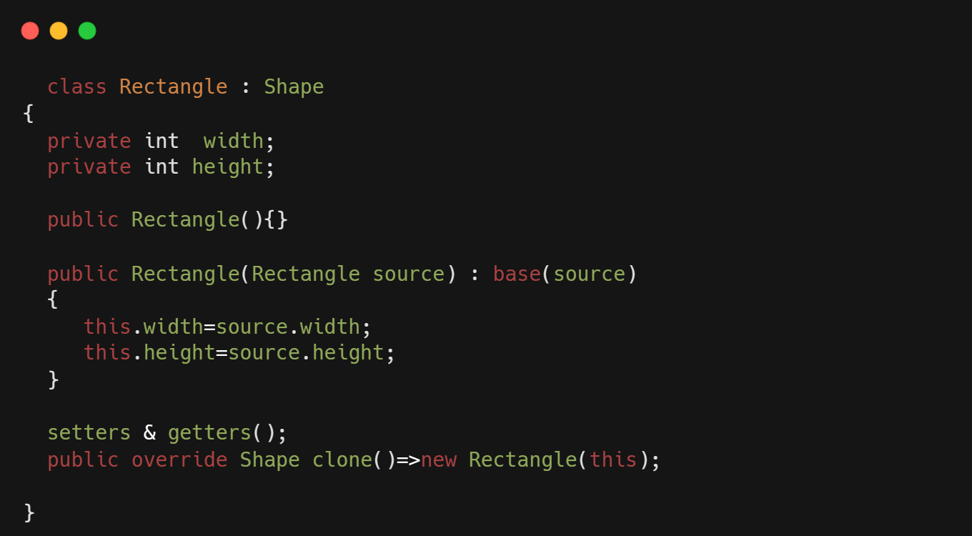
Example cont.

Slide 10
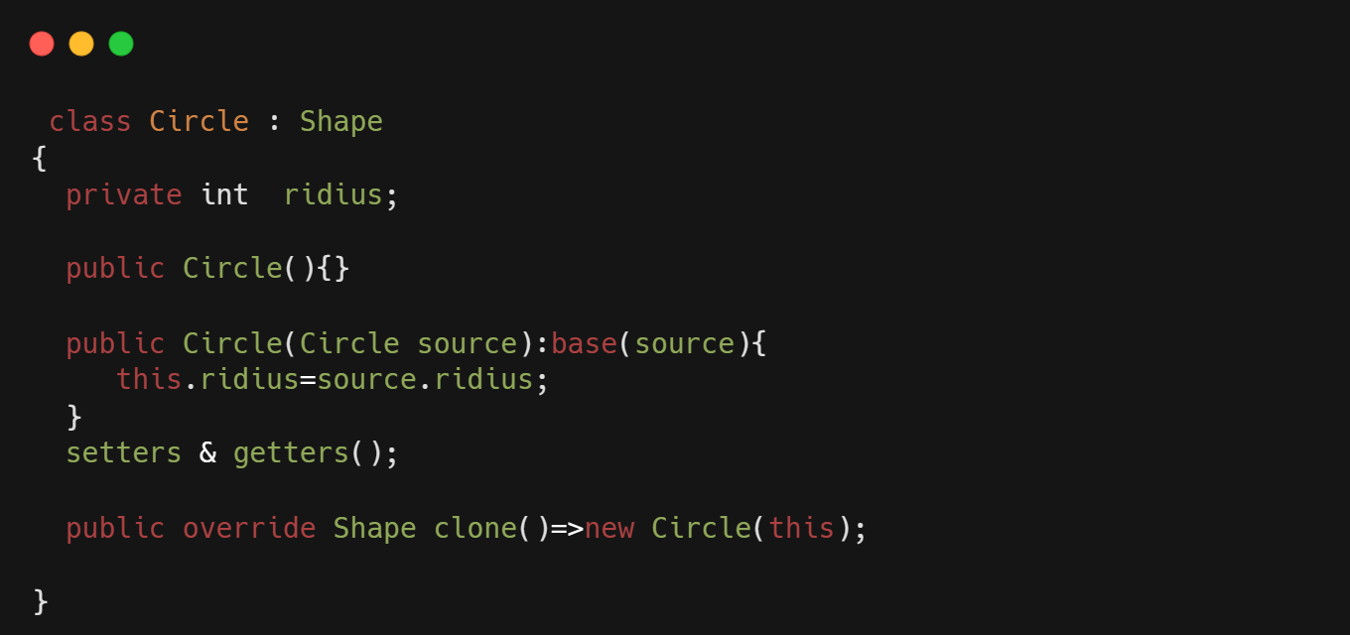
Example cont.

Slide 11
Pros.
Cloning objects is easier and can be done without coupling to the implementation.
Will remove the repeated initialization code because of the use of pre built prototypes.
Cons.
Cloning complex object with circular reference might be tricky.

Slide 12
THANKS!

