Slide 1

Decorator Design Pattern

Slide 2
BY:
Dima Abu Jaber

Slide 3
What Is Decorator Design Pattern
The Decorator design pattern is a structural design pattern that allows you to dynamically add functionality to an object without changing its original class. It is also known as the Wrapper pattern.

Slide 4
Problem!
The traditional approach to achieving this would be to modify the original and adds the required functionality if we want to add new features. However, this approach can quickly become complex and the code will not be flexible or maintainable.

Slide 5
The Idea Of A Decorator!
The basic idea of the Decorator pattern is to wrap an existing class with a new class that provides additional functionality. The new class, called the "decorator," has the same interface as the original class, which means it can be used in the same way. The decorator adds new behavior to the original object by delegating some of its tasks to the wrapped object and adding some new functionality of its own.

Slide 6

The Idea Of A Decorator!

Slide 7
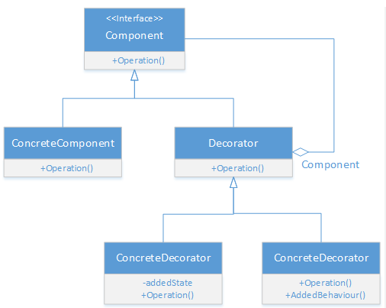
UML

Slide 8
Decorator Components
Main Interface
Concrete Class
Abstract Decorator
Sub-Decorators

Slide 9
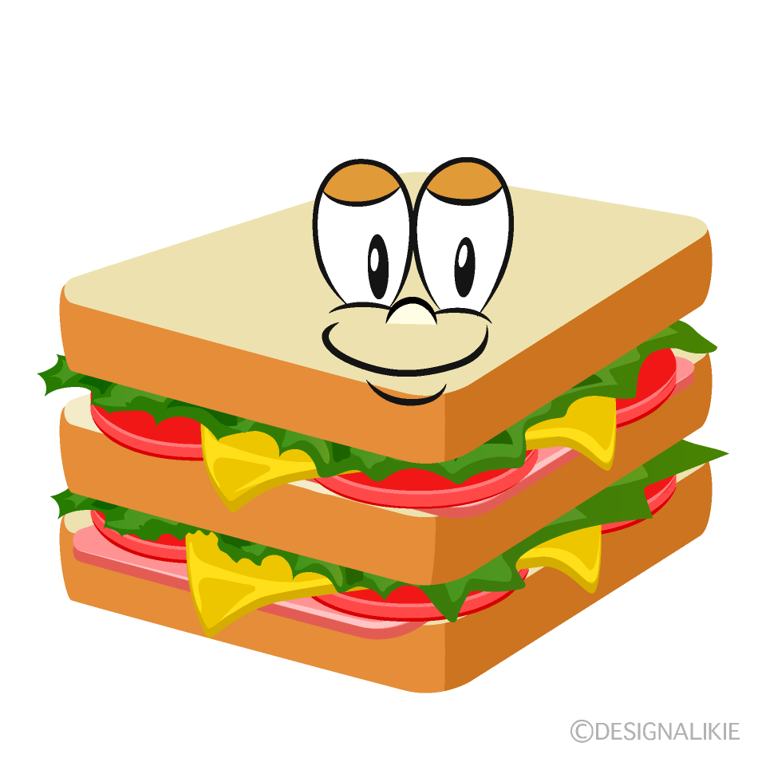
Example Of Decorator Design Pattern
Making a sandwich using a decorator

Slide 10
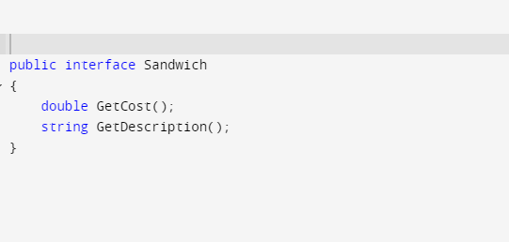
Example Of Decorator Design Pattern

Slide 11
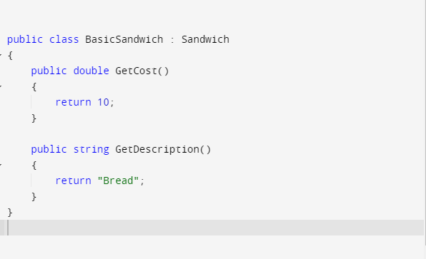
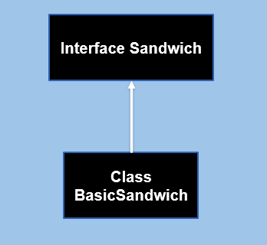
Example Of Decorator Design Pattern

Slide 12
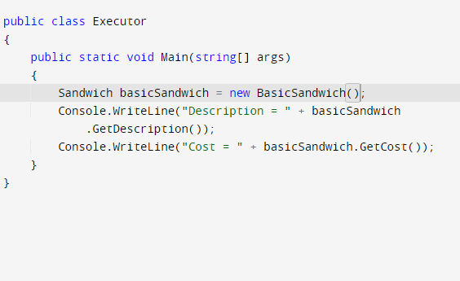
Example Of Decorator Design Pattern

Slide 13
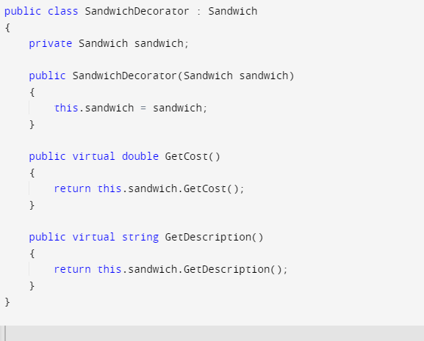
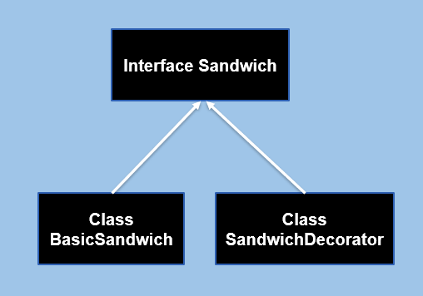
Example Of Decorator Design Pattern

Slide 14
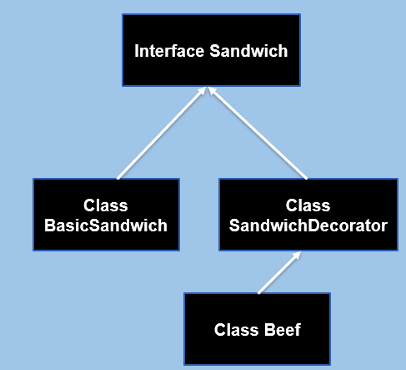
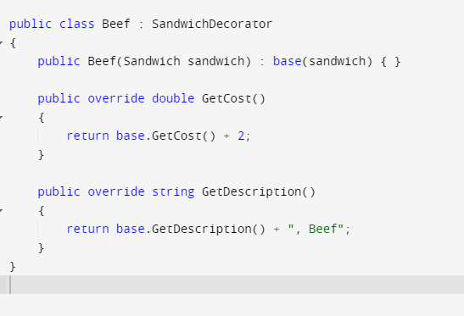
Example Of Decorator Design Pattern

Slide 15
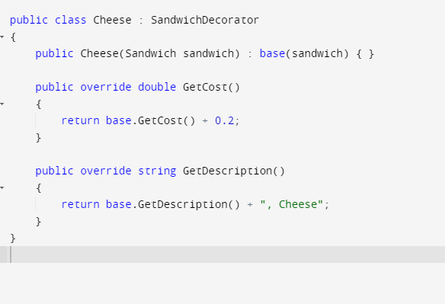
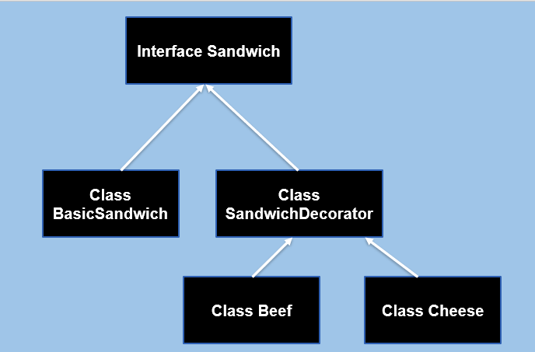
Example Of Decorator Design Pattern

Slide 16
Example Of Decorator Design Pattern

Slide 17
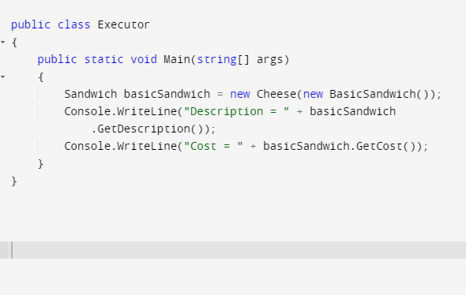
Example Of Decorator Design Pattern

Slide 18
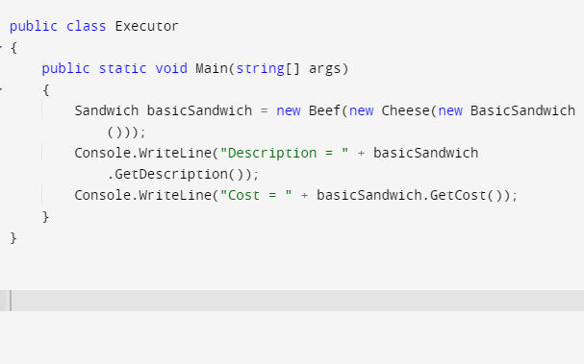
Example Of Decorator Design Pattern

Slide 19
The Benefits Of The Decorator!
One of the key benefits of the Decorator pattern is that it allows you to add new behavior to an object without changing its interface or the behavior of other objects that use it. Adding new features to an existing system is easy without affecting the existing code.
Another advantage of the Decorator pattern is that it allows you to add functionality at runtime, which can be useful in situations where you don't know in advance what features will be required.
The Decorator pattern is a flexible and powerful way to add functionality to an object while keeping the code clean and maintainable.
Single Responsibility Principle.
Open Closed Principle.

Slide 20
Disadvantage
Increased complexity
High number of objects
Difficulty in removing specific decorators

Slide 21

Any question ?

