Slide 1
Burglar Detection using closed circuit television
19BCE0832 KANDALA SAI KRISHNA
19BCE0499 NAKKA DEEPAK
19BCE0829 KANDRA KSHEERAJ

Slide 2
Abstract
Burglary is one of the most intrusive types of crime committed against the general population. It's also known as Breaking and Entering or Home Invasion, and it's described as the unauthorised intrusion into the premises of another with the intent to commit a criminal within. The way detectives and police officers investigate this crime may make the difference between solving the case and enabling burglaries to continue in the community, and burglaries, regrettably, have some of the lowest clearing rates in police investigations.
Computer vision enables computers and systems to derive meaningful information from any visual inputs like digital images, videos. Most of the people have used the cv2.videocapture() function to read from a webcam or a video recording from a disk but only a few people know how easy it is to stream a video from a URL, in most cases this URL is from an IP camera. Stream a Live Video wirelessly from your phone’s camera to OpenCV’s cv2.VideoCapture() function in your PC and do all sorts of image processing on the spot. This acts as a Surveillance system which will record video samples whenever someone enters your room. Easily take this setup and swap the mobile camera with multiple IP Cams to create a much larger system.

Slide 3
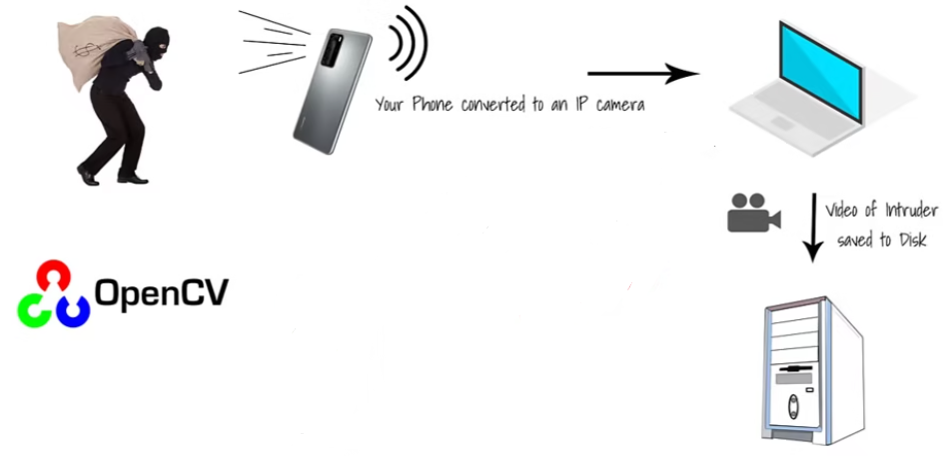
Flowchart

Slide 4
Techniques used
1. cv2.VideoCapture()
Using Live camera feed: You pass in an integer number i.e. 0,1,2 etc e.g. cap = cv2.VideoCapture(0), now you will be able to use your webcam live stream. The number depends upon how many USB cams you attach and on which port.
Playing a saved Video on Disk: You pass in the path to the video file e.g. cap = cv2.VideoCapture(Path_To_video).
Live Streaming from URL using Ip camera or similar: You can stream from a URL e.g. cap = cv2.VideoCapture( protocol://host:port/video) Note: that each video stream or IP camera feed has its own URL scheme.
Read a sequence of Images: You can also read sequences of images, e.g. GIF.

Slide 5
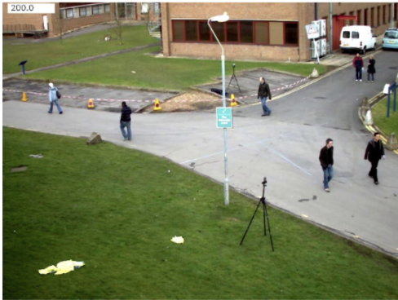
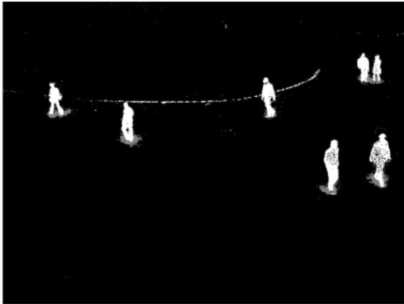
2. Background Subtraction
It is a technique for separating out foreground elements from the background and is done by generating a foreground mask. This technique is used for detecting dynamically moving objects from static cameras. Background subtraction technique is important for object tracking. There are several techniques for background subtraction. The foremost step of the method comprises of generation of background frame using statistical information of an initial set of frames not containing any targets. The generated background frame is made adaptive by continuously updating the background using the motion information of the scene.

Slide 6
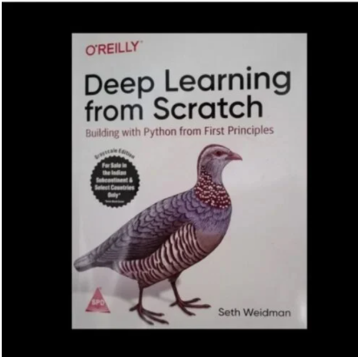
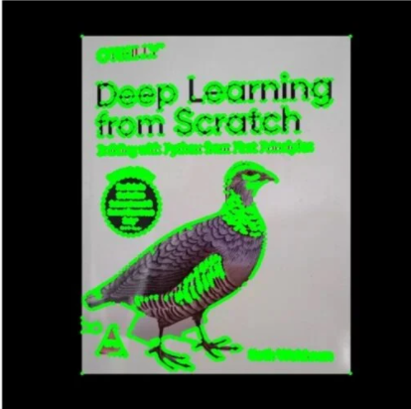
3. Contour Detection
Detect the borders of objects, and localize them easily in an image. Applications such as image-foreground extraction, simple-image segmentation, detection and recognition. The background subtraction method followed by a clutter rejection stage ensure the detection of foreground objects. The next step comprises of detection of contours and distinguishing the target boundaries from the noisy background. This is achieved by using the Canny edge detector that extracts the contours followed by a k-means clustering approach to differentiate the object contour from the background contours. The post processing step comprises of morphological edge linking approach to close any broken contours and finally flood fill is performed to generate the silhouettes of moving targets.

Slide 7
Requirements
IP Webcam app on mobile or wifi smart cctv cams
External storage device or computer storage
Jupyter notebook or google collab
Libraries
Numpy
Opencv
Time
Datetime
deque

Slide 8
Implementation & Results

Slide 9
Conclusion & Future Works
Complete simulation of an easy simulation system has be achieved using appropriate techniques by decreasing additional effort for securing a place.
The IP Camera has a dynamic IP and need to update it every time.
Accessing IP Camera Outside of the local WIFI Network by determining external IP and configuring it.
Sending notifications to registered mobile when some moment is captured.

Slide 10
Thank you

