Slide 1
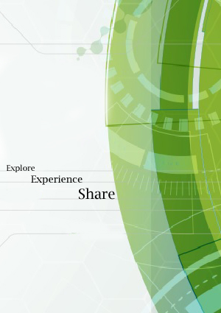


Learn
Experience
Explore

Slide 2

Problem Statement
Consider a situation..
I am concerned about the safety of the ladies at home.
I need to change
the details of my bank accounts!
Where do I go ?
What are the common cultural differences in this place ? I don’t want to offend anyone!
A Lonely Man
A New City
Unlimited Questions!
I need a government document urgently. Can I get it efficiently ?

Slide 3
And much more!
Do I really need to install
15 different apps ?
No. FindMyPlaces is for the rescue!

Slide 4
Basic functionality of the application
Find places in city
This Mobile app enables the user to find the nearest Banks, Blood Banks , police stations, ATMs, Shopping Mall, Bus Stands, Railway Stations, Schools, Colleges, Hotels, Restaurants and Hospitals according to their location.
Women Safety
Women safety has become one of the utmost priority of the Indian government considering the increasing crimes against women. Our app Has been designed keeping in view the security and protection of women to ensure that they are not alone wherever they go.
Get Platform Ticket
You can get platform tickets on your mobile phones to cut queues at the reservation counters, Making your life fast and easier in a Jiffy!
Get Official Documents And Know Your Trip Fare
Arranging for official documents that are legally bound for a temporary basis is another important part of the application. Just request the document and a unique digital signature generated for every individual will officiate it. Also, the app is useful for finding the standard and the most basic fare of travelling from one place to another.

Slide 5



Development Platforms and Data-source
Android Studio for
Mobile app development
and UX Design
Image editing
and logo design
Data set retrieval
Image Credits: Google and Shutterstock.

Slide 6
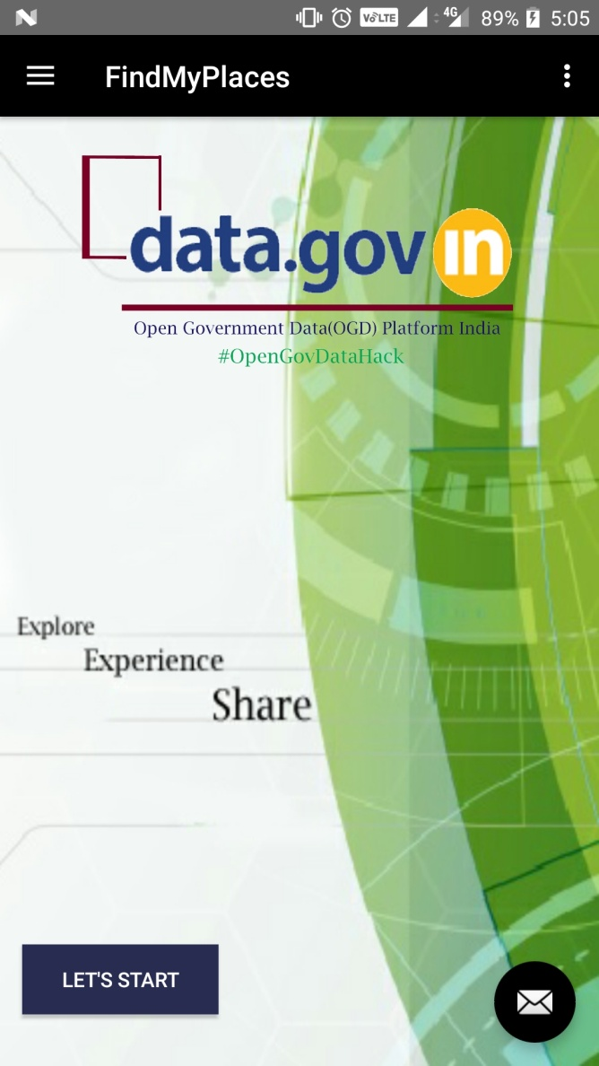
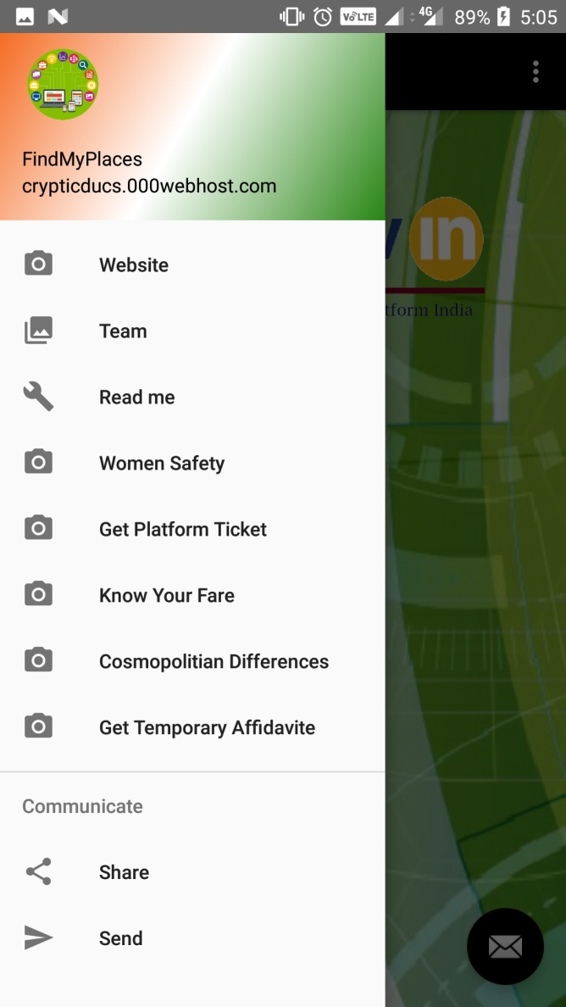
Step by Step Explanation of the
working of the App
The app launches from..
The app launches with the Home
Activity. The Button, Let’s Start enables the
User to find the banks near a particular
Location pinned on the Virtual Map.
The location pinned on the map are taken
from the data set retrieved from data.gov.in
The navigation panel depicts the other
Functionalities associated with the app
And lets the user take advantage of
Different services they would need.
Home Activity
Navigation Panel

Slide 7
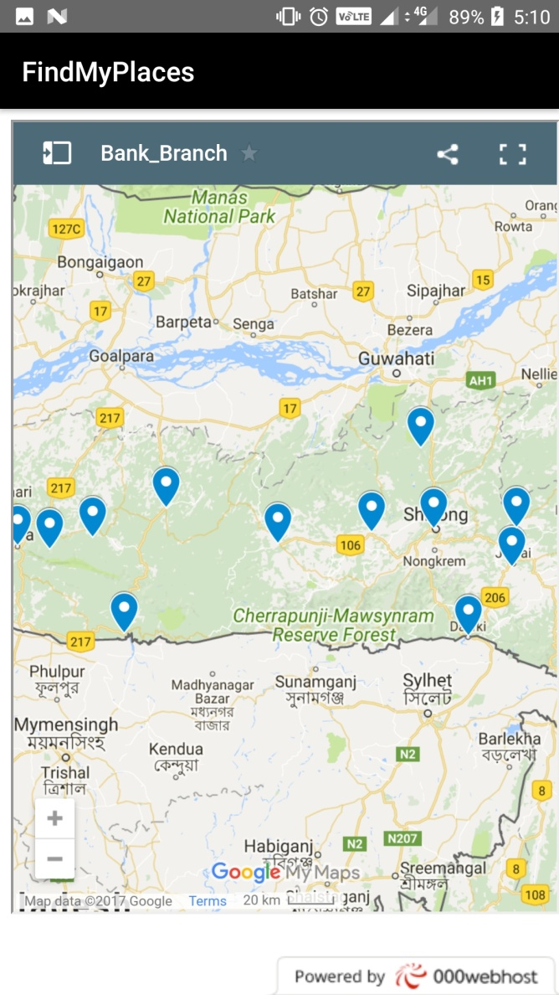
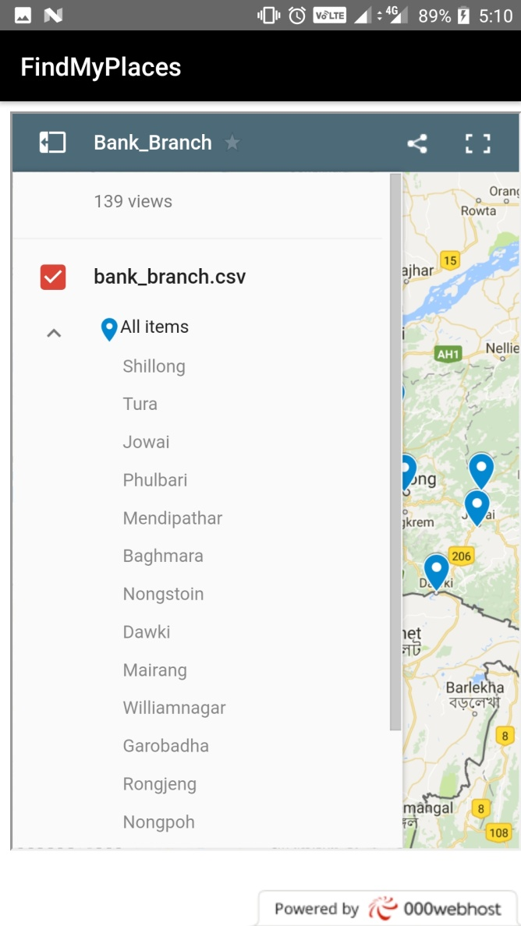
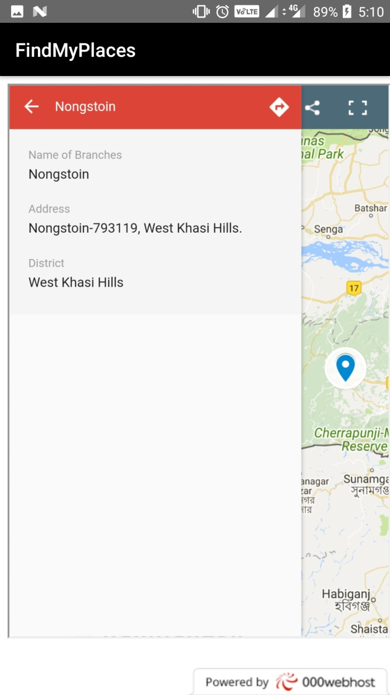
Need some Money ? Looking for a Bank nearby ?
No Problem!
Just choose
Your location
amongst the
pool
Find the
address of
your bank
Enter
the current
location
Broader Location of the Banks,
region-wise

Slide 8
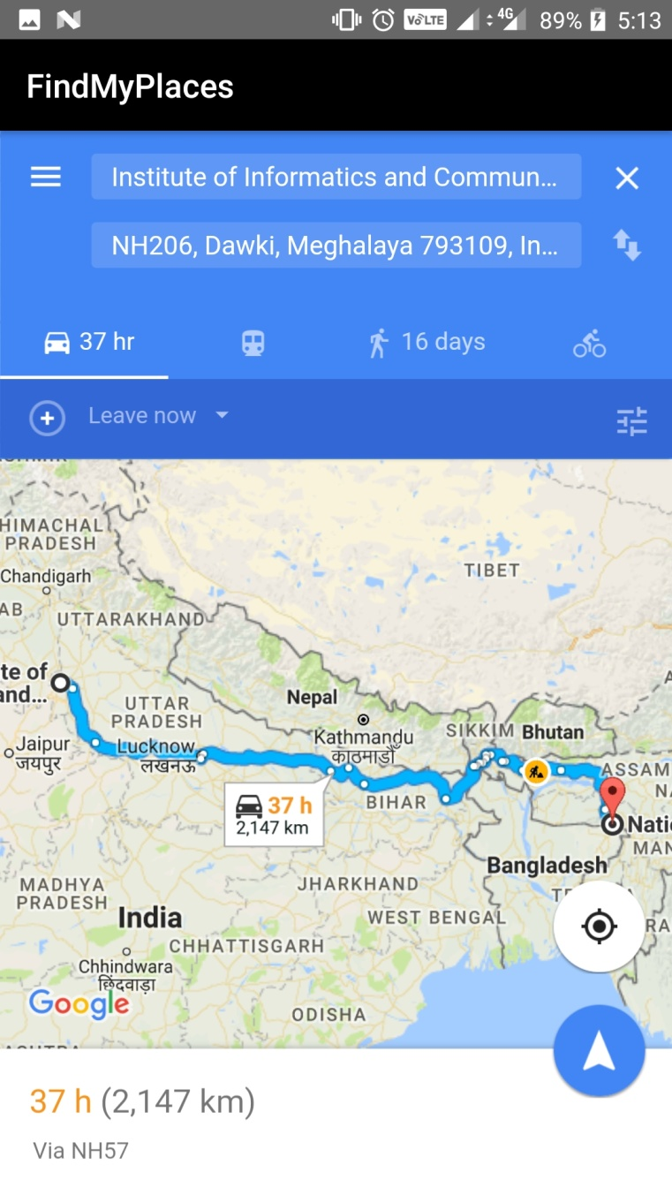
Need some Money ? Looking for a Bank nearby ?
No Problem!
And Voila!
You have found the navigation to the bank from your current location!

Slide 9
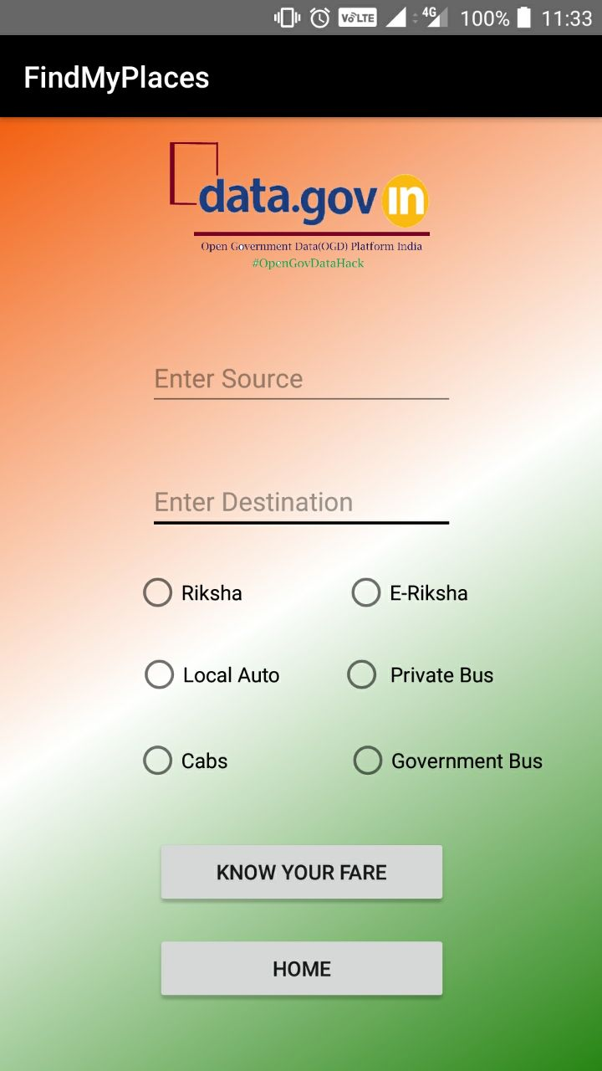
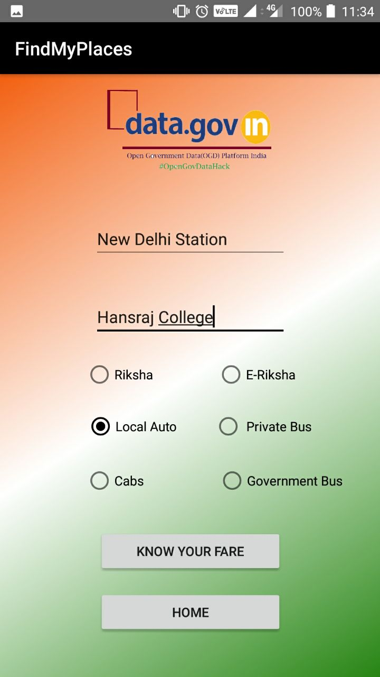
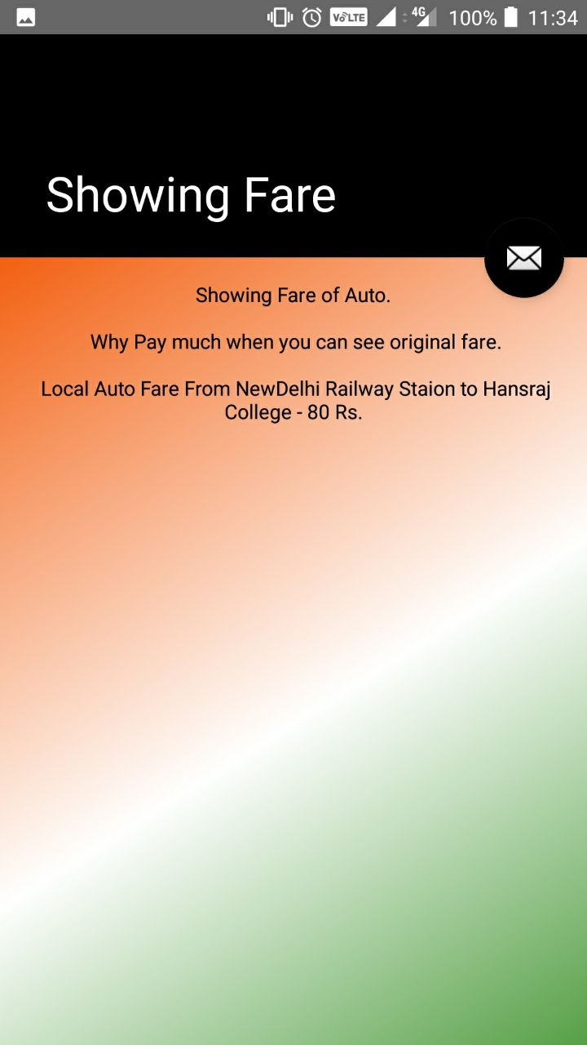
If you’re new, you’ll be looted!
Know your fare..
Enter the Source of Journey
Enter the Destination
Select the commute method
Get the Basic/Standard Fare
*No surge Pricing*
No! It’s not like Uber and Ola.

Slide 10
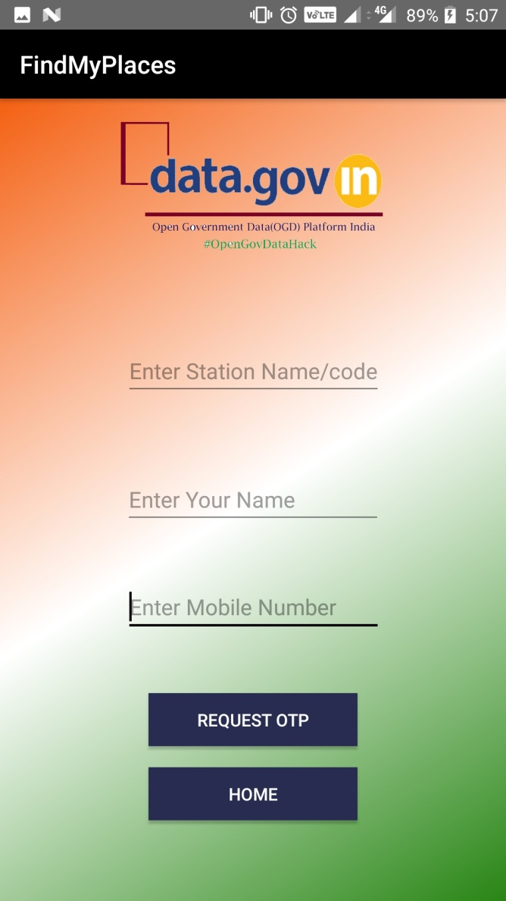
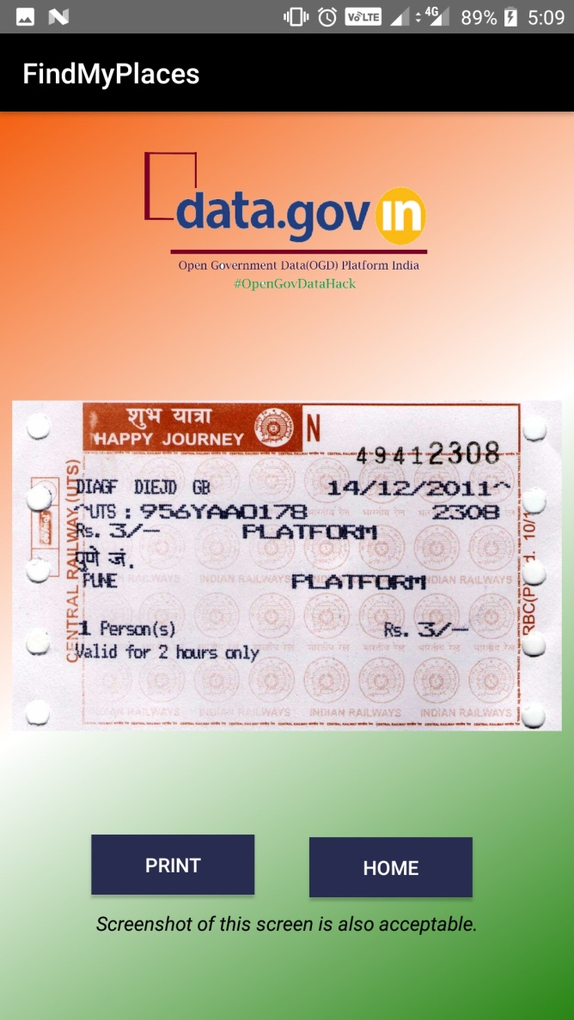
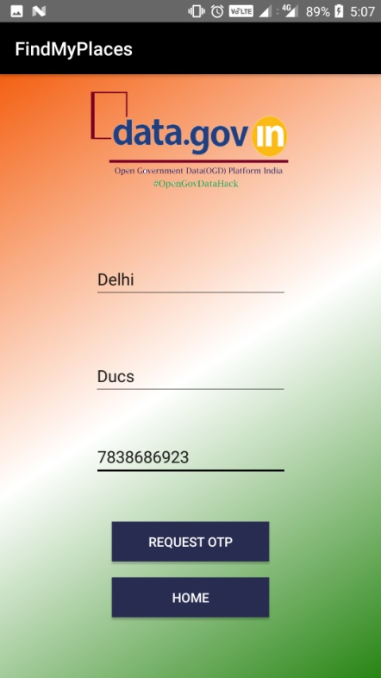
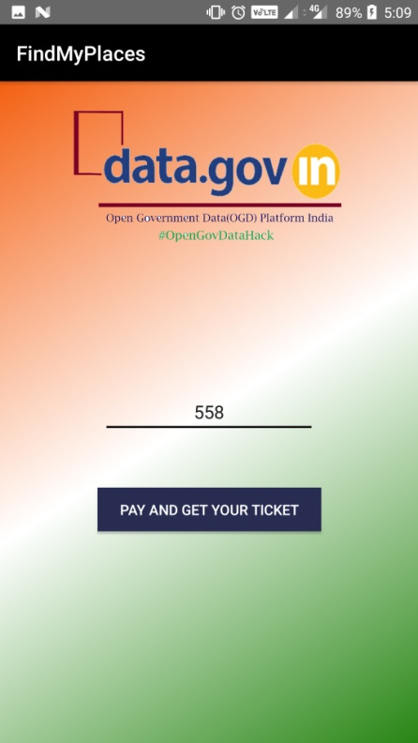

Getting a Railway Platform Ticket was never easier!
Standing in Lines for Railway Platform Ticket is a work full of Hassle!
Welcome our new platform:
Receive OTP
On the entered
number
Enter your
Personal Details
OTP driven Ticket Generation
System
Print or Screenshot your Ticket

Slide 11
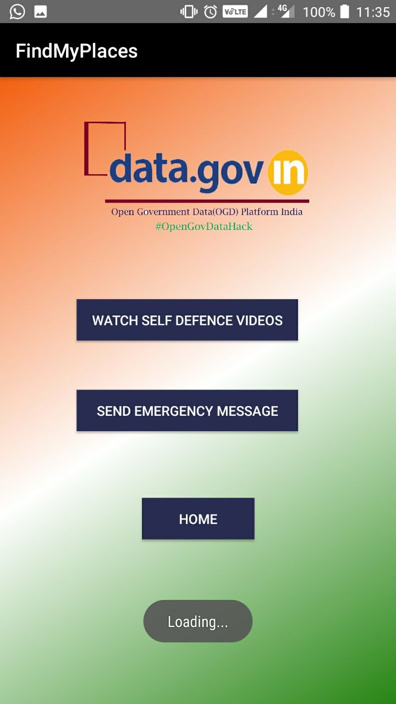
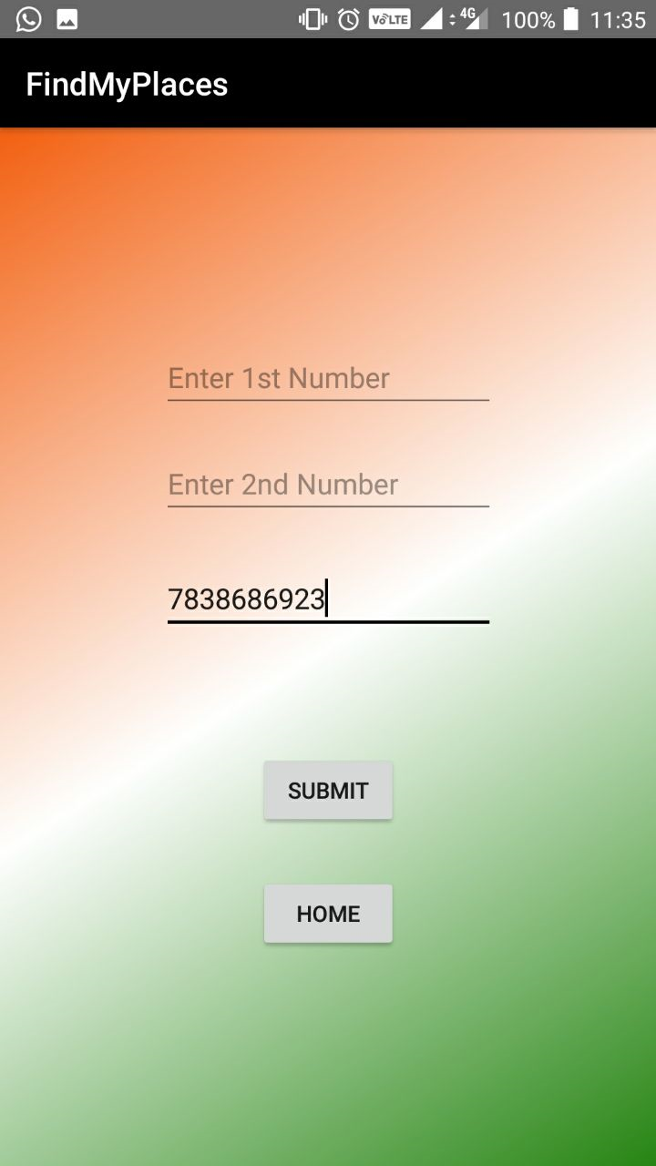

Women Safety!
The users are asked to add 3 emergency numbers.
Everytime after that, one tap on the button sends
An emergency message on all the three phone numbers

Slide 12
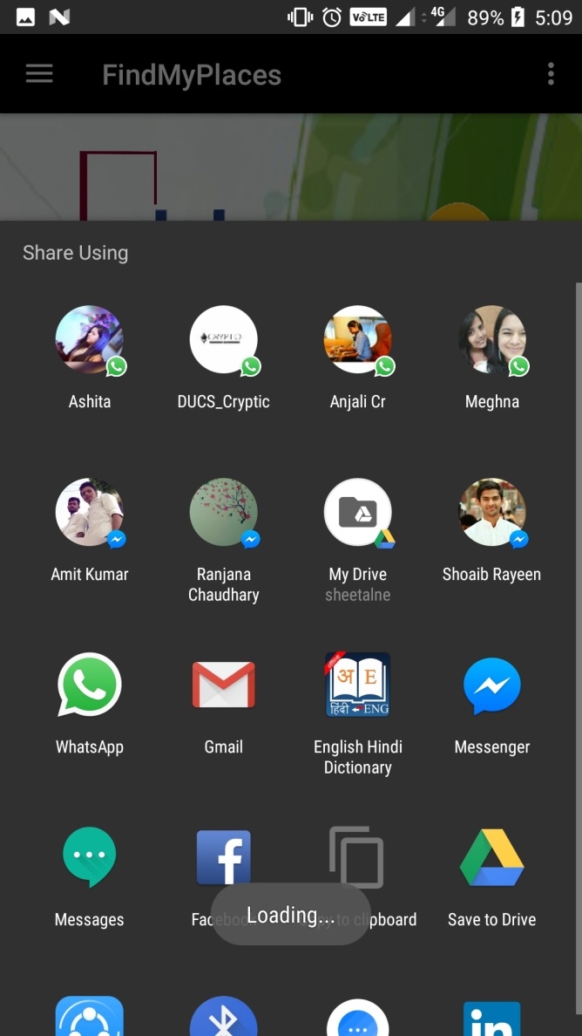
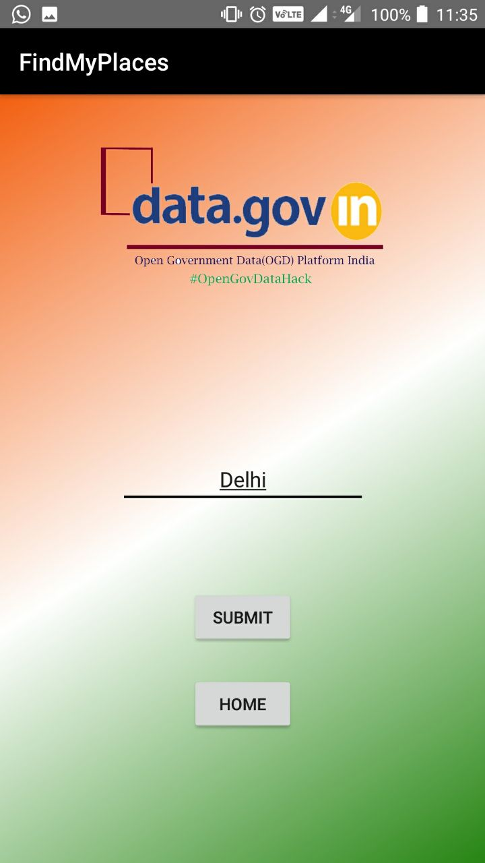
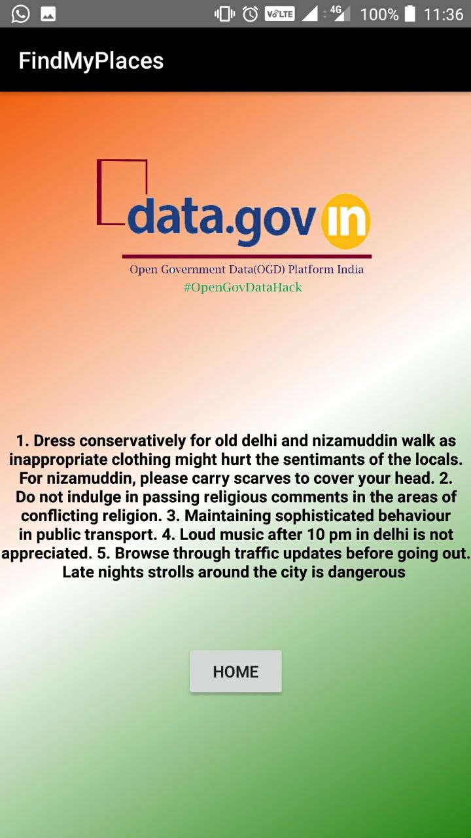
Additional Features..
And of course, the app can be
shared among the peers
And in the end, some guidelines for not offending the regional people

Slide 13
Plausible Futuristic Developments..
Rendering the app multilingual which will cater to a
diverse population of a particular region.
The restriction of finding Banks will be developed further to
include food, cinema, hospitals and much more.
In the feature of Women safety, we propose to send the location
of the woman along with the help message.
The introduction of digital signature corresponding to every
Individual that will help in the generation of the temporary form
of an official document, in case of emergencies.

Slide 14


