Slide 1
DevSECops
Basics, TOOLS, TECHNIQUES

Slide 2
Basics
Basic Understanding of Software development process.
High level understanding of Web application security. ( OWASP )
Basics of Linux Cli.
Basics of Automation tools / Techniques.
Version control .
Configuration management tools.
Deployment tools / Pipelines.

Slide 3
Sdlc (software DEVELOPMENT LIFE CYCLE)
Types of SDLC’s
Agile vs Non-Agile models
Devops model

Slide 4
What is devops ?
DevOps is the combination of cultural philosophies, practices, and tools that increases an organization’s ability to deliver applications and services at high velocity: evolving and improving products at a faster pace than organizations using traditional software development and infrastructure management processes. This speed enables organizations to better serve their customers and compete more effectively in the market.

Slide 5
How it works ?
Speed
Rapid delivery
Reliabilty
Scale
Improved collaboration
Security *

Slide 6
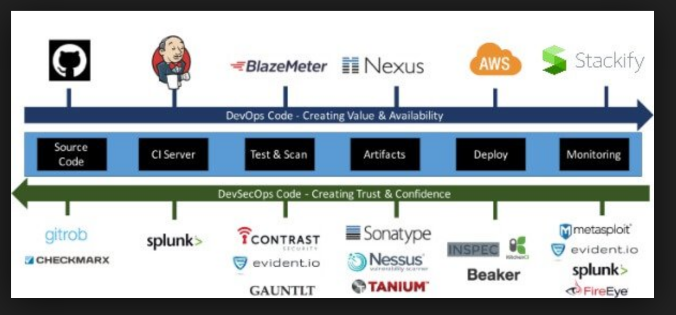
“devsecops”

Slide 7
Linux cli
Directory structure and how to navigate
Basic trouble shooting Commands
Find , Search and pipes
Basic shell scripting
Hands on

Slide 8
automation
List of automation tools / Frameworks.
Types of Automation tools.
Choosing the right tool .
What you can achieve ?
What you Can not achieve using automation ?

Slide 9
Ci / cd Pipelines
What is continues integration ?
What is continuous deployment ?

Slide 10
version CONTROL
What is Version control.
Why do we need it.
Basics of Version control. (GIT )
Intermediate skill generation on Version control.

Slide 11
Continuous integration
CI tools set.
Where to start ?
Basics of Jenkins .

Slide 12
continuous DEPLOYMENT
What is continuous delivery
Required skill sets.
Tools required.
Basic hands on demo

Slide 13
configuration management
What is configuration management ?
Tools required ?
CHEF / Ansible / Puppet.
Deployment as code.

Slide 14
Monitoring and logging
capturing, categorizing, and then analysing data and logs generated by applications and infrastructure
Creating alerts or performing real-time analysis of this data

Slide 15
basics OF web APPLICATION SECURITY
Security threats.
Security standards.
Security scanners.
Vulnerability management
Log analysis.

Slide 16
Continuous security
Security in continuous delivery pipeline.
Security automation.
Functional Security Tests.
Specific non-functional tests against known weaknesses.
Security scanning of the application and infrastructure.

Slide 17
OWASP TOP 10
What is OWASP
The top ten list ?
Other standards.
Understanding each one in the top 10 list.

Slide 18
Timelines
BASICS | 15 MINS | VERSION CONTROL | 1 HOUR
SDLC | 15 MINS | CONTINOUS INTEGRATION | 30MINS
WHAT IS DEVOPS | 15 MINS | CONTINOUS DEPLOYMENT | 30 MINS
HOW IT WORKS | 30 MINS | CONFIGURATION MANAGEMENT | 1 HOUR
DEVSECOPS | 30 MINS | MONITORNING AND LOGGING | 30 MINS
LINUX CLI | 1 HOUR | BASICS OF APPLICATION SECURITY | 1 HOUR
AUTOMATION | 30 MINS | CONTINOUS SECURITY | 1 HOUR
CI / CD PIPELINES | 30 MINS | OWASP TO 10 | 1 HOUR

