Slide 1
STOCK MARKET PERFORMANCE AND PREDICTION ANALYSIS
Presented by: Drew Barnhart, Alex De La O, Kevin Lopez, Nathan Payne and Kamran Shirazi

Slide 2

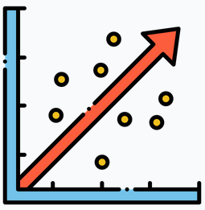

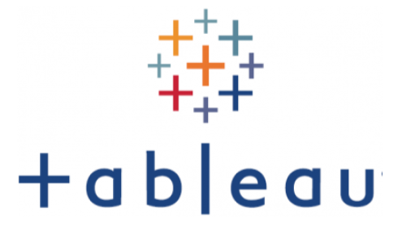
Table of Contents
Introduction
Introduction into our project, including purpose, datasets used and intro to other sections of presentation.
I
SQL Analysis
Yearly and 6 month growth, Tesla’s impact, COVID-19, most profitable month, relation with interest rates, and S&P500 comparison with presidential cycles.
ML
SQL
Machine Learning
Stock prediction analysis using Linear Regression. Demonstration of real-time stock data with Streamlit app.
T
Tableau Analysis
Data sets used, examples of codes used, commodity comparison and created visualizations in Tableau using multi-datasets.

Slide 3

Introduction
01
The purpose of this project is to create a predictive model that can assist users in analyzing financial data in real-time. The predictive model will be able to provide users with financial information such as stock prices and other relevant financial data. The predictive model will also be able to answer questions related to financial news, trends, and market updates. It will be designed to analyze financial data and provide users with insights and recommendations based on their financial goals and preferences.
Source: S&P Dow Jones Indices LLC, Dow Jones Industrial Average [DJIA], retrieved from FRED, Federal Reserve Bank of St. Louis; https://fred.stlouisfed.org/series/DJIA, May 16, 2023.
Second Source (For additional years): https://www.investing.com/indices/us-30-historical-data

Slide 4

SQL Analysis
02

Slide 5
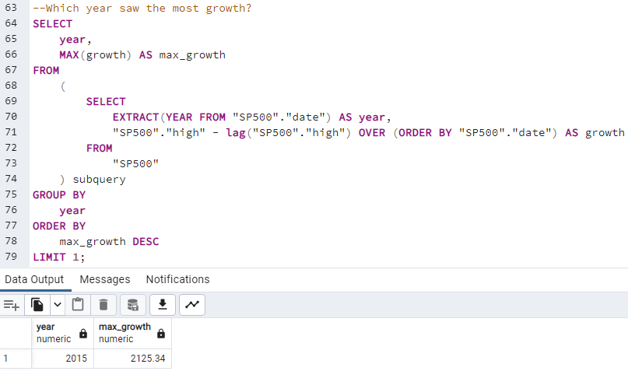
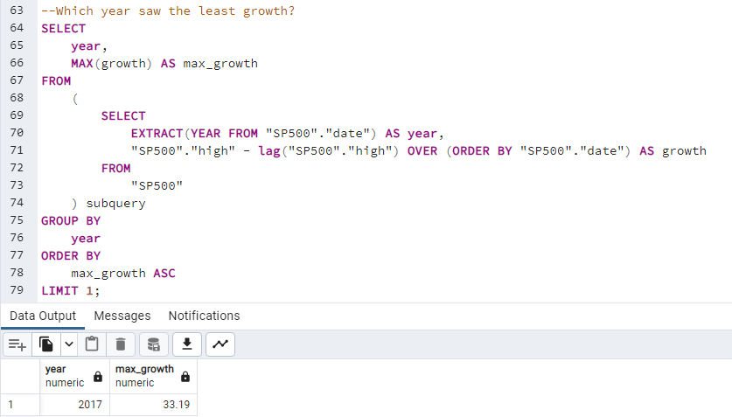
Yearly Growth
Year with most growth - 2015
Year with least growth - 2017

Slide 6
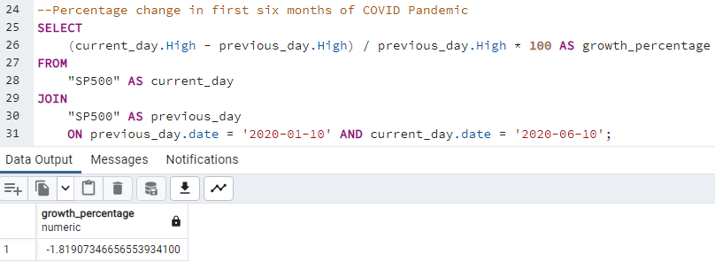
6 Month Growth
Over the last six month, the S&P 500 has decreased 1.82%

Slide 7
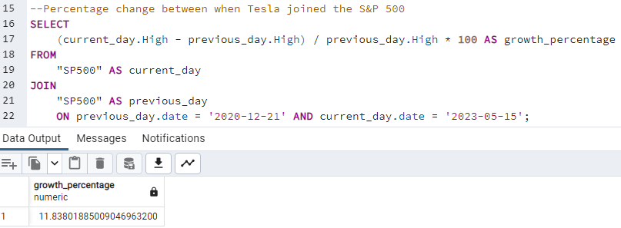
How did Tesla joining impact the S&P 500?
11.84% growth since joining

Slide 8
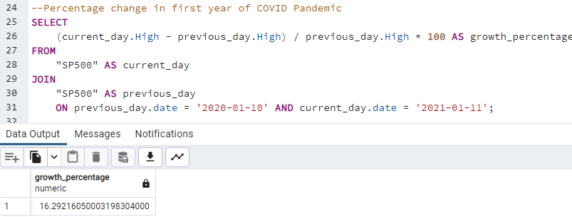
How did COVID pandemic impact the S&P 500?
16.29% growth over the first year

Slide 9
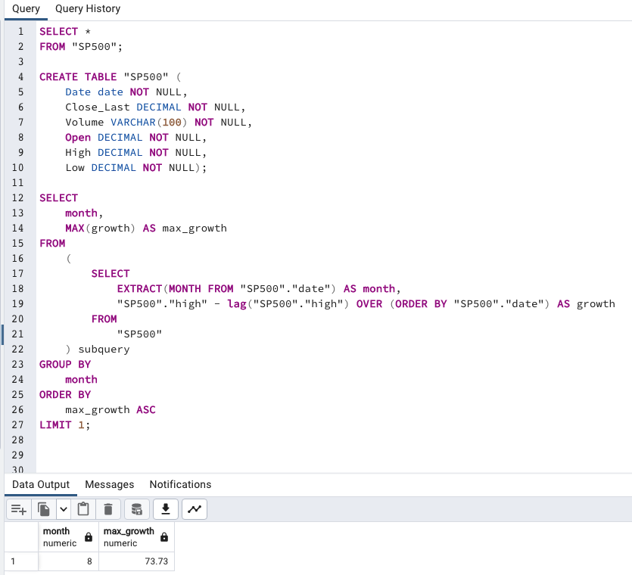
Most profitable month?
October 2022 was the most profitable month between 2013-2022.

Slide 10
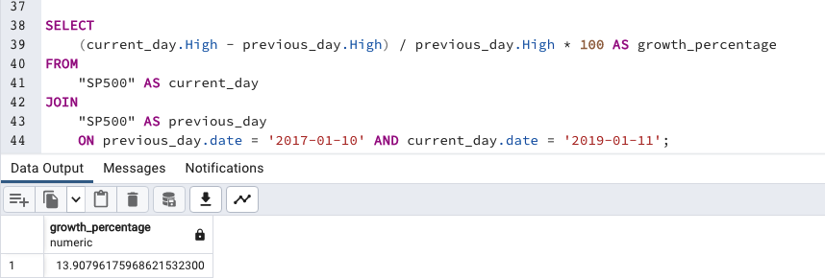
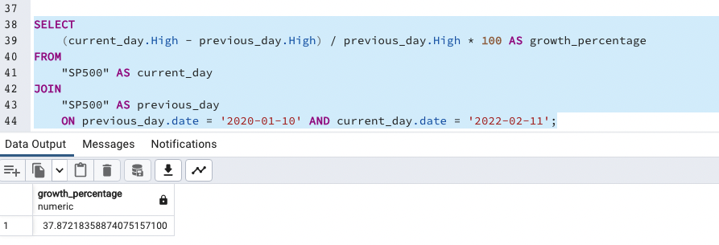
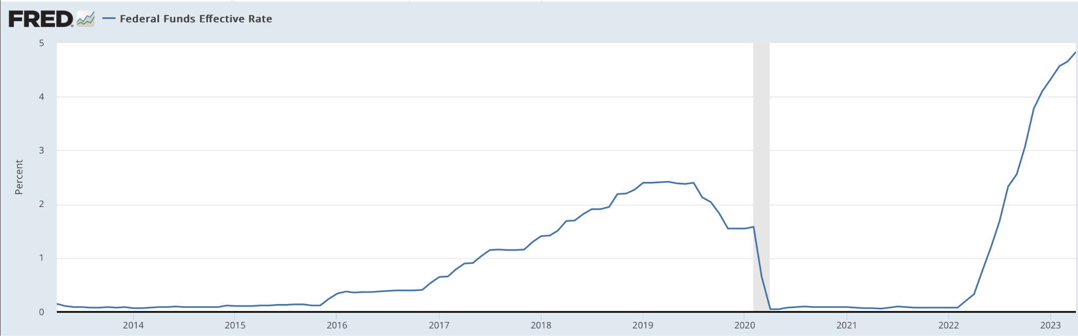
Relation with interest rates?
2020-2022 had the higher growth rate in S&P500 compared to 2017-2019. 2020-2022 had lower interest rates compared to 2017-2019.

Slide 11
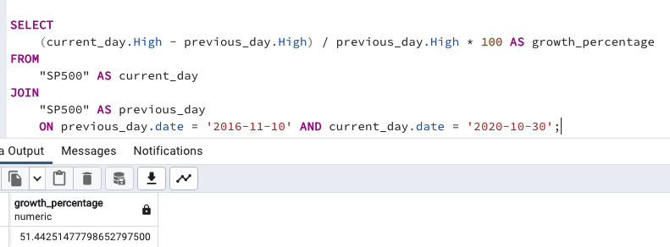
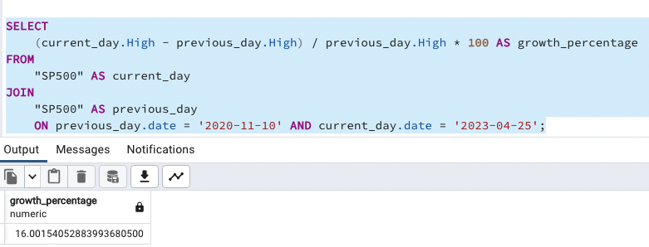
S&P500 comparison between presidential cycles
As of April 2023, the 2016-2020 Presidential cycle had a higher overall growth rate compared to the current 2020- cycle.

Slide 12

Machine Learning
03

Slide 13
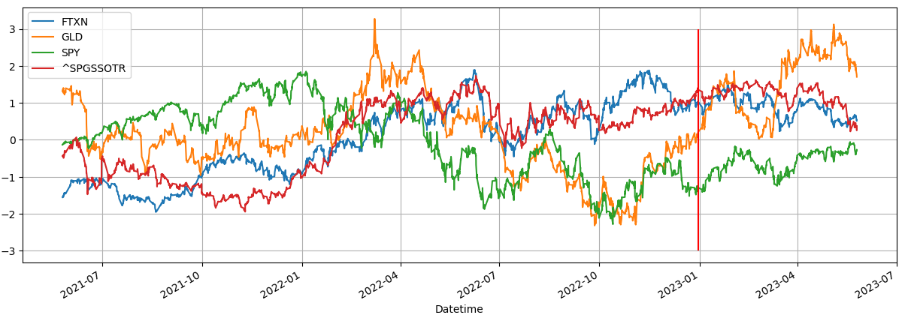
Stock Data Comparison
Ticker:
Oil: FTXN
Gold: GLD
S&P500: SPY
Soy: ^SPGSSOTR

Slide 14

Prediction Process
1
2
3
4
5
COLLECT/ORGANIZE
DATA
TRAIN THE MODEL
TEST THE MODEL
MAKE THE PREDICTION
CREATE VISUALIZATION
Collected and preprocessed data found on Yahoo Finance that includes S&P500, gold, oil and soy prices. Data collected in two year periods.
Tested the model by presenting the training data to test and to see the difference between the actual values and the predictions.
Created a visualization through Streamlit app to show real-time stock data with visualizations for each ticker that updates every hour.
Created a training model to make the prediction based on our data taken from each stock dataset to identify target variables, i.e (X, y).
Created a prediction with the model to show closing stock prices for each dataset and were able to predict in 1 hour intervals to see what the closing prices would be.

Slide 15

Tableau
04

Slide 16
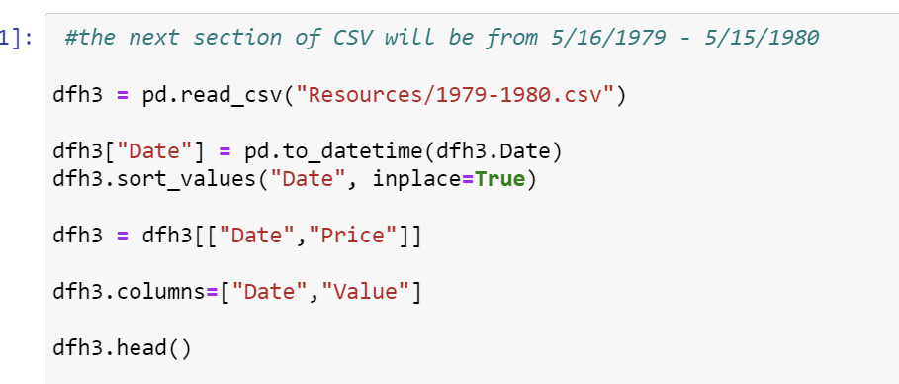
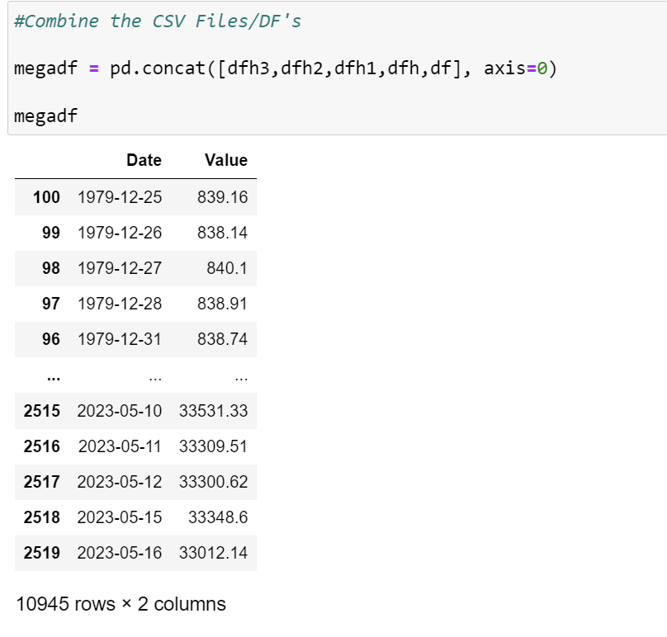
Example of Code From Jupyter Notebook
Example of 1 of 5 DF’s created

Slide 17
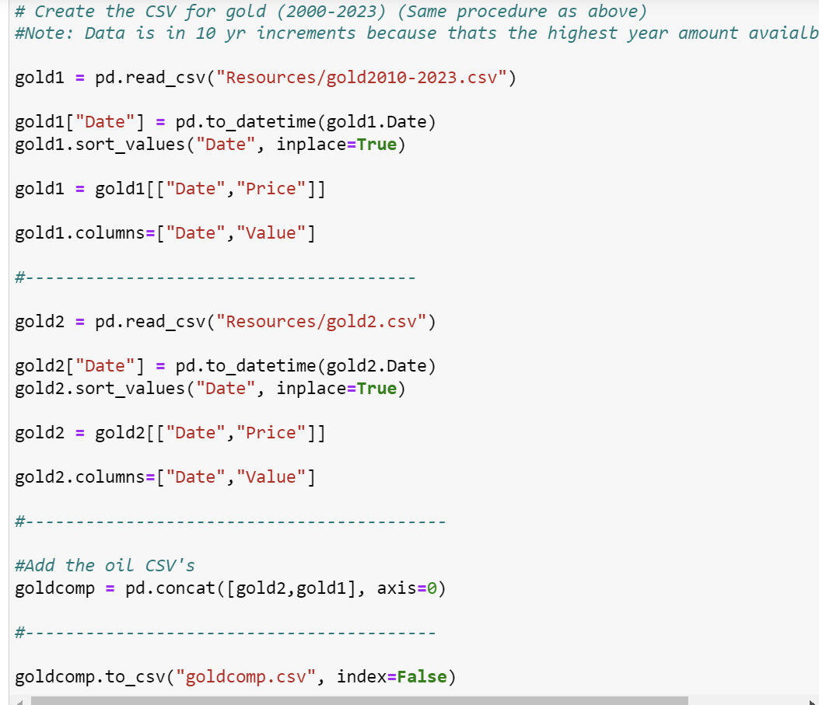
Commodity Comparative CSV
Created a metric to graphically compare a multitude of commodities and indices for comparative analysis to the Dow Jones/S&P 500

Slide 18
Tableau Visuals

Slide 19
END
Thank you!

