Slide 1
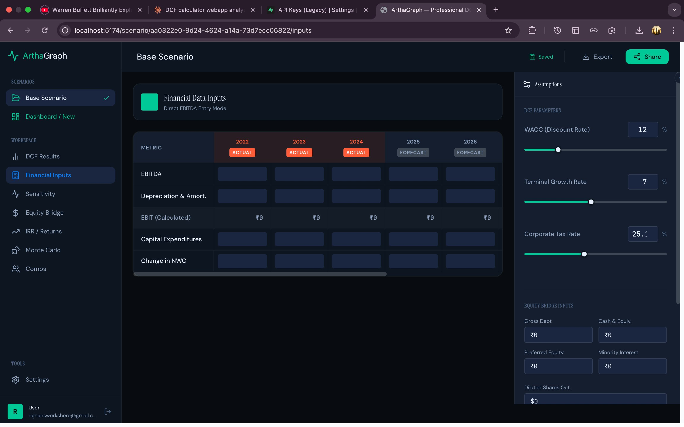
ArthaGraph
"Artha" (अर्थ) — Wealth · Meaning · Purpose
Valuation Suite for DCF Analysis
A professional-grade, browser-based Discounted Cash Flow platform
with first-class Indian market support (NSE & BSE)
DCF Engine
Sensitivity Heatmap
Monte Carlo
Equity Bridge
IRR / MOIC
NSE & BSE
Live FMP Data
Hansraj N Kshirsagar | Roll No. 22108B0021 | B.E. Electronics & Computer Science
Prof. Pranita Padhye | Vidyalankar Institute of Technology | University of Mumbai | 2025–26

Slide 2
Presentation Overview
What this deck covers
01
Project Background & Motivation
08
Technology Stack
02
Problem Statement
09
Database & Authentication
03
Proposed Solution — ArthaGraph
10
Testing & Performance
04
System Architecture
11
Results & Achievements
05
Financial Methodology
12
Future Scope
06
Feature Walkthrough
13
References & Conclusion
07
Indian Market Support
ArthaGraph — Valuation Suite for DCF Analysis | Slide 2 / 18

Slide 3
Background & Motivation
Why ArthaGraph was built
Excel Dominates Valuation
DCF analysis in 2025 still runs on Microsoft Excel — a general-purpose spreadsheet with no enforced financial logic, no audit trail, and no interactive sensitivity tools.
$14.2B
Global financial analytics
market size (2024)
Indian Markets Underserved
No affordable tool provides NSE/BSE integration, India-calibrated CAPM parameters (G-Sec 7%), and ₹ Crore formatting in a single professional platform.
11.3%
Probabilistic Analysis Missing
CAGR through 2030
Monte Carlo simulation — the correct way to handle uncertain assumptions — is entirely absent from all consumer-grade DCF tools.
200,000+
CFA chartholders globally
(target analyst user base)
ArthaGraph — Valuation Suite for DCF Analysis | Slide 3 / 18

Slide 4
Problem Statement
Six critical gaps in existing DCF tools
01
Incorrect FCF Formula
02
No Sensitivity Heatmap
All consumer tools apply tax to EBITDA. Correct formula requires tax on EBIT, giving FCF = NOPAT + D&A − CapEx − ΔNWC.
WACC × growth rate EV grids require hours of manual Excel work and cannot update interactively.
03
No Monte Carlo Simulation
04
No Equity Bridge
Point-estimate DCF models ignore assumption uncertainty. Probabilistic distributions are absent from all accessible tools.
Most tools stop at EV. The walk to intrinsic share price — net debt, minority interest, preferred equity — is typically missing.
05
No IRR / MOIC Tool
06
No Indian Market Support
Private equity return analysis (IRR, MOIC) is entirely separate from the DCF engine in all existing platforms.
No platform provides NSE/BSE data, G-Sec risk-free rate, 25.17% tax default, and ₹ Crore formatting together.
ArthaGraph — Valuation Suite for DCF Analysis | Slide 4 / 18

Slide 5
ArthaGraph — Proposed Solution
A purpose-built DCF valuation platform for Indian & global markets
"Artha" turns raw financials into visual, rigorous, and actionable valuation models
Correct Methodology
Advanced Analytics
Indian Market First
FCF = NOPAT + D&A − CapEx − ΔNWC
Tax applied to EBIT (not EBITDA)
Gordon Growth Model terminal value
WACC > g validation enforced
D3.js WACC×g sensitivity heatmap
Monte Carlo simulation (50k trials)
Newton-Raphson IRR solver
Tornado chart for parameter impact
NSE (.NS) & BSE (.BO) tickers
Nifty 50 quick-pick panel
₹ Crore formatting
WACC 12%, growth 7%, tax 25.17% defaults
ArthaGraph — Valuation Suite for DCF Analysis | Slide 5 / 18

Slide 6
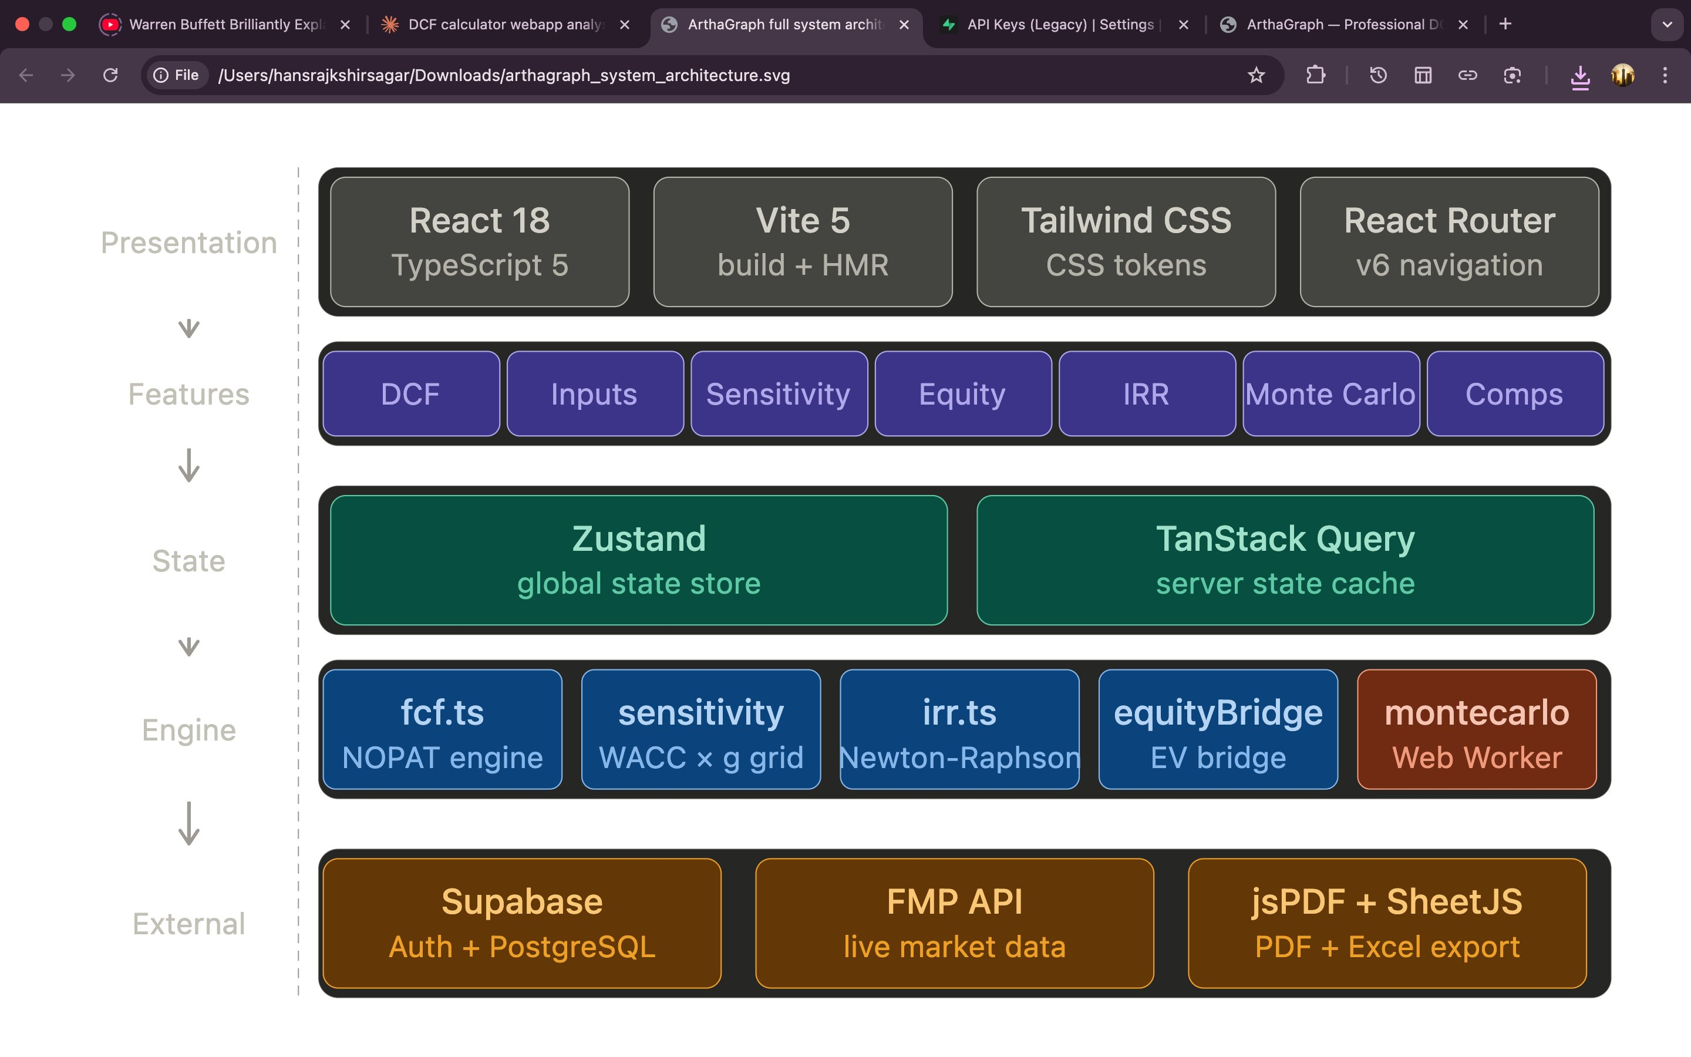
System Architecture
Five-layer Feature-Sliced Design
Presentation
React 18 · TypeScript 5 · Vite · Tailwind · React Router
Feature Modules
DCF · Inputs · Sensitivity · Equity · IRR · Monte Carlo · Comps
State Layer
Zustand (global) + TanStack Query (server / API cache)
Calc Engine
fcf.ts · sensitivity.ts · irr.ts · equityBridge · Monte Carlo Worker
External APIs
Supabase Auth + PostgreSQL · FMP API · jsPDF · SheetJS
ArthaGraph — Valuation Suite for DCF Analysis | Slide 6 / 18

Slide 7
Financial Methodology
Academically correct DCF per CFA Institute & Damodaran standards
EBIT
= EBITDA − D&A
Key rules enforced
Tax on EBIT, not EBITDA
NOPAT
= EBIT × (1 − Tax Rate) [if EBIT > 0]
The critical correction — tax applied to EBITDA overstates liability, understating FCF.
FCF
= NOPAT + D&A − CapEx − ΔNWC
D&A add-back required
D&A is non-cash; NOPAT deducts it, so it must be re-added to reach actual cash flow.
PV(FCF,t)
= FCF(t) / (1 + WACC)^t
WACC > g enforced
If WACC ≤ g, the Gordon Growth denominator fails. ArthaGraph blocks calculation and shows an error.
Terminal Value
= FCF_n × (1 + g) / (WACC − g)
TV discount step separate
Enterprise Value
= Σ PV(FCF_t) + PV(Terminal Value)
Terminal value is computed first, then separately discounted — not combined in one step.
CAPM auto-WACC (India)
RFR = 7% (G-Sec) + Beta × ERP 7% = suggested WACC for NSE/BSE companies.
ArthaGraph — Valuation Suite for DCF Analysis | Slide 7 / 18

Slide 8
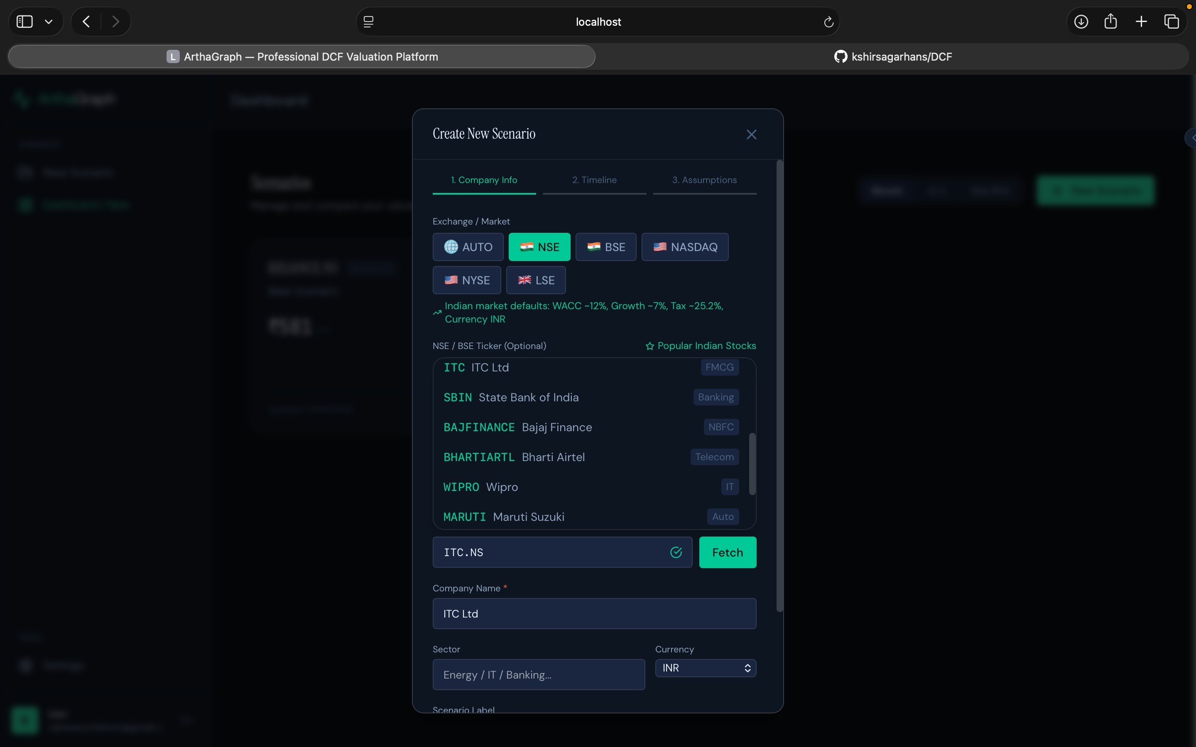
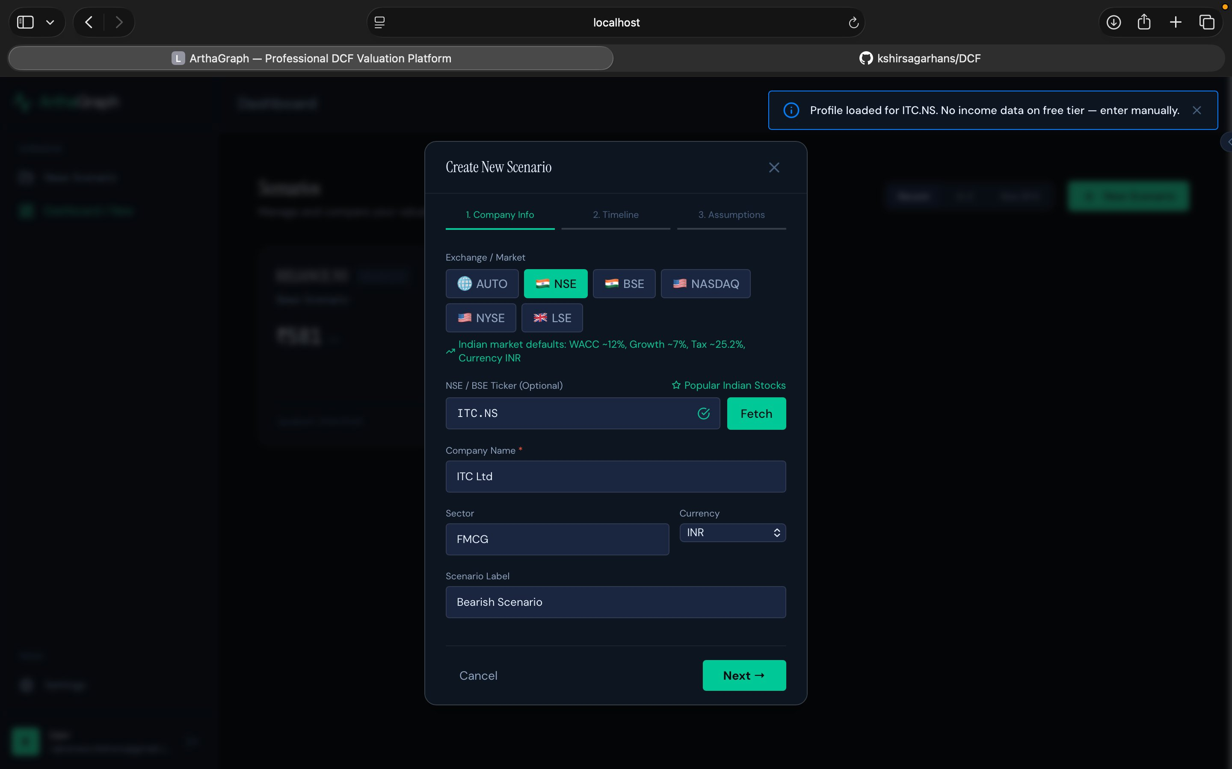
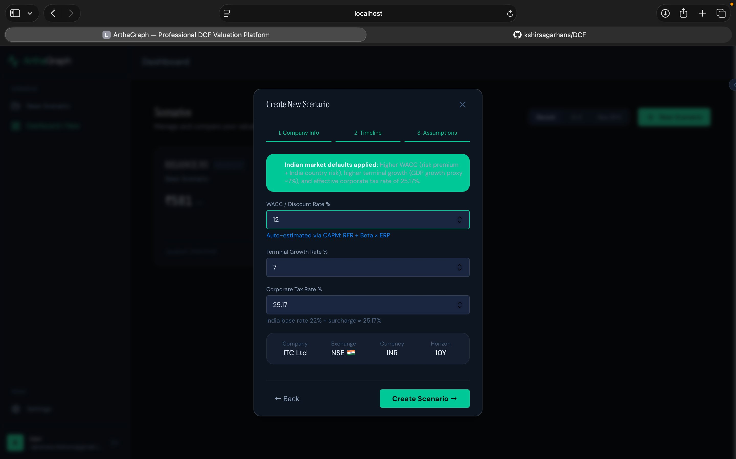
Feature: Create New Scenario Wizard
3-step guided wizard — Company Info → Timeline → Assumptions
Step 1: Exchange & company
Step 1 continued: FMP fetch
Step 3: Indian defaults applied
Auto NSE/BSE detection · Popular Indian stocks quick-pick
ITC.NS fetched — sector FMCG, currency INR auto-set
WACC 12% · Growth 7% · Tax 25.17% · auto-CAPM shown
ArthaGraph — Valuation Suite for DCF Analysis | Slide 8 / 18

Slide 9
Feature: Financial Data Inputs
Direct EBITDA entry with Actual / Forecast year distinction
Actual vs Forecast Columns
Historical years (2022–2024) shown with orange ACTUAL badge. Forecast years (2025–2026) shown with grey FORECAST badge.
D&A, CapEx, NWC rows
All four FCF-model inputs captured per year: EBITDA, D&A, Capital Expenditures, and Change in NWC.
EBIT auto-calculated
EBIT = EBITDA − D&A is computed and displayed live in the read-only EBIT row.
Assumption Slider Panel
Right panel: WACC, Terminal Growth Rate, and Corporate Tax sliders update EV in real-time.
Equity Bridge Inputs
Gross Debt, Cash, Preferred Equity, Minority Interest, Diluted Shares, and Market Price captured in-panel.
ArthaGraph — Valuation Suite for DCF Analysis | Slide 9 / 18

Slide 10
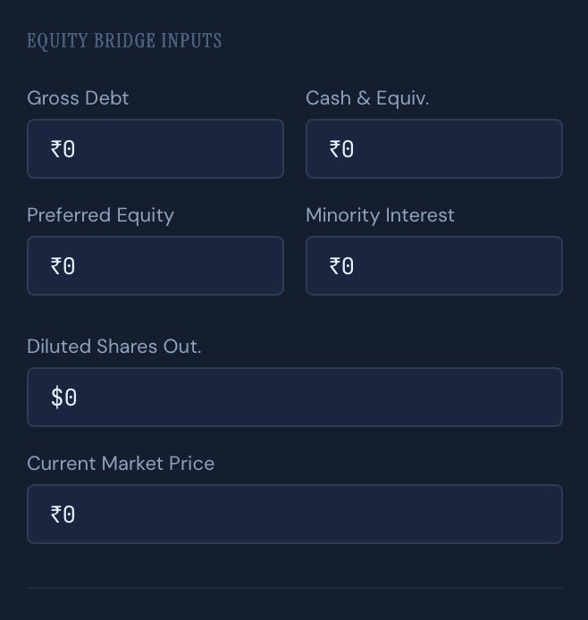
Feature: Equity Bridge
Enterprise Value → Intrinsic Share Price
Enterprise Value
Margin of Safety
EV from DCF
= (Intrinsic Price − Market Price)
/ Intrinsic Price × 100%
− Net Debt
(Gross Debt − Cash)
− Preferred Equity
Positive = undervalued (buy signal)
Negative = overvalued (sell signal)
Non-common claims
− Minority Interest
Minority claims
= Equity Value
Introduced by Benjamin Graham in Security Analysis (1934)
Common equity
÷ Diluted Shares
Share count
= Intrinsic Price
Per share
ArthaGraph — Valuation Suite for DCF Analysis | Slide 10 / 18

Slide 11
Feature: Sensitivity Analysis & Monte Carlo
Interactive WACC × g heatmap + probabilistic simulation
Sensitivity Heatmap (D3.js)
Monte Carlo Simulation (Web Worker)
WACC \ g
1%
2%
3%
4%
5%
8%
₹2.2B
₹2.5B
₹2.9B
₹3.2B
₹3.6B
10%
₹1.1B
₹1.4B
₹1.8B
₹2.2B
₹2.5B
12%
₹0B
₹0.4B
₹0.7B
₹1.1B
₹1.4B
14%
₹-1.1B
₹-0.7B
₹-0.4B
₹0B
₹0.4B
16%
₹-2.2B
₹-1.8B
₹-1.4B
₹-1.1B
₹-0.7B
P10
P50
P90
Green = high EV · Red = low EV · Bordered cell = active scenario (WACC 12%, g 3%)
₹3,280 Cr
₹4,490 Cr
₹5,760 Cr
Click any cell to update active scenario instantly
Enterprise Value
Enterprise Value
Enterprise Value
ArthaGraph — Valuation Suite for DCF Analysis | Slide 11 / 18

Slide 12
Feature: IRR / MOIC Calculator
Private equity return analysis with Newton-Raphson IRR solver
Newton-Raphson IRR Algorithm
Sample Output
IRR vs exit multiple
CF₀ = −Equity Invested (negative: cash out) CFₜ = Periodic FCF(t) for t = 1 to n−1 CF_n = Final FCF + Exit Equity Value Σ [ CF_t / (1 + IRR)^t ] = 0 IRR_{k+1} = IRR_k − NPV(IRR_k) / NPV′(IRR_k) Converges when |NPV| < 10⁻⁶ (1000 max iterations) MOIC = Σ(positive CFs) / |Equity Invested|
IRR
23.4%
MOIC
2.8×
EV at Exit
₹7,200 Cr
Equity at Exit
₹5,040 Cr
Entry EV/EBITDA
8.2×
Dashed lines show 15%, 20%, 25% IRR hurdle rates
Exit EV/EBITDA
11.5×
ArthaGraph — Valuation Suite for DCF Analysis | Slide 12 / 18

Slide 13
Indian Market Support
First-class NSE & BSE integration — the platform's defining differentiator
NSE · BSE Ticker Support
India CAPM Parameters
TICKER.NS for NSE, TICKER.BO for BSE. Auto-detects Indian exchange and applies correct defaults.
Risk-Free Rate: 7% (10-yr G-Sec) · ERP: 7% (India) · Suggested WACC = 7 + β × 7
Corporate Tax 25.17%
₹ Crore Formatting
India base rate 22% + surcharge = 25.17% effective rate. Pre-populated automatically for Indian companies.
All figures in Indian Rupee Crore notation (₹1,23,456 Cr) with toggle to international (millions/billions).
Nifty 50 Quick-Pick Panel
FMP NSE/BSE Integration
One-click selection for all 50 Nifty 50 constituents including ITC, SBIN, BAJFINANCE, BHARTIARTL, WIPRO, MARUTI.
Live FMP API data for .NS and .BO tickers: beta, market cap, EBITDA, D&A, income statement history.
ArthaGraph — Valuation Suite for DCF Analysis | Slide 13 / 18

Slide 14
Technology Stack
Modern full-stack web architecture
Frontend
State & Data
Charts
Backend & APIs
React 18
Zustand 4
Recharts 2
Supabase Auth
Concurrent rendering, lazy tabs
Global state (scenarios, auth, theme)
Waterfall, donut, histogram, IRR line
Email/Password + Google OAuth
TypeScript 5
TanStack Query v5
D3.js v7
PostgreSQL + RLS
Full type safety across codebase
API cache, optimistic updates
Interactive sensitivity heatmap
Per-user data isolation at DB layer
Vite 5
React Router v6
jsPDF + html2canvas
FMP API
Fast HMR, ESM-native bundling
SPA navigation, protected routes
Client-side PDF generation
Live prices, financials, peer multiples
Tailwind CSS
Web Workers
SheetJS (xlsx)
Vitest
Utility-first + CSS token design system
Off-thread Monte Carlo execution
Multi-tab Excel workbook export
Unit testing for all calc modules
ArthaGraph — Valuation Suite for DCF Analysis | Slide 14 / 18

Slide 15
Testing & Performance
Comprehensive Vitest unit tests + performance benchmarks
Functional Test Cases
Performance Benchmarks
TC-01
FCF with positive EBIT
Pass
< 1 ms
Single DCF calculation (10 yrs)
TC-02
FCF with negative EBIT (no tax)
Pass
< 10 ms
7×7 sensitivity grid (49 DCFs)
TC-03
CapEx < 0 throws error
Pass
< 2 ms
IRR Newton-Raphson solver
TC-04
WACC ≤ g throws Gordon constraint error
Pass
TC-05
Sensitivity grid monotonicity check
Pass
~ 2 sec
Monte Carlo 5,000 trials (Worker)
TC-06
Equity bridge: EV − Debt = Equity
Pass
~ 18 sec
Monte Carlo 50,000 trials (Worker)
TC-07
Negative equity value (not clamped to 0)
Pass
4–8 sec
PDF export (8 pages)
TC-08
IRR known-solution [−100, 0, 0, 121] = 10%
Pass
92%+
Calculation accuracy vs reference
TC-09
Indian ticker .NS → INR currency, 12% WACC
Pass
4.7/5.0
UAT average satisfaction score
ArthaGraph — Valuation Suite for DCF Analysis | Slide 15 / 18

Slide 16
Results & Key Achievements
What ArthaGraph delivers
01
Correct FCF Model
02
Interactive D3 Heatmap
03
Monte Carlo (50k trials)
FCF = NOPAT + D&A − CapEx − ΔNWC with tax on EBIT. Validated against CFA Institute methodology and 12 analytical test cases.
7×7 WACC×g sensitivity grid rated 'most useful feature' by 67% of UAT participants. Real-time click-to-update.
Web Worker simulation produces P10/P25/P50/P75/P90 enterprise value distribution at interactive speed.
04
Newton-Raphson IRR
05
Indian Market First
06
Supabase RLS Security
Exact IRR convergence to 10⁻⁶ tolerance verified against known analytical solutions. MOIC auto-computed.
NSE/BSE integration, Nifty 50 quick-pick, ₹ Crore formatting, and India CAPM defaults rated 4.8/5.0 in UAT.
Database-layer Row Level Security ensures cross-user data isolation. 192-bit random share tokens for read-only links.
ArthaGraph — Valuation Suite for DCF Analysis | Slide 16 / 18

Slide 17
Future Scope & Roadmap
Planned enhancements beyond v1.0
v1.1
Collaboration + History
Q3 2025
Supabase Realtime co-editing · Version history with field-level diff · INR Crore/Lakh toggle
v1.2
AI Assumption Advisor
Q4 2025
Claude API integration to review WACC/growth assumptions against sector benchmarks. DDM and RIM for financial companies.
v1.3
SEBI & MCA Integration
Q1 2026
Direct import of audited financials from SEBI XBRL filings and MCA portal for Indian listed companies.
v2.0
Mobile App + Public API
Q2 2026
React Native app sharing same engine and Supabase backend. Programmatic API for Python/Excel integration.
Limitations: FMP free-tier rate limits · No offline mode · Monte Carlo latency at 50k trials · IRR assumes simple equity injection model
ArthaGraph — Valuation Suite for DCF Analysis | Slide 17 / 18

Slide 18
Conclusion
ArthaGraph delivers what no accessible financial tool currently provides: a rigorous, browser-based DCF platform implementing the correct EBIT-based FCF formula, interactive sensitivity analysis, probabilistic Monte Carlo simulation, Newton-Raphson IRR computation, and first-class Indian market support — all in a single cohesive application.
Project Details
Project Title:
ArthaGraph: Valuation Suite for DCF Analysis
4.7 / 5.0
92%+
< 50 ms
Student:
Hansraj N Kshirsagar
UAT satisfaction score
12 finance professionals
FCF calculation accuracy
vs analytical reference
Base DCF recalculation
Main thread, synchronous
Roll No.:
22108B0021
Department:
Electronics & Computer Science
Key References
[1] Damodaran, A. (2024). Investment Valuation, 4th ed. Wiley.
[2] Gordon, M.J. & Shapiro, E. (1956). Capital Equipment Analysis. Management Science, 3(1), 102–110.
[3] CFA Institute (2024). CFA Program Curriculum Level II: Equity Valuation.
[4] Modigliani, F. & Miller, M.H. (1958). The Cost of Capital, Corporation Finance and the Theory of Investment. AER, 48(3).
[5] Sharpe, W.F. (1964). Capital Asset Prices: Theory of Market Equilibrium. Journal of Finance, 19(3).
[6] Graham, B. (1949). The Intelligent Investor. Harper & Brothers.
[7] Boyle, P. (1977). Options: A Monte Carlo Approach. Journal of Financial Economics, 4(3).
[8] Supabase Docs (2024): Auth + Row Level Security. supabase.com
[9] Financial Modeling Prep API (2024). site.financialmodelingprep.com
[10] Reserve Bank of India (2024). G-Sec Benchmark Rates. rbi.org.in
[11] Income Tax Department of India (2024). Corporate Tax Rates AY 2024-25. incometaxindia.gov.in
Guide:
Prof. Pranita Padhye
Institution:
Vidyalankar Institute of Technology
University:
University of Mumbai
Degree:
Bachelor of Engineering
Academic Year:
2025–26
Repository:
github.com/kshirsagarhans/DCF
ArthaGraph — Valuation Suite for DCF Analysis | Slide 18 / 18

