Slide 1

TRAFFIC LIGHTS CONTROL SYSTEMS
By:
Kshiteeja (BE A 30)
Ajinkya (BE A 70)

Slide 2
ABSTRACT:
To provide the control and co-ordination within the traffic lights to ensure that the traffic moves as smoothly and safely as possible

Slide 3
Software :
Proteus 8.11
Keil uVision5

Slide 4
Proteus 8.11:
Proteus is a simulation software used to simulate components and is capable of drawing desired circuit.
It is being used for fast checkup of code you have written for microcontrollers.
Proteus have huge list of components and many libraries available which can be added to include more components.
Proteus is ahead in simulating the circuits containing the micro controllers where we can simulate the circuit by uploading the hex code to the Micro-controller.

Slide 5
Proteus 8.11:
Comparison:-
Tinker CAD -Mostly used for Arduino based applications, also for 3D designs and architecture (In our case we’re using 8051 microcontroller)
Ki CAD - It doesn’t have default 8051 microcontroller as Proteus already have a default library
Autodesk Eagle CAD - Preferred because of flexibility and open source software, otherwise no difference. Both Proteus and Eagle CAD are suitable to use.
Fritzing - Complex to use.
Multism - Proteus is ahead in simulating the circuits containing the micro controllers where we can simulate the circuit by uploading the hex code to the Micro-controller where as Multism can’t do this.

Slide 6
Keil uVision5:
Keil MDK is the complete software development environment for a wide range of Arm Cortex-M based microcontroller devices.
MDK includes the µVision IDE which is a window-based software development platform that combines a robust and modern editor with a project manager and make facility tool.
It integrates all the tools needed to develop embedded applications including a C/C++ compiler, macro assembler, linker/locator, and a HEX file generator

Slide 7
Components:
AT89C51 (1 placed, 8051Microcontroller 4kB code, 33 MHz, 2 X 16-bit Timers, UART)
TRAFFIC LIGHTS (4 placed, animated traffic light modules)
RESPACK-8 (1 placed, Pull up register, 8 way register)
7SEG-MPX2-CA-BLUE (4 placed, blue 2 –digit, 7 segment anode display)

Slide 8
AT89C51:
1 placed-8051Microcontroller
4kB ROM, 128 bytes RAM,33 MHz, 2 X 16-bit Timers
4 parallel 8 ports which will be connected to bus
Compared to Arduino-
Ease scalability, quick change in logics and run time configurations
A typical microcontroller based solution would cost much less(One can get them for as low as ₹25 per unit)
Low level of complexity and maintenance.
Input/ Output Ports Information:
Total 32 input/output pins
Pin configuration, i.e. the pin can be configured as 1 for input and 0 for output as per the logic state.

Slide 9
AT89C51:
Port 0 − The P0 (zero) port is characterized by two functions:
Input Configuration--If any pin of this port is configured as an input, then the input has unlimited input resistance and in-determined potential.
Output Configuration--When the pin is configured as an output, then it acts as an “open drain”. In order to apply logic 1 (5V) on this output pin, it is necessary to build an external pull up resistor.
Port 1 - P1 is a true I/O port as it doesn’t have any alternative functions as in P0, but this port can be configured as general I/O only. It has a built-in pull-up resistor and is completely compatible with TTL circuits

Slide 10
AT89C51:
Port 2 −P2 is similar to P0 when the external memory is used. Pins of this port occupy addresses intended for the external memory chip.
Port 3 -In this port, functions are similar to other ports except that the logic 1 must be applied to appropriate bit of the P3 register.

Slide 11
TRAFFIC LIGHTS :
4 placed
Animated traffic light modules
7SEG-MPX2-CA-BLUE :
4 placed
blue 2 –digit, 7 segment anode display

Slide 12
RESPACK-8:
1 placed
8 way register
Pull up register - for port 0 so that we can apply logic 0 and 1

Slide 13
Working:
This project use LED lights as an indicator and 8051 Microcontroller for auto changing signal after a pre-specified time interval i.e. for centralized control of traffic lights.
The LED’s are automatically on and off by making the corresponding port pin of the microcontroller high.
The 4 ports- Port 0, Port 1, Port 2, Port 3 works as input as well as output port.
The LED’s which is used as lights are connected to microcontroller by means of common anode configuration.
Microcontroller is programmed in such a way that the respective LED’s glow by setting the required bit using c language, also to adjust their timing and phasing to meet the changing traffic conditions.

Slide 14
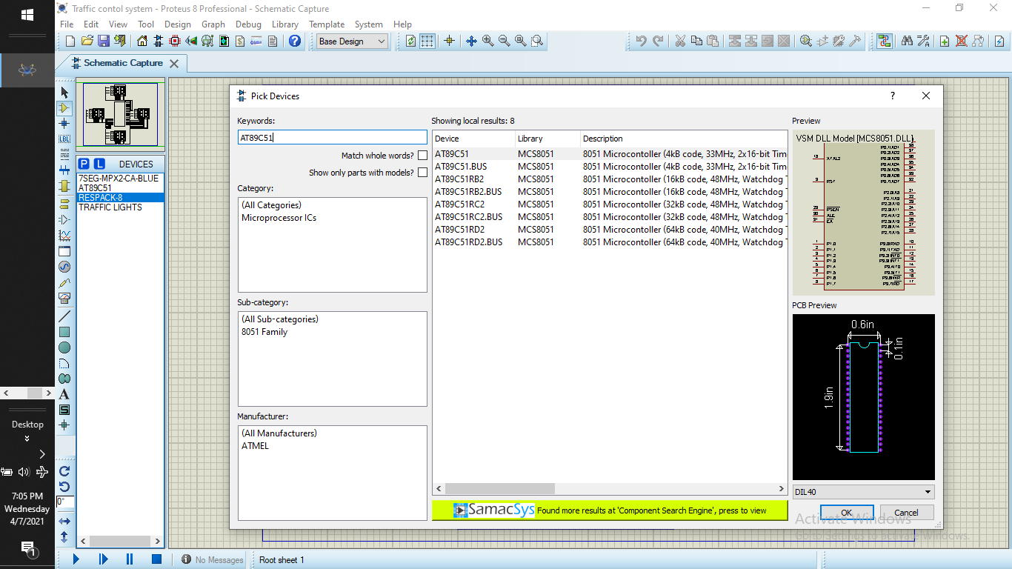

Slide 15
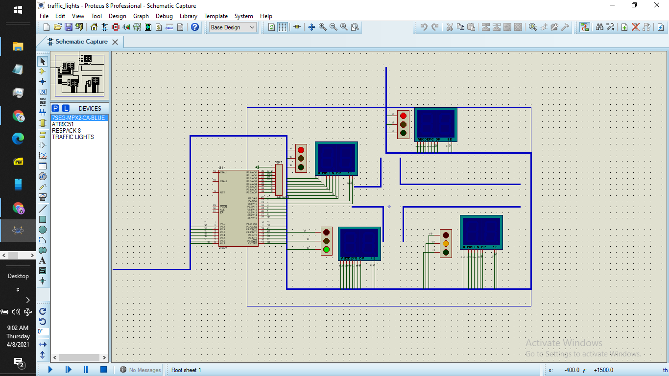

Slide 16
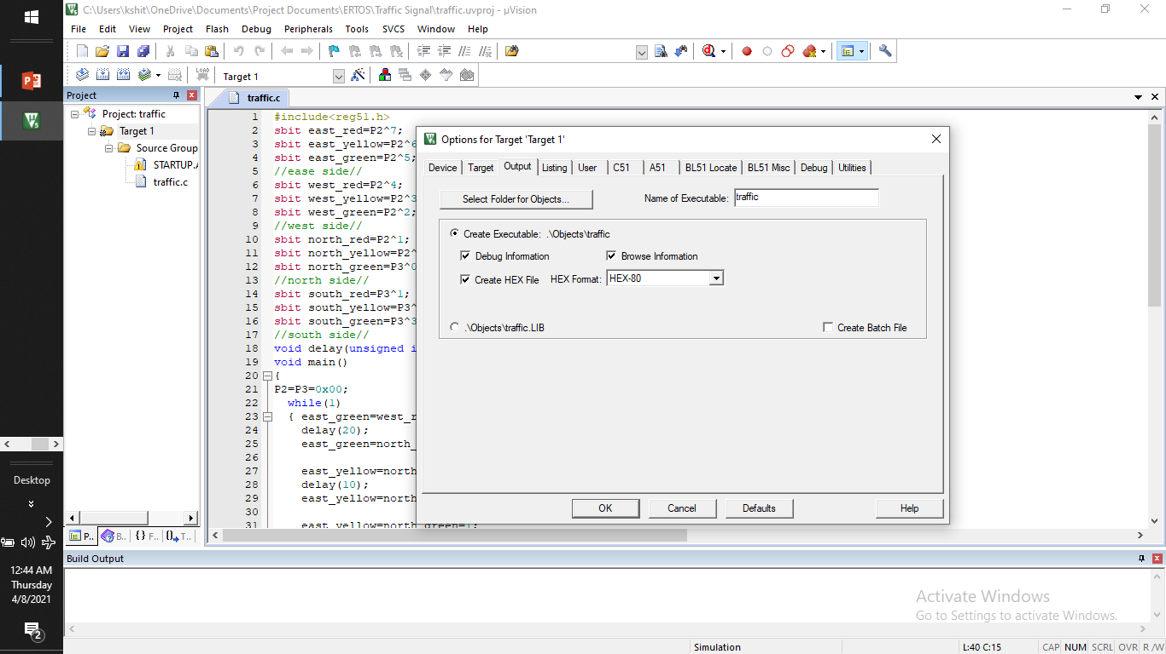

Slide 17
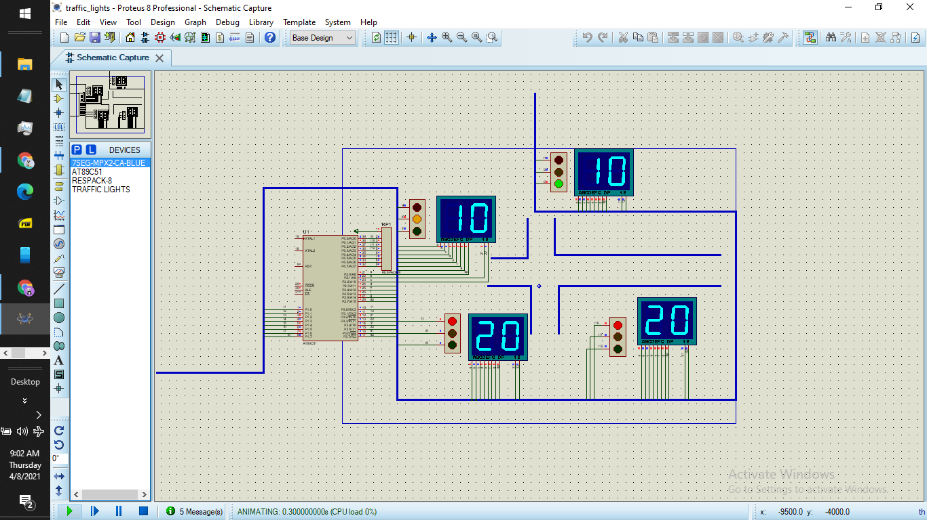

Slide 18
Conclusion:
We’ve successfully performed the simulation of traffic light control system using 8051 microcontroller, traffic lights, 7 segment anode displays in the Proteus simulation environment.

Slide 19
Thank You!

