Slide 1
Team NVR Stock Analysis and Trading Model
Khajan Joshi Kshitija Suryavanshi
Saad Ghojaria
Sushmita Maity
Kunwar Rajesh Chopra

Slide 2
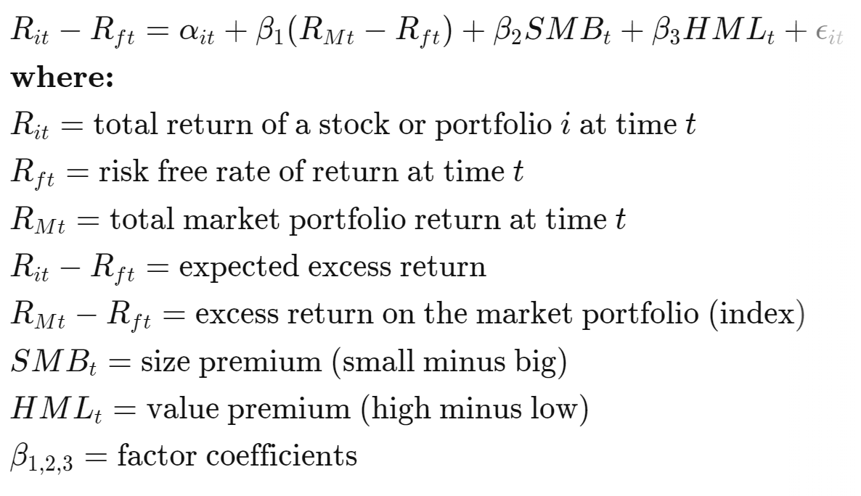
3 Factor Fama French
Factors used are:
Small minus big (SMB)
High minus low (HML)
Return less the risk-free rate of return
Factors driving expected returns:
Sensitivity to the market
Sensitivity to size
Sensitivity to value stocks

Slide 3
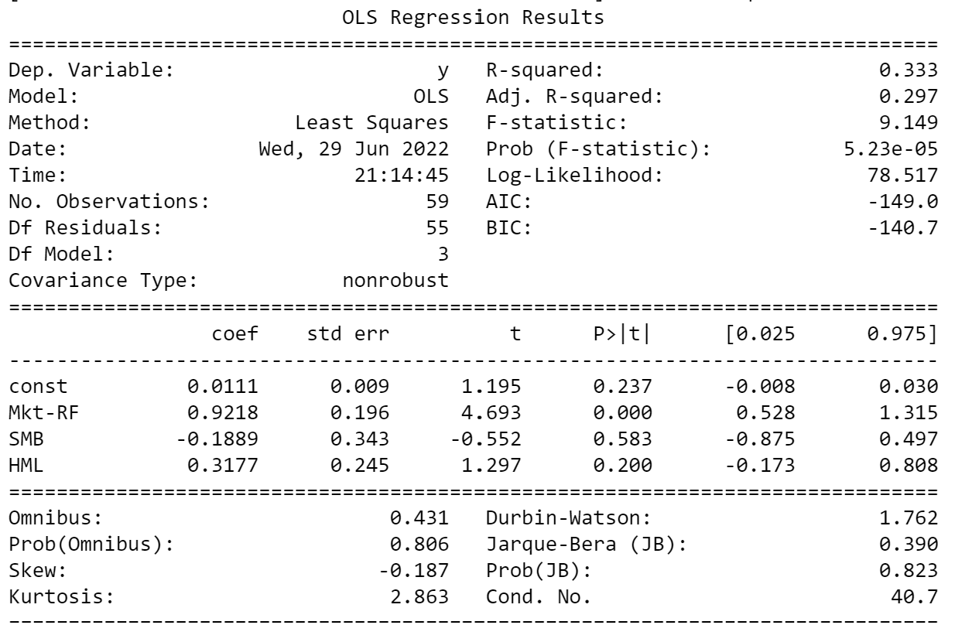

3 Factor Model
Coefficients:
Alpha- 0.011
Market Return - 0.9218
SMB - -0.1889
HML - 0.3177
Expected Return: 0.095

Slide 4
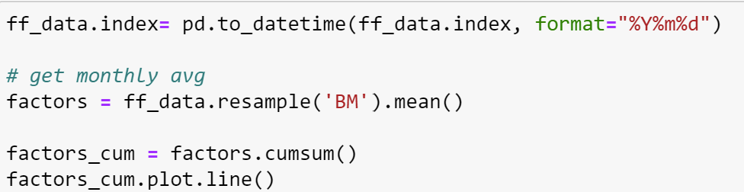
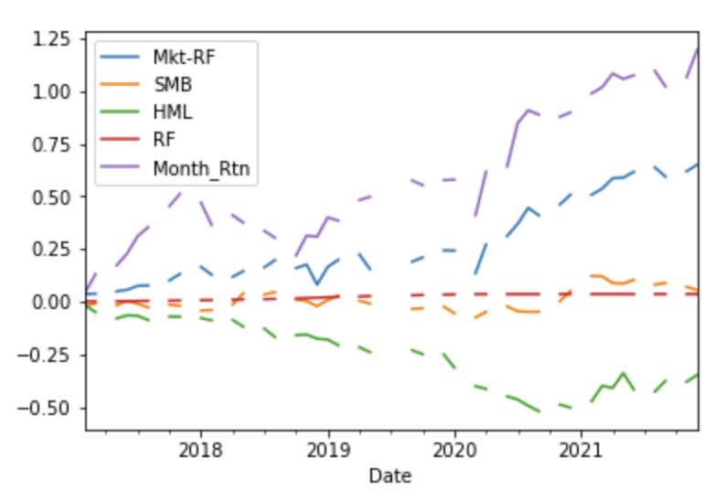
3 factor
Monthly Average Cumulative

Slide 5
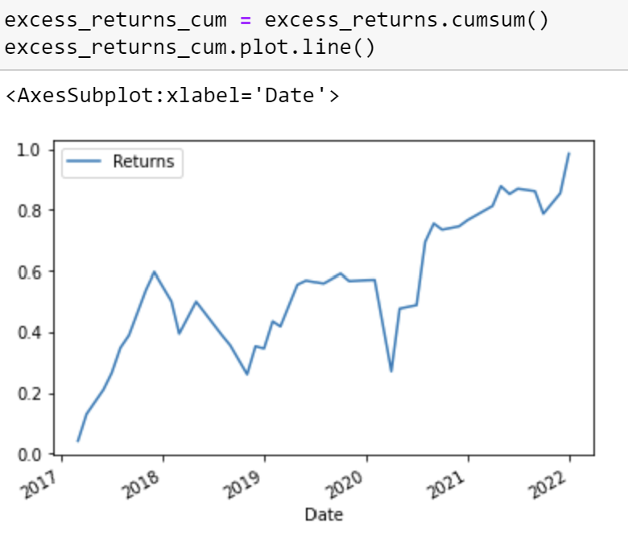
3 Factor
Excess Monthly Returns cumulative year wise

Slide 6
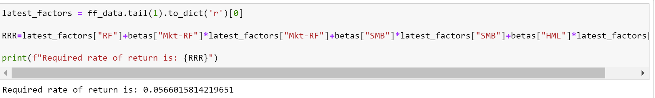
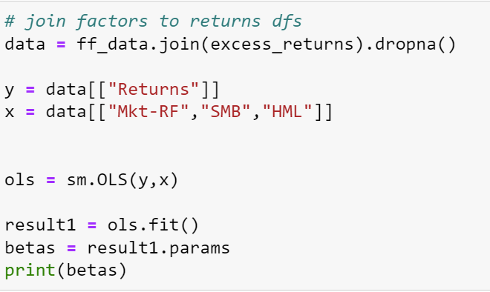
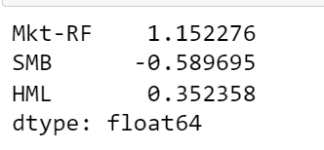
3 Factor
Required Rate of Return
Values of Beta Coefficients (Sensitivity)

Slide 7
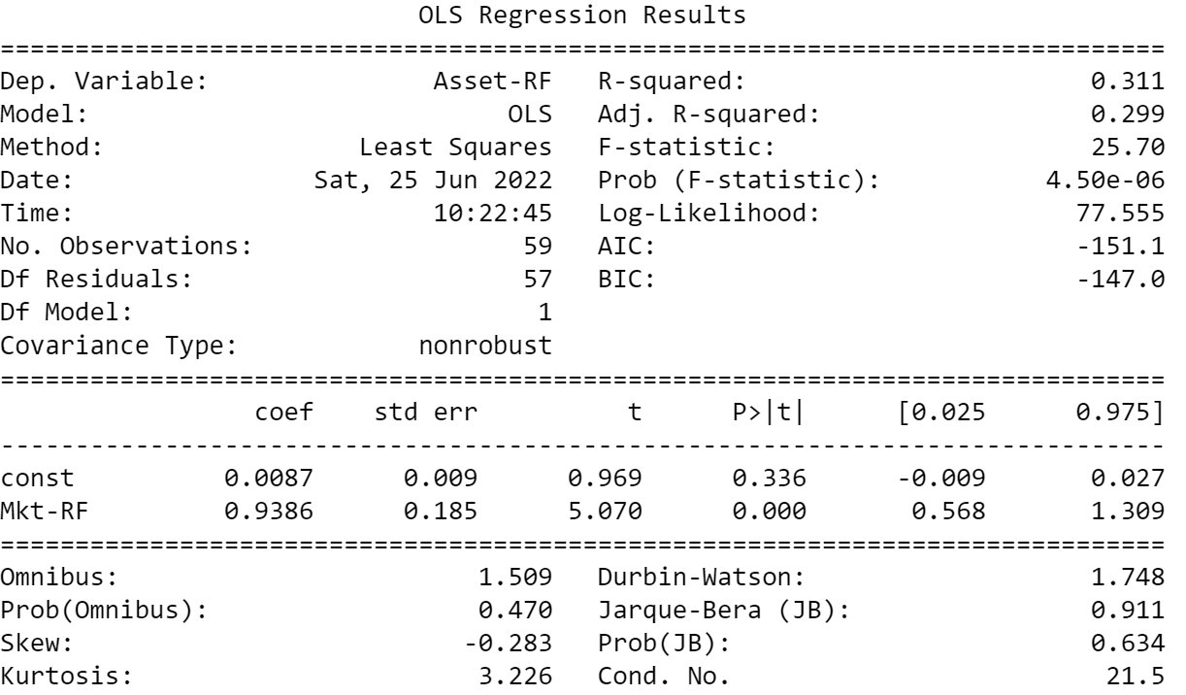
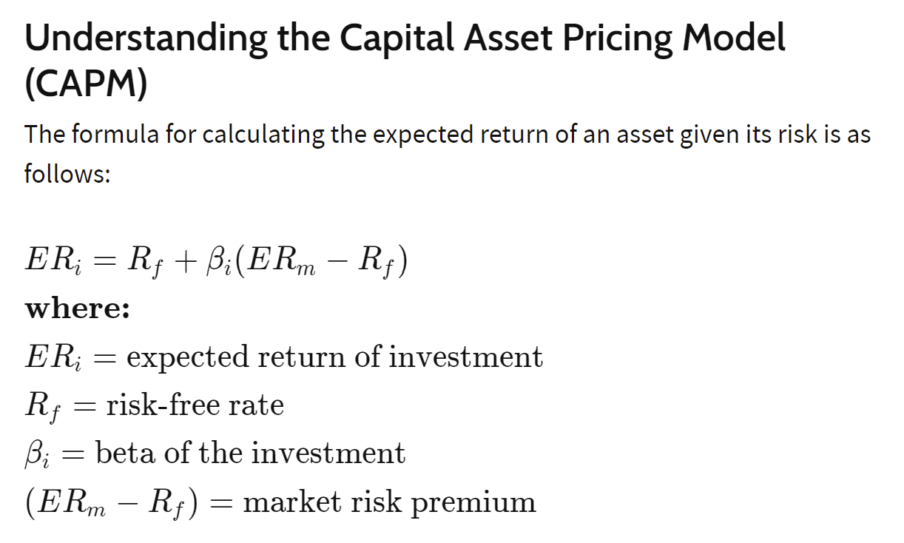
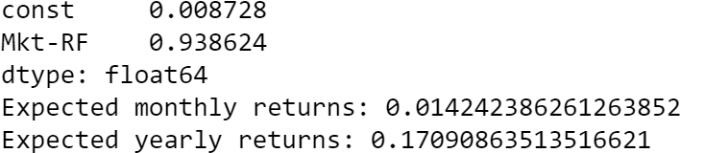
CAPM Model
Used For
Pricing risky securities
Get expected returns for assets given the risk and cost of capital.

