Slide 1
Yelp - Restaurants
DA5030 – Project
Professor: Martin Schedlbauer
Kshitij Aggarwal

Slide 2
Problem Statement
This project aims on predicting the current operational status of a Restaurant in the United States.
Data had been used from Kaggle.
Details of establishment, reviews and daily operating hours have been provided.

Slide 3
CRISP - DM
Business Understanding
Data Understanding
Data Preparation
Modeling
Evaluation
Deployment

Slide 4
Business Understanding
Considering the geography, we understand that most of restaurants would be there in the major cities.
Customers in these cities are more likely to be active on social media and use the Yelp service.
Reaction by customers can be sometimes erratic and spike up the reviews.
There might be reviews that would be fake.

Slide 5
Data Understanding
We have the following files within the scope of this project.
Business
Within this file we have data representing each establishment and an overview of it.
Review
Reviews from customer and the reactions those reviews have received over the entire time span.
Business Hours
Day wise operation hours of the establishments.
Population
Population by Postal Code from last 7 years

Slide 6
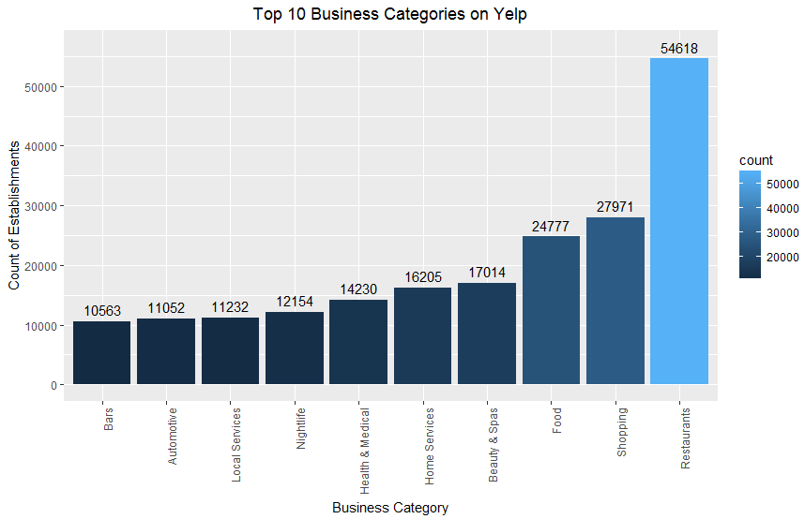
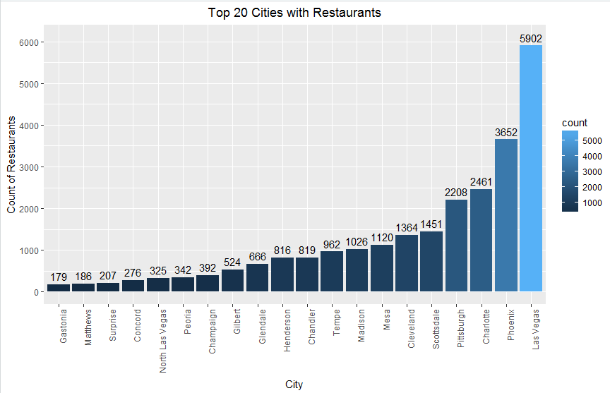
Data Understanding
Data Exploration
Among all the establishments from the data, we most interested on Restaurants which also have the most amount of data.
There are various cities around the world within the top 20 list of “Top 20 Cities with Restaurants”. We will further focus to US cities.

Slide 7
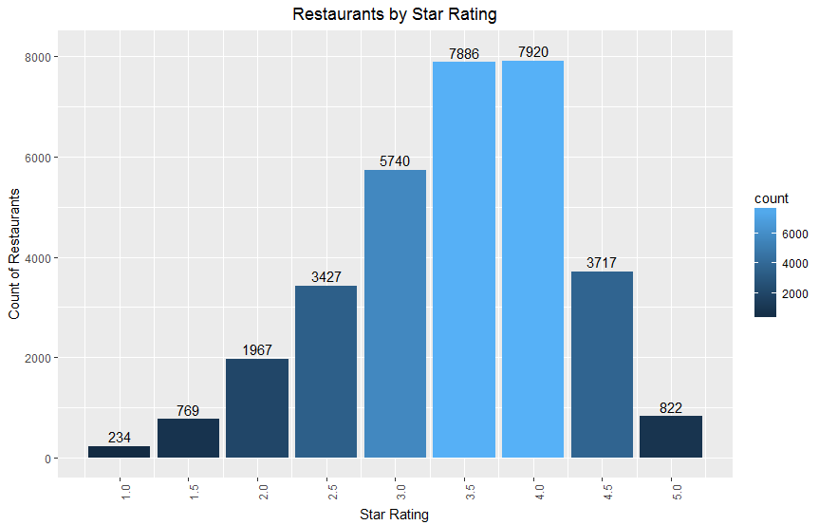
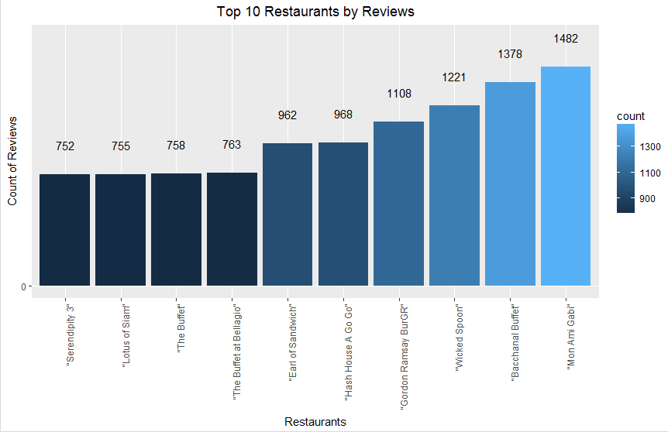
Data Understanding
Data Exploration
Most of the restaurants have been rated 4.0 and 3.0 stars. Which also consistent with the general rationale.
Here are the top 10 restaurants with the highest reviews. As we extend the list there is very gradual decrease but not a sudden drop.

Slide 8
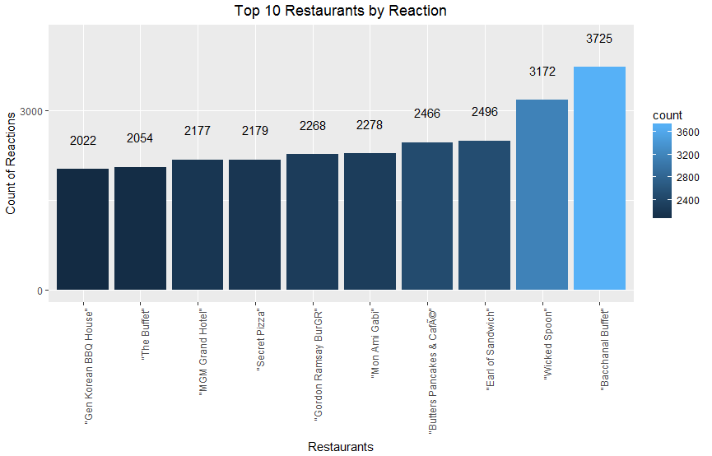
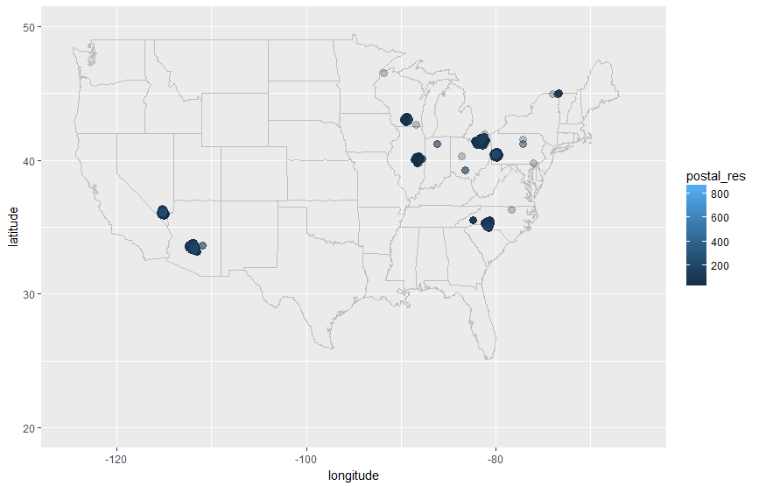
Data Understanding
Data Exploration
The restaurants with number of reactions received on the reviews are very much similar to the reviews received.
Within the US we have data among some of the prominent cities within the US but not all.

Slide 9
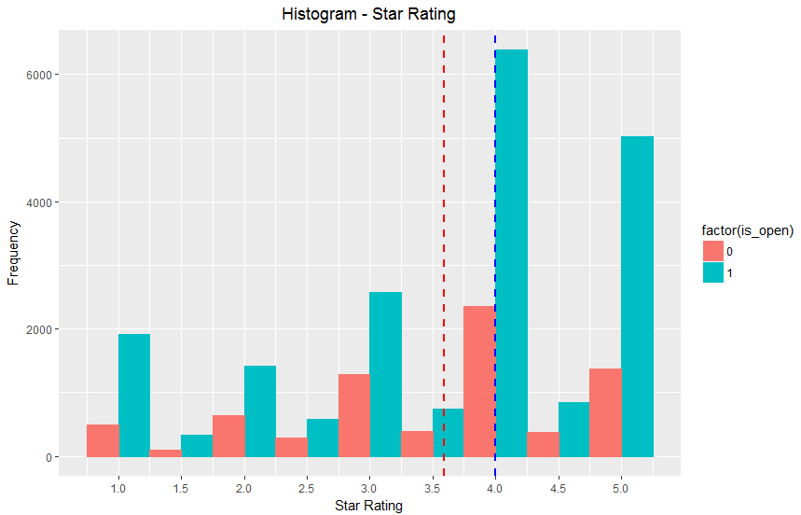
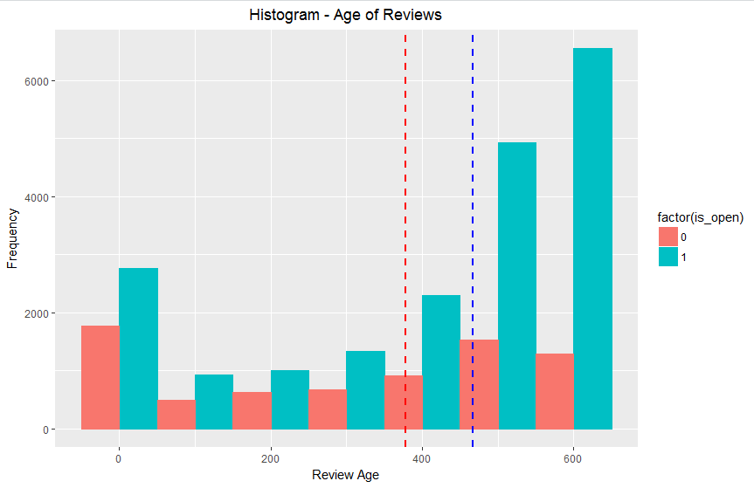
Data Understanding
Data Exploration
The histogram for the star rating shows the central tendency around the 4.0 and 3.5 rating for open and closed restaurants respectively.
The histogram for Age of reviews i.e. the difference between the first and last review received (in weeks) centers around the 400 range ( roughly 7.5 years).

Slide 10
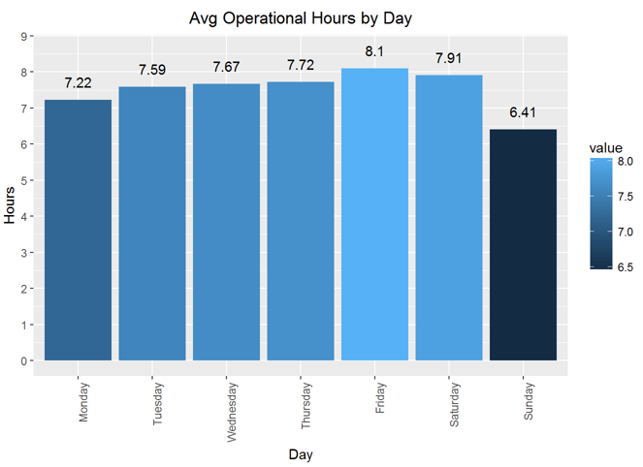
Data Understanding
Data Exploration
Looking into the average operational hours of the restaurants, Friday is more longer than others and as expected drops to a low on Sunday.

Slide 11
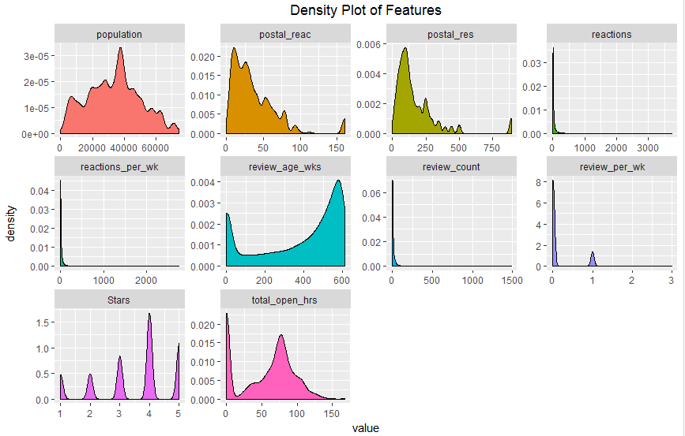
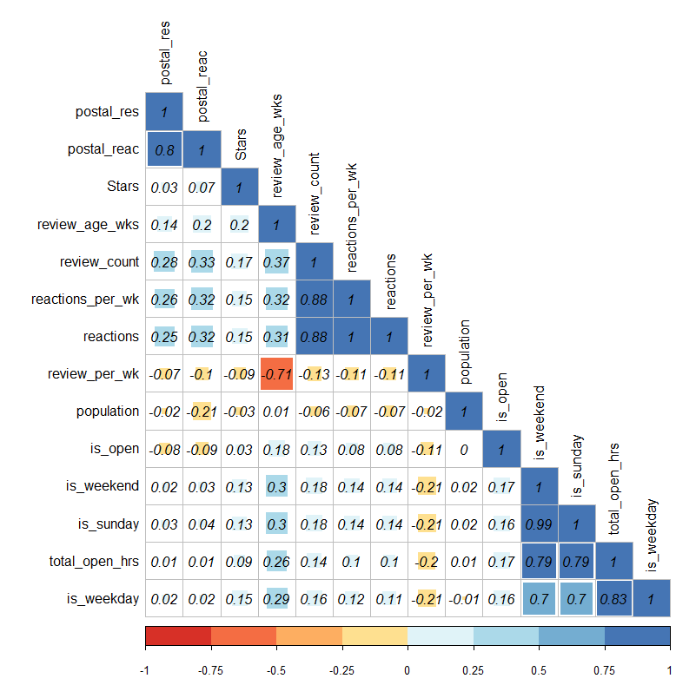
Data Understanding
Data Exploration
A lot of variation between the final features of the data set. But all of it emphasizes on the way the restaurants operate and how they are rated accordingly.
Correlation between the independent and dependent variable (is_open) is fairly low and this allows us to create a better model and avoid biases.

Slide 12
Data Preparation
With such variety and options, structuring of the data was a challenge.
Selection and Exclusion of Data
From the Global data across all establishment types, restaurants within the United States was selected to stay within the scope of the project.
Cleaning of Data
The postal codes that were given the data set needed to be made consistent on files to maintain consistency.
Some postal codes were missing and had to be imputed using the geographical coordinates.
Some outliers had to be removed that had very high count of reviews.
Feature Generation
Lot of aggregation within the data set were made. All the data points seen earlier are derived and aggregated features.
Merging of Data
Finally all the data aggregations were merged to form 14 features, 13 independent and 1 dependent.

Slide 13
Modeling
5 models were used for this data set.
Logistic Regression
Random Forest
Support Vector Machine
Boosting
Ensemble – Top layer as Boosting

Slide 14
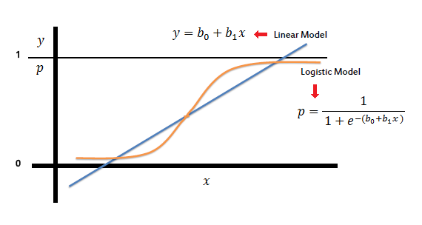
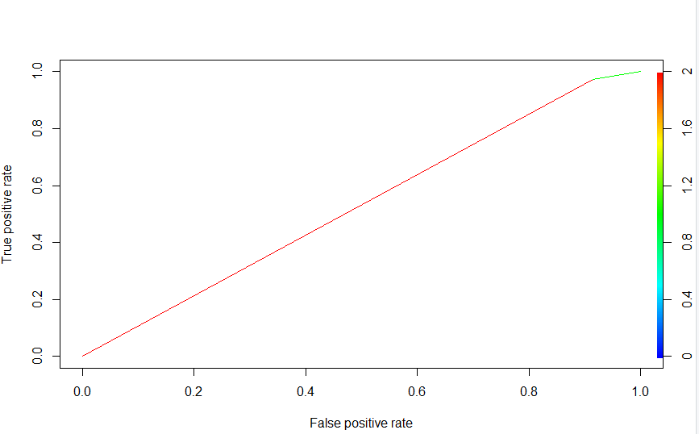
Modeling
Logistic Regression
The general model used in classification.
Within the implementation, step wise reduction was done based on the p-value till all the significant features remained.
This model gave and accuracy of 73.36% and AUC 0.71.
*Image from https://www.saedsayad.com/logistic_regression.htm

Slide 15
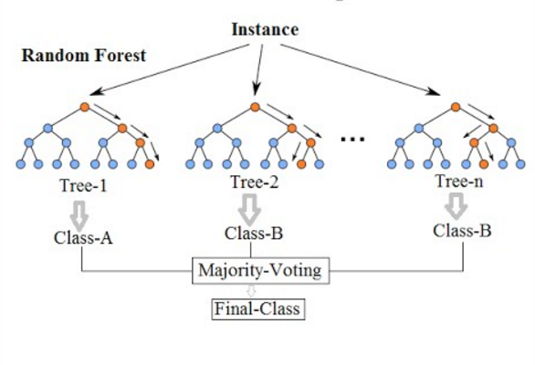
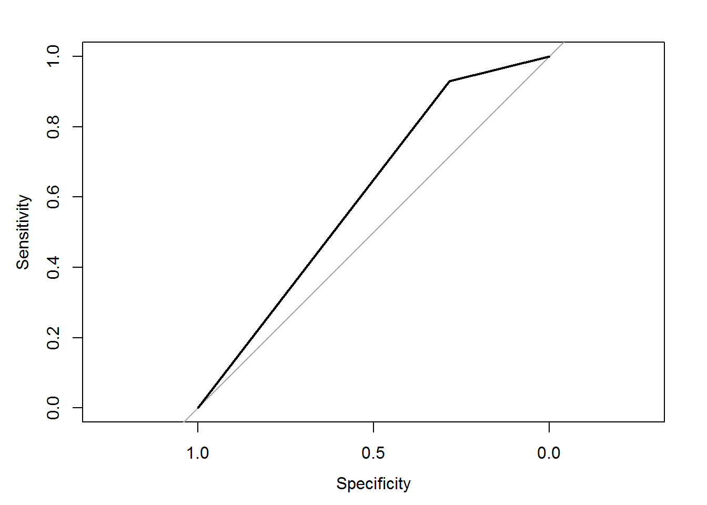
Modeling
Random Forest
This model was used to take into account the large data set and have regression applied to it which would be a collection of many decision trees.
To tune the model, the accuracy was checked to get the best value of “Number of variables randomly sampled” (mtry).
This model gave and accuracy of 75.41% and AUC 0.59.
*Image from https://medium.com/@williamkoehrsen/random-forest-simple-explanation-377895a60d2d

Slide 16
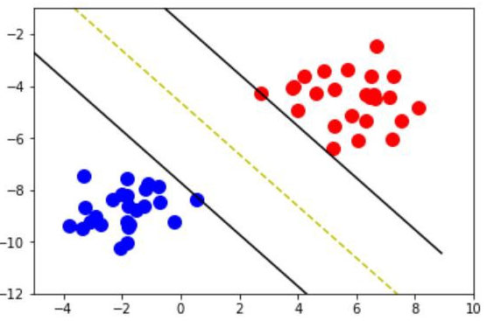

Modeling
Support Vector Machine (kernel)
This model was used to create more distinguishable hyper planes between the data points.
To tune the model, the accuracy was checked to get the best value of by changing the kernel and the highest accuracy was achieved by “laplacedot”.
This model gave and accuracy of 70.89% and AUC 0.59.
*Image from https://medium.com/deep-math-machine-learning-ai/chapter-3-support-vector-machine-with-math-47d6193c82be

Slide 17
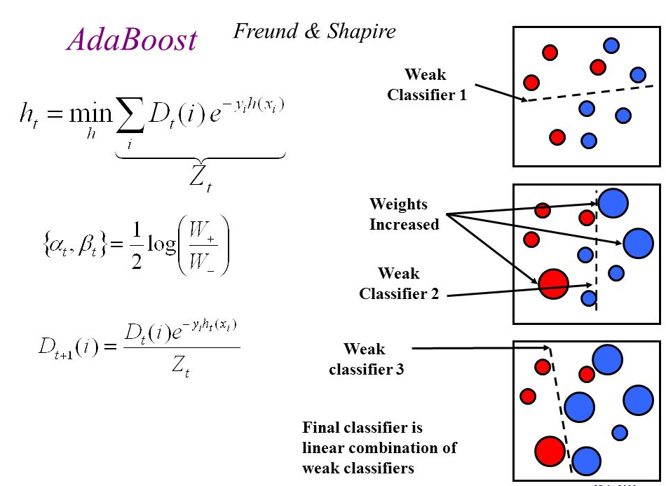
Modeling
Boosting
To have a stronger classification model, adaBoost algorithm was used which did increase the accuracy of prediction to 75.19%.
This model would form the top layer in the ensemble model.
*Image from https://slideplayer.com/slide/5099827/

Slide 18
Modeling
Ensemble
To have a stronger classification model, adaBoost algorithm was used which had accuracy of prediction to 64.43%.
The representation on the right would form the ensemble model.
Accuracy 64.43% and AUC 0.62.
Boosting
Logistic Regression
Random Forest
Support Vector Machine
*Image from https://slideplayer.com/slide/5099827/

Slide 19
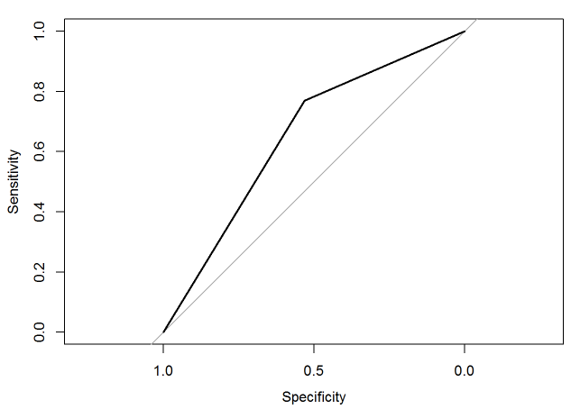
Modeling
Boosting
Logistic Regression
Random Forest
Support Vector Machine
With the final model we had increased accuracy and also increased AUC which both lead to a better model rather than just using one individual model.
All the algorithms were implemented with Principal Component Reduction, but the Accuracy and AUC were lower than the normalized data.
*Image from https://slideplayer.com/slide/5099827/

Slide 20
Evaluation
The models were evaluated on the basis of Accuracy using confusion matrix and also Area Under the Curve metric (AUC)
Moving forward certain business decisions can be made with these predictions and also reasoned further to see why the restaurants are closed and what can be done further to avoid the closure.

Slide 21
Deployment
The model formulation details will be shared with the faculty for further review.
A short report in the format of a R notebook will also be shared.
The code and data files are uploaded on GitHub.

Slide 22
Thank You!
*Please reach out for any questions or suggestions.

