Slide 1



POETS OF BHAKTI ERA
By:- Kshitij Khanka XII

Slide 2
CONTENTS
BHAKTI ERA
SAINTS & POETS
REFERENCES

Slide 3

BHAKTI ERA
An all-India socio-religious movement spread in the Middle Ages in India. Its aim was to stop conversions to Islam and fight the tyranny of Brahmans in the social set-up of Hindus. Its great exponents were Ramanuja in the South, Jaidev and Chaitanya in Bengal, Ramanand and Kabir in U.P., Namdev, Ramdas, Tukaram in Maharashtra and Nanak in Punjab. They believed in the unity of God, and they regarded true devotion Bhakti as means of attaining God; denounced caste-system, idol worship and pilgrimages; bought about socio-religious reforms in Hindu society.

Slide 4
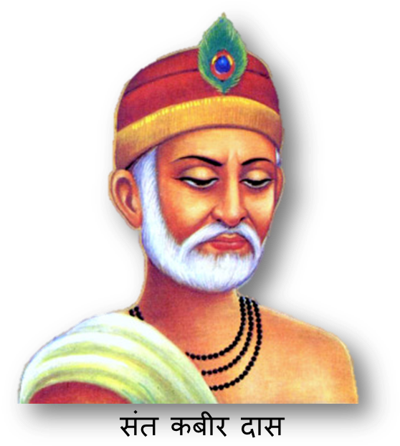
SANT KABIR DAS
Kabir was a disciple of Ramananda. He followed in the same path. Kabir conceived the lofty ideal of uniting Hindus and Muslims in the worship of one God. “The city of the Hindu God,” he said, “is in the east (Varanasi), and the city of the Muslim God is in the west (Mecca), but search your hearts, and there you will find the God both of Hindus and Muslims.” “If the Creator dwells in tabernacles, whose dwelling is the universe?” Kabir’s teachings known as Kabir Chaura are preserved in Varanasi, and his followers are still numerous in the Deccan, Central India, and Gujarat.

Slide 5
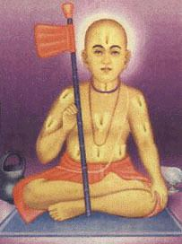
SANT RAMANANDA
Fifth in the apostolic succession from Ramanuja was the great Ramananda, who preached the same ennobling doctrine and faith in Northern India. He traveled far and wide from Varanasi, and preached and wrote in Hindi that was a local language of the people of Northern India. Religious reforms have often led to the improvement and culture of the spoken tongue in India and the Hindi language was greatly strengthened by Ramananda’s life work.

Slide 6
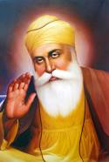
GURU NANAK
Guru Nanak was born in 1469. He preached the same monotheism and conceived the same great idea of uniting Hindus and Muslims in the worship of One God. The Granth of Nanak is well known, and has been translated into English. His peaceful followers, the Sikhs, were converted by the oppression of later Muslim rulers into the most marital race of modern India.

Slide 7
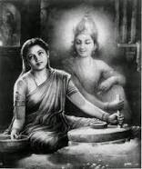
JANADEVI
Janabai was born in a low caste shudra family in the 13th century. She was sent to work in the upper- caste family of Namdev, one of the most famous bhakti saints. She wrote over 300 poems. All her poems focused on domestic chores and the restrictions she faced as a low- caste woman.

Slide 8
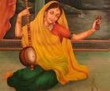
MIRABAI
Mirabai or Mira was born into a ruling Rajput family. Mirabai’s poetry is about her love for Lord Krishna since her childhood and considered herself as his bride. Despite her wishes, she was married into another princely family at a young age yet her love and devotion for Lord Krishna continued. Mirabai left her husband and family and went on a pilgrimage to various places associated with her Lord.

Slide 9
THANK YOU!

