Slide 1
Hephaestus NG — 30-Day Dashboard
March 10 – April 9, 2026 | East US 2 & Sweden Central
Leadership Review

Slide 2
Key Metrics at a Glance
91,371
56,758
34,613
952
Total NG Requests
ChatStream Requests
ColdStart Requests
V2 Requests (5 days)
15,453
~700/day
~100%
~5-6s
Unique Users
Avg Weekday Users
Success Rate
P95 Latency (typ.)
~6-8s
83%
17%
62%/38%
P99 TTFB (typ.)
East US 2 Traffic
Sweden Central Traffic
ChatStream / ColdStart

Slide 3
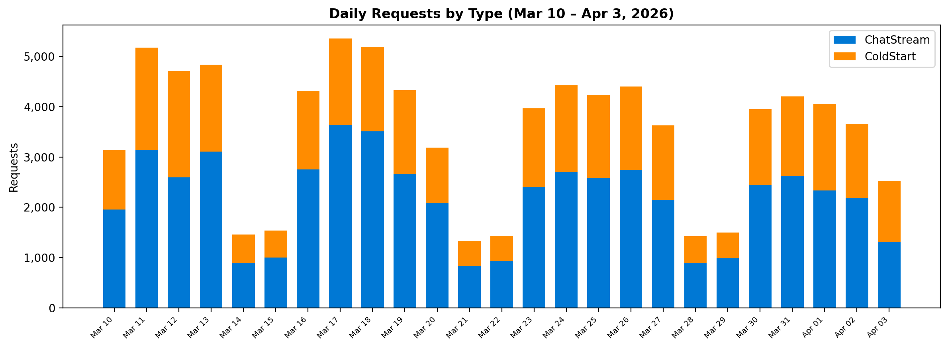
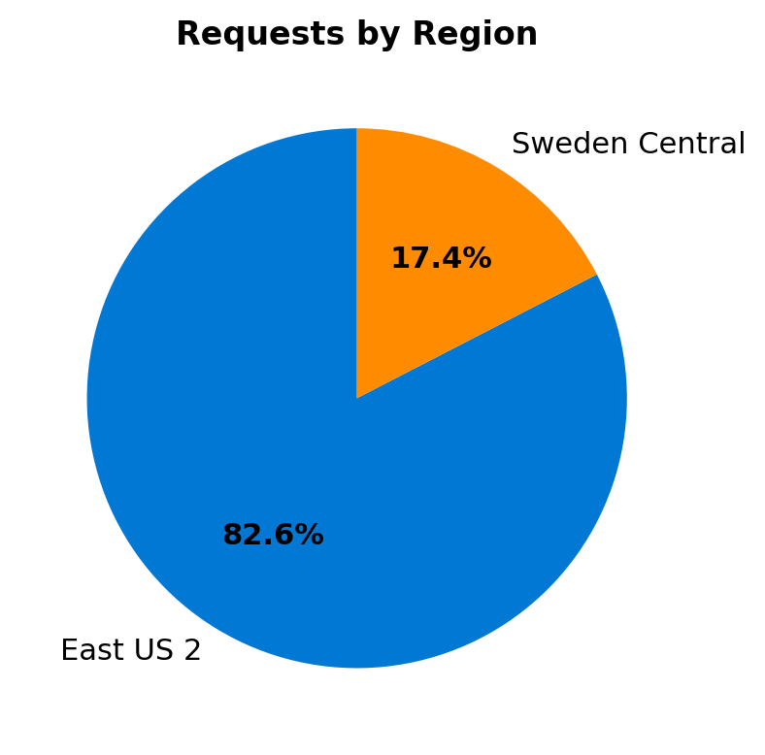
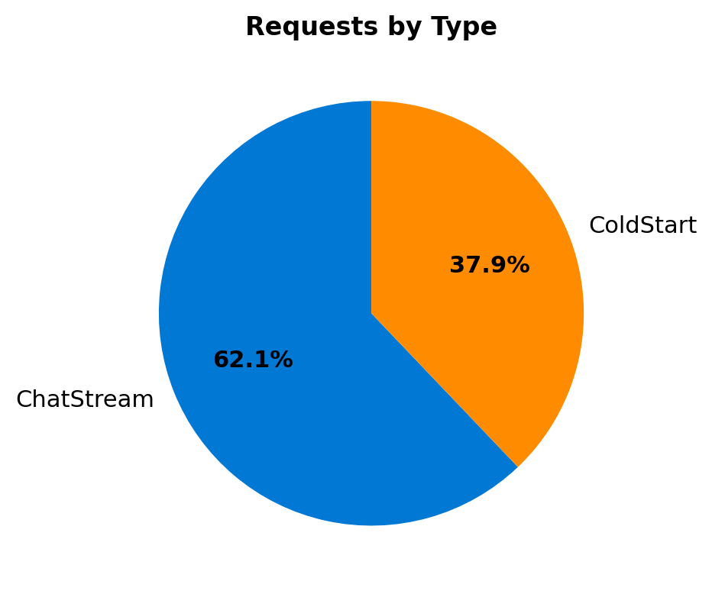
Request Volume & Distribution

Slide 4
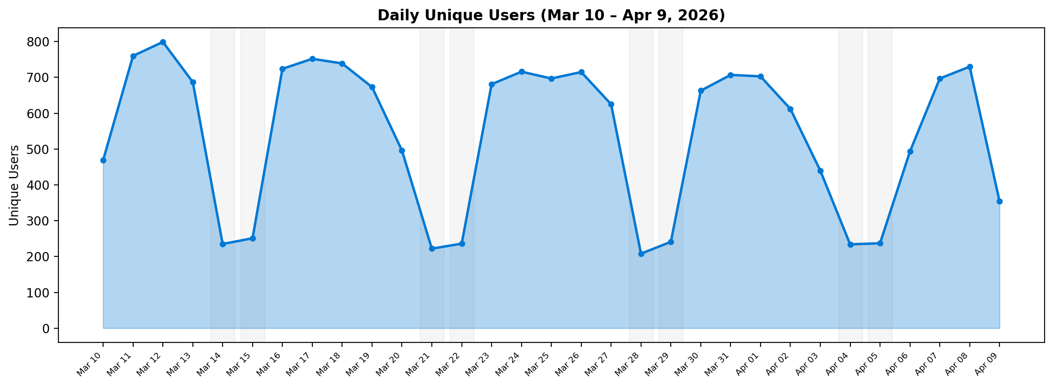
User Adoption & Engagement
📊 Key Insights
• 15,453 unique users (30 days) • ~700 daily active (weekdays) • ~235 daily active (weekends) • Peak: 799 users (Mar 12) • Clear weekday/weekend pattern • Consistent WoW growth

Slide 5
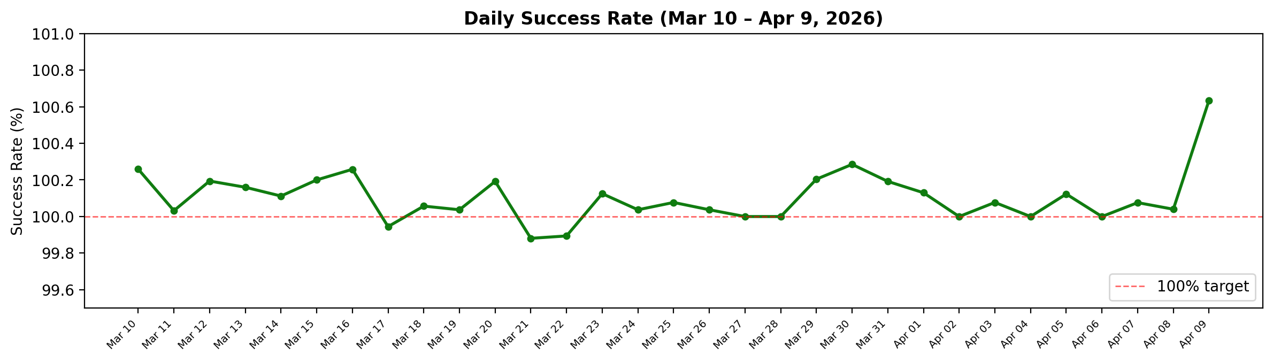
SLO Performance
SLO Summary
✅ Success Rate: ~100% (Min: 99.88%, Max: 100.64%) ✅ P95 Latency: 5–6s (typical) (Best: 3.3s, Worst: 8.4s) ⚠️ P99 TTFB: 6–8s (typical) (Spikes to ~100s — timeout retries at 99th percentile) 📌 Only 3 of 31 days had success rate marginally below 100%
Latency Breakdown
P95 Latency: Consistently in the 5–6 second range across both regions. P99 TTFB: Typically 6–8s, with occasional spikes to ~100s due to cold-start timeout retries hitting the 99th percentile — these are expected outliers and do not impact the majority of users.

Slide 6
Summary & Takeaways
📈 Strong Adoption
91K+ requests from 15,453 unique users in 30 days with consistent weekday engagement (~700 DAU).
🌍 Multi-Region
83% East US 2, 17% Sweden Central — healthy geo-distribution with both regions fully operational.
✅ Near-Perfect Reliability
~100% daily success rate across the entire 30-day window. Only 3 days marginally below 100%.
⚡ Healthy Latency
P95 latency steady at 5–6s. P99 TTFB at 6–8s with explainable outlier spikes from cold-start retries.
🔄 V2 → NG Migration
V2 traffic is minimal (~952 req/5 days) compared to NG's 91K — migration is effectively complete.

