Slide 1
Hephaestus NG — 30-Day Dashboard Review
March 10 – April 9, 2026 | East US 2 & Sweden Central
AskAI Service Team
📊 In This Review
Manager: Nupur Kinger
• Request Volume & Trends
• User Adoption & Engagement
• SLO Performance (Success Rate & Latency)
• V2 → NG Migration Status
• Key Takeaways & Next Steps
Team Members:
• Amit Chauhan
• Mohammed Sheraj
• Kshitij Chawla
• Ayushh Garg

Slide 2
Key Metrics at a Glance
91,371
15,453
~700/day
83% / 17%
1,319
Total NG Requests (30d)
Unique Users (30d)
Avg Weekday DAU
EUS2 / Sweden Central
V2 Requests (30d)
96.8%
94.8%
96.5%
~5–6s
~6–8s
V1 Avg Success Rate
V2 Avg Success Rate
Per-Region Weighted Avg
P95 Latency (typical)
P99 TTFB (typical)
V1 Success Rate: Avg 96.8% | Min 93.918% | Max 98.982% │ V2 Success Rate: Avg 94.8% | Min 88.525% | Max 100.0%
NG handles 98.6% of all traffic (91,371 NG vs 1,319 V2) — migration is effectively complete.
Per-region weighted: Avg 96.5% | Min 83.14% (Apr 13) | Max 98.8% (Mar 29).

Slide 3
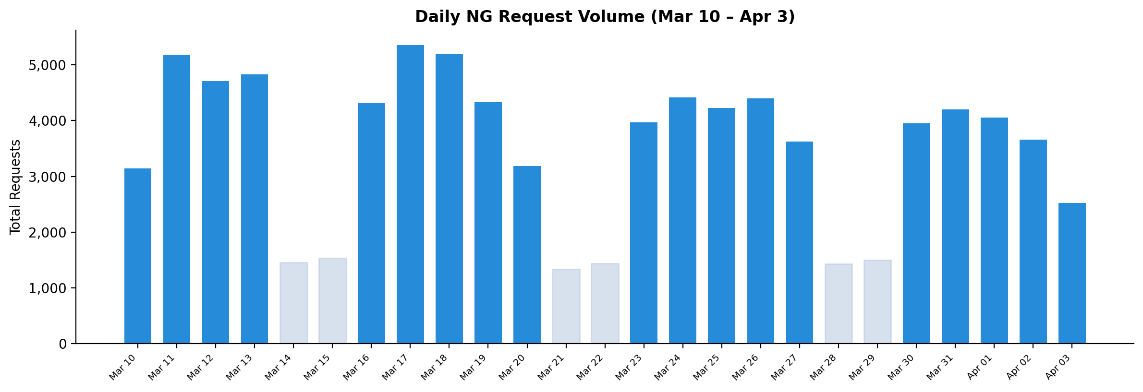
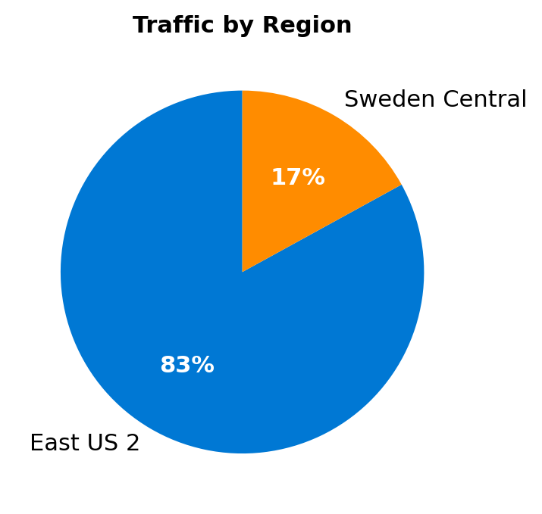
Request Volume & Regional Distribution
Key Observations:
• 91,371 total requests (30d)
• ~3,600 avg daily (weekdays)
• ~1,400 avg daily (weekends)
• East US 2 carries 83% of load
• Lighter bars = weekend days

Slide 4
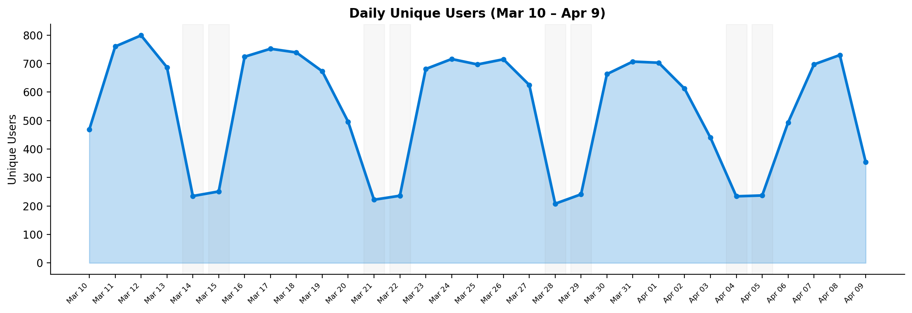
User Adoption & Engagement
📊 User Highlights
• 15,453 unique users (30d)
• ~700 DAU (weekdays)
• ~235 DAU (weekends)
• Peak: 799 users (Mar 12)
• Consistent WoW pattern
• Shaded areas = weekends
🔄 Retention Snapshot
• ~8.0% returning (weekday avg)
• Returning % trending up: 0% → ~10%
• Growing repeat engagement
• See next slide for details

Slide 5
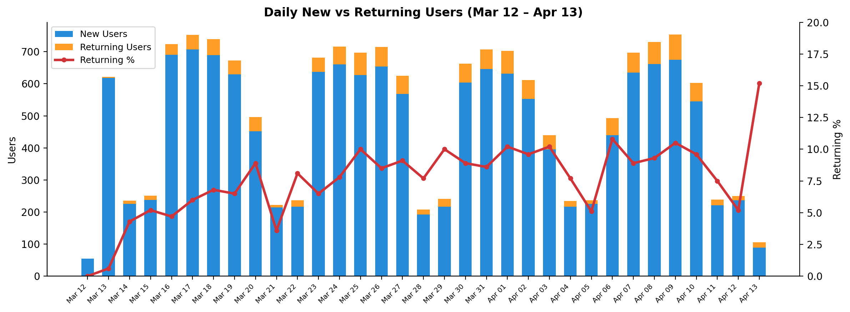
User Retention: New vs Returning
📊 Retention Highlights
• Total new users: 15,063
• Total returning: 1,292
• Avg returning %: 7.6%
• Weekday avg: 8.0%
📈 Trend Analysis
• Day 1: 0% returning (baseline)
• By week 4: ~10% returning
• Steady upward trend shows
growing user stickiness
• ‘New’ = first seen in 30-day window
Note: ‘New’ = first appearance within the 30-day analysis window. Returning % is steadily increasing, indicating healthy user stickiness.

Slide 6
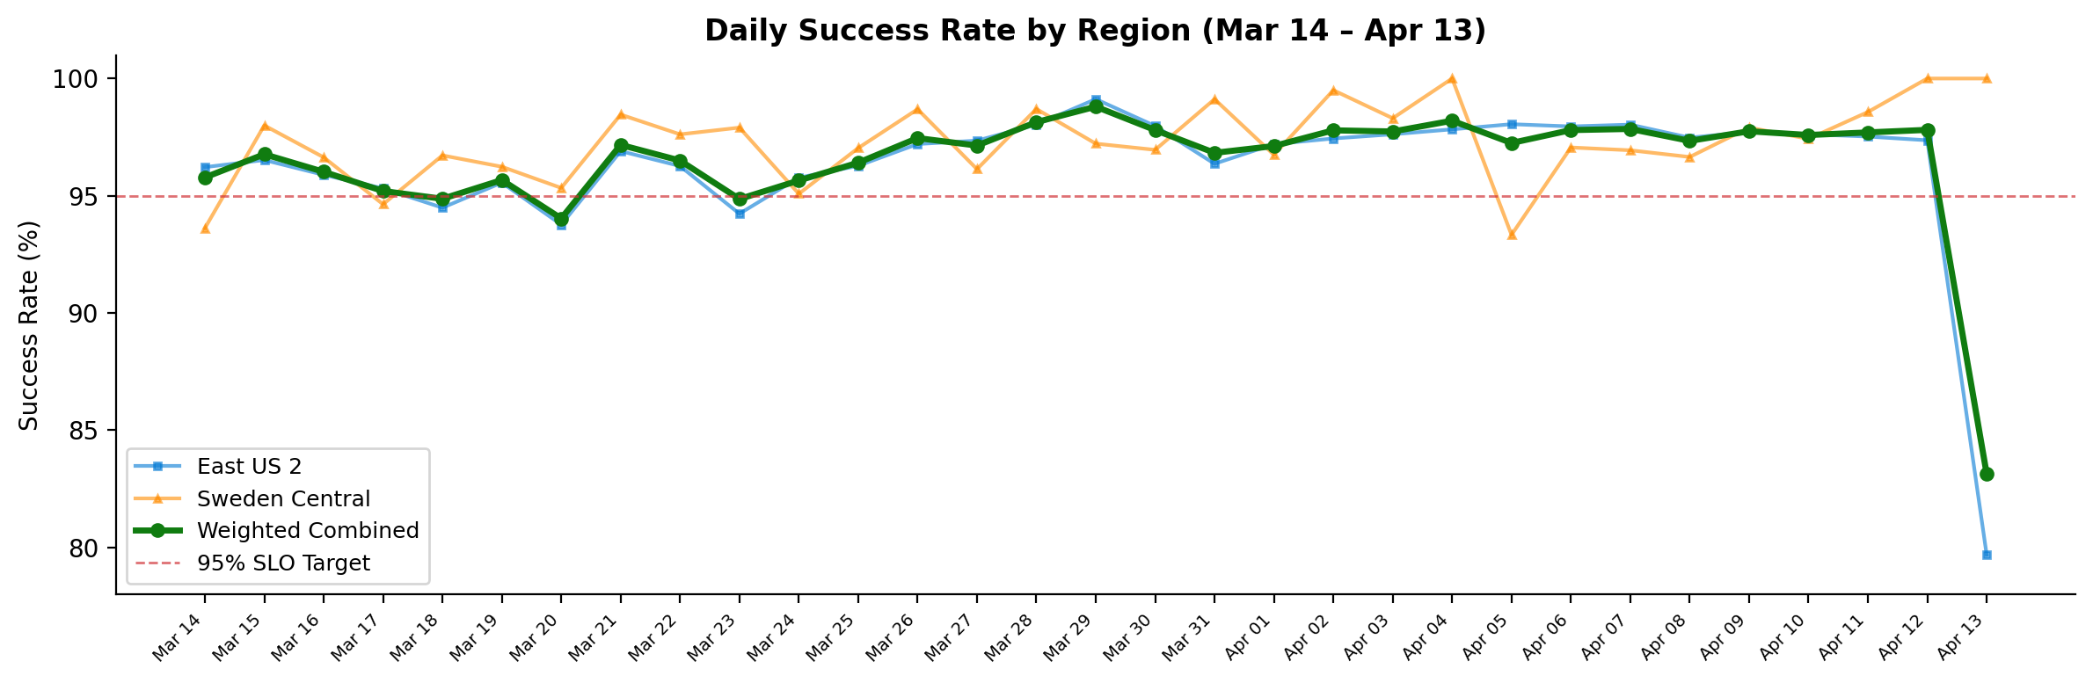
SLO Performance
SLO Summary
✅ Avg Success Rate: 96.5%
EUS2 avg: ~97% | SC avg: ~97%
Min: 83.14% (Apr 13)
⚠️ Apr 13 EUS2 dip: 79.7%
✅ P95 Latency: 5–6s
Best: 3.3s Worst: 8.4s
⚠️ P99 TTFB: 6–8s (typical)
Spikes to ~100s (cold-start
retries at 99th percentile)
P95 Latency Details
• Consistently 5,000–6,000 ms
• Best: ~3,336 ms (Mar 11)
• Worst: ~8,423 ms (Mar 14)
• Within acceptable thresholds
P99 TTFB Details
• Typically 6,000–8,000 ms
• Periodic spikes to ~100–109s
• Caused by cold-start timeout retries
• Affects <1% of requests
• Action: Monitor & optimize cold-start path
Data source: tile bd391155. Weighted combined = 83% EUS2 + 17% SC. Avg: 96.5% | Min: 83.14% | Max: 98.8%

Slide 7
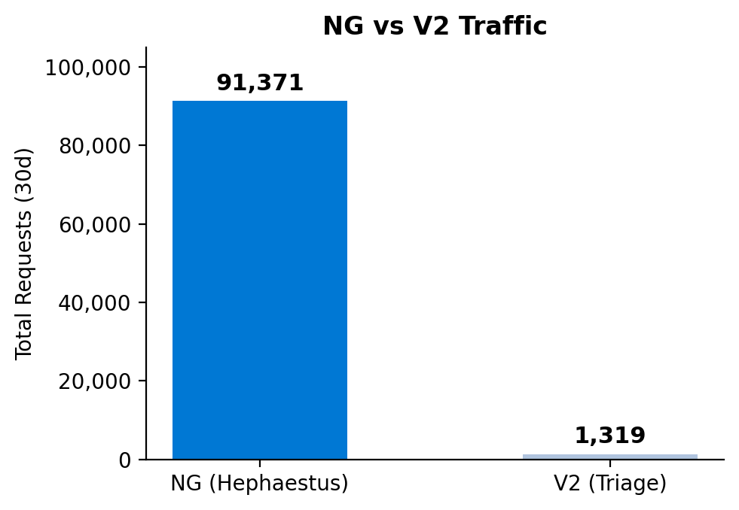
V2 → NG Migration Status
Migration Summary
• NG Requests (30d): 91,371 (98.6%)
• V2 Requests (30d): 1,319 (1.4%)
• V2 traffic is sporadic & declining
• Several days with zero V2 requests (Mar 24–Apr 1)
• Migration to NG is effectively complete
V2 Daily Breakdown:
Mar 16: 72
Mar 17: 69
Mar 18: 61
Mar 19: 53
Mar 20: 79
Mar 21: 9
Mar 22: 3
Mar 23: 21
Apr 02: 232
Apr 03: 230
Apr 04: 125
Apr 05: 104
Apr 06: 261
Data Source:
Traces table query filtering
message contains
"Running for AgentId=triage"

Slide 8
Summary & Takeaways
📈 Strong Adoption
91,371 requests from 15,453 unique users in 30 days. ~700 weekday DAU with consistent week-over-week engagement.
🔄 Growing Retention
Returning users grew from 0% to ~10% over 30 days (weekday avg 8.0%). 1,292 repeat users demonstrate increasing stickiness.
🌍 Multi-Region Health
83% East US 2, 17% Sweden Central — healthy geo-distribution with both regions fully operational.
✅ Strong Reliability
Avg 96.5% success rate across both regions. EUS2 & SC both averaging ~97%. Apr 13 EUS2 dip (79.7%) under investigation.
⚡ Healthy Latency
P95 steady at 5–6s. P99 TTFB at 6–8s with explainable outlier spikes from cold-start retries (<1% of traffic).
🔄 V2 → NG Migration Complete
V2 traffic: 1,319 (1.4%) vs NG: 91,371 (98.6%). Multiple days with zero V2 requests. Migration effectively done.

Slide 9
Appendix: Dashboard Links & References
Live Dashboard (Azure Data Explorer):
https://dataexplorer.azure.com/dashboards/4584380f-1dcf-43ff-b174-beb56a9a51ea?p-_startTime=30days&p-_endTime=now&p-_env=v-eastus2&p-_env=v-swedencentral
Individual Tile Links:
📊 NG Requests
https://dataexplorer.azure.com/dashboards/4584380f-1dcf-43ff-b174-beb56a9a51ea?p-_startTime=30days&p-_endTime=now&p-_env=v-eastus2&p-_env=v-swedencentral&tile=400a95ab-6ff8-4bd4-bbae-18898d1a54a0
📊 V2 Requests (Triage)
https://dataexplorer.azure.com/dashboards/4584380f-1dcf-43ff-b174-beb56a9a51ea?p-_startTime=30days&p-_endTime=now&p-_env=v-eastus2&p-_env=v-swedencentral&tile=d24ef970-b3cd-4383-9e17-6ec5099ab134
📊 P95 Latency
https://dataexplorer.azure.com/dashboards/4584380f-1dcf-43ff-b174-beb56a9a51ea?p-_startTime=30days&p-_endTime=now&p-_env=v-eastus2&p-_env=v-swedencentral&tile=5bf7b1d4-63e0-4af6-8f26-7d0f4297412a
📊 P99 TTFB
https://dataexplorer.azure.com/dashboards/4584380f-1dcf-43ff-b174-beb56a9a51ea?p-_startTime=30days&p-_endTime=now&p-_env=v-eastus2&p-_env=v-swedencentral&tile=c1c9cc13-1713-43b4-b0ed-36d94d192c0c
📊 Success Rate (Overall)
https://dataexplorer.azure.com/dashboards/4584380f-1dcf-43ff-b174-beb56a9a51ea?p-_startTime=30days&p-_endTime=now&p-_env=v-eastus2&p-_env=v-swedencentral&tile=20253c74-5866-4fa1-bf3c-d62c65ab710e
📊 Success Rate (Daily)
https://dataexplorer.azure.com/dashboards/4584380f-1dcf-43ff-b174-beb56a9a51ea?p-_startTime=30days&p-_endTime=now&p-_env=v-eastus2&p-_env=v-swedencentral&tile=2e6b6b6c-dafc-41ed-9113-70f243c8dece
📊 Success Rate (Region)
https://dataexplorer.azure.com/dashboards/4584380f-1dcf-43ff-b174-beb56a9a51ea?p-_startTime=30days&p-_endTime=now&p-_env=v-eastus2&p-_env=v-swedencentral&tile=bd391155-bdda-44f0-9195-b4d47e382277
Methodology Notes:
📊 V1 Success Rate
https://dataexplorer.azure.com/dashboards/4584380f-1dcf-43ff-b174-beb56a9a51ea?p-_startTime=30days&p-_endTime=now&p-_env=v-eastus2&p-_env=v-swedencentral&tile=2e6b6b6c-dafc-41ed-9113-70f243c8dece
📊 V2 Success Rate
https://dataexplorer.azure.com/dashboards/4584380f-1dcf-43ff-b174-beb56a9a51ea?p-_startTime=30days&p-_endTime=now&p-_env=v-eastus2&p-_env=v-swedencentral&tile=dce01fdf-308a-4d63-8438-9d3745a065c0
• NG data: UnionOfAllLogs("Vienna", "requests") — app == "hephaestus-agent"
• V2 data: UnionOfAllLogs("Vienna", "traces") — message contains "AgentId=triage"
• Regions: eastus2, swedencentral | Period: 30 days
• Success rate: Per-region data from tile bd391155, weighted 83% EUS2 + 17% SC
• Full KQL queries available in companion Word document

Slide 10
Appendix: Pending Analysis
✅ User Retention (Resolved)
Retention data collected and analysed. Returning users grew from 0% to ~10%. See Slide 5 for full breakdown.
⚠️ Pending: % of NG Users vs Total AskAI Users
let ngUsers = toscalar(UnionOfAllLogs("Vienna", "requests") | where operation_Name in ("POST Hephaestus/ColdStart","POST Hephaestus/ChatStream") | where PreciseTimeStamp >= _startTime and ... <= _endTime and env in (_env) | where app == "hephaestus-agent" | summarize dcount(user_Id)); let askAIUsers = toscalar(UnionOfAllLogs("Vienna", "requests") | where PreciseTimeStamp >= _startTime and ... <= _endTime and env in (_env) | where app == "hephaestus-agent" | summarize dcount(user_Id)); print NGUsers=ngUsers, AskAIUsers=askAIUsers, PctOfAskAI = round(todouble(ngUsers)/todouble(askAIUsers)*100, 2)
⚠️ Run the above query in the live dashboard to complete this analysis.

