Slide 1
Hephaestus NG — 30-Day Dashboard Review
March 10 – April 9, 2026 | East US 2 & Sweden Central
AskAI Service Team
📊 In This Review
Manager: Nupur Kinger
• Request Volume & Trends
• User Adoption & Engagement
• SLO Performance (Success Rate & Latency)
• V2 → NG Migration Status
• Key Takeaways & Next Steps
Team Members:
• Amit Chauhan
• Mohammed Sheraj
• Kshitij Chawla
• Ayushh Garg

Slide 2
Key Metrics at a Glance
91,371
15,453
~700/day
83% / 17%
1,319
Total NG Requests (30d)
Unique Users (30d)
Avg Weekday DAU
EUS2 / Sweden Central
V2 Requests (30d)
96.8%
94.8%
96.5%
V1 Avg Success Rate
V2 Avg Success Rate
Per-Region Weighted SR
~5.6s
~7.4s
~5.1s
~5.0s
V1 P95 Latency
V1 P99 TTFB
V2 P95 Latency
V2 P99 TTFB
V1 SR: 96.8% (min 93.918% / max 98.982%) │ V2 SR: 94.8% (min 88.525% / max 100.0%) │ Per-Region: 96.5% (min 83.14% / max 98.8%)
V1 P95: 5–6s (max 8.4s) │ V2 P95: 4–7s (max 17.7s) │ V1 P99: 6–8s typ, spikes to 109.3s │ V2 P99: 4–6s (max 17.7s)
NG handles 98.6% of all traffic (91,371 NG vs 1,319 V2) — migration is effectively complete.

Slide 3
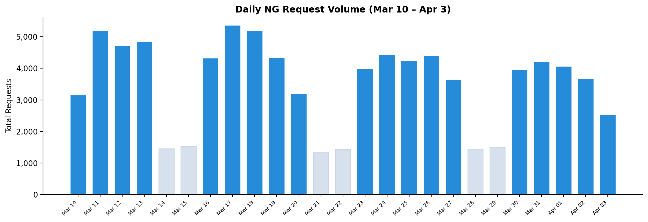
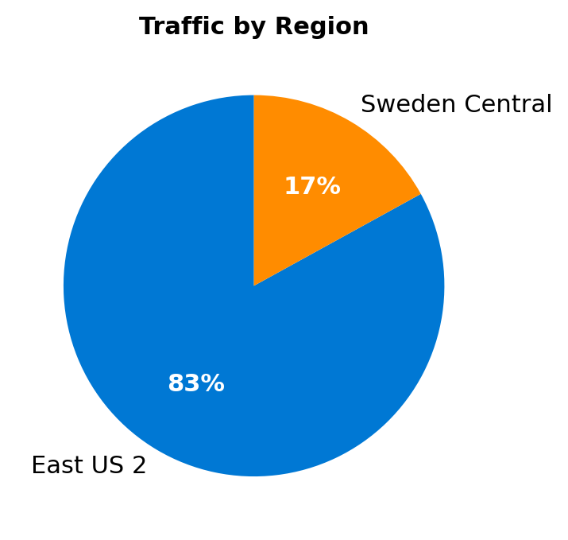
Request Volume & Regional Distribution
Key Observations:
• 91,371 total requests (30d)
• ~3,600 avg daily (weekdays)
• ~1,400 avg daily (weekends)
• East US 2 carries 83% of load
• Lighter bars = weekend days

Slide 4
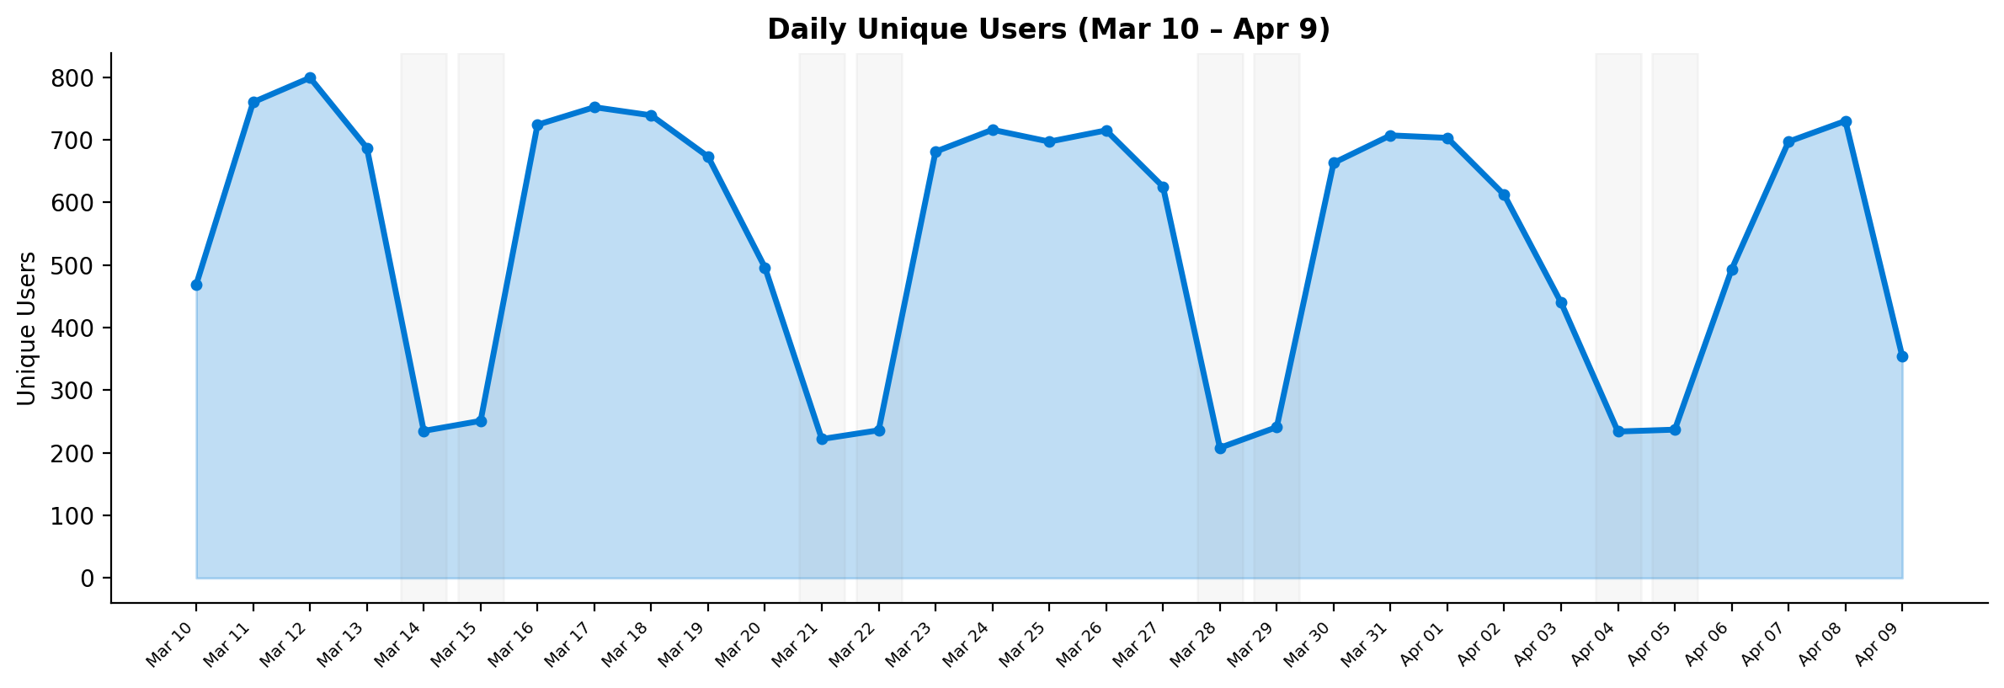
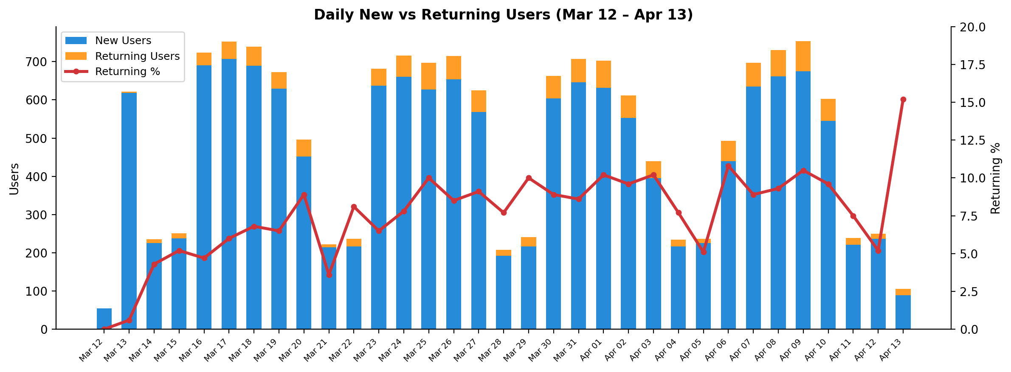
User Adoption, Retention & AskAI Reach
📊 User Highlights
• 15,453 unique users (30d)
• ~700 DAU (weekdays) / ~235 (weekends)
• Peak: 799 users (Mar 12)
🔄 Retention Highlights
• 1,292 returning users
• Weekday avg: 8.0% returning
• Trend: 0% → ~10% over 30 days
🌐 AskAI Reach
• 118,082 total AskAI users
• 16,239 use Hephaestus NG
• 13.75% of AskAI users on NG
Returning % = repeat visitors within 30-day window. ‘New’ = first appearance in window.
NG users are 13.75% of 118,082 total AskAI users.

Slide 5
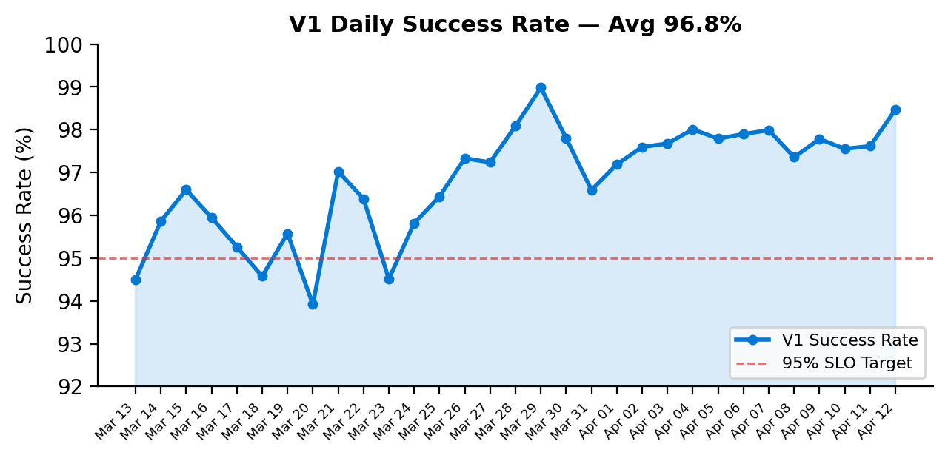
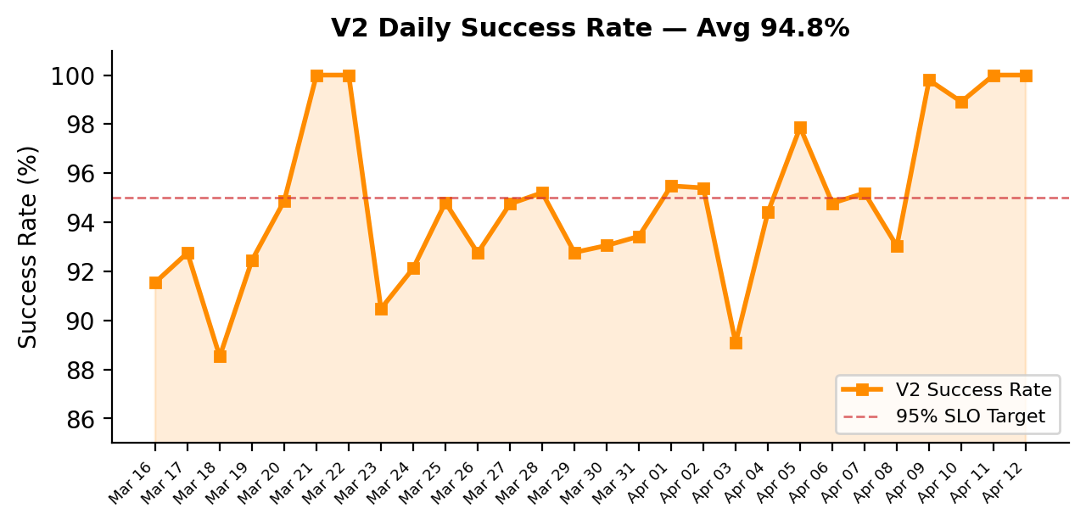
SLO Performance
V1 Success Rate
✅ Average: 96.8%
Min: 93.918% | Max: 98.982%
31 days (Mar 13–Apr 12)
Consistently above 95% SLO
V2 Success Rate
⚠️ Average: 94.8%
Min: 88.525% | Max: 100.0%
28 days (Mar 16–Apr 12)
More volatile; dips below 90%
Latency Summary
V1 P95: 5–6s | V2 P95: 4–7s
V1 P99: 6–8s | V2 P99: 4–6s
V1 P99 spikes to ~109.3s (cold-start)
V2 no extreme spikes observed
V1 tile: 2e6b6b6c | V2 tile: dce01fdf | Region tile: bd391155
Per-region weighted avg: 96.5% (83% EUS2 + 17% SC). Region chart in Word report.

Slide 6
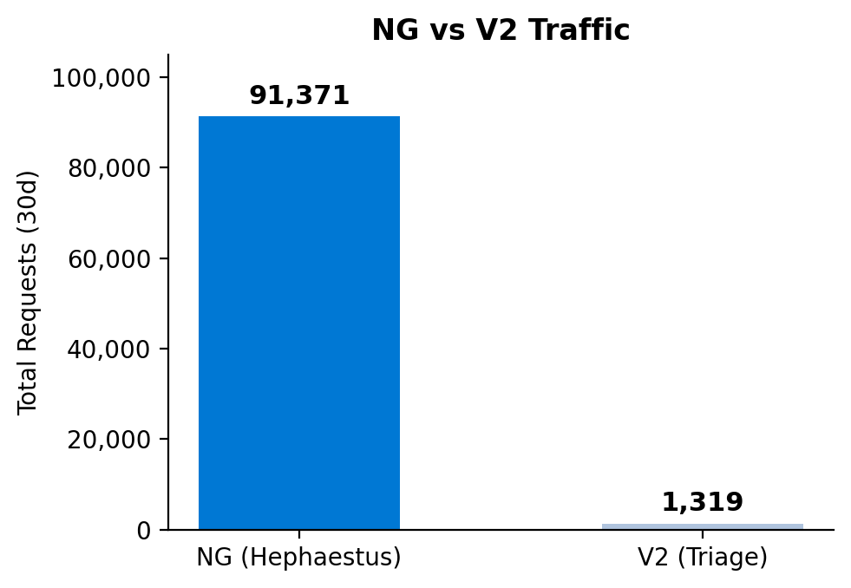
V2 → NG Migration Status
Migration Summary
• NG Requests (30d): 91,371 (98.6%)
• V2 Requests (30d): 1,319 (1.4%)
• V2 traffic is sporadic & declining
• Several days with zero V2 requests (Mar 24–Apr 1)
• Migration to NG is effectively complete
V2 Daily Breakdown:
Mar 16: 72
Mar 17: 69
Mar 18: 61
Mar 19: 53
Mar 20: 79
Mar 21: 9
Mar 22: 3
Mar 23: 21
Apr 02: 232
Apr 03: 230
Apr 04: 125
Apr 05: 104
Apr 06: 261
Data Source:
Traces table query filtering
message contains
"Running for AgentId=triage"

Slide 7
Summary & Takeaways
📈 Strong Adoption
91,371 requests from 15,453 unique users in 30 days. ~700 weekday DAU. 13.75% of all AskAI users (16,239 / 118,082).
🔄 Growing Retention
Returning users grew from 0% to ~10% over 30 days (weekday avg 8.0%). 1,292 repeat users demonstrate increasing stickiness.
✅ V1 Reliability
V1 avg 96.8% success rate (min 93.918% / max 98.982%). P95: 5–6s. P99: 6–8s with cold-start spikes.
⚠️ V2 Reliability
V2 avg 94.8% success rate (min 88.525% / max 100.0%). More volatile with occasional dips below 90%.
🌍 Multi-Region Health
83% East US 2, 17% Sweden Central — healthy geo-distribution with both regions fully operational.
🔄 V2 → NG Migration Complete
V2 traffic: 1,319 (1.4%) vs NG: 91,371 (98.6%). Multiple days with zero V2 requests. Migration effectively done.

Slide 8
Appendix: Dashboard Links & References
Live Dashboard (Azure Data Explorer):
https://dataexplorer.azure.com/dashboards/4584380f-1dcf-43ff-b174-beb56a9a51ea?p-_startTime=30days&p-_endTime=now&p-_env=v-eastus2&p-_env=v-swedencentral
Individual Tile Links:
📊 NG Requests
https://dataexplorer.azure.com/dashboards/4584380f-1dcf-43ff-b174-beb56a9a51ea?p-_startTime=30days&p-_endTime=now&p-_env=v-eastus2&p-_env=v-swedencentral&tile=400a95ab-6ff8-4bd4-bbae-18898d1a54a0
📊 V2 Requests (Triage)
https://dataexplorer.azure.com/dashboards/4584380f-1dcf-43ff-b174-beb56a9a51ea?p-_startTime=30days&p-_endTime=now&p-_env=v-eastus2&p-_env=v-swedencentral&tile=d24ef970-b3cd-4383-9e17-6ec5099ab134
📊 V1 P95 Latency
https://dataexplorer.azure.com/dashboards/4584380f-1dcf-43ff-b174-beb56a9a51ea?p-_startTime=30days&p-_endTime=now&p-_env=v-eastus2&p-_env=v-swedencentral&tile=5bf7b1d4-63e0-4af6-8f26-7d0f4297412a
📊 V1 P99 TTFB
https://dataexplorer.azure.com/dashboards/4584380f-1dcf-43ff-b174-beb56a9a51ea?p-_startTime=30days&p-_endTime=now&p-_env=v-eastus2&p-_env=v-swedencentral&tile=c1c9cc13-1713-43b4-b0ed-36d94d192c0c
📊 V2 P99 TTFB
https://dataexplorer.azure.com/dashboards/4584380f-1dcf-43ff-b174-beb56a9a51ea?p-_startTime=30days&p-_endTime=now&p-_env=v-eastus2&p-_env=v-swedencentral&tile=fac37981-da6c-4d16-bba0-a625a4939fc9
📊 V2 P95 Latency
https://dataexplorer.azure.com/dashboards/4584380f-1dcf-43ff-b174-beb56a9a51ea?p-_startTime=30days&p-_endTime=now&p-_env=v-eastus2&p-_env=v-swedencentral&tile=abcd56e7-4390-4c2d-8931-24a3346232d3
📊 Success Rate (Overall)
https://dataexplorer.azure.com/dashboards/4584380f-1dcf-43ff-b174-beb56a9a51ea?p-_startTime=30days&p-_endTime=now&p-_env=v-eastus2&p-_env=v-swedencentral&tile=20253c74-5866-4fa1-bf3c-d62c65ab710e
Methodology Notes:
📊 Success Rate (Daily)
https://dataexplorer.azure.com/dashboards/4584380f-1dcf-43ff-b174-beb56a9a51ea?p-_startTime=30days&p-_endTime=now&p-_env=v-eastus2&p-_env=v-swedencentral&tile=2e6b6b6c-dafc-41ed-9113-70f243c8dece
📊 Success Rate (Region)
https://dataexplorer.azure.com/dashboards/4584380f-1dcf-43ff-b174-beb56a9a51ea?p-_startTime=30days&p-_endTime=now&p-_env=v-eastus2&p-_env=v-swedencentral&tile=bd391155-bdda-44f0-9195-b4d47e382277
• NG data: UnionOfAllLogs("Vienna", "requests") — app == "hephaestus-agent"
• V2 data: UnionOfAllLogs("Vienna", "traces") — message contains "AgentId=triage"
• Regions: eastus2, swedencentral | Period: 30 days
• Success rate: Per-region data from tile bd391155, weighted 83% EUS2 + 17% SC
• Full KQL queries available in companion Word document
📊 V1 Success Rate
https://dataexplorer.azure.com/dashboards/4584380f-1dcf-43ff-b174-beb56a9a51ea?p-_startTime=30days&p-_endTime=now&p-_env=v-eastus2&p-_env=v-swedencentral&tile=2e6b6b6c-dafc-41ed-9113-70f243c8dece
📊 V2 Success Rate
https://dataexplorer.azure.com/dashboards/4584380f-1dcf-43ff-b174-beb56a9a51ea?p-_startTime=30days&p-_endTime=now&p-_env=v-eastus2&p-_env=v-swedencentral&tile=dce01fdf-308a-4d63-8438-9d3745a065c0

Slide 9
Appendix: Analysis Status
✅ User Retention (Resolved)
Returning users grew from 0% to ~10%. Weekday avg: 8.0%. See Slide 4 for charts.
✅ % of NG Users in AskAI (Resolved)
Total AskAI Users: 118,082 | Hephaestus NG Users: 16,239 | NG as % of AskAI: 13.75%
✅ All planned analyses are now complete.

