Slide 1

Introduction to Fake News Detection
In today's digital age, the rise of fake news has become a growing concern. This presentation will guide you through the process of building a fake news detector using Python and popular machine learning libraries.
Submitted by :
AASHVI CHAVLA(2210990019)
KSHITIJ RAJ SHUKLA(2210990526)
LIV ARPIT (2210990543)
LOKESH VAID(2210990545)
Submitted to:
MS.SHAGUN SHARMA
MR.TUSHAR KHITOLIA

Slide 2
CONTENT
Problem Statement
Objective
Tools Used
Data Summary
Data Processing
Model Selection
Model Training and Evaluation
Conclusion

Slide 3
PROBLEM STATEMENT
In today's digital age, the proliferation of fake news has become a significant concern, often leading to misinformation, confusion, and even societal unrest. To address this challenge, there is a need to develop a robust fake news detector using Python.
The goal of this project is to create a machine learning-based system capable of accurately distinguishing between real and fake news articles. The system will analyze various textual features of news articles and employ natural language processing (NLP) techniques to classify them as either authentic or deceptive.

Slide 4
OBJECTIVE
Dataset Acquisition: Collect a diverse dataset of news articles labeled as either real or fake to train and evaluate the model.
Data Preprocessing: Clean and preprocess the text data by removing noise, such as HTML tags, punctuation, and stopwords, and perform tokenization and lemmatization.
3.Model Development: Develop and train machine learning models, such as logistic regression, random forest, or neural networks, to classify news articles based on their features.
4.Model Evaluation: Evaluate the performance of the trained models using appropriate metrics, such as accuracy, through cross-validation and/or holdout validation.

Slide 5
OBJECTIVE
6.Deployment : Implement the trained model into a user-friendly application or web service that allows users to input news articles and receive predictions on their authenticity.
7.Continuous Improvement: Continuously monitor and update the fake news detector to adapt to evolving news sources and deceptive tactics.

Slide 6
Tools Used
VS Code(Python Environment)
Pandas and NumPy are used for Data Manipulation & Pre-processing and Mathematical functions respectively.
Seaborn is a data visualization library based on matplotlib and Matplotlib is a plotting library for creating static
Sklearn is used to split data into training and testing sets for model evaluation and text report showing the main classification metrics, such as precision, recall, F1-score, and support, for each class in the dataset.
Exploratory data analysis is automated by data prep.
For visualization of the plots, Matplotlib, Seaborn, and Plotty are used.
GitHub is used as a version control system

Slide 7
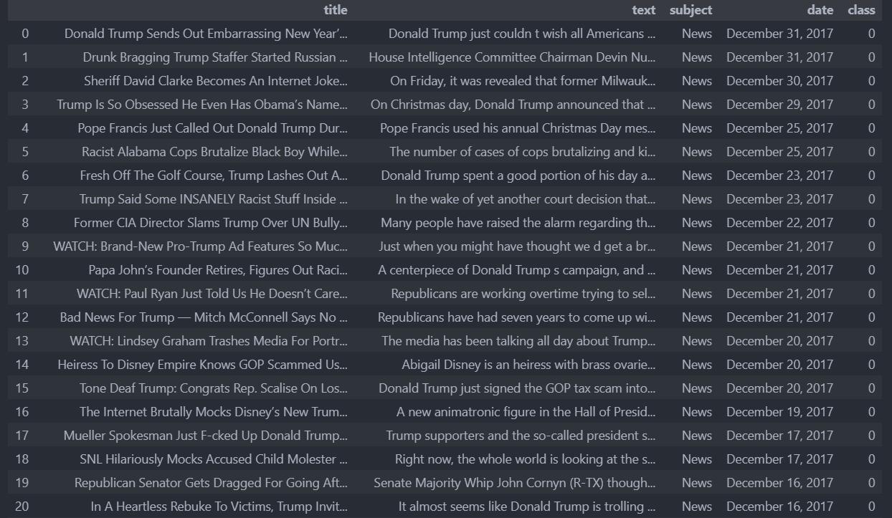
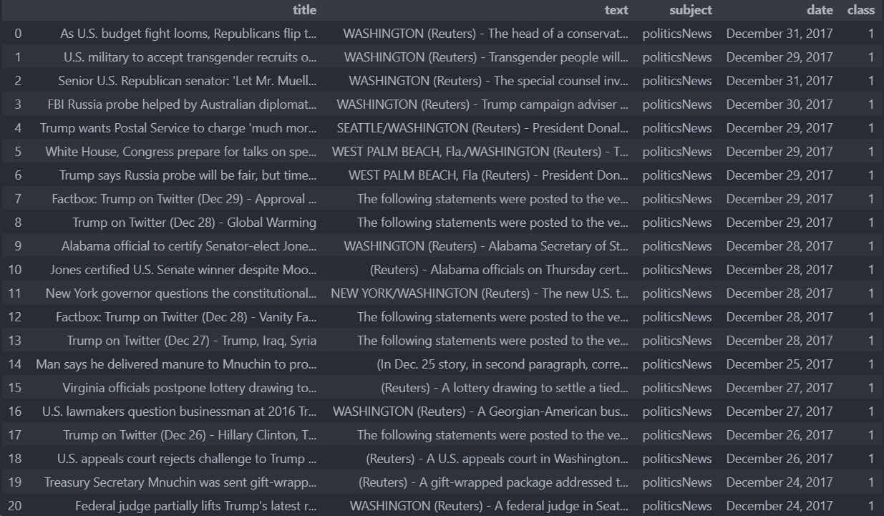
DATA SUMMARY
This dataset shows the real and fake news.

Slide 8
Data Preprocessing
Data Collection
Gather a dataset of verified fake and real news articles.
Tokenization
Split the text into individual words or tokens.
1
2
3
Text Cleaning
Remove noise, such as HTML tags, URLs, and special characters.

Slide 9

Model Selection
Logistic Regression
Random Forest
A simple and interpretable model for binary classification.
An ensemble method that can capture non-linear relationships.
Decision Tree
Gradient Boosting Classifier
A powerful classifier that can handle high-dimensional data.
An ensemble method that can improve performance through boosting.

Slide 10



Model Training and Evaluation
Train-Test Split
Divide the dataset into training and testing sets.
Model Training
Train the selected model using the training data.
Model Evaluation
Evaluate the model's performance on the test data.

Slide 11

Conclusion and Future Improvements
1
Key Takeaways
2
Limitations and Challenges
3
Future Enhancements
Summarize the main steps in building a fake news detector.
Discuss the challenges in detecting evolving fake news strategies.
Explore advanced techniques, such as deep learning and multimodal analysis.

Slide 12
Reference
Dataset :
https://www.kaggle.com/datasets/bjoernjostein/fake-news-data-set

Slide 13
Thank You

