Slide 1
DARK CRIMENET
RESEARCH PROJECT · BENNETT UNIVERSITY
An offline investigation-intelligence platform for FIR analysis, link prediction and tamper-evident case records
Harsh Khandelwal · Kshitij Saxena
School of Computer Science and Technology, Bennett University, Greater Noida, India
Orange dashed line = a missing link the model suggests
Notes:
Opening. DARK CRIMENET is an offline platform that helps an investigator read FIRs, see the links between people, phones and accounts, decide whom to look at first, and keep a record that cannot be changed quietly. Say that it uses small classical machine-learning models, not deep learning, and that all results are on synthetic data.

Slide 2




FIRs hold clues, but the links stay hidden
Unstructured text
Hidden connections
FIRs are open text documents, may be in English, Hindi or Marathi.
The same phone number can be present in multiple cases, but connections can be difficult to see.
Trust in records
Real-world limits
An investigation should have records of any unauthorized changes .
Some police systems may have limited internet access or no GPU.
Notes:
The problem in four points. First, a FIR is a story, not a table, and many are scanned and written in Hindi or Marathi. Second, the same phone number or bank account can appear in several cases and nobody notices. Third, investigators need proof that records were not altered. Fourth, many police computers have no internet and no GPU, so cloud AI or large models are not an option. These four points decide every design choice that follows.

Slide 3
What DARK CRIMENET does
1
Read
2
Translate
3
Extract
FIR text, PDF or scan, using OCR
Hindi and Marathi to English, locally
People, phones, accounts, places, dates
4
Build graph
5
Analyse
6
Record
One graph per case, and links suggested to the officer
Missing links, anomalies, lead ranking
Every action in a signed ledger
Notes:
Walk through the six steps left to right, then the second row. It reads the document, translates it locally, pulls out the people, phones, accounts, places and dates, builds one graph per case, runs the analysis modules, and records every action in a signed ledger. Stress that merges of the same person are only proposed to the officer, never applied silently.

Slide 4
Where this work fits
 | Drafting systems, e.g. [1] | DARK CRIMENET
Focus | Helps write the FIR | Analyses FIRs after filing
Core models | LegalBERT, BERT NER | Parser, regex, small classical models
Hardware | GPU for fine-tuning | Runs offline, no GPU
Network analysis | None | Link prediction, lead ranking
Audit trail | Blockchain-inspired log | Ed25519 signed hash chain
Reported result | 84% section prediction | Evaluated on synthetic and simulated data
[1] P. Mathivanan et al., "AI-enabled smart FIR drafting and legal validation system," AIML 2026.
Notes:
The reference paper, Mathivanan et al., builds an assistant that helps write the FIR and predict IPC sections with LegalBERT. Our project starts after the FIR exists: it analyses it. Be careful with the claim: it only covers the systems reviewed in that paper, and the two are not directly comparable because the data and tasks differ. Their abstract says 93 percent section accuracy but their results section says 84 percent, so we quote 84.

Slide 5
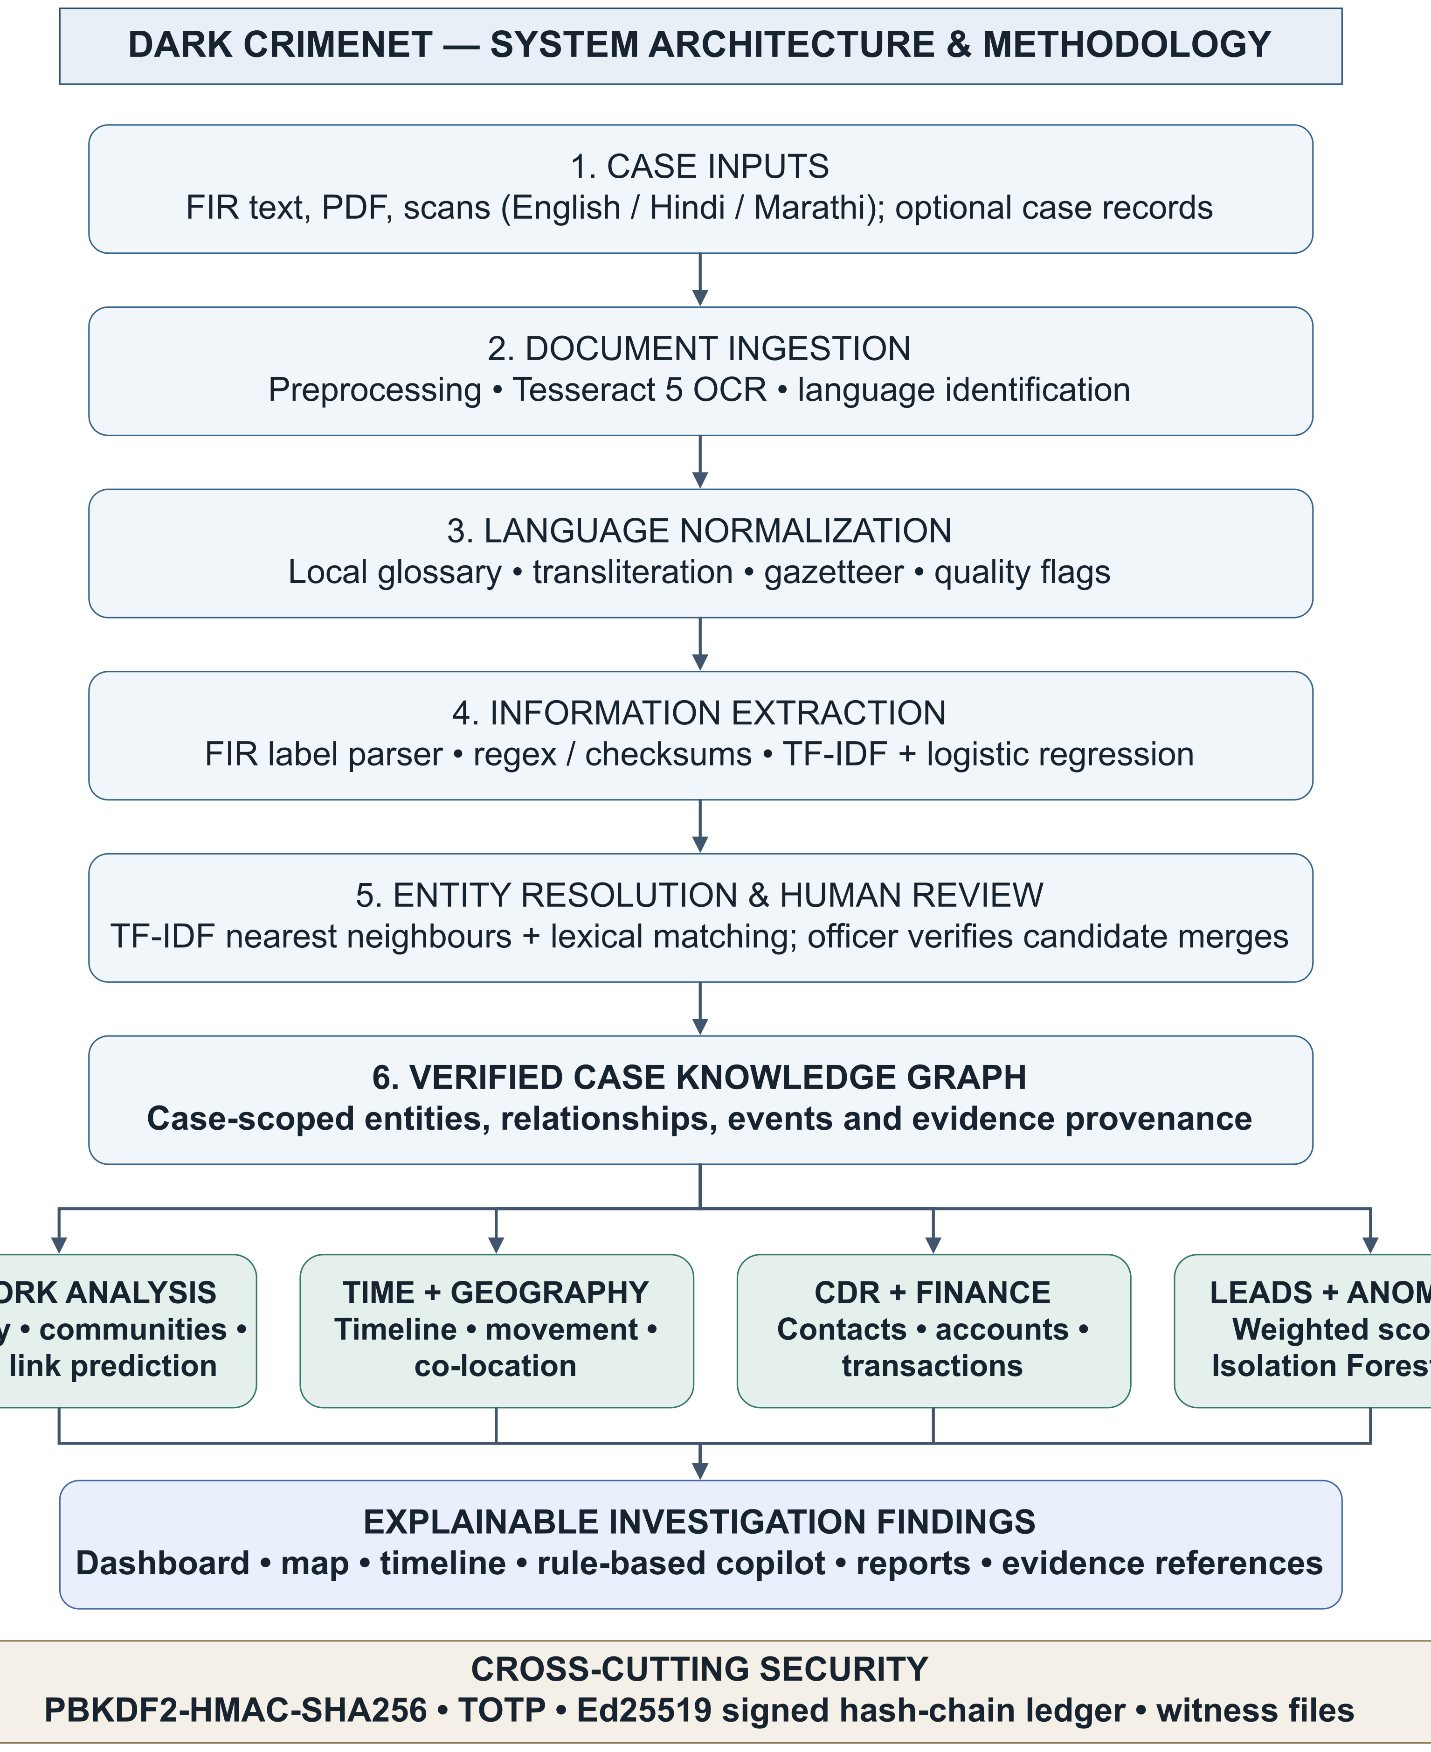
System architecture
Top to Bottom
A document becomes a case graph.
Four analysis modules
Link prediction, anomaly detection, lead scoring, entity resolution.
Outputs and security
Dashboard, map, timeline, copilot and reports, all under a signed ledger.
Notes:
Read the diagram top to bottom. A document goes through OCR and language identification, translation, extraction, then becomes a case graph. Four analysis modules read the graph. The outputs are the dashboard, map, timeline, a rule-based copilot and reports. The security layer sits under everything. The copilot does not generate free text, so it cannot invent a fact.

Slide 6



How a FIR is read
OCR
Translation
Extraction
Tesseract 5, three language packs
Image preprocessing
Language identified using script and common words
Glossary with word reordering
Phone and account numbers protected
Unknown words kept in [[brackets]]
Quality flag on every sentence
Label-driven FIR parser
Regex with checksum checks
Context classifier, 10 classes
Section number mapped to its Act
Notes:
Three stages. OCR uses Tesseract 5, an existing open-source engine, with English, Hindi and Marathi packs. Translation is rule-based: a glossary with word reordering, identifiers such as phone numbers are protected so they pass through unchanged, and unknown words are kept in double square brackets so a reader sees exactly what was not understood. Extraction first reads labels like Complainant Name, then regular expressions with checksum validators such as Verhoeff, then a small classifier that checks the words around each value.

Slide 7
Models and Techniques Used
Module | Method | Trained | Evaluated
Entity context | TF-IDF + logistic regression | Yes | Yes
FIR parser, validators | Rules, checksums | No | Yes (30 FIRs)
Translation | Glossary, rules | No | Quality flags
OCR | Tesseract 5 | Pre-trained | No
Entity resolution | TF-IDF KNN + string match | No | No
Link prediction | Logistic regression, 12 features | Self-supervised | Yes
Anomaly | Isolation Forest + LOF | Unsupervised | No
Lead score | Weighted blend | No | Yes (simulated)
Social flags | 97 rules | No | Yes
Copilot | Intent matching | No | n/a
0
No custom deep-learning models or LLMs required for core analysis pipeline
Every result can be traced to a rule, a weight or a small model.
Notes:
Use this slide when a judge asks which model is used where. Two modules learn from data: the entity-context classifier (labelled snippets) and the link predictor (self-supervised on the case graph). Anomaly detection is unsupervised. Entity resolution, the parser and translation are rules and similarity measures. The lead score is a hand-weighted blend, not trained, and we say so. No large language model is used anywhere; the copilot is intent matching. OCR is the pre-trained Tesseract engine.

Slide 8
Choosing the entity classifier
Four models tie near 99%
Accuracy alone cannot pick one.
Remove the label words
Only the value is left: a harder test.
Logistic regression keeps 90.6%
Random Forest falls to 83.3%.
Synthetic, templated snippets: an upper bound, not real-world accuracy.
Notes:
The same data split was used for all six models. Four of them tie near 99 percent, so accuracy alone cannot choose. We added a stress test: remove the label words, for example Complainant Name, and keep only the value. Logistic regression and the linear SVM keep 90.6 percent, Random Forest falls to 83.3 percent. We kept logistic regression because it ties on accuracy, is most robust to missing labels and gives class probabilities, which an SVM does not. The data is templated and synthetic, so these are upper bounds, not accuracy on real FIRs.

Slide 9
Link prediction beats heuristics
0.85 to 0.96
AUC, logistic regression
0.24 to 0.29
AUC, common neighbours
Hold-out 20% of known links, add 3x as many sampled negative pairs, and rank the hidden links.
AUC = 0.5 indicates random guessing.
Notes:
How it is tested: hide 20 percent of the known links, add three times as many fake pairs, train on the rest of the graph, then see whether the hidden real links rank above the fake ones. AUC is the chance that a hidden real link outranks a fake pair; 0.5 is guessing. Common neighbours scores below 0.5 because the hidden links mostly join entities that share no contacts, so that heuristic ranks them last. Be honest: the graphs are small, 8 hidden links in Case 101 and 5 in the others, so this shows direction, not precision.

Slide 10
Ranking leads on simulated networks
0.42
PageRank on the hard network: below random chance
0.79
Weighted score with partial roles on the same network
Notes:
The simulator has known ground truth, with three difficulty levels. PageRank is slightly better on the easy network, 0.999, but falls to 0.42, worse than guessing, on the hard one where the central people are deliberately hidden. A purely structural score fails when the structure is incomplete, which is the normal situation in a real investigation. Our weighted score degrades more gracefully and gets 0.79 when partial role information is available. It is hand-weighted, not trained, and we say so.

Slide 11



Security and tamper evidence
Sign-in
Block 1
PBKDF2 with 210,000 iterations for hashing, and TOTP two-factor authentication.
action + hash H1
Signed ledger
Block 2
Each block contains the previous hash and an Ed25519 signature.
previous = H1, signed
Anchors
Block 3
Merkle root recorded every 50 blocks, and a witness file helps detect changes to the chain.
previous = H2, signed
Changing one record breaks the hash chain for subsequent blocks.
Notes:
Sign-in uses PBKDF2 password hashing with 210,000 rounds, and two-step codes that follow the TOTP standard, RFC 6238. Every action becomes a block in a ledger. Each block holds the hash of the previous block and an Ed25519 signature. A Merkle root is written every 50 blocks and a separate witness file records the chain heads so deleting the end is visible. To change a record unnoticed an attacker would need the signing key, the witness file and every later block. The two-step QR code was checked by decoding it automatically; it has not been scanned with a real phone yet.

Slide 12
What is not proven yet
Limits today
Next steps
Results based on synthetic data, and may overestimate performance on real FIRs
OCR, entity resolution and anomaly accuracy not yet measured
Lead score is manually weighted, not learned
Link graphs are small: 5 to 8 hidden links per case
Test on public FIR and legal-text datasets
Label a sample to measure real accuracy
Compare a transformer NER model
Add voice input and learn the lead weights
Notes:
This slide protects you in the viva, so say it plainly before a judge asks. All data is synthetic or invented because real FIRs are confidential, so every score is an upper bound. OCR, entity resolution and anomaly detection accuracy have not been measured. The lead score is hand-weighted. The link graphs are small. Next steps: test on public FIR and legal-text datasets, label a sample to get real accuracy, compare a transformer NER model, add voice input and learn the lead weights if labelled outcomes exist.

Slide 13
Thank you
Offline, explainable system, using small classical models
Link prediction AUC 0.85 to 0.96, against 0.24 to 0.29 for neighbour heuristics
Signed ledger makes tampering visible
All results are from synthetic and simulated data
Harsh Khandelwal · Kshitij Saxena
Bennett University, Greater Noida
Notes:
Close with the three takeaways, repeat that the results come from synthetic data, and invite questions. If asked about accuracy: 99.6 percent is the entity-context classifier on a synthetic hold-out set; 0.85 to 0.96 is link-prediction AUC on three demo cases. Both are upper bounds, not real-world accuracy.

