Slide 1
Coincheck NEM Theft, January 2018
Cryptocurrency exchange hack investigation: key findings and recommendations
Kshitij Randhire | Independent research project

Slide 2
What happened
526.3M
~523M
260,000
XEM left Coincheck’s wallet in 11 transfers (my blockchain count)
XEM was Coincheck’s own figure; about 58 billion yen at the time
customers affected; more than 46 billion yen refund pledged
The XEM sat in an internet-connected hot wallet that one key could empty.
Coincheck noticed at 11:25 on 26 January (case study), over eight hours after its stated start (Reuters).
Sources: Reuters, BBC, ScienceDirect case study, blockchain data collected 28 Sep 2026 (EVD-001, 004, 011)
Limits: one public node, one hop traced, and the two discrepancy explanations are interpretations (see slide 7).

Slide 3
Timeline (26 January 2018, JST)
Time | Event | Basis
00:02 | First transfer out of Coincheck’s wallet: 10 XEM test | Blockchain
00:04 to 00:21 | 523,000,000 XEM moved to a new address (Address B) | Blockchain
02:57 to 03:29 | Address B splits exactly 523,000,000 XEM across 8 addresses | Blockchain
03:35 to 08:26 | Three more transfers, 3.3M XEM in total | Blockchain
11:25 | Coincheck notices the drop and freezes all but Bitcoin | Case study, BBC
30 Jan | FSA business improvement order discussed at press conference | FSA transcript
All times use the corrected NEM epoch (00:06:25 UTC). Details: Incident Report, Section 3

Slide 4
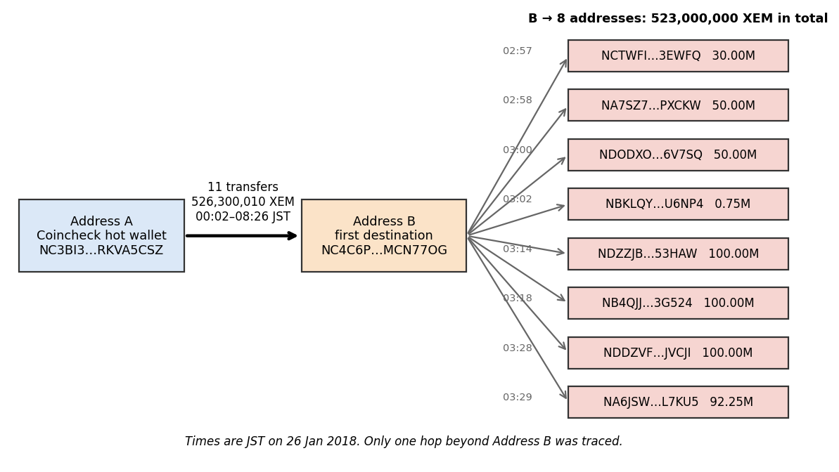
How the funds moved
Address A to B: 11 transfers, 526,300,010 XEM.
B to 8 new addresses: exactly 523,000,000 XEM in 33 minutes.
I traced one hop. Where the coins went next is not established.
Source: NIS1 node data, EVD-017 to 019. Method and hashes: Evidence Portfolio

Slide 5
Two gaps between the blockchain and the reports
1. The missing 3.3M XEM
2. When it started
Coincheck said ~523M. The chain shows 526.3M. The first eight transfers add up to 523,000,010 and the last three to exactly 3,300,000. My reading: Coincheck’s figure matches the first eight. Why the last three are not reflected is unknown.
Coincheck gave 02:57. The first transfer out of its wallet is at 00:02. The 02:57 matches the first onward transfer from Address B. My reading: the company described when the coins began to be spread out, which makes the true detection gap about 11 h 23 min.
Both are my interpretations. The arithmetic is confirmed; I found no Coincheck confirmation of the explanations.

Slide 6
Why it was possible, and what it cost
Single key: all 11 transfers were plain transfers signed by one key, with no co-signatures.
Hot wallet: the COO and BBC describe the XEM as held online, not in cold storage.
Slow detection: about 11 hours from the first transfer to discovery.
Thin resources: the president cited technical difficulties and a staff shortage.
Not established: how the attacker got access, who they were, and whether customer data was exposed.
Sources: EVD-001, 004, 011. Attack vector is marked Unknown in the Incident Report (one case study reports malware on a company terminal; unconfirmed).

Slide 7
What this analysis cannot tell you
1 node
1 hop
2 readings
All blockchain data came from one public NIS1 node and has not yet been cross-checked
Funds are traced from A to B to eight addresses. Where they went next is not traced
The two discrepancy explanations are my interpretations, not confirmed facts
No internal Coincheck logs, disk images, memory dumps or malware samples are public.
How the attacker got in, who they were and whether customer data was exposed remain unknown.
Details: Incident Report Sections 7.7 and 11; Evidence Portfolio Section 6.

Slide 8
Recommendations
Immediate
Long term
Suspend withdrawals for the affected asset
Share destination addresses with exchanges and the NEM Foundation
Treat the signing key as compromised
Preserve logs and images, tell regulators and customers
Multiple signatures on every hot wallet
Cold storage for most funds, with a hot-wallet cap
Real-time outflow alerts and daily reconciliation
Key management review, annual audit, tested response plan
Full plan with risk ratings: Mitigation Plan. Limits: public sources only, one node, one hop traced.

