Slide 1
Integrating Chainlink with Ethereum
By Kshitij Garg

Slide 2
Index
Introduction
Consensus Protocols
Ethereum Mainnet & Rinkeby Testnet
Smart Contracts
Development Environment
Oracles
The Oracle Problem
Chainlink & the LINK token
Advantages of Chainlink
Integrating Chainlink with Ethereum smart contracts and DApps

Slide 3
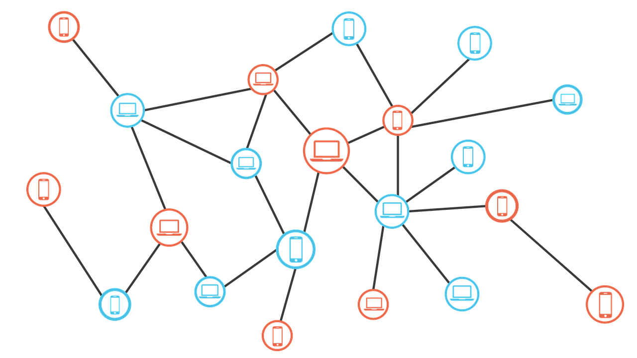
Blockchain Introduction
A Blockchain is a transparent, immutable ledger shared across nodes which stores transactions and helps in tracking assets. Thus eliminating any third party which might act as a single point of failure.
While the tracking of assets is open to everyone this does not mean that the privacy of the network is compromised. This is because every user is hidden behind a public address, hence as long as the address cannot be linked to a person, the transactions remain anonymous in a sense.
As the ‘ledger’ is immutable, a node is only allowed to add data and not change previously added data. This is achieved by creating consensus between nodes, which do not necessarily need to trust each other. Things work out as long as the participants trust the system through which they achieved consensus.

Slide 4
Blockchain Introduction
Hashing
A hashing algorithm is a one way function, which generates a near unique output for a given input, but generating the input on the basis of the output is very difficult.
Hashes of previous transactions, their timestamps and other block data are used to generate the block hash and be able to reference it uniquely. The task of hash generation for the block and hence the block itself is done by competing miners by solving a complex cryptography problem, to reduce forks within the blockchain.(However the process varies with the consensus protocol followed by the blockchain)
Public-private key encryption
A key pair consists of a public and a private key, the two work in sync i.e. one is required to decrypt the data encrypted using the other key.
The sender encrypts the data with his private and the receiver's public key, this ensures that only the desired recipient is able to read the data using his private key while ensuring the recipient that the data did indeed come from the original sender as he will have to use the public key of the sender to decrypt the data.
Notes:
HASHING & MERKLE TREES SLIDE
In the Bitcoin blockchain, ‘mining’ is essentially conducted by running a series of SHA-256 hashing functions.
In cryptocurrency blockchains today, hashing is used to write new transactions, timestamp them, and ultimately to
add a reference to them in the previous block. When a block of transactions is added to the blockchain, and consensus
is reached among operators of different nodes (validating that all of them have the right and true version of the
entire ledger), it is nearly impossible to reverse a transaction due to the enormous computing power that would be
required by anyone attempting to tamper with the blockchain, and the one-way nature of the hashing. Hashing is
therefore crucial to maintain the cryptographic integrity of the blockchain.

Slide 5
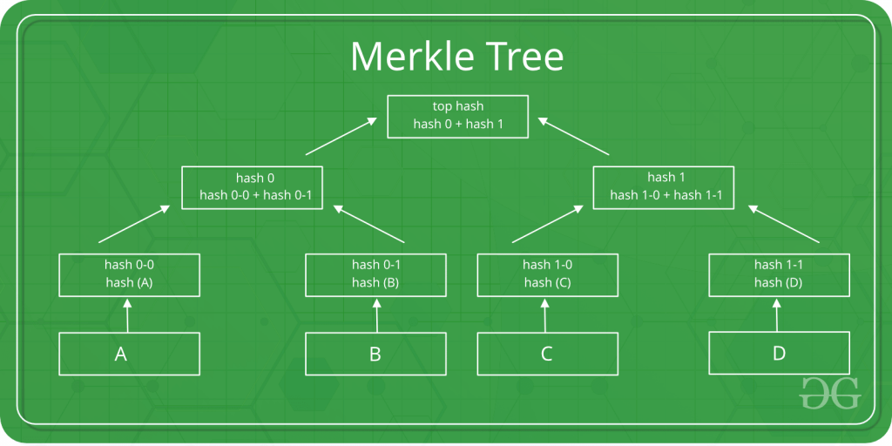
Blockchain Introduction
Merkle Trees
A Merkle tree is a data structure used to efficiently ensure the integrity and secure verification of the contents of a large body of data. It is a binary tree, where the parent nodes are the hashes of the two child nodes. In a blockchain the leaves are the hashes of individual transactions in a particular block. Thus even a small change in one of the node values completely changes the merkle root value, ensuring that the data is not tampered with and also eliminates the need to store the data of every transaction separately. It ensure that all past data is recorded and that too in a chronological order.
Notes:
Merkle trees have three major benefits:
1. They provide a means to prove the integrity and validity of data
2. They require little memory or disk space as the proofs are computationally easy and fast
3. Their proofs and management only require tiny amounts of information to be transmitted across networks
Ethereum uses three different Merkle Roots in each block:
1. The first root is of the transactions in the block
2. The second root represents the state
3. The third root is for transaction receipts

Slide 6
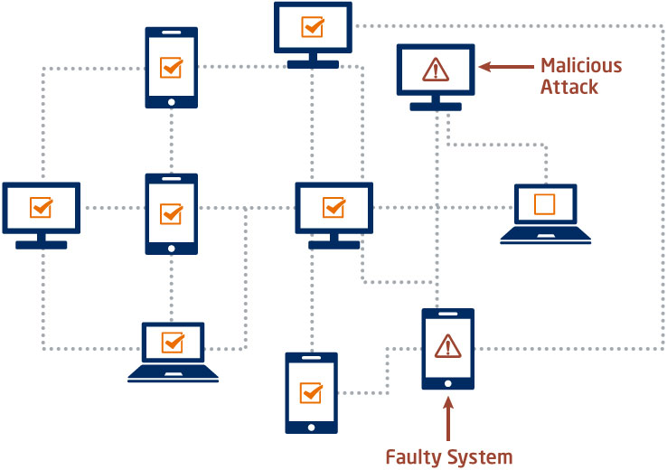
Consensus Protocols
The appropriate consensus protocol varies with the use case and the nature of the blockchain such as private, public or consortium. The various types of consensus protocols solve the 51% attack problem in various ways.
The following are few of the most popular consensus protocols:
PoW(Proof of Work)
PoS(Proof of Stake)
DPos(Delegated Proof of Stake)
Proof of Space
Proof of Elapsed Time
Proof of Authority (Used by rinkeby Testnet)
Notes:
CONSENSUS PROTOCOLS:
https://www.section.io/engineering-education/blockchain-consensus-protocols/

Slide 7
Ethereum Mainnet & Rinkeby Testnet
Ethereum Mainnet
Ethereum mainnet refers to the primary public ethereum network, transacting in ETH(ethers). Applications that are built on the Mainnet are able to interoperate, similarly to how applications built on the Internet can connect to each other, leveraging the full potential of decentralized blockchain.
The mainnet follows a version of the Proof of Stake consensus model.
Rinkeby Testnet
The Rinkeby testnet is one of the most popular Ethereum testnet. A testnet allows blockchain developers to deploy their smart contracts and DApps on themselves for testing purposes before being migrated to the mainnet . The testnet uses ‘Test Ethers’ that can be obtained from a variety of sources instead of actual ETH.
The Rinkeby Testnet follows the Proof of Authority consensus model, whereby the block creation is done by only the select few in charge of maintaining the testnet in a round robin fashion.
Notes:
LAYER 2
Scalability solutions
Layer 2 is a set of technologies or systems that run on top of Ethereum (Layer 1), inherit security properties from
Layer 1, and provide greater transaction processing capacity (throughput), lower transaction fees (operating cost),
and faster transaction confirmations than Layer 1. Layer 2 scaling solutions are secured by Layer 1, but they enable
blockchain applications to handle many more users or actions or data than Layer 1 could accommodate. Many of them
leverage recent advances in cryptography and zero-knowledge (ZK) proofs to maximize performance and security.
Building your application on top of a Layer 2 scalability solution can help address many of the concerns that have
previously driven companies to build on private blockchains, yet retain the benefits of building on Mainnet.

Slide 8
Smart Contracts
Blockchains being a decentralised system remove the need for middlemen to carry out tasks,enforce contracts and handle conflicts. Smart contracts or self executing contracts, do just this by allowing all this functionality to be written in the form of code and be executed on the blockchain when called upon. They eliminate the need for a middleman or any trust between the parties to carry a transaction. Smart contracts are a type of ‘account’ i.e. they have a balance and an address and can therefore carry out transactions. They are executed over the Ethereum Virtual Machine.
Smart contracts can be written using languages like Solidity or Vyper. An excellent IDE for the same would be Remix. Deploying a smart contract is similar to any other transaction and requires the payment of a fee or gas. Smart contracts can be thought of as open APIs.
The one major limitation of this revolutionary idea is that they themselves have no access to real world information/data because they cannot send HTTP requests. This causes a huge loss in adaptability and hence a loss in their application to the real world. However ‘Oracles’ provide a workable solution.
Notes:
Smart Contracts are written as code and committed to the blockchain. The code and conditions in the contract are publicly available on the ledger. When an event outlined in the contract is triggered, like an expiration date or an asset’s target price is reached- the contract executes.
Smart contracts alone cannot get information about "real-world" events because they can't send HTTP requests. This is by design. Relying on external information could jeopardise consensus, which is important for security and decentralization.
There are ways to get around this using oracles.
Another limitation of smart contracts is the maximum contract size. A smart contract can be a maximum of 24KB or it will run out of gas. This can be circumnavigated by using The Diamond Pattern

Slide 9
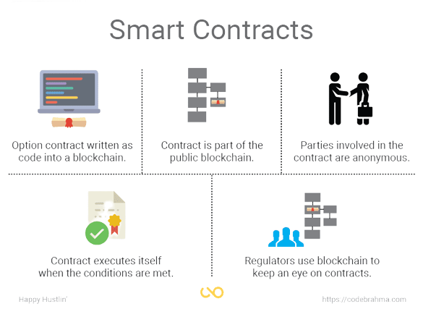
Notes:
Smart Contracts are written as code and committed to the blockchain. The code and conditions in the contract are publicly available on the ledger. When an event outlined in the contract is triggered, like an expiration date or an asset’s target price is reached- the contract executes.
Smart contracts alone cannot get information about "real-world" events because they can't send HTTP requests. This is by design. Relying on external information could jeopardise consensus, which is important for security and decentralization.
There are ways to get around this using oracles.

Slide 10

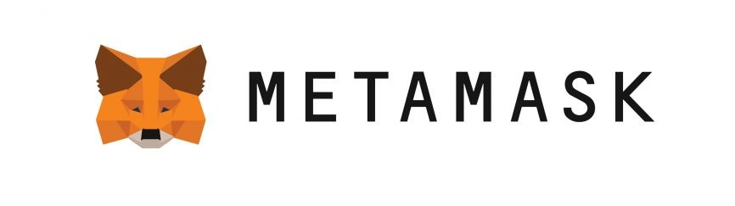

Development Environment
Infura
Infura is a service provider for managed Ethereum nodes, communication to which is done with the help of its API. This saves the time and effort of syncing a local client to set up a full node.
MetaMask
MetaMask provides cryptocurrency wallets used to interact with Ethereum blockchains including both the Mainnet and the testnets.
Node.js
Node.js provides the JavaScript environment for Truffle.
Notes:
Looked through a variety of cloud platform options to set up an ethereum node or use an API based service including Google Cloud, Amazon AWS, Alchemy supernodes, Moralis speedynodes and Infura. Finally Infura was chosen for its easy to use API on recommendation by my peers and the fact that it eliminates the need to sync up the blockchain unlike setting up a full node either locally or on cloud.
Metamask (from slide)
Test ether was collected from the chainlink faucet instead of the rinkeby faucet as it was down.

Slide 11
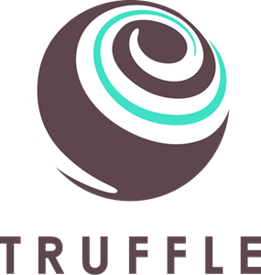
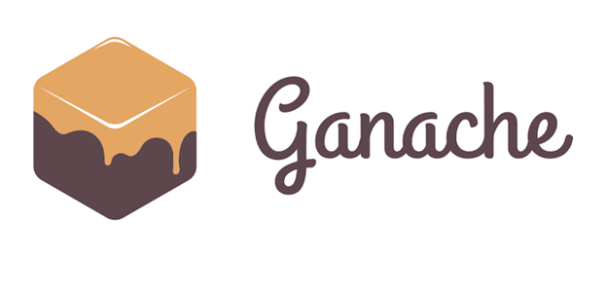

Development Environment
Truffle
Truffle Suite is a development environment based on Ethereum Blockchain, used to develop DApps (Distributed Applications). It can be used for building DApps: Compiling Contracts, Deploying Contracts, Injecting it into a web app, Creating front-end for DApps and Testing.
Ganache
Ganache is part of the TruffleSuite. It provides a local personal blockchain for deploying smart contracts, running applications and carrying out tests.
Remix
Remix is an online IDE.
Notes:
Ganache
Was used to complete the University at Buffalo Coursera course 1 project.
Remix
Was used to create and play around with basic smart contracts while learning solidarity using cryptozombies.io

Slide 12
Chainlink

Slide 13
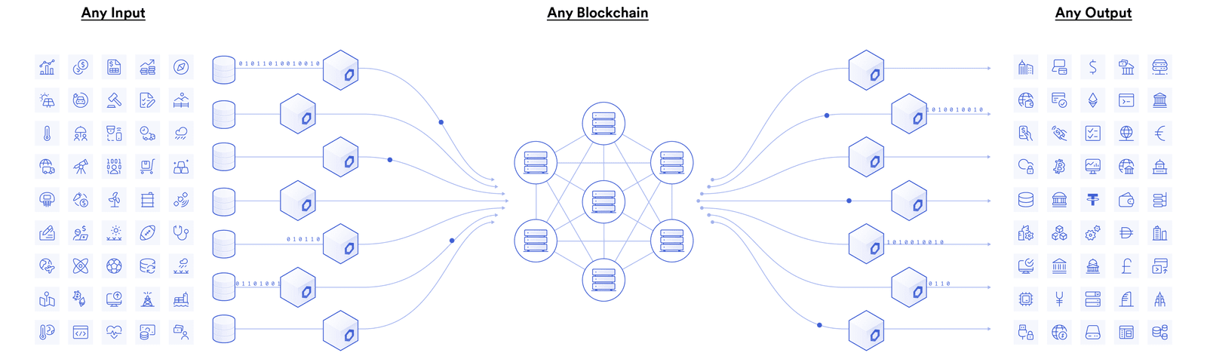
Oracles
A blockchain oracle is a secure piece of middleware that facilitates communication between blockchains and any off-chain system, including data providers, web APIs, enterprise backends, cloud providers, IoT devices, e-signatures, payment systems, other blockchains, and more. Inshort, oracles are a trusted third party source of information that give real-world data to a blockchain.
Notes:
The accessibility of off-chain data/information within smart contracts is essential for a number of use cases. A simple example being a prize dispensing contract, which gives away some prize to the winner of a tournament. Here the participants are all required to deposit some money into an escrow account to create a prize pool, which is transferred to the winner of the tournament. But a problem arises as the contract inherently does not know whom to release the funds to. The answer is it requires an oracle mechanism to fetch accurate match outcomes off-chain and deliver it to the blockchain in a secure and reliable manner.

Slide 14
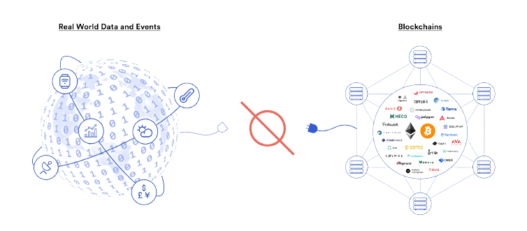
The Oracle Problem
Blockchains are deterministic by design-they execute exactly as written with a much higher degree of certainty than traditional systems, thus integration of an oracle like functionality into the base layer was avoided on purpose. Blockchains are not well suited to answer questions that are subjective, require external data that may not be equally accessible to all nodes or data that may vary with time.
By being purposely isolated from external systems, blockchains obtain their most valuable properties like strong consensus on the validity of user transactions, prevention of double-spending attacks, and reduction of network downtime.
Notes:
Securely interoperating with off-chain systems from a blockchain requires an additional piece of infrastructure or an “oracle” to bridge the two environments.
For example, financial smart contracts need market information to determine settlements, insurance smart contracts need IoT and web data to make decisions on policy payouts, trade finance contracts need trade documents and digital signatures to know when to release payments, and many smart contracts want to settle in fiat currency on a traditional payment network. None of this information is inherently generated within the blockchain, nor are these traditional services directly accessible

Slide 15
Chainlink
Oracles help bridge the gap between the blockchain world and the real world by facilitating transfer of information in the two directions. But for the system to work, the input cannot come from a single or centralized source, because this would go against the very nature of a blockchain. This is the very problem that Chainlink helps solve.
Chainlink is a decentralised proof-of-stake network of nodes that connects off-blockchain data and information to on-blockchain smart contracts via oracles.
In order to bring determinism to the oracle layer, Chainlink has developed a network of decentralized oracle networks (DONs), with each DON involving a combination of multiple security techniques needed to service a particular use case. A Decentralized Oracle Network, or DON for short, combines multiple independent oracle node operators and multiple reliable data sources to establish end-to-end decentralization.
Notes:
In order to overcome these shortcomings, oracles need to create the same security and reliability guarantees of a blockchain, although in a different manner given their many differences. This is where chainlink comes into the picture.

Slide 16
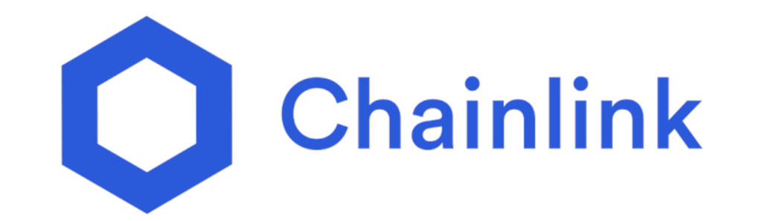
LINK Token
The LINK token is the official cryptocurrency used for working with/on the chainlink network. It is an ERC-20 token. Requesting Contract holders use LINK to pay Chainlink node operators for their work. Prices are set by the Chainlink node operator based on demand for the data they can provide and the current market for that data. It is also used by node operators to stake in the network as part of the PoS protocol. Nodes with greater stake in the network are more likely to be picked for completing requests and hence earn LINK tokens for their service. The system maintains response quality by taxing the stakes of dishonest or faulty nodes.

Slide 17
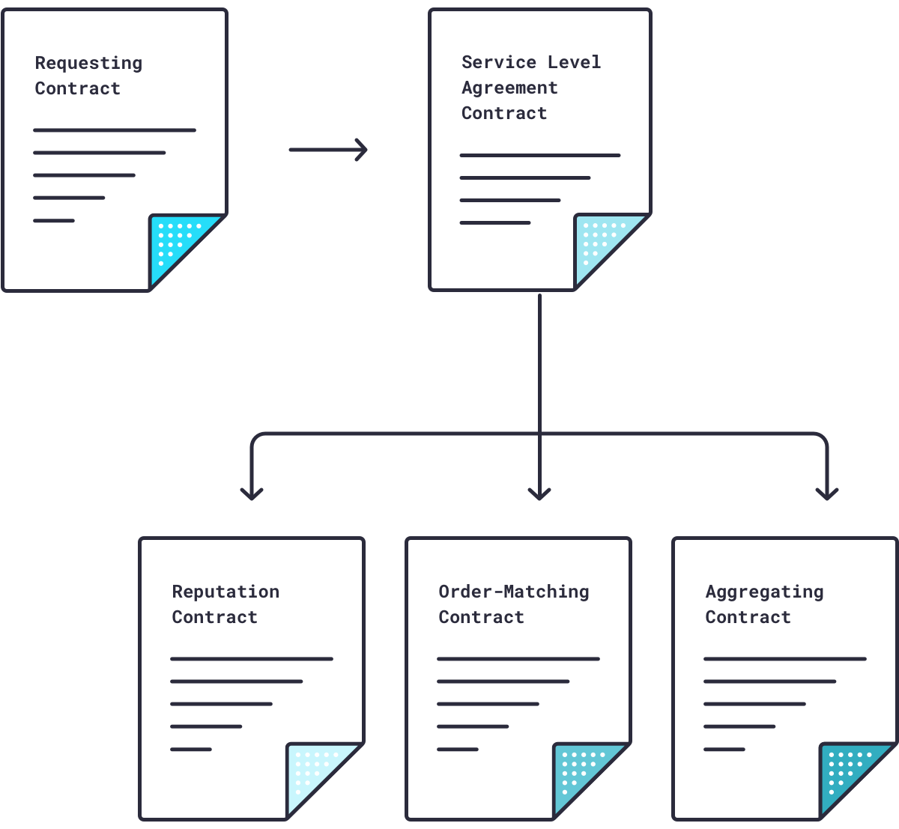
What goes on behind the scenes
A smart contract puts out a request for some off-chain data, which gets registered as an event by the Chainlink protocol. A Service Level Agreement Contract is generated on the blockchain, which in turn generates three sub-contracts, namely, a Chainlink Reputation Contract, a Chainlink Order-Matching Contract, and a Chainlink Aggregating Contract.
The Chanlink Core is used to translate requests into off chain language and the fetched results into on-chain language.
Notes:
The requesting contract also has the functionality to choose a specific set of data nodes, the ones which are trusted by the contract.

Slide 18
SLA Sub-Contracts
Reputation Contract
It is responsible for checking the oracle provider’s past record for verifying its authenticity and reliability. The contract discards disreputable or unreliable nodes.
Aggregating Contract
The aggregating contract aggregates the data returned by the chosen oracles and validates it for accurate results. It can reconcile data from single or multiple sources. The Chainlink Aggregating Contract can repeat this validation process for multiple sources, then reconcile all validated data by averaging it into a single piece of data.
Order-Matching Contract
The order Matching Contract delivers the requesting contracts request to chainlink nodes and allows them to bid for the request, incase no specific set of nodes has already been chosen by the requesting contract. It then selects the right number and types of nodes to fulfill the request.

Slide 19
Advantages of Chainlink
Chainlink is agnostic, and hence can be used with a variety of blockchains that provide the functionality of executing smart contracts.
Chainlink offers a network of decentralized oracle networks (DONs), with each DON involving a combination of multiple security techniques needed to service a particular use case.
Employing decentralization at the node and data source level ensures no one node or data source acts as a single point of failure, providing users strong guarantees that data will be available, delivered on time, and resistant to manipulation.
Chainlink is an open source network.
Strict performance check with monetary incentives, due to data signings. Also since the network is immutable, the track records of nodes and data sources remain open for everyone to see and analyze.
Providing flexibility for more advanced cryptography (like zero-knowledge proofs) and hardware (such as trusted execution environments) enables oracles to perform additional functions like proving the origin of data and keeping data confidential.
Chainlink provides a wide application set of its services like Oracle Computation.
Notes:
Higher-speed blockchains optimize for higher-throughput transactions, but cannot natively support more advanced computations like end-to-end privacy or transaction automation. Instead of blockchains performing all dApp computations, many computations can be performed off-chain with the results relayed on-chain. However using the centralized web2 for complex computations to increase their capabilities defeats the purpose of decentralization. This is where ORACLE COMPUTATION comes in.
Oracle computation uses (DONs) to perform off-chain computation on behalf of smart contracts while remaining anchored to blockchains to create trust-minimization guarantees. In this manner, DONs can perform any computation in a highly scalable, privacy-preserving, and feature-rich manner that’s on par with centralized Web 2.0 systems while also leveraging various blockchain techniques and dependencies to hold the oracle’s computation to higher standards of correctness, tamper-proofness, uptime, and transparency.

Slide 20
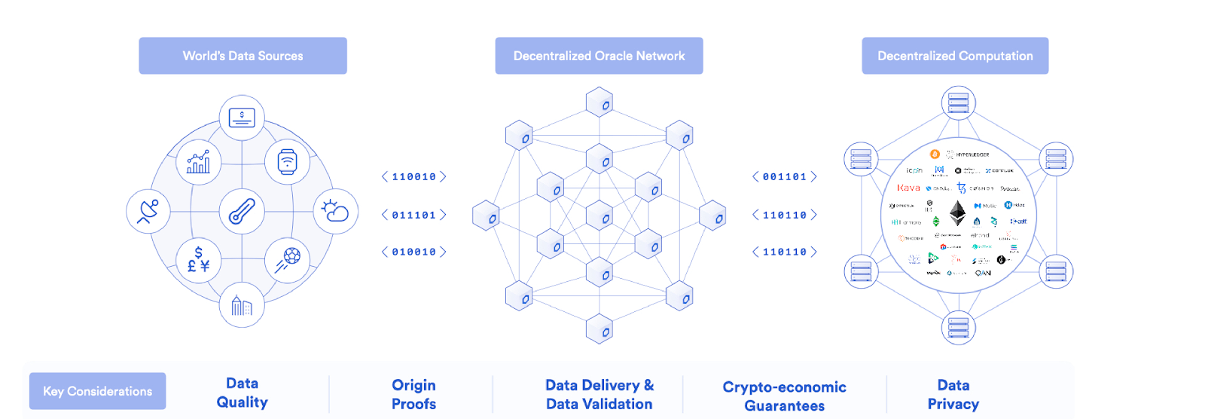
Notes:
Higher-speed blockchains optimize for higher-throughput transactions, but cannot natively support more advanced computations like end-to-end privacy or transaction automation. Instead of blockchains performing all dApp computations, many computations can be performed off-chain with the results relayed on-chain. However using the centralized web2 for complex computations to increase their capabilities defeats the purpose of decentralization. This is where ORACLE COMPUTATION comes in.
Oracle computation uses (DONs) to perform off-chain computation on behalf of smart contracts while remaining anchored to blockchains to create trust-minimization guarantees. In this manner, DONs can perform any computation in a highly scalable, privacy-preserving, and feature-rich manner that’s on par with centralized Web 2.0 systems, while also leveraging various blockchain techniques and dependencies to hold the oracle’s computation to higher standards of correctness, tamper-proofness, uptime, and transparency.

Slide 21
Integrating Chainlink with Ethereum smart contracts and DApps
Initiator: Instructions that tell a node when/how to start getting external data.
Each chainlink node has a specified initiator that they are going to be listening to.
Adapters/tasks: Instructions that tell a node what to do with the data when they receive it. We can use prebuilt adapters from sites like market.link or use external adapters to carry out custom tasks.

Slide 22
The code for integrating a Chainlink request into your solidity smart contract looks a bit like this:
//first import ChainlinkClient.sol and the other required interfaces according to need.
function functionName() public{
Chainlink.Request memory req = buildChainlinkRequest(JOBID,address(this),this.dataFunction.selector);
req.add(“get”,URL);
sendChainlinkRequestTo(address(ORACLEADDRESS),req,ORACLE_PAYMENT);
}
function dataFunction(byte32 _requestId, PARAMETER) public recordChainlinkFullfilment(_requestId)
//to ensure that only the requested oracle can fulfill the request
{ //function definition making use of the off chain data received
}

